Slide 1
Adaptive Immunity
CCV
Microbiology
Ch. 16

Slide 2
Overview of Adaptive Immunity
Adaptive immunity is the body's ability to recognize and defend itself against distinct invaders and their products
Five attributes of adaptive immunity
Specificity
Inducibility
Clonality
Unresponsiveness to self (tolerance)
Memory

Slide 3
Overview of Adaptive Immunity
Involves activity of lymphocytes
Two main types of lymphocytes
B lymphocytes (B cells)
Mature in the bone marrow
T lymphocytes (T cells)
Mature in the thymus
Two types of adaptive immune responses
Cell-mediated immune responses
Antibody immune responses

Slide 4
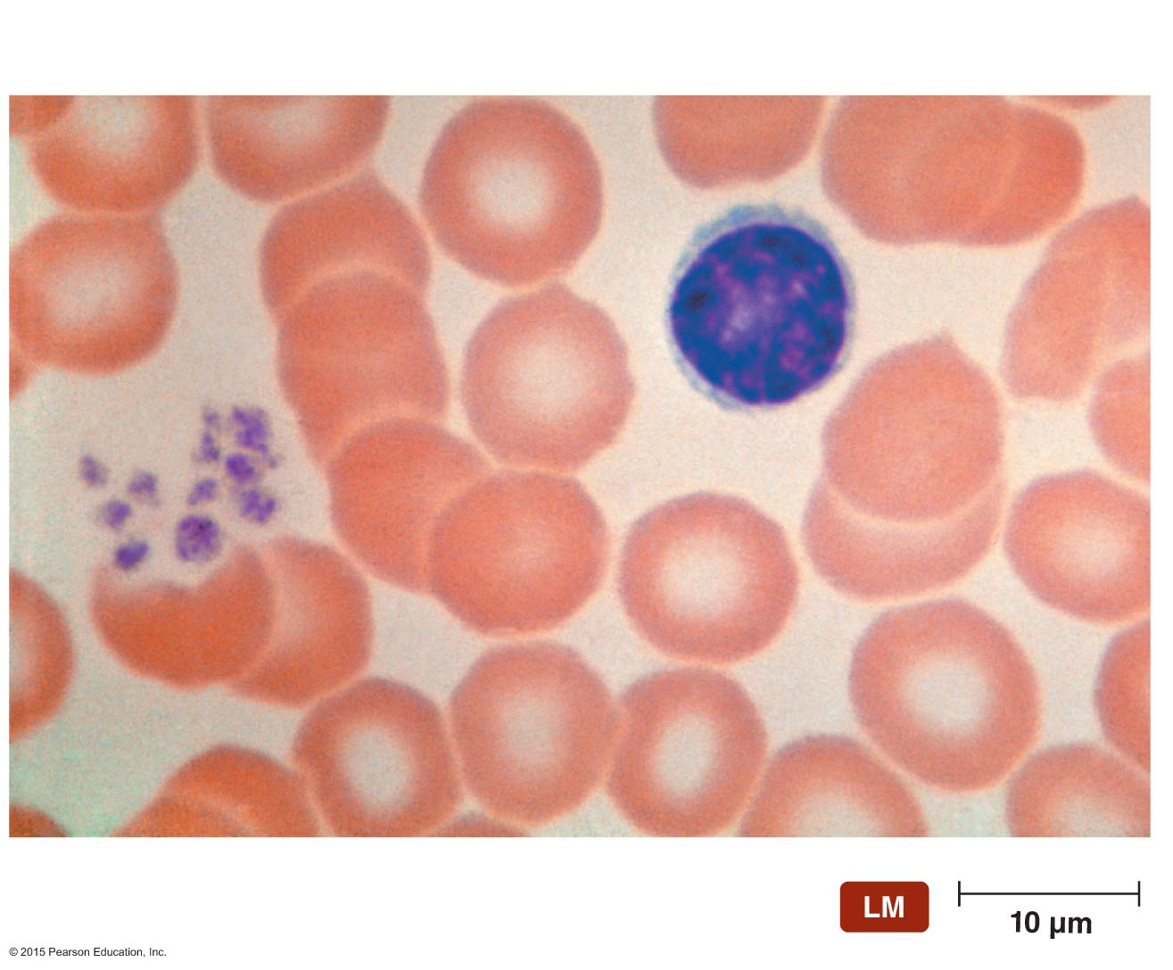
Figure 16.1 Lymphocytes play a central role in adaptive immunity.
Lymphocyte
Red blood cell
Notes:
4

Slide 5
Elements of Adaptive Immunity
The Tissues and Organs of the Lymphatic System
Composed of lymphatic vessels and lymphatic cells, tissues, and organs
Screen the tissues of the body for foreign antigens

Slide 6
Elements of Adaptive Immunity
The Tissues and Organs of the Lymphatic System
The lymphatic vessels and the flow of lymph
Lymphatic vessels
One-way system that conducts lymph from tissues and returns it to the circulatory system
Lymph
Liquid with composition similar to blood plasma
Arises from fluid leaked from blood vessels into surrounding tissues

Slide 7
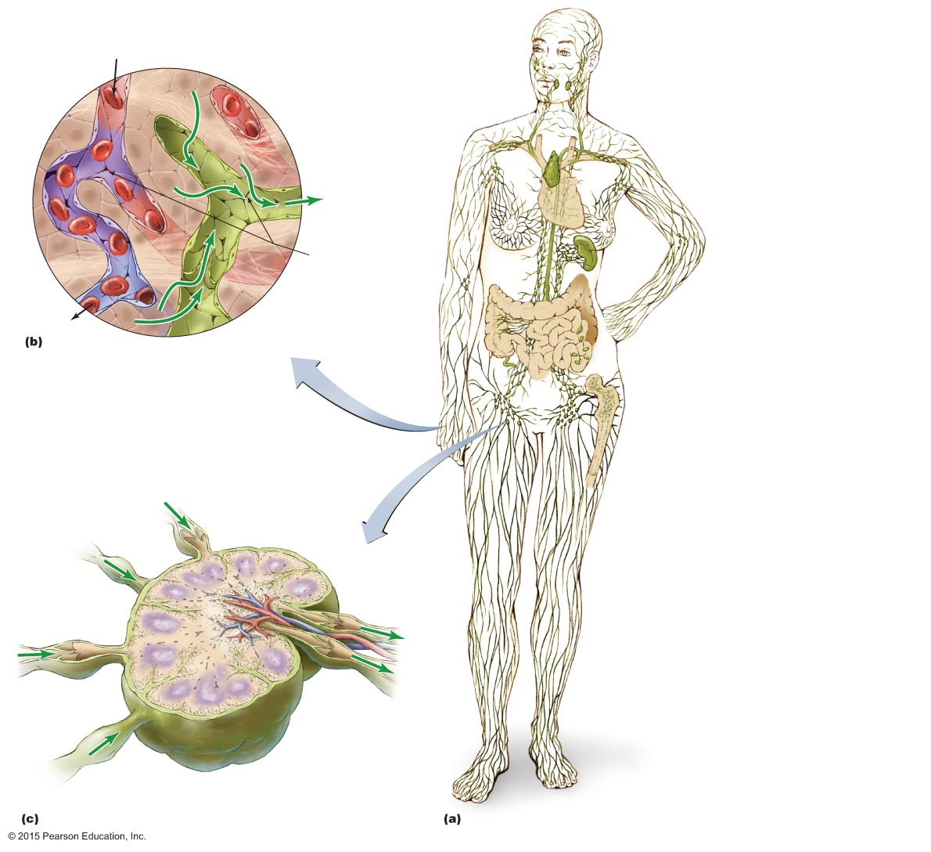
Figure 16.2 The lymphatic system.
Blood
capillary
From heart
Tissue cell
Tonsils
Cervical lymph node
Intercellular
fluid
Lymphatic ducts
Thymus gland
Lymph
to heart
via lymphatic
vessels
Axillary lymph
node
Heart
Gap in wall
Breast lymphatics
Spleen
Valve
Abdominal
lymph node
To heart
Lymphatic capillary
Intestines
Peyer's patches in
intestinal wall
Part of mucosa-
associated lymphoid
tissue (MALT)
Appendix
Red bone
marrow
Afferent
lymphatic vessel
Inguinal lymph
node
Cortex
Medulla
Lymphatic
vessel
Vein
Valve
(prevents backflow)
Artery
Lymphatic nodule
Efferent
lymphatic
vessel
Capsule
Primary follicle
Notes:
7

Slide 8
Elements of Adaptive Immunity
The Tissues and Organs of the Lymphatic System
Lymphoid organs
Primary lymphoid organs
Red bone marrow
Thymus
Secondary lymphoid organs
Lymph nodes
Spleen
Tonsils
Mucosa-associated lymphoid tissue (MALT)

Slide 9
Elements of Adaptive Immunity
Antigens
Properties of antigens
Molecules that the body recognizes as foreign and worthy of attack
Recognized by three-dimensional regions called epitopes on antigens
Large foreign macromolecules make the best antigens
Include various bacterial components as well as proteins of viruses, fungi, and protozoa
Food and dust can also contain antigenic particles

Slide 10
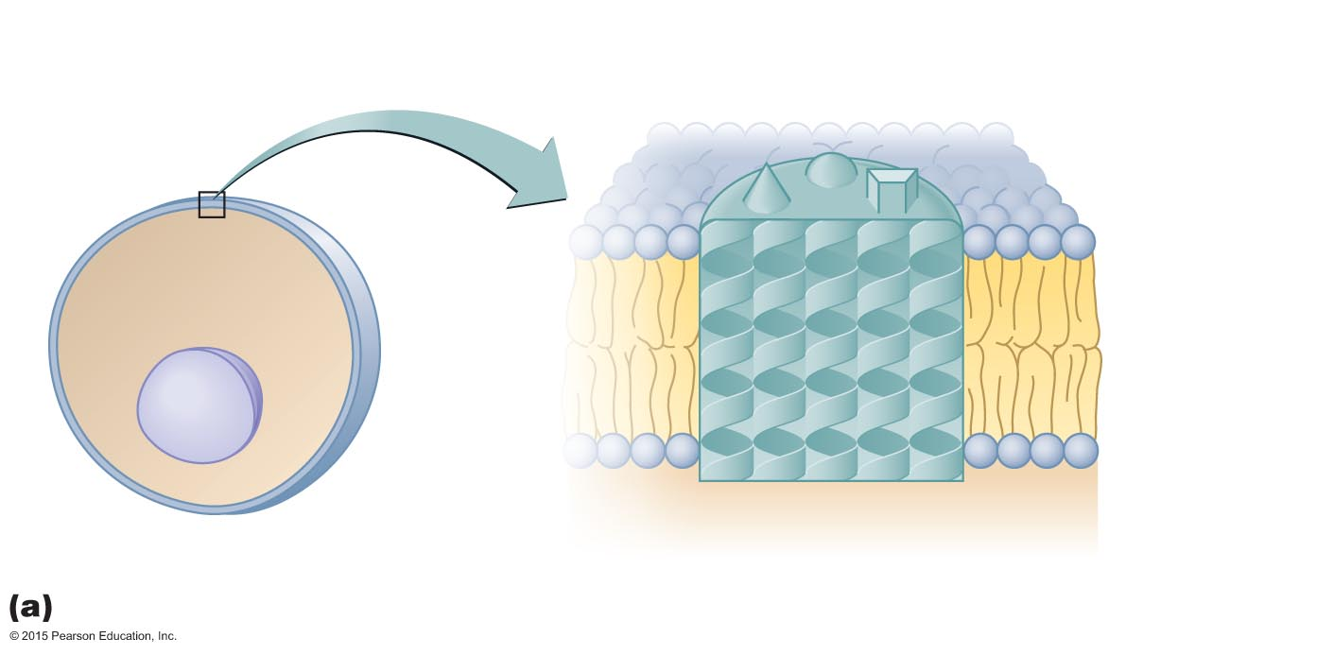
Figure 16.3a Antigens, molecules that provoke a specific immune response.
Epitopes
(antigenic
determinants)
Cytoplasmic
membrane
Nucleus
Antigen
Cytoplasm
Epitopes (antigenic determinants)
Notes:
10

Slide 11
Figure 16.3b-d Antigens, molecules that provoke a specific immune response.
Extracellular
microbes
Endogenous
antigens
Autoantigens
(normal cell antigens)
Intracellular
virus
Virally
infected
cell
Normal
(uninfected)
cell
Exogenous
antigens
Exogenous antigens
Endogenous antigens
Autoantigens
Notes:
11

Slide 12
Elements of Adaptive Immunity
T Lymphocytes (T Cells) and Preparation for an Adaptive Immune Response
T cells act primarily against cells that harbor intracellular pathogens
Some T cells act against body cells that produce abnormal cell-surface proteins
Circulate in the lymph and blood
Migrate to the lymph nodes, spleen, and Peyer's patches
Have T cell receptors (TCRs) on their cytoplasmic membrane

Slide 13
Elements of Adaptive Immunity
T Lymphocytes (T Cells) and Preparation for an Adaptive Immune Response
Specificity of the T cell receptor (TCR)
Each cell's TCR has a specific antigen-binding site
TCRs do not recognize epitopes directly
TCRs bind only epitopes associated with an MHC protein

Slide 14
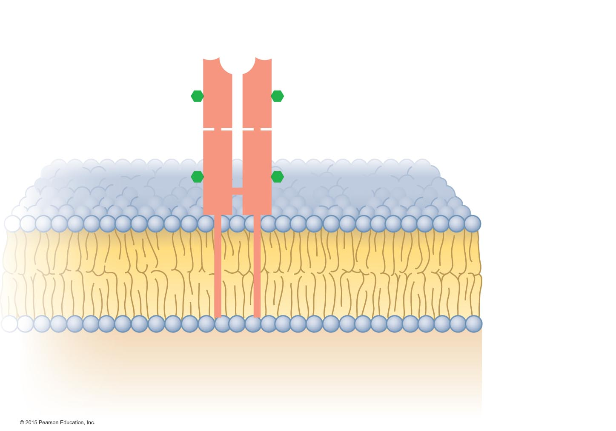
Figure 16.4 A T cell receptor (TCR).
Antigen-binding
site
Carbohydrate
Variable
regions
Constant
regions
Cytoplasmic
membrane
of T cell
T cell receptor
(TCR)
Cytoplasm
Notes:
14

Slide 15
Preparation for an Adaptive Immune Response
T Lymphocytes (T Cells) and Preparation for an Adaptive Immune Response
The Roles of the Major Histocompatibility Complex and Antigen-Presenting Cells
Group of antigens first identified in graft patients
Important in determining compatibility of tissues for tissue grafting
Major histocompatibility antigens are glycoproteins found in the membranes of most cells of vertebrate animals
Hold and position antigenic determinants for presentation to T cells

Slide 16
Preparation for an Adaptive Immune Response
T Lymphocytes (T Cells) and Preparation for an Adaptive Immune Response
The Roles of the Major Histocompatibility Complex and Antigen-Presenting Cells
Antigens bind in the antigen-binding groove of MHC molecules
Two classes of MHC proteins
MHC class I
Present on all cells except red blood cells
MHC class II
Present on antigen-presenting cells (APCs)
Include B cells, macrophages, and dendritic cells

Slide 17
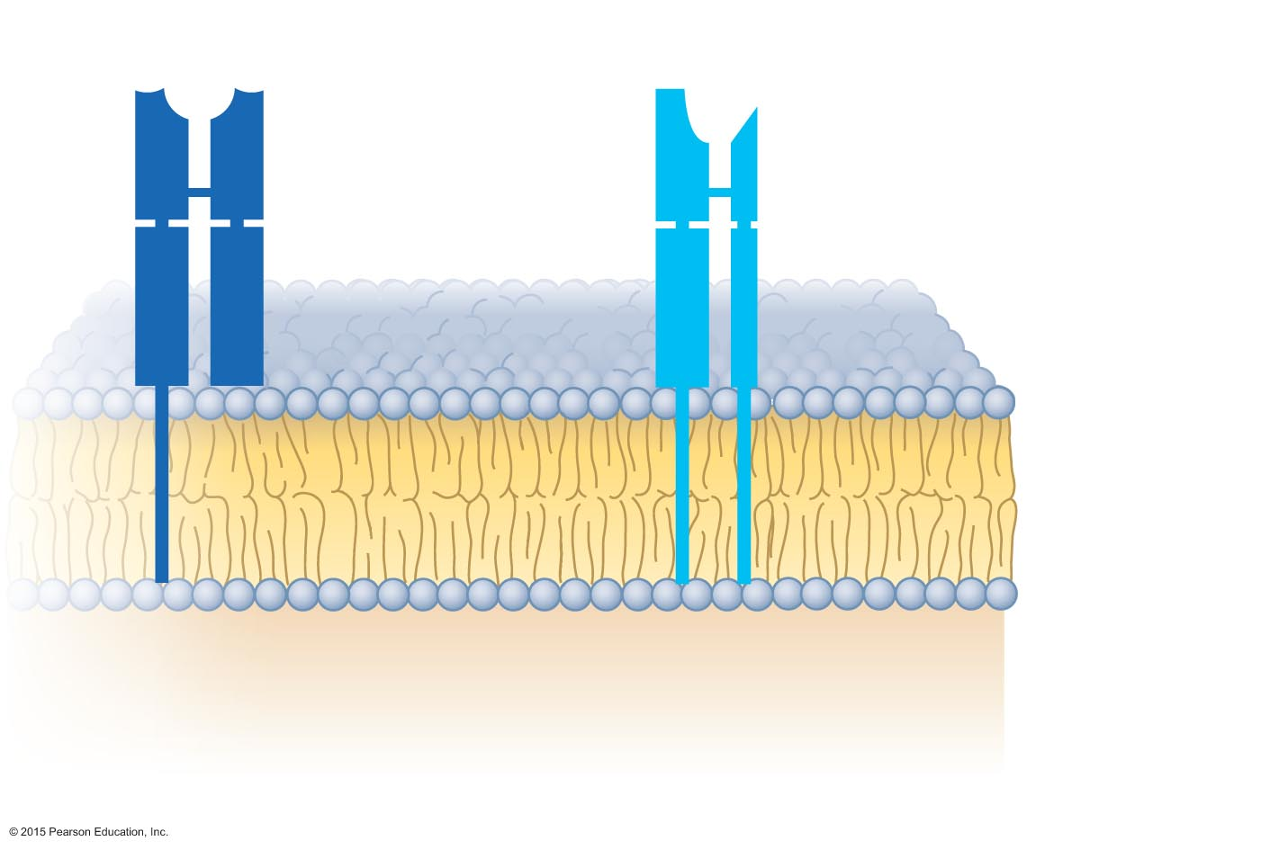
Figure 16.5 The two classes of major histocompatibility complex (MHC) proteins.
Antigen-binding sites
(grooves)
Cytoplasmic
membrane
Class I MHC
on every
nucleated
cell
Class II MHC
on B cell or other
antigen-presenting
cell (APC)
Cytoplasm
Notes:
17

Slide 18
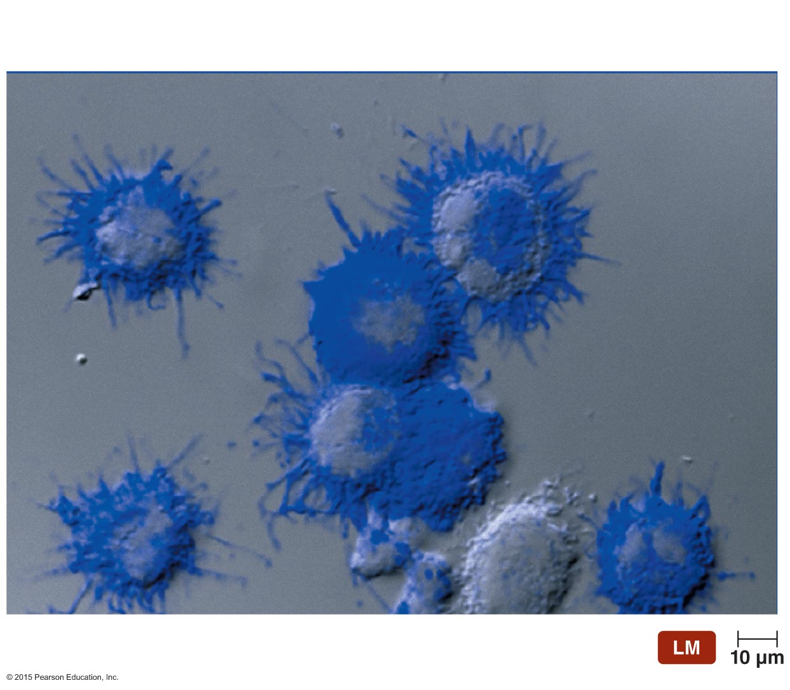
Figure 16.6 Dendritic cells.
Dendrites
Notes:
18

Slide 19
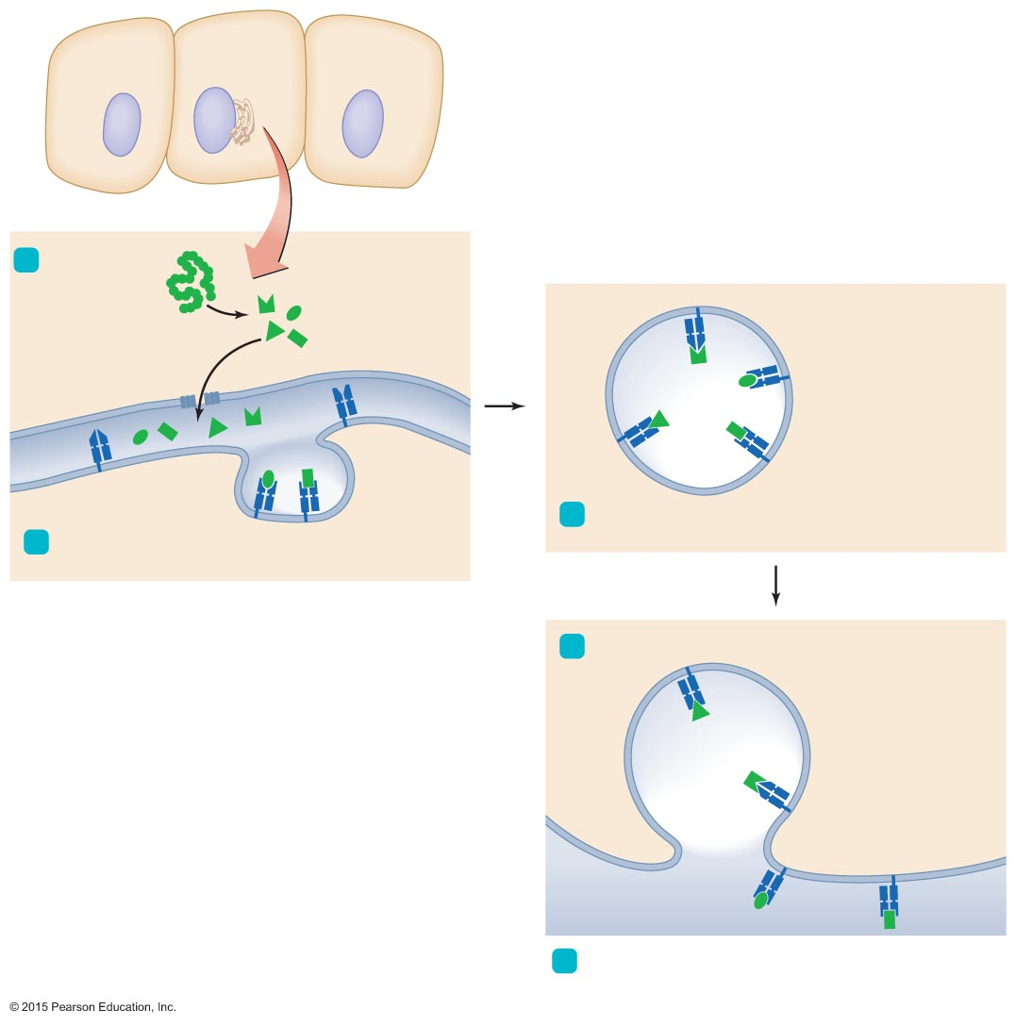
Figure 16.7 The processing of T-dependent endogenous antigens.
1
Polypeptide
is catabolized.
MHC I protein
in membrane
of endoplasmic
reticulum
Epitopes
MHC I protein–
epitope complex
Lumen of
endoplasmic
reticulum
3
Golgi bodies package MHC I protein–epitope
complexes into vesicles.
2
Epitopes are loaded onto complementary MHC I
proteins in the ER.
4
Vesicles fuse with cytoplasmic membrane.
MHC I protein–epitope
complexes on
cell surface
Cytoplasmic
membrane
5
MHC I protein–epitope complexes are displayed
on cytoplasmic membranes of all nucleated cells.
Notes:
19

Slide 20
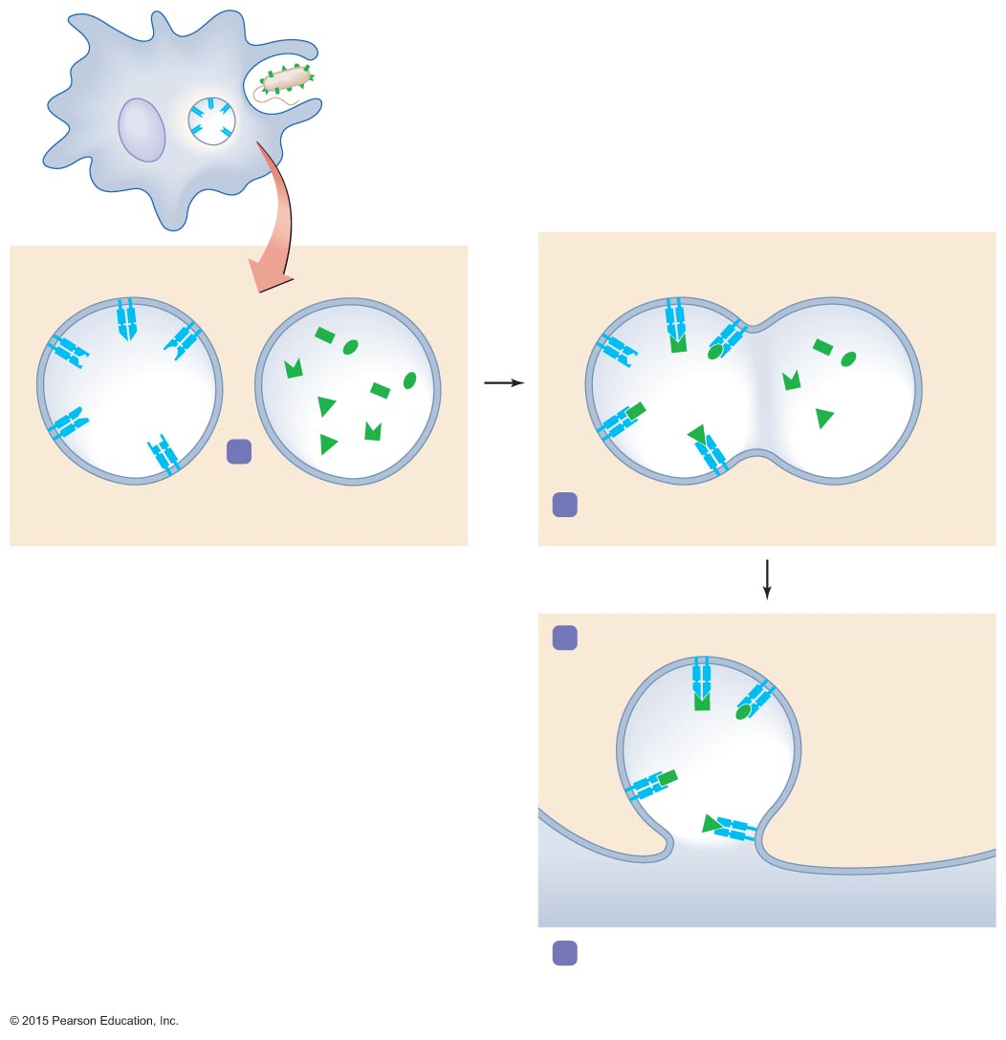
Figure 16.8 The processing of T-dependent exogenous antigens.
Phagocytosis
by APC
Exogenous
pathogen
with antigens
MHC II protein–
epitope complex
1
MHC II protein in
membrane of vesicle
Epitopes in
phagolysosome
2
Vesicles fuse and epitopes bind to
complementary MHC II molecules.
3
Vesicle fuses with cytoplasmic membrane.
MHC II protein–
epitope
complexes on
cell surface
Cytoplasmic
membrane
4
MHC II protein–epitope complexes are displayed
on cytoplasmic membranes of antigen-
presenting cell.
Notes:
20

Slide 21
Elements of Adaptive Immunity
T Lymphocytes (T Cells) and Preparation for an Adaptive Immune Response
Types of T lymphocytes
Based on surface glycoproteins and characteristic functions
Cytotoxic T lymphocyte
Directly kills other cells
Helper T lymphocyte
Helps regulate B cells and cytotoxic T cells
Includes type 1 and type 2 helper T cells
Regulatory T lymphocyte
Represses adaptive immune responses

Slide 22
Notes:
22

Slide 23
Elements of Adaptive Immunity
T Lymphocytes (T Cells) and Preparation for an Adaptive Immune Response
Clonal deletion
Vital that immune responses not be directed against autoantigens
Body eliminates self-reactive lymphocytes
Lymphocytes that react to autoantigens undergo apoptosis

Slide 24
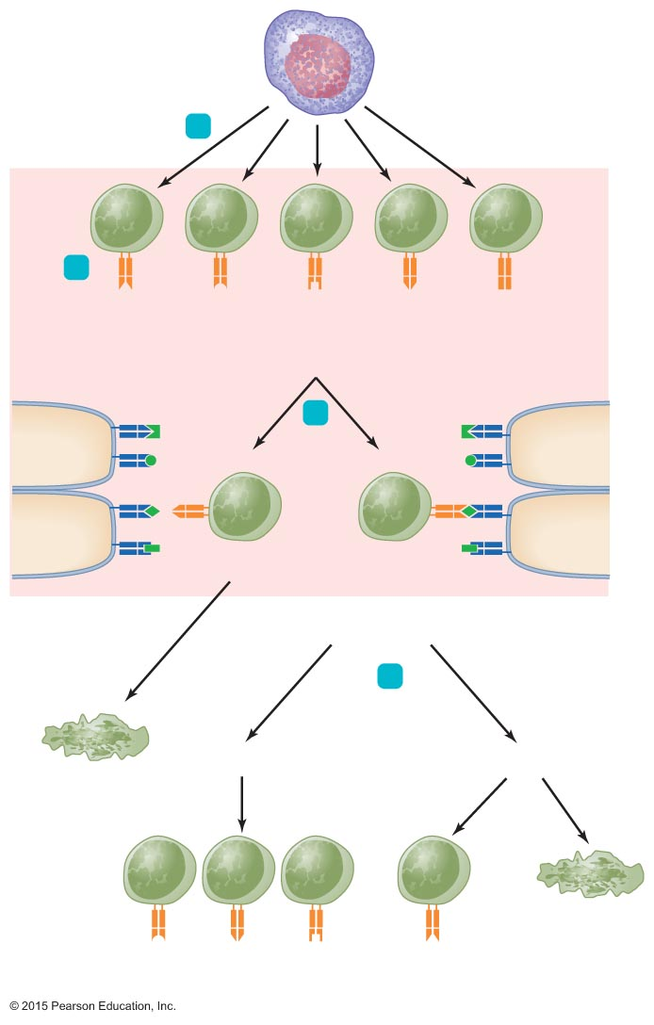
Figure 16.9 Clonal deletion of T cells.
Stem cell
(in red bone marrow)
1
Thymus
T cells
2
TCRs with
differently shaped
binding sites
MHC
Epitope
3
Recognize
MHC?
Thymus
cells
Thymus
cells
No
Yes
Receive survival
signal
4
Recognize
MHC-autoantigen?
Apoptosis
No
Yes
Few
Most
Apoptosis
Repertoire of
immature Tc cells
Regulatory
T cell (Tr)
Notes:
24

Slide 25
Elements of Adaptive Immunity
B Lymphocytes (B Cells) and Antibodies
Found primarily in the spleen, lymph nodes, and MALT
Small percentage of B cells circulate in the blood
Major function is the secretion of antibodies

Slide 26
Elements of Adaptive Immunity
B Lymphocytes (B Cells) and Antibodies
Specificity of the B cell receptor (BCR)
Each B lymphocyte has multiple copies of the B cell receptor (BCR)
Each B cell generates a single BCR
Two variable regions of the BCR form the antigen-binding sites
Each BCR recognizes only one epitope
The entire repertoire of an individual's BCRs is capable of recognizing millions of different epitopes

Slide 27
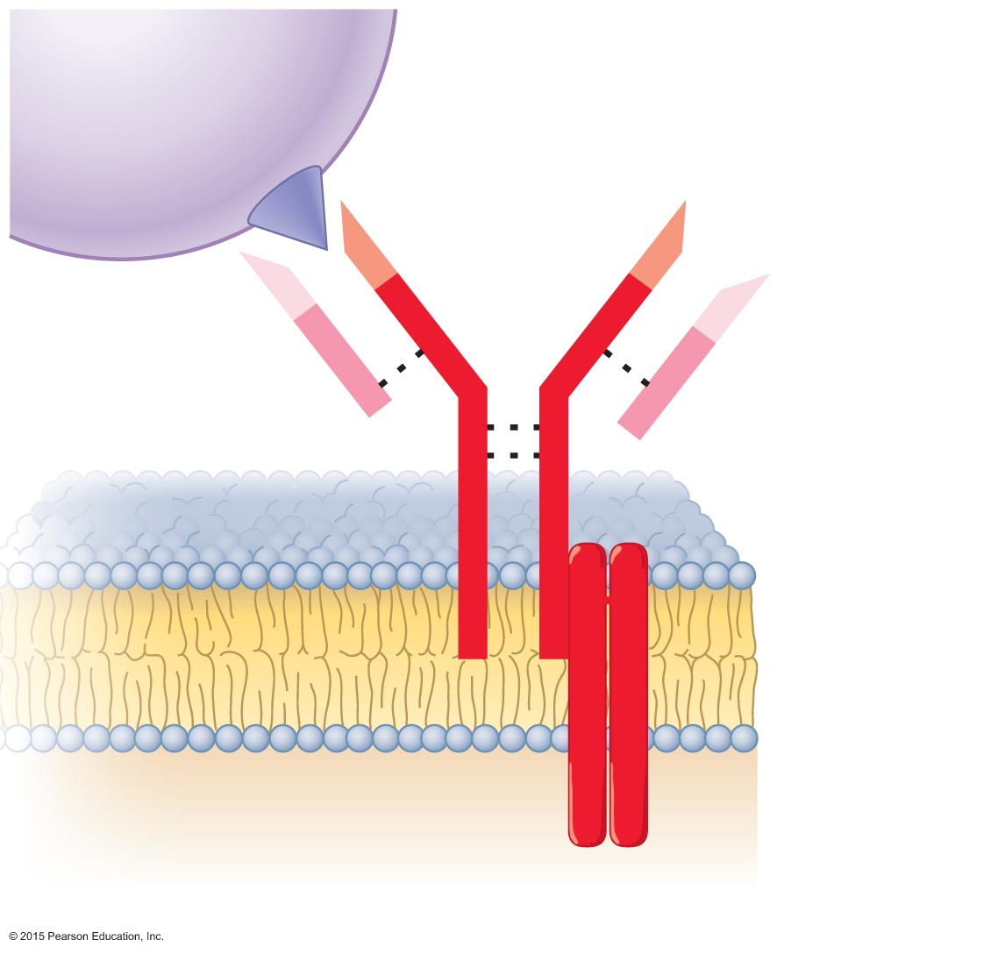
Figure 16.10 B cell receptor (BCR).
Epitope
Antigen-
binding
sites
Heavy chain
Variable
region
Light chain
S
S
S
S
S
S
S
S
Disulfide bond
Cytoplasmic
membrane of
B lymphocyte
Transmembrane
portion of BCR
Cytoplasm
Notes:
27

Slide 28
Elements of Adaptive Immunity
B Lymphocytes (B Cells) and Antibodies
Specificity and antibody structure
Antibodies are immunoglobulins similar to BCRs
Secreted by activated B cells called plasma cells
Have antigen-binding sites and antigen specificity identical to the BCR of the activated B cell

Slide 29
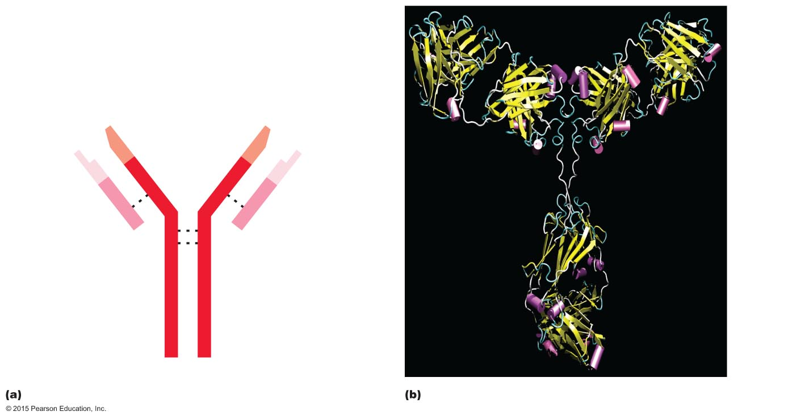
Figure 16.11 Basic antibody structure.
Arm (F_{ab})
Light chain
Antigen-binding sites
Variable region
of heavy chain
Variable region
of light chain
Hinge
Arm (F_{ab})
S
S
S
S
Hinge
S
S
Constant region
of light chain
S
S
Stem (F_{c})
Constant region
of heavy chain
Stem (F_{c})
Heavy chains
Notes:
29

Slide 30
Elements of Adaptive Immunity
B Lymphocytes (B Cells) and Antibodies
Antibody function
Antigen-binding sites are complementary to epitopes
Antibodies function in several ways
Activation of complement and inflammation
Neutralization
Opsonization
Killing by oxidation
Agglutination
Antibody-dependent cellular cytotoxicity (ADCC)

Slide 31
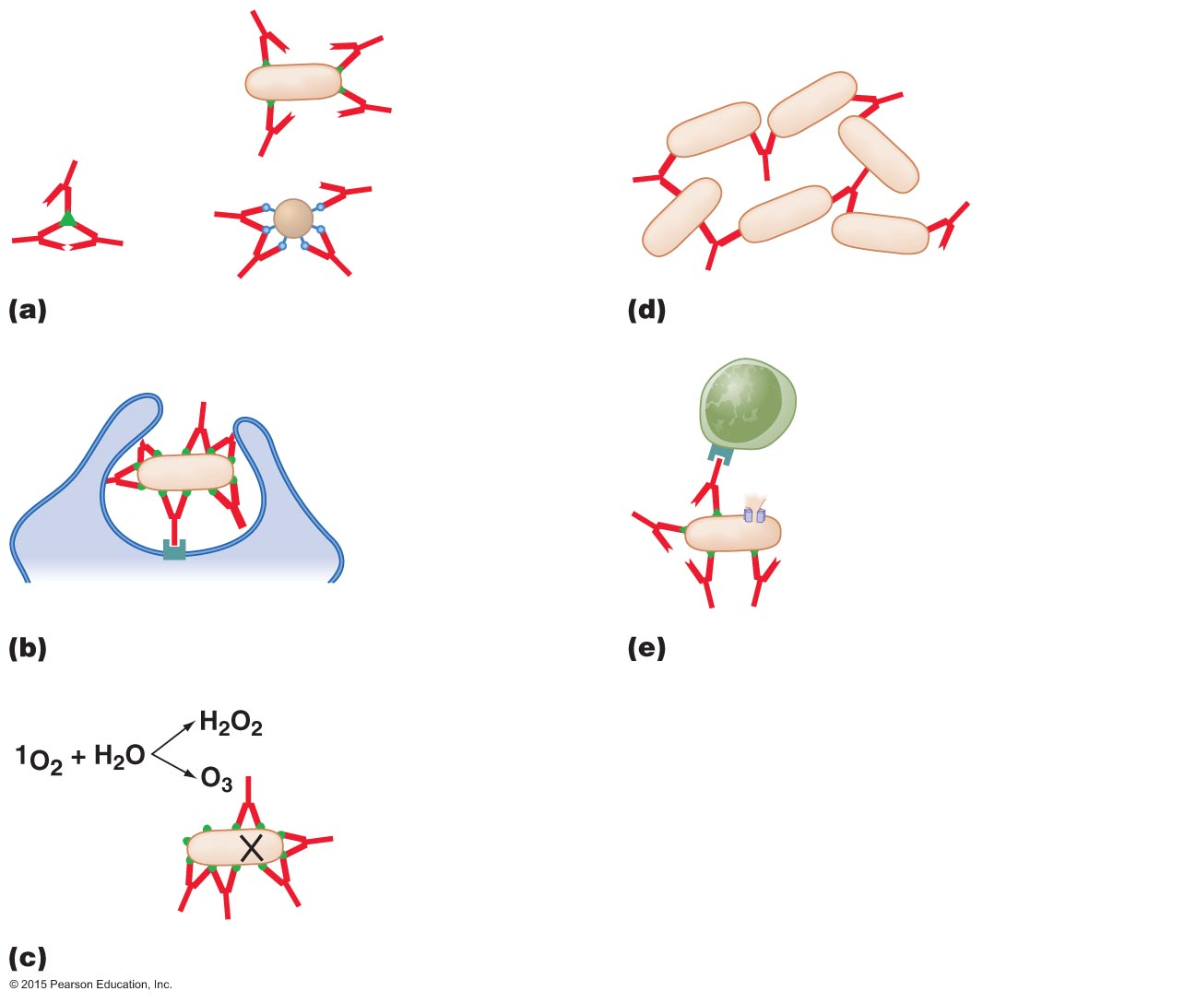
Figure 16.12 Five functions of antibodies.
Adhesin
proteins
Bacterium
Toxin
Virus
Neutralization
Agglutination
NK lymphocyte
Pseudopod
of phagocyte
F_{c}receptor protein
Perforin allows granzyme
to enter, triggers apoptosis
and lysis
F_{c}receptor protein
Opsonization
Antibody-dependent cellular
cytotoxicity (ADCC)
Bacteria die
Oxidation
Notes:
31

Slide 32
Elements of Adaptive Immunity
B Lymphocytes (B Cells) and Antibodies
Classes of antibodies
Threats confronting the immune system are variable
Antibody class involved in the immune response varies
Type of antigen
Portal of entry
Antibody function needed
Five different classes of antibodies

Slide 33
Elements of Adaptive Immunity
B Lymphocytes (B Cells) and Antibodies
Classes of antibodies
IgM – first antibody produced
IgG – most common and longest-lasting antibody
IgA – associated with body secretions
IgE – involved in response to parasitic infections and allergies
IgD – exact function is not known

Slide 34
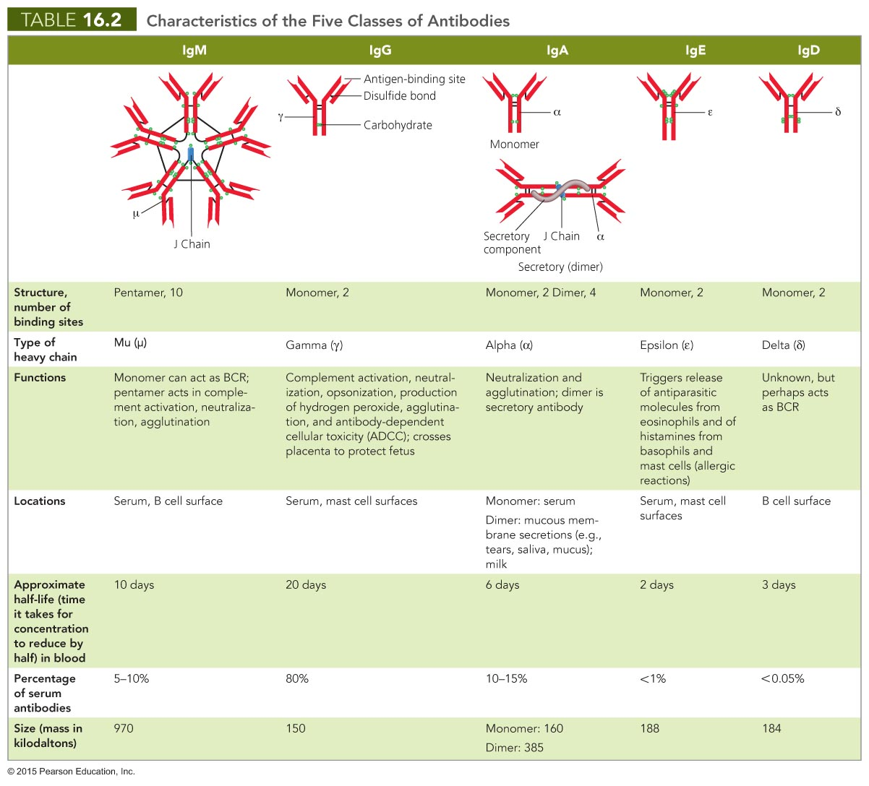
Notes:
34

Slide 35
Elements of Adaptive Immunity
B Lymphocytes (B Cells) and Antibodies
Clonal deletion of B cells
Occurs in the bone marrow
Similar to deletion of T cells
Self-reactive B cells may become inactive or change their BCR

Slide 36
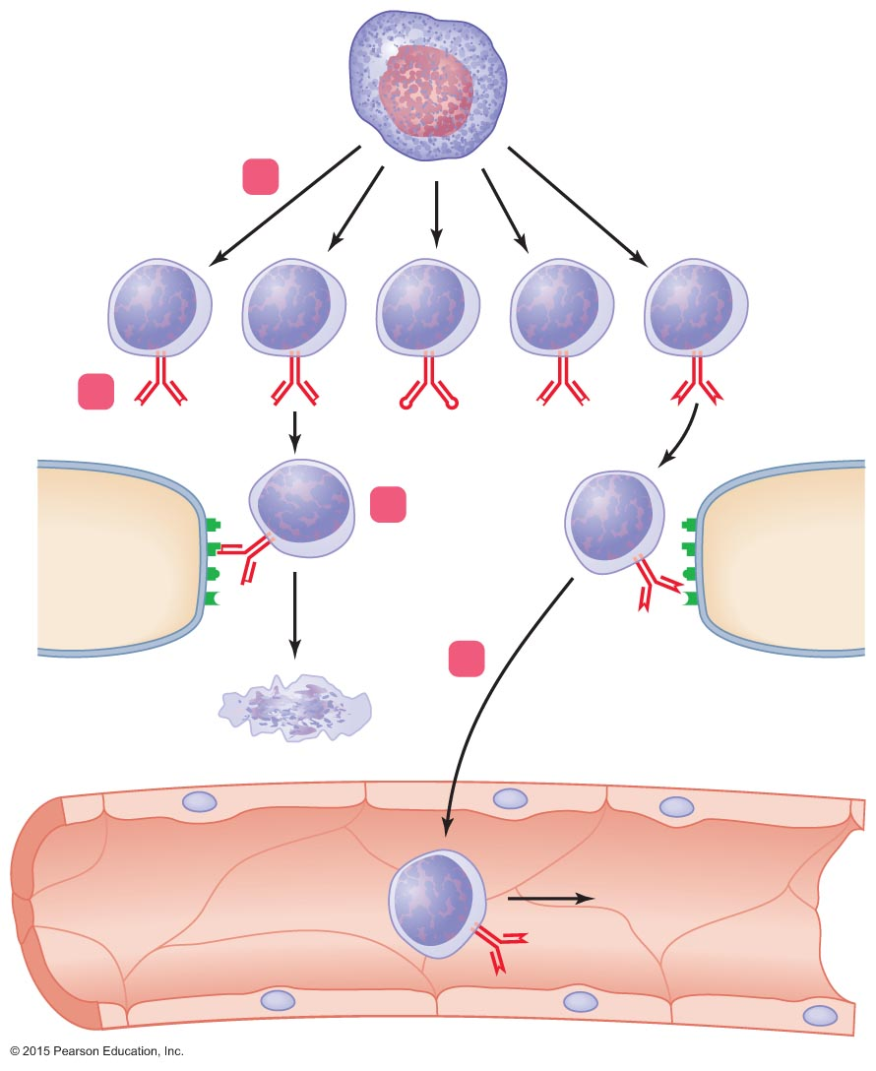
Figure 16.13 Clonal deletion of B cells.
Stem cell
(in red bone marrow)
1
B cells
2
BCRs with
differently
shaped
binding sites
3
Cell with
autoantigens
Cell with
autoantigens
4
Apoptosis
Blood vessel
To spleen
Notes:
36

Slide 37
Elements of Adaptive Immunity
Immune Response Cytokines
Soluble regulatory proteins that act as intercellular signals
Cytokines secreted by various leukocytes
Cytokine network
Complex web of signals among cells of the immune system

Slide 38
Elements of Adaptive Immunity
Immune System Cytokines
Interleukins (ILs)
Signal among leukocytes
Interferons (IFNs)
Antiviral proteins that may act as cytokines
Growth factors
Proteins that stimulate stem cells to divide
Tumor necrosis factor (TNF)
Secreted by macrophages and T cells to kill tumor cells and regulate immune responses and inflammation
Chemokines
Chemotactic cytokines that signal leukocytes to move

Slide 39
Cell-Mediated Immune Responses
Respond to intracellular pathogens and abnormal body cells
Common intracellular pathogens are viruses
The response is also effective against cancer cells, intracellular protozoa, and intracellular bacteria

Slide 40
Cell-Mediated Immune Responses
Activation of Cytotoxic T Cell Clones and Their Functions
Adaptive immune responses initiated in lymphoid organs
Steps involved in activation of cytotoxic T cells
Antigen presentation
Helper T cell differentiation
Clonal expansion
Self-stimulation

Slide 41
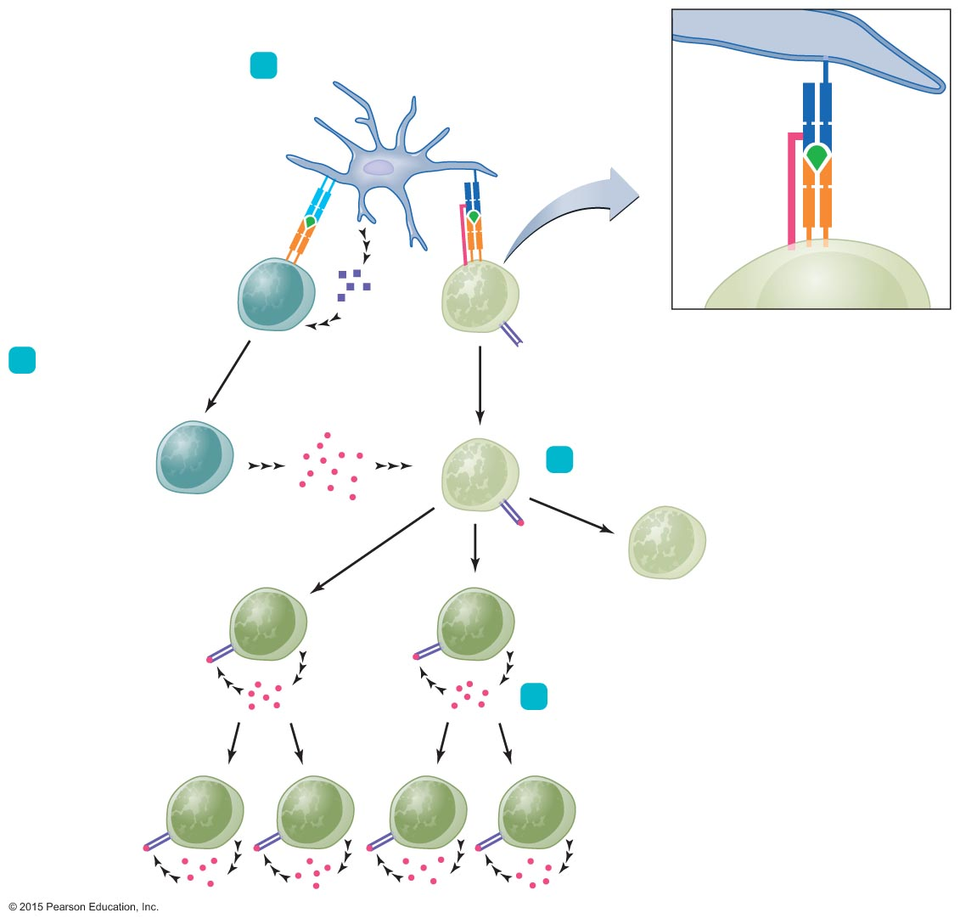
Figure 16.14 Activation of a clone of cytotoxic T (Tc) cells.
Dendritic cell
1
Antigen presentation
MHC I
DC
CD8
Epitope
MHC II
MHC I
TCR
Epitope
TCR
Th
cell
IL-12
Inactive
Tc cell
Tc cell
IL-2 receptor
(IL-2R)
Immunological synapse
2
Th differentiation
IL-2
Th1 cell
3
Clonal expansion
Active
Tc cells
Memory
T cell
IL-2R
IL-2
IL-2
4
Self-stimulation
IL-2R
Active Tc cells
IL-2
Notes:
41

Slide 42
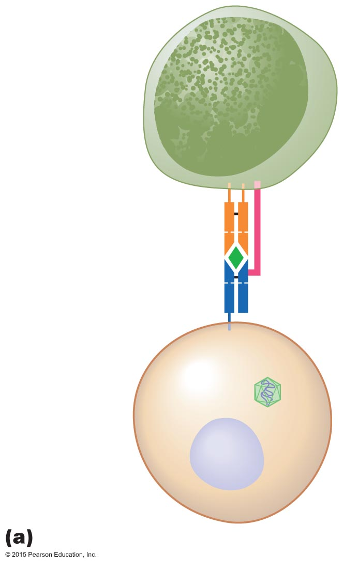
Figure 16.15a A cell-mediated immune response.
Active
cytotoxic T
(Tc) cell
TCR
CD8
Viral epitope
MHC I
protein
Virally
infected cell
Intracellular
virus
Notes:
42

Slide 43
Cell-Mediated Immune Responses
Activation of Cytotoxic T Cell Clones and Their Functions
Cytotoxic T cells kills their targets by two pathways
Perforin-granzyme pathway
Involves synthesis of killing proteins
CD95 pathway
Mediated by a glycoprotein on the body's cells

Slide 44
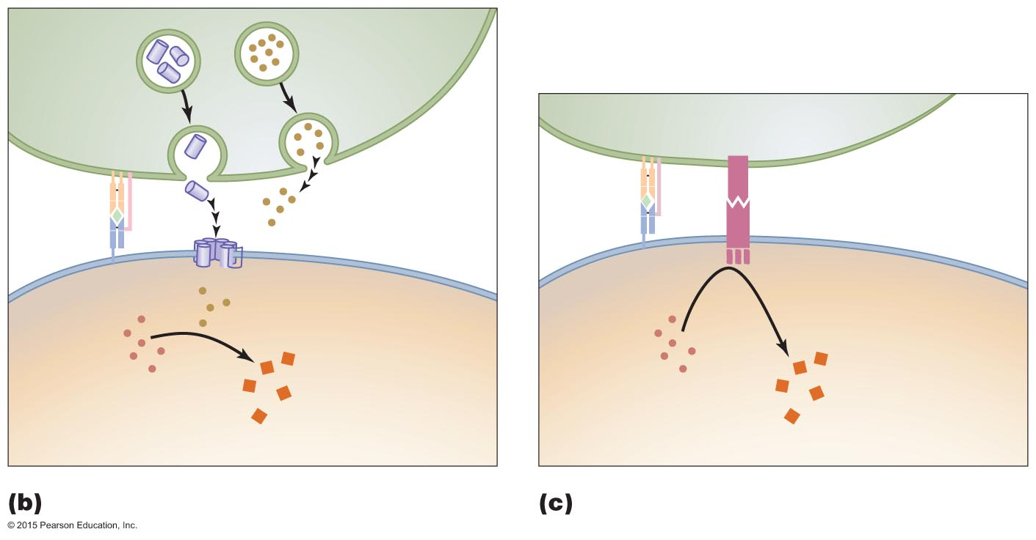
Figure 16.15b-c A cell-mediated immune response.
Tc cell
Perforin
Granzyme
Tc cell
CD95L
Perforin
complex (pore)
CD95
Enzymatic
portion of CD95
becomes active
Granzymes activate
apoptotic enzymes
Inactive
apoptotic
enzymes
Inactive
apoptotic
enzymes
Active enzymes
induce apoptosis
Active enzymes
induceapoptosis
Virally infected cell
Virally infected cell
Notes:
44

Slide 45
Cell-Mediated Immune Responses
Memory T Cells
Some activated T cells become memory T cells
Persist for months or years in lymphoid tissues
Immediately functional upon subsequent contacts with epitope-MHC complex specific to its TCR
Memory response is more effective than the primary response

Slide 46
Cell-Mediated Immune Responses
T Cell Regulation
Regulation needed to prevent T cell response to autoantigens
T cells require additional signals from an antigen-presenting cell
Interaction of the T cell and antigen-presenting cell stimulates the T cell to respond to the antigen
Regulatory T cells also moderate cytotoxic T cell activity

Slide 47
Antibody Immune Responses
Antibody immune responses mounted against exogenous pathogens and toxins
Activates only in response to specific pathogens

Slide 48
Antibody Immune Responses
Memory B Cells and the Establishment of Immunological Memory
Memory B cells
Produced by B cell proliferation but do not secrete antibodies
Have BCRs complementary to the epitope that triggered their production
Long-lived cells that persist in the lymphoid tissue
Initiates antibody production if antigen is encountered again

Slide 49
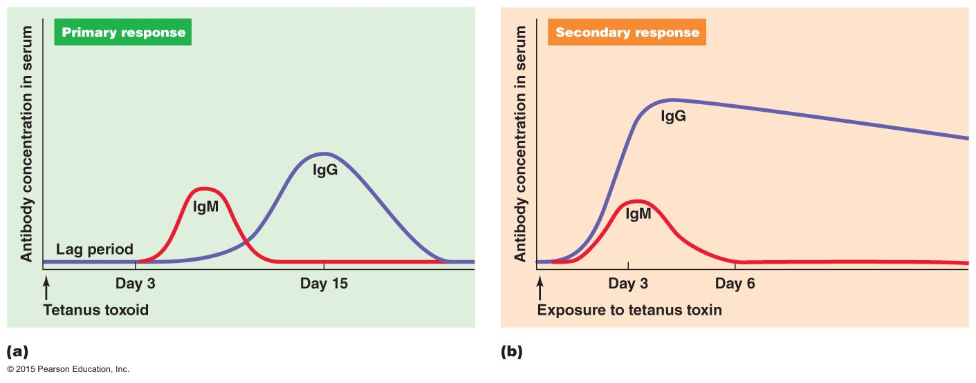
Figure 16.19 The production of primary and secondary antibody immune responses.
Notes:
49

Slide 50
Types of Acquired Immunity
Specific immunity acquired during an individual's life
Two types
Naturally acquired
Response against antigens encountered in daily life
Artificially acquired
Response to antigens introduced via a vaccine
Distinguished as either active or passive

Slide 51
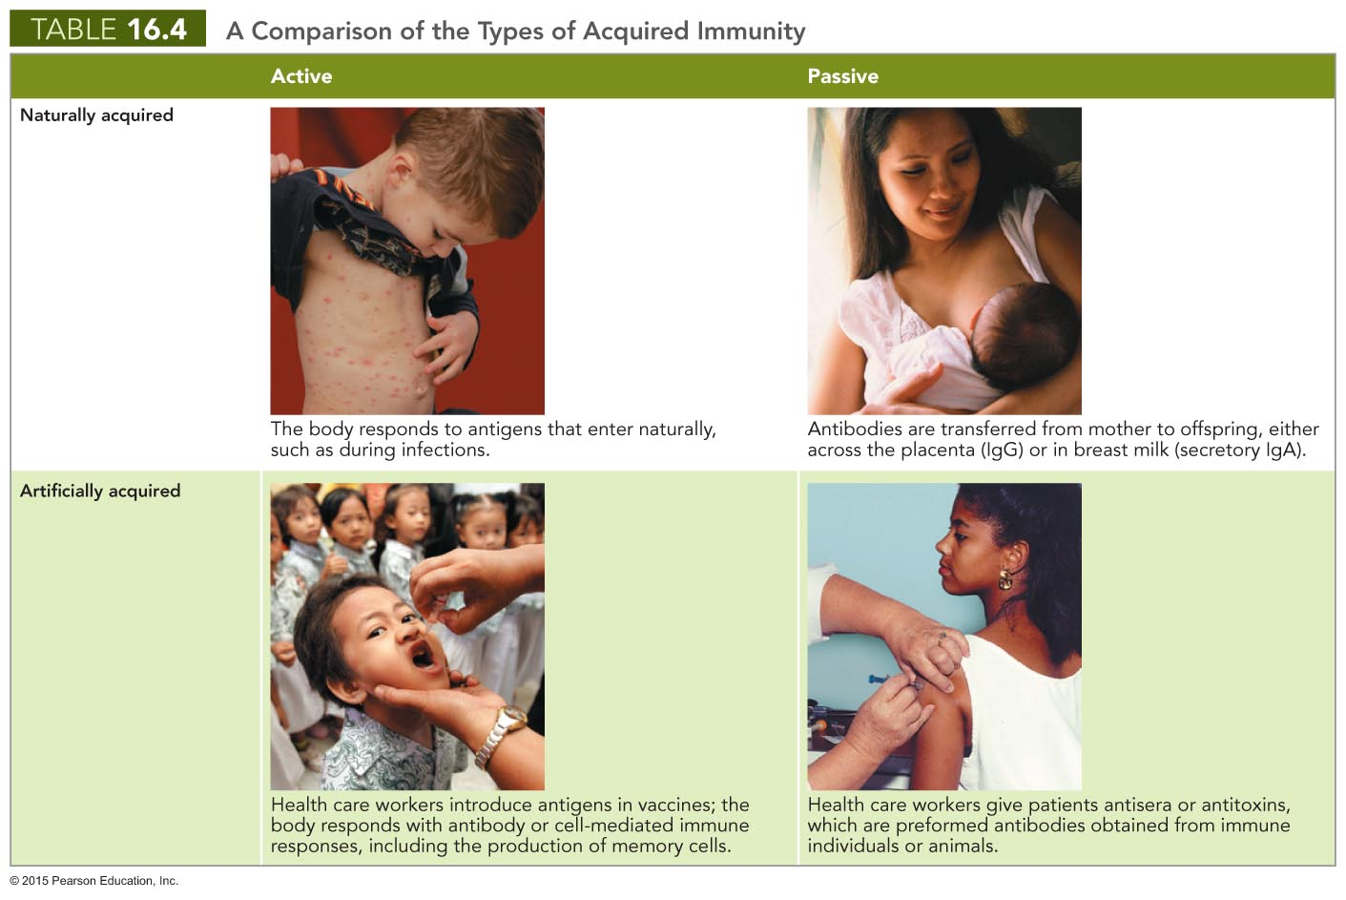
Notes:
51

