Slide 1
Microbial Diseases: Cardiovascular and Systemic
Microbiology
CCV

Slide 2
Structures of the Cardiovascular System
Cardiovascular system is composed of heart, blood, and blood vessels
Heart pumps blood into arteries connected via capillaries to veins
Arteries carry blood away from the heart
Veins carry blood to the heart
Blood composition
Serum: liquid part of blood
Formed elements: erythrocytes, leukocytes, platelets

Slide 3
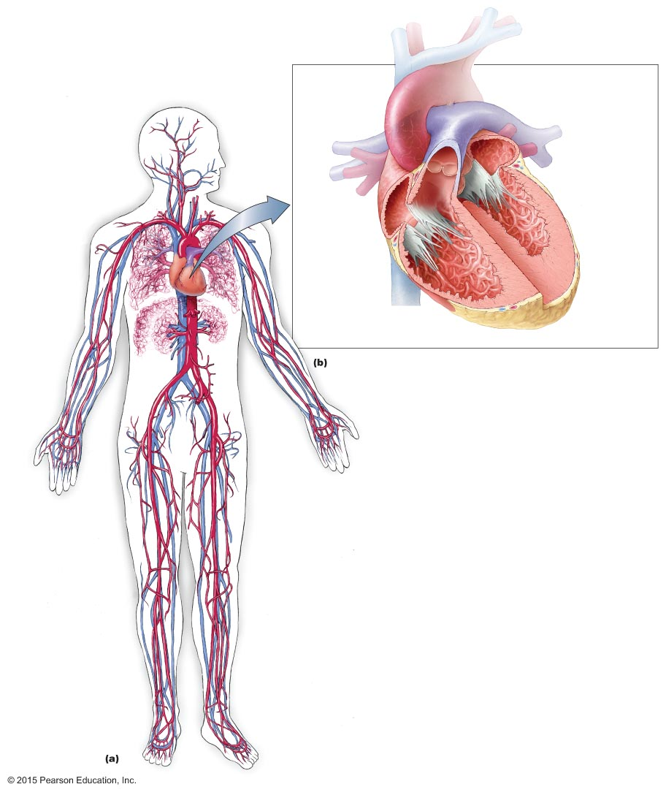
Figure 21.1 The cardiovascular system.
Pulmonary
arteries
Superior
vena cava
(main vein)
Pulmonary
veins
Valves
(closed)
Right
pulmonary
artery
Right
atrium
Left
atrium
Right
pulmonary
veins
Endocardium
Heart
Valves
(open)
Myocardium
Vessels
of liver
Pericardium
Vessels of
kidney
Aorta
(main
artery)
Right
ventricle
Left
ventricle
Inferior
vena cava
(main vein)
The heart
Vein
Artery

Slide 4
Structures of the Cardiovascular System
Movement of Blood and Lymph
The right ventricle pumps blood to the lungs
Oxygen enters blood, and carbon dioxide diffuses out
Oxygenated blood returns to the heart through the left ventricle
Blood then moves to the arteries and capillaries
Capillaries carry blood to the surrounding tissues
Leaked fluid is picked up by the lymphatic vessels

Slide 5
Bacterial Cardiovascular and Systemic Diseases
Septicemia, Bacteremia, and Toxemia
Septicemia
Any microbial infection of the blood that produces illness
Bacteremia
Bacterial septicemia
Toxemia
Release of bacterial toxins into the blood
Lymphangitis
Infection and inflammation of the lymphatic vessels

Slide 6
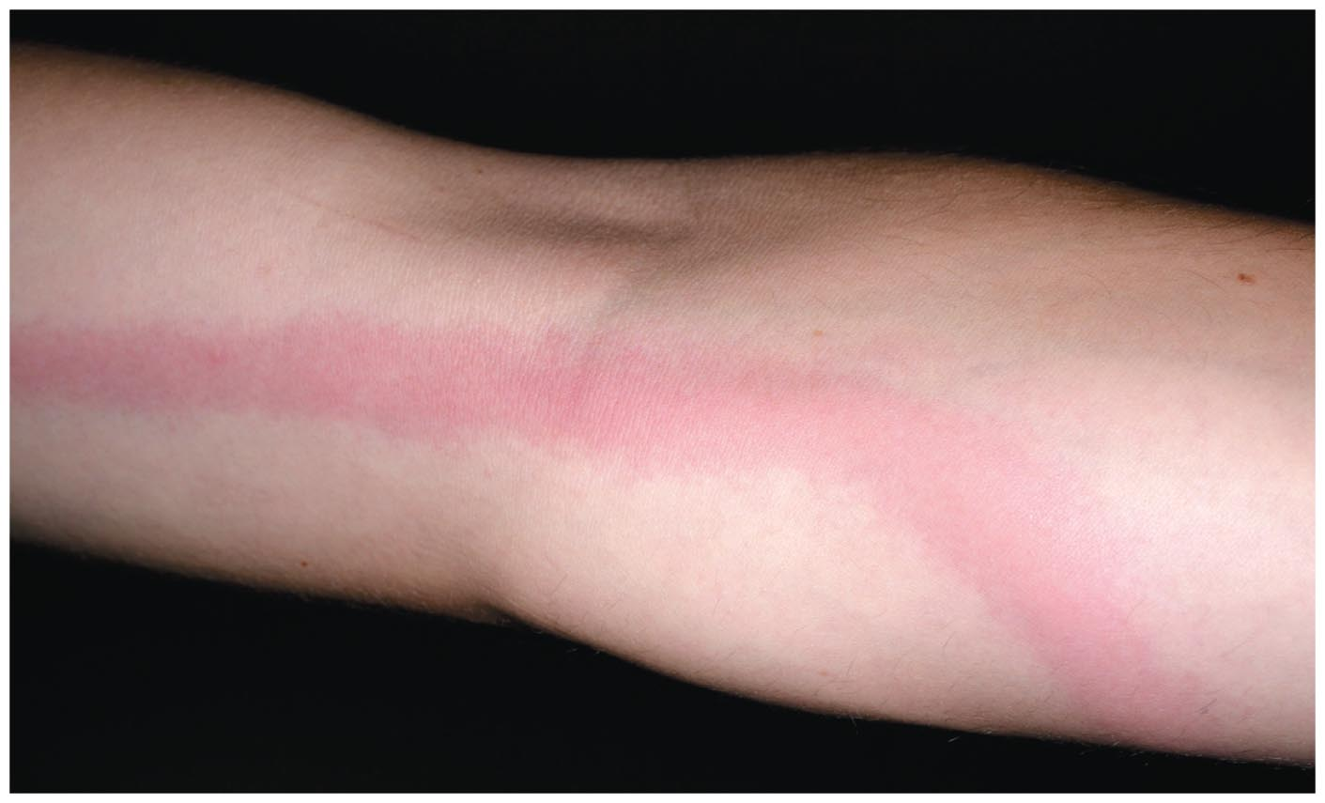
Figure 21.2 Lymphangitis, a sign of septicemia.

Slide 7
Bacterial Cardiovascular and Systemic Diseases
Septicemia, Bacteremia, and Toxemia
Signs and symptoms
Fever, chills, nausea, vomiting, diarrhea, malaise
Septic shock can develop rapidly
Small hemorrhagic lesions called petechiae can develop
Osteomyelitis occurs if bacteria invade the bones
Toxemia symptoms vary depending on the toxin
Exotoxins: released from living microorganisms
Endotoxin: released from Gram-negative bacteria

Slide 8
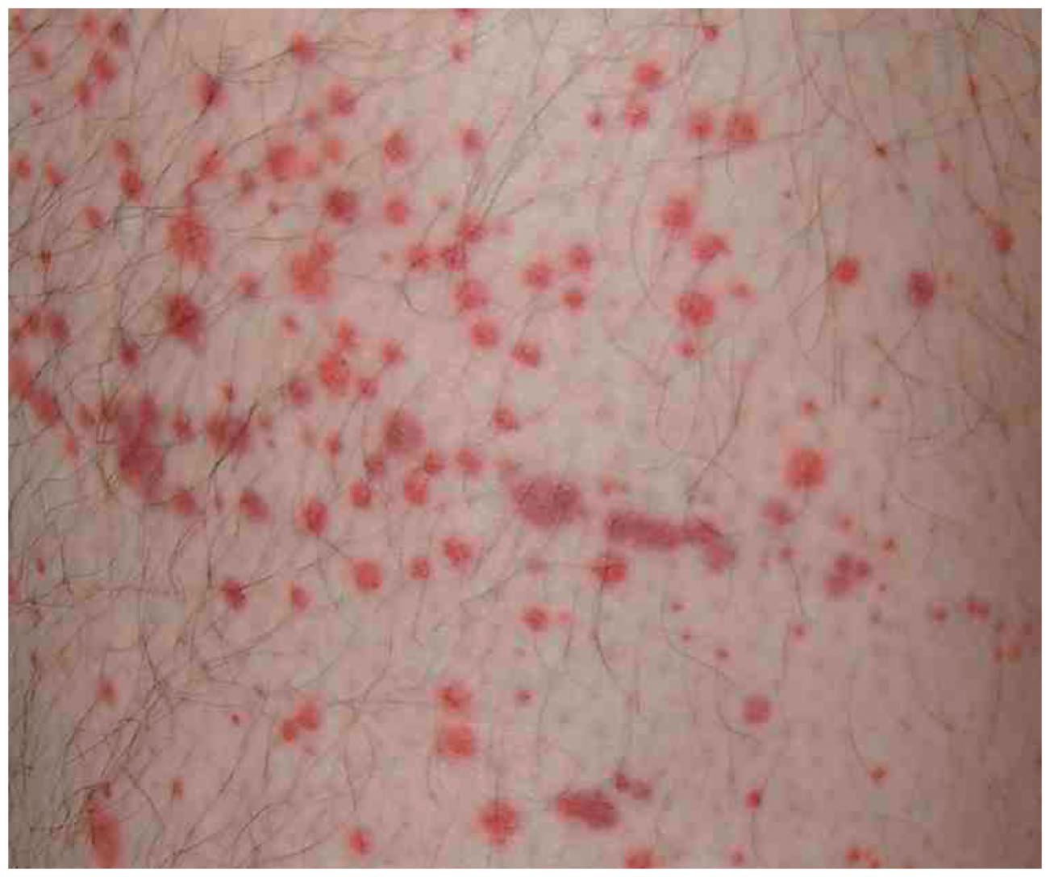
Figure 21.3 Petechiae, a sign of bacteremia.

Slide 9
Bacterial Cardiovascular and Systemic Diseases
Septicemia, Bacteremia, and Toxemia
Pathogens and virulence factors
Septicemia and toxemia are caused by various bacteria
Often opportunistic or healthcare associated infections
Septicemia is caused more often by Gram-negative bacteria
Bacteria that produce capsule may resist phagocytosis
Use siderophores to acquire iron needed for bacterial metabolism
Endotoxin is produced by Gram-negative bacteria

Slide 10
Bacterial Cardiovascular and Systemic Diseases
Septicemia, Bacteremia, and Toxemia
Pathogenesis and epidemiology
Septicemia is due to direct inoculation of bacteria into the blood
Immunocompetent individuals rarely have septicemia
Bacterial infections self-limited in these people
Gram-negative bacteria more often produce severe septicemia
Due to release of endotoxin as the bacteria die
Activates various defensive reactions by the body

Slide 11
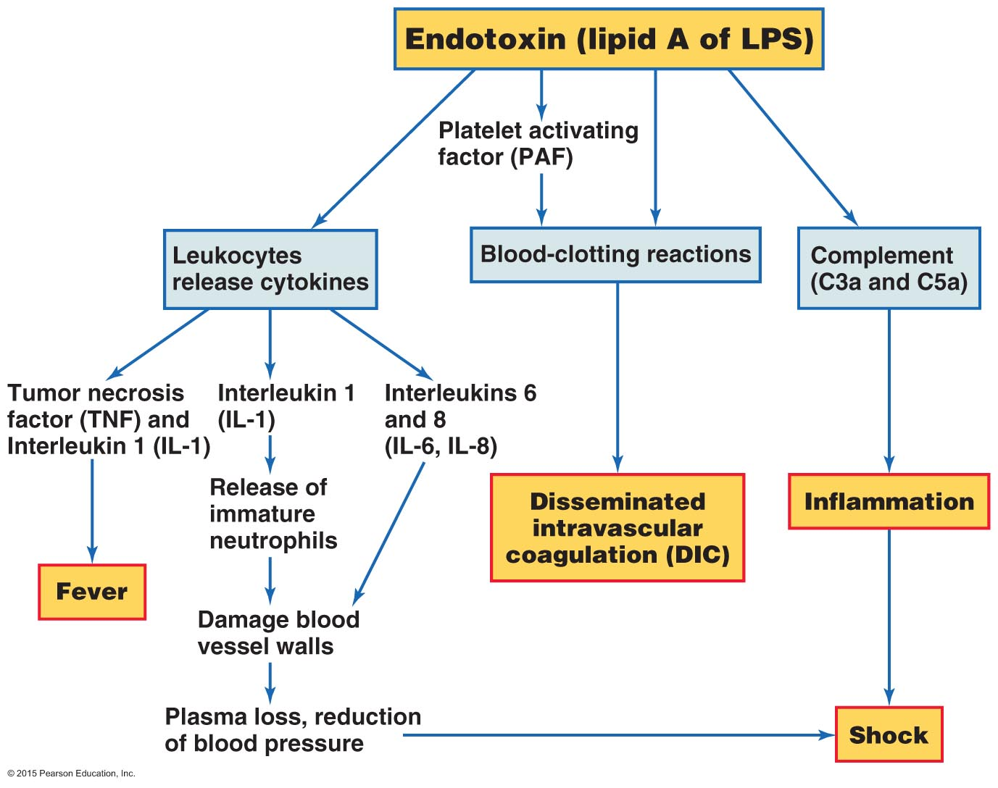
Figure 21.4 Potential effects of endotoxin.

Slide 12
Bacterial Cardiovascular and Systemic Diseases
Septicemia, Bacteremia, and Toxemia
Diagnosis, treatment, and prevention
Signs and symptoms are usually diagnostic
Treated with prompt diagnosis and administration of antimicrobial drugs
Prevention includes immediate treatment of infections
Important in individuals with compromised immune systems

Slide 13
Bacterial Cardiovascular and Systemic Diseases
Endocarditis
Signs and symptoms
Inflammation of the endocardium
Fever, fatigue, malaise, and difficulty breathing
Tachycardia may be detected
Pathogens
Normal microbiota are usually responsible
Viridans streptococci cause almost half the cases
Pathogenesis and epidemiology
Patients usually have obvious source of infection
Patients with abnormal heart have increased risk
Embolus can block blood vessels in other organs

Slide 14
Bacterial Cardiovascular and Systemic Diseases
Endocarditis
Diagnosis, treatment, and prevention
Diagnosis is based on symptoms
Vegetations visualized by echocardiogram
Treated with intravenous antibacterial drugs
Prophylactic antibiotics for high-risk patients when needed

Slide 15
Bacterial Cardiovascular and Systemic Diseases
Systemic diseases are diseases that are carried throughout the body
Pathogens are carried by the blood and lymph

Slide 16
Bacterial Cardiovascular and Systemic Diseases
Brucellosis
Signs and symptoms
Fluctuating fever that spikes every afternoon
Pathogen and virulence factors
Caused by Brucella melitensis strains
Endotoxin causes some of the signs and symptoms
Pathogenesis and epidemiology
Consumption of contaminated dairy products
Contact with animal blood, urine, or placentas
Diagnosis, treatment, and prevention
Diagnosed by serological tests and presence of fever
Usually requires no treatment
Attenuated vaccine exists for animals

Slide 17
Bacterial Cardiovascular and Systemic Diseases
Tularemia
Signs and symptoms
Skin lesions and swollen lymph nodes at infection site
Ascending lymphangitis
Pathogen and virulence factors
Caused by Francisella tularensis
Diverse host range includes mammals, birds, fish, ticks, and insects
F. tularensis can survive within infected cells
Endotoxin causes many signs and symptoms

Slide 18
Bacterial Cardiovascular and Systemic Diseases
Tularemia
Pathogenesis and epidemiology
Transmitted via bite of infected tick or contact with infected animal
Small size of bacteria allows entry through seemingly unbroken skin
Individuals in contact with dead animals at highest risk
Diagnosis, treatment, and prevention
Diagnosis is difficult and requires serological confirmation
Treated with antimicrobials
Vaccine available for people at risk for exposure

Slide 19
Bacterial Cardiovascular and Systemic Diseases
Plague
Signs and symptoms
Bubonic plague
Characterized by enlarged lymph nodes called buboes
Pneumonic plague
Occurs when the bacterium spreads to the lungs
Difficulty breathing can develop rapidly
Pathogen and virulence factors
Caused by Yersinia pestis
Various virulence factors
Adhesins, type III secretion systems, capsules, and antiphagocytic proteins

Slide 20
Figure 21.5 Bubo.
Bubo

Slide 21
Bacterial Cardiovascular and Systemic Diseases
Plague
Pathogenesis and epidemiology
Transmitted by contact with infected animal or flea feces
Bubonic plague fatal in 50% of cases if untreated
Pneumonic plague fatal in 100% of cases if untreated
Diagnosis, treatment, and prevention
Diagnosis is based on characteristic symptoms
Must be diagnosed and treated immediately
Treated with various antimicrobial drugs
Prevented with rodent and flea control and good hygiene

Slide 22
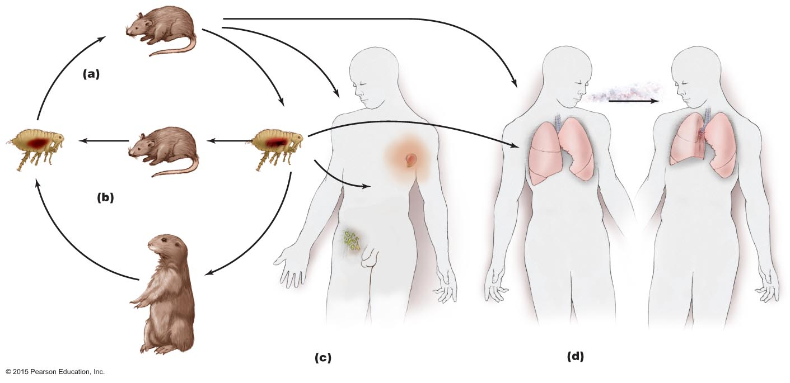
Figure 21.6 The natural history and transmission of Yersinia pestis, the bacterium that causes plague.
Direct contact
Airborne
transmission
Natural endemic
reservoir hosts (rodents)
Bubo
Flea bite
Amplifying hosts
(most mammals)
Normal
lymph
nodes
Bubonic plague
Pneumonic plague

Slide 23
Bacterial Cardiovascular and Systemic Diseases
Lyme Disease
Signs and symptoms
Three phases in untreated patients
Bull's-eye rash at infection site
Neurological symptoms
Severe arthritis
Pathogen and virulence factors
Caused by the spirochete Borrelia burgdorferi
Use of manganese instead of iron circumvents host defense
Avoids immune detection by altering membrane proteins

Slide 24
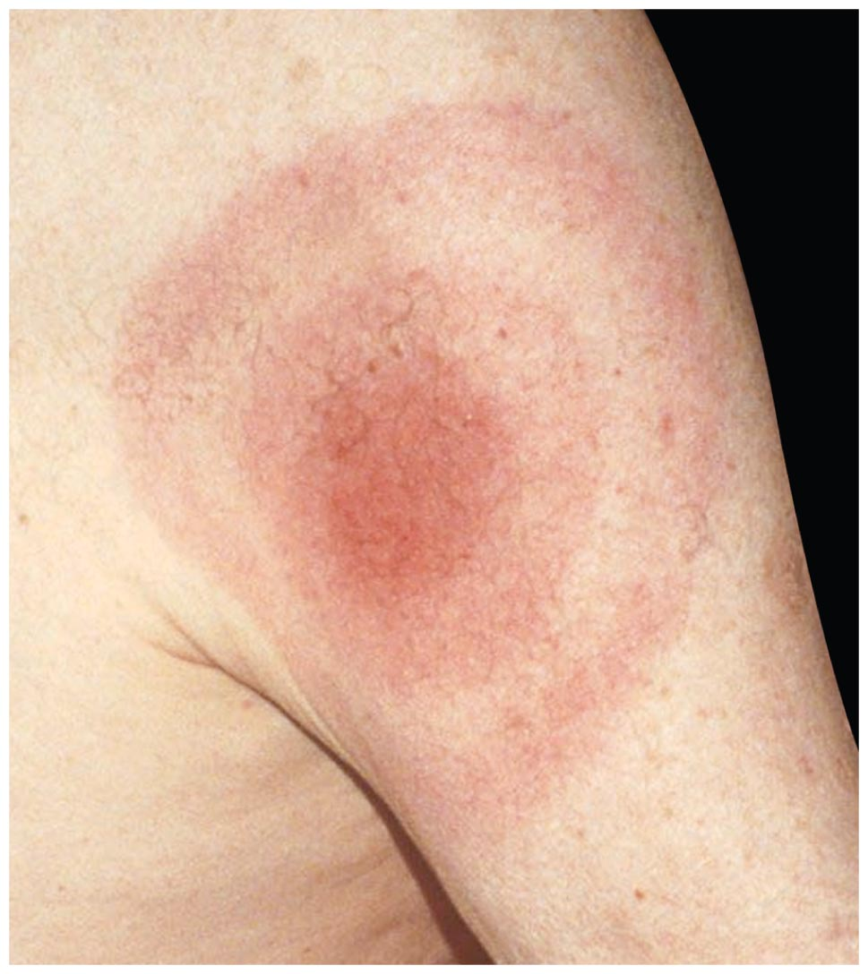
Figure 21.7 Distinctive "bull's-eye" rash of Lyme disease.

Slide 25
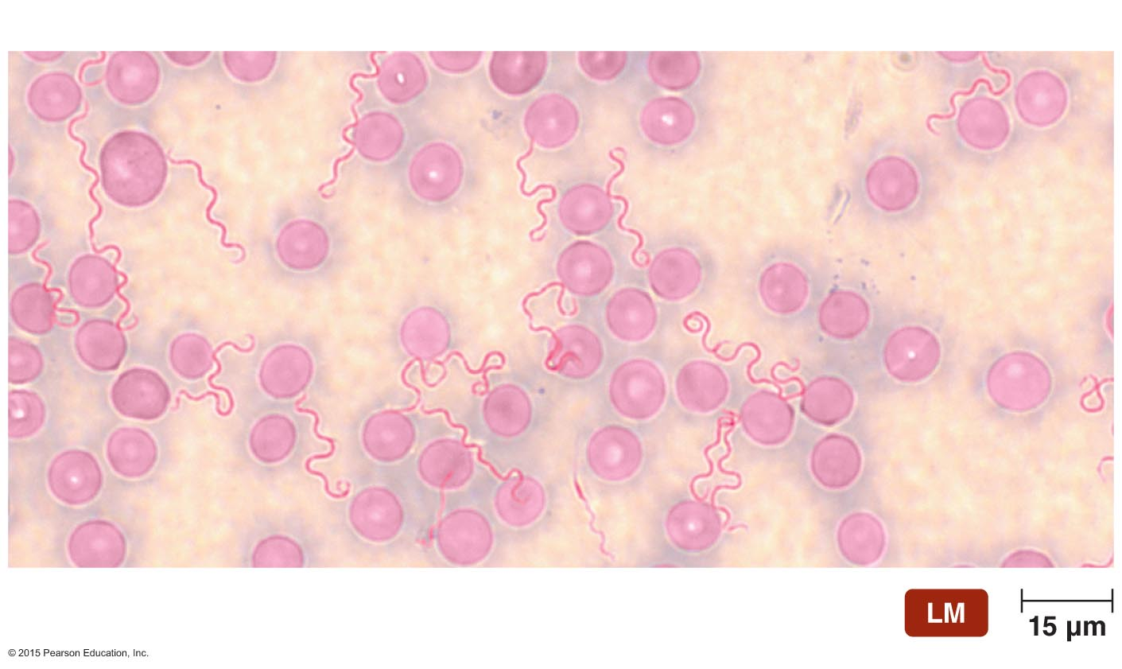
Figure 21.8 Borrelia burgdorferi.
Borrelia
Red blood cell

Slide 26
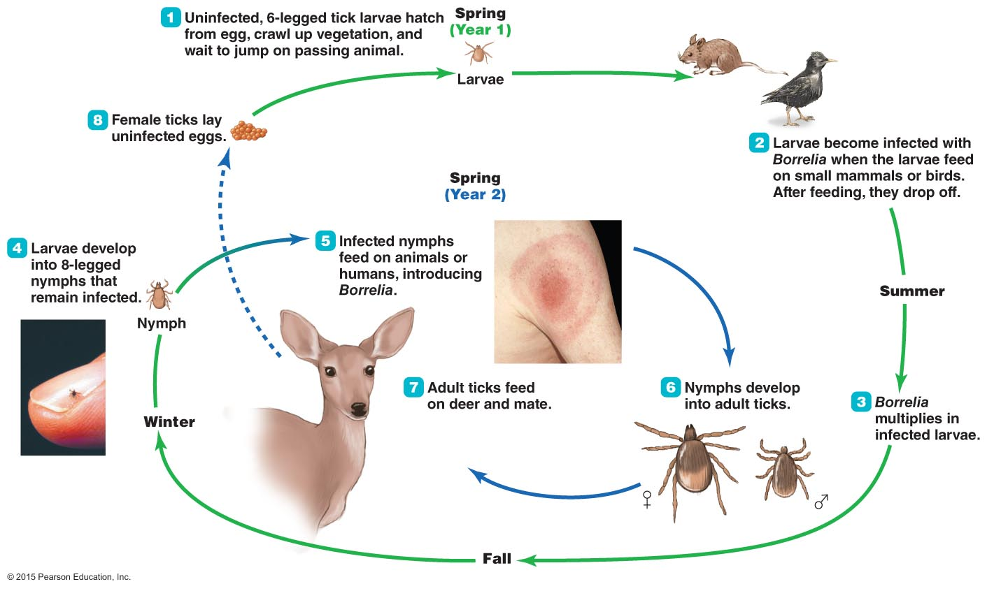
Figure 21.9 The life cycle of the deer tick Ixodes and its role as the vector of Lyme disease.

Slide 27
Bacterial Cardiovascular and Systemic Diseases
Lyme Disease
Epidemiology
One of the most reported vector-borne diseases in United States
Three events contributed to an increase in Lyme disease
Movement of human populations into woodland areas
Protection of the deer population
Coyotes have displaced the foxes that help control the mouse population

Slide 28
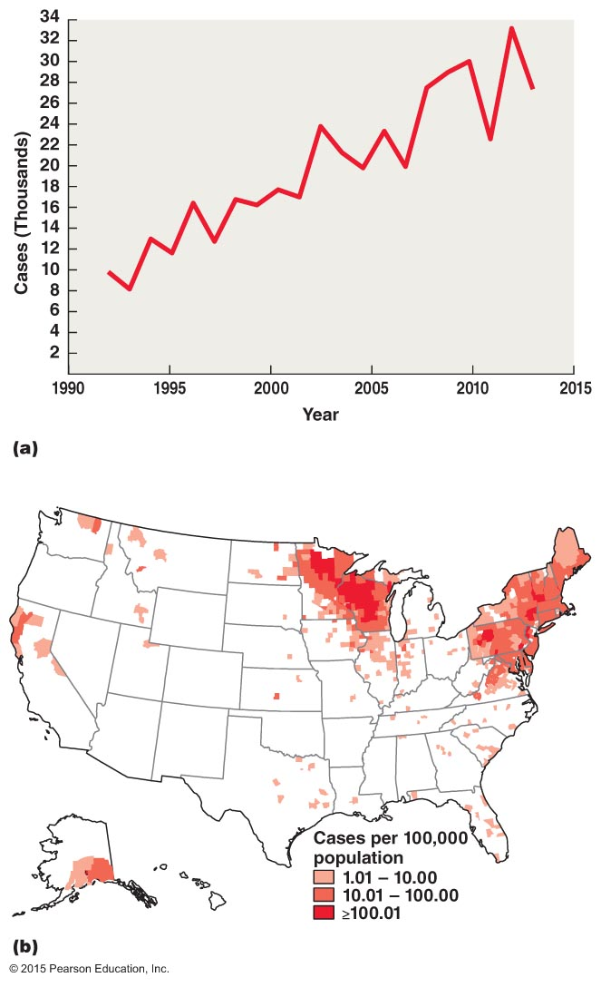
Figure 21.10 The occurrence of Lyme disease in the United States.

Slide 29
Bacterial Cardiovascular and Systemic Diseases
Lyme Disease
Diagnosis, treatment, and prevention
Diagnosis is based on the signs and symptoms of the disease
Bacterium is rarely detected in the blood
Antimicrobial drugs are used in the early phases
Treatment of later phases is difficult
Symptoms often caused by the immune system
Prevented with repellents containing DEET and with protective clothing

Slide 30
Bacterial Cardiovascular and Systemic Diseases
Ehrlichiosis and Anaplasmosis
Signs and symptoms
Resemble the flu
Leukopenia and thrombocytopenia also occur
Pathogen and virulence factors
Ehrlichia chaffeensis causes ehrlichiosis
Anaplasma phagocytophilum causes anaplasmosis
Both bacteria live inside infected cells
Pathogenesis
Ticks transmit bacteria to humans

Slide 31
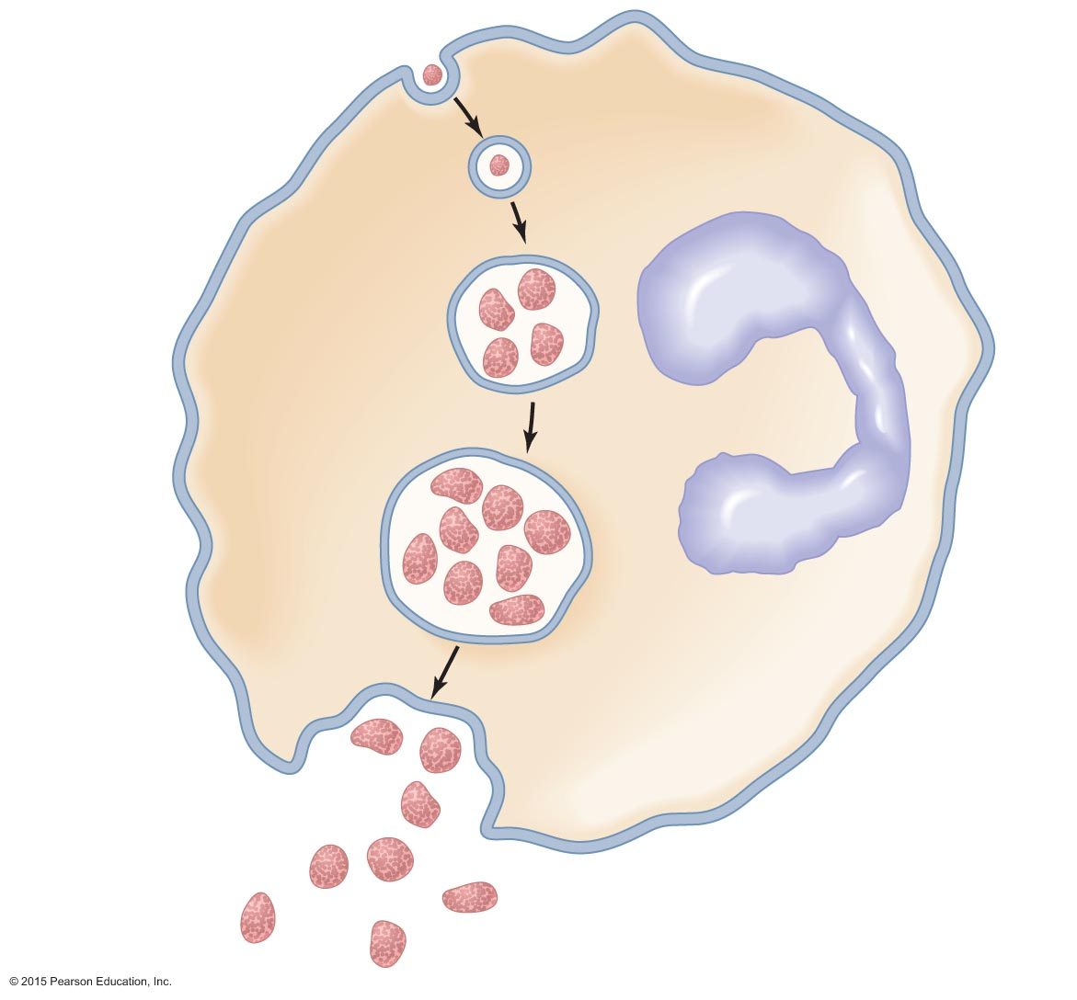
Figure 21.11 The growth and reproduction of Ehrlichia and Anaplasma in an infected leukocyte.
Entry
Elementary body
in phagosome
Nucleus
Initial
body
Morula
Release

Slide 32
Bacterial Cardiovascular and Systemic Diseases
Ehrlichiosis and Anaplasmosis
Epidemiology
Both considered emerging diseases
Diagnosis, treatment, and prevention
Diagnosis difficult since symptoms resemble other diseases
Antimicrobials effective against both bacteria
Prevention involves avoiding tick-infested areas

Slide 33
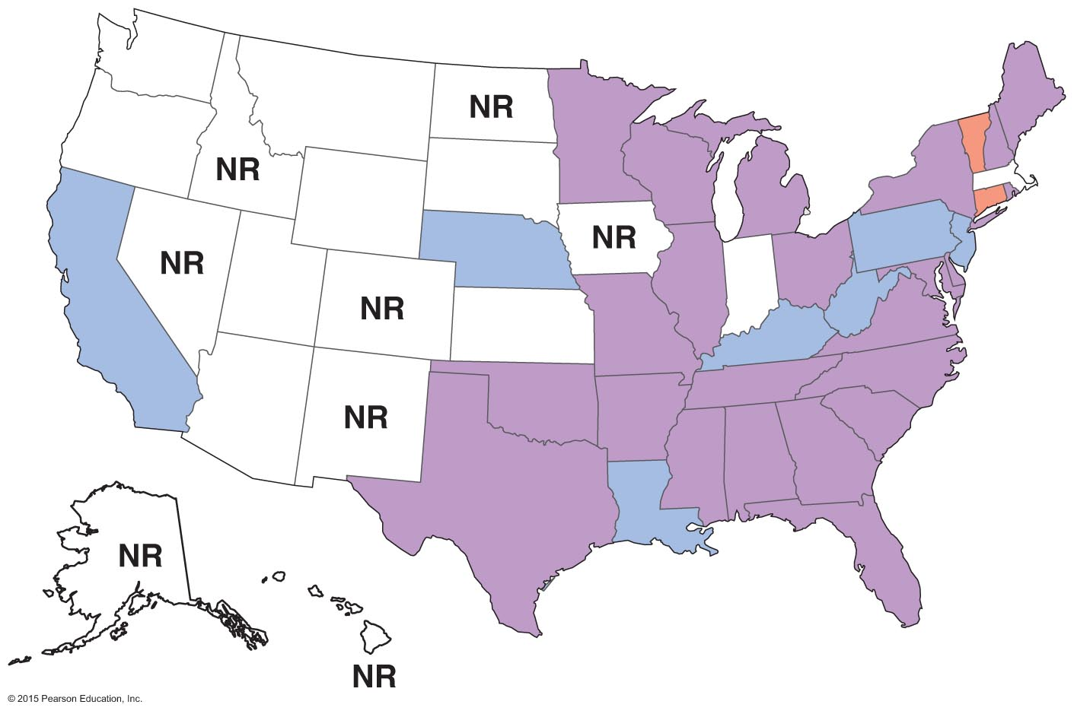
Figure 21.12 The geographical distribution of ehrlichiosis and anaplasmosis in the contiguous United States (2010).

Slide 34
Viral Cardiovascular and Systemic Diseases
Infectious Mononucleosis
Signs and symptoms
Severe sore throat and fever occur initially
Followed by swollen lymph nodes, fatigue, appetite loss, and a skin rash
Pathogen and virulence factors
Epstein-Barr virus (EBV or HHV-4) is the causative agent
EBV establishes latent infection in host
Suppresses apoptosis of infected B cells
EBV is implicated in a number of other diseases

Slide 35
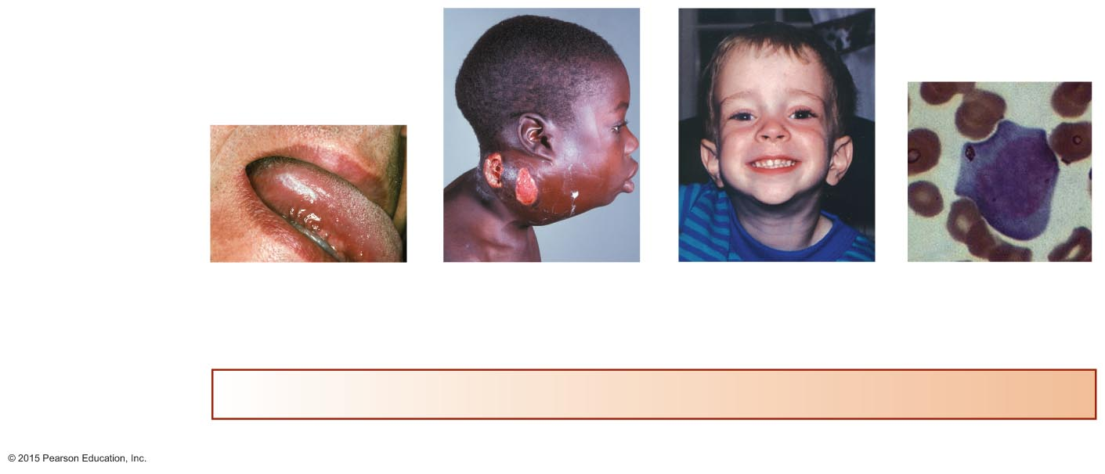
Figure 21.13 Diseases associated with Epstein-Barr virus.
Diseases of EBV
Oral hairy leukoplakia*
Burkitt’s lymphoma (shown)
Nasopharyngeal cancer*
Chronic fatigue syndrome*
Hodgkin’s lymphoma*
Asymptomatic
Infectious
mononucleosis
State of cellular immunity
Lacking
Poor
Immature
Vigorous
* EBV implicated, not proven

Slide 36
Viral Cardiovascular and Systemic Diseases
Infectious Mononucleosis
Pathogenesis and epidemiology
Transmission occurs via saliva
EBV infects B lymphocytes
Majority of adults have antibodies against EBV
Diagnosis, treatment, and prevention
Diagnosed by presence of large, lobed B lymphocytes and neutropenia
Treatment focuses on relieving symptoms
Prevention is difficult since EBV occurrence is widespread

Slide 37
Viral Cardiovascular and Systemic Diseases
Cytomegalovirus Disease
Signs and symptoms
Asymptomatic in most cases
Complications in neonates and the immunocompromised
Pathogen and virulence factors
Caused by Cytomegalovirus
Pathogenesis and epidemiology
Transmit by direct contact with bodily fluids or transplacentally
One of the most common infections of humans
Diagnosis, treatment, and prevention
Diagnosed by identifying enlarged cells with inclusions
Fomivirsen is administered for eye infections
No vaccine is available

Slide 38
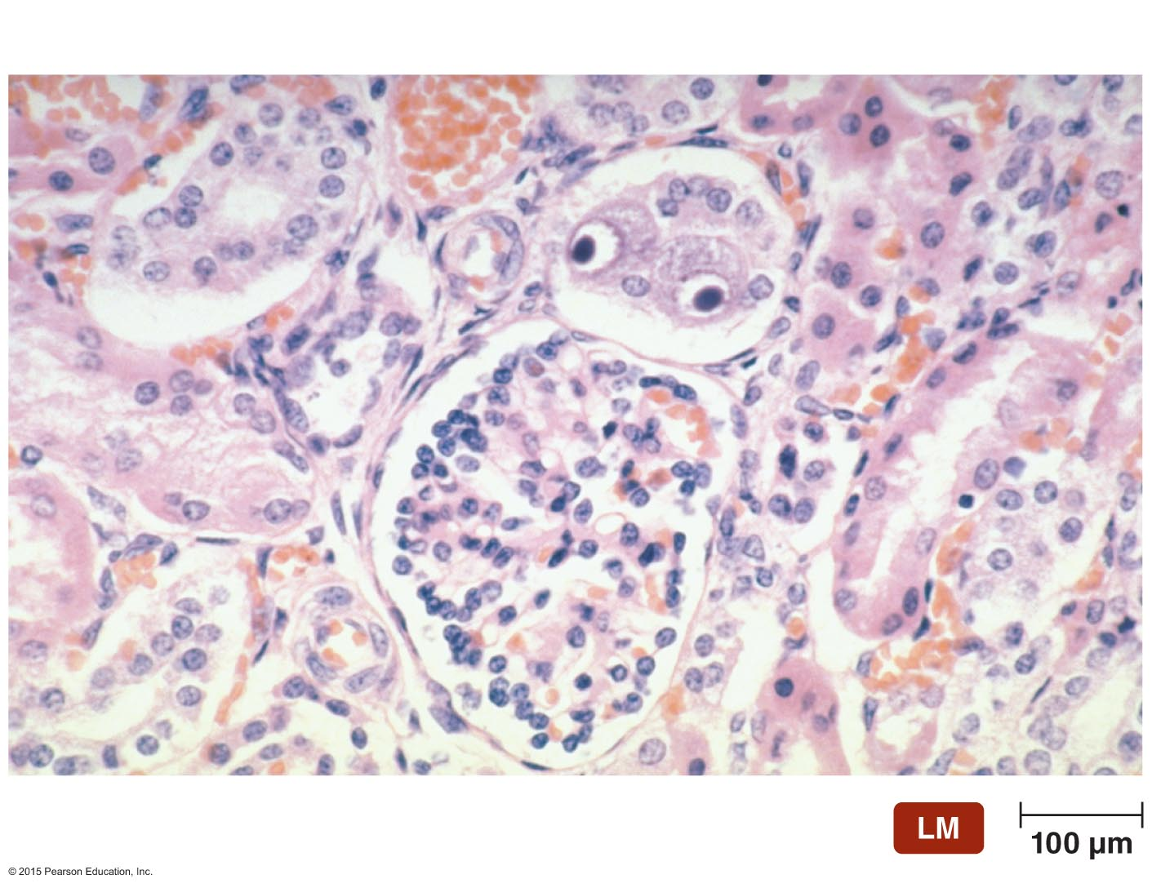
Figure 21.14 An abnormally enlarged "owl's eye" cell indicates Cytomegalovirus (CMV) infection.
"Owl's eye" cell

Slide 39
Viral Cardiovascular and Systemic Diseases
Yellow Fever
Signs and symptoms
First stage: fever, headache, muscle aches
Second stage: period of remission
Third stage: delirium, seizures, coma, hemorrhaging
Pathogen and virulence factors
Caused by yellow fever virus

Slide 40
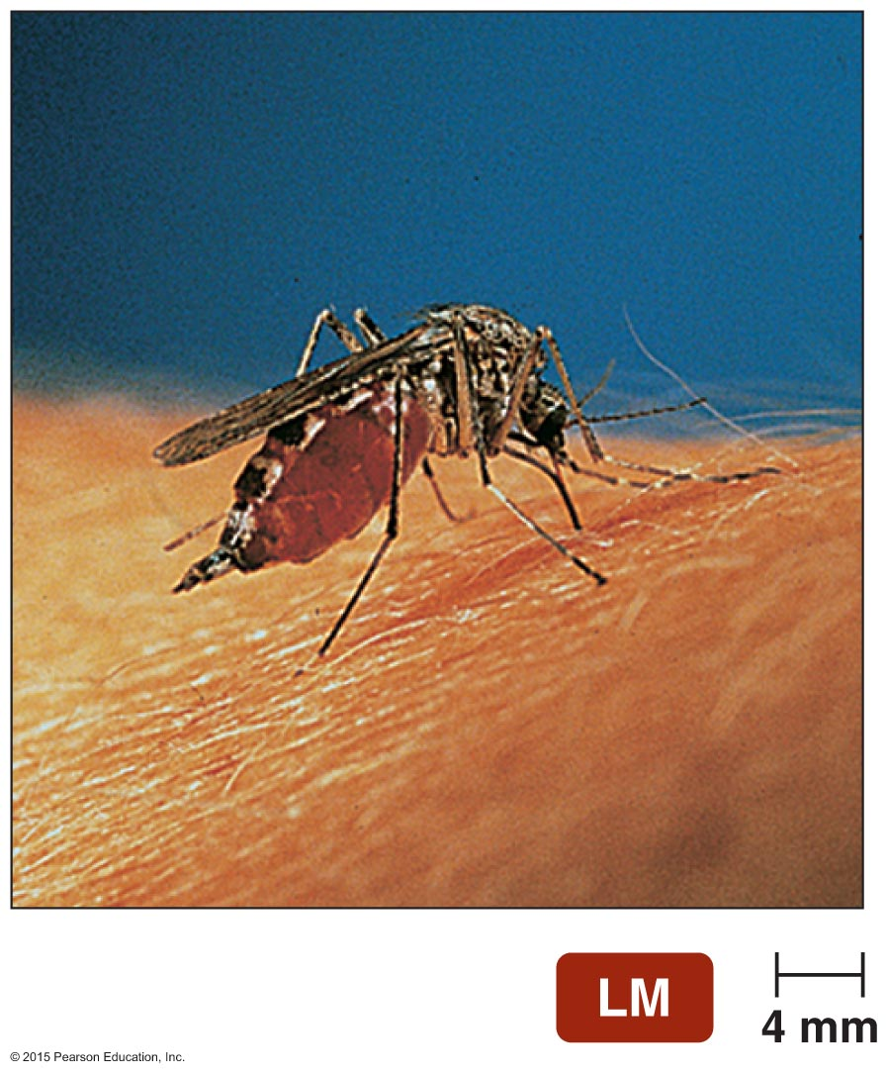
Figure 21.15 Aedes aegypti, the vector of yellow fever and dengue.

Slide 41
Viral Cardiovascular and Systemic Diseases
Yellow Fever
Pathogenesis and epidemiology
Transmitted via the bite of an infected Aedes mosquito
Virus travels to the liver, where it replicates
Yellow fever cases occur today in South America and Africa
Diagnosis, treatment, and prevention
Diagnosed by detecting viral antigens in the blood
Treatment is supportive
Vaccine is available

Slide 42
Viral Cardiovascular and Systemic Diseases
Dengue Fever and Dengue Hemorrhagic Fever
Signs and symptoms
Dengue fever
First phase: fever, edema, head and muscle pain
Second phase: return of fever and red rash
Dengue hemorrhagic fever
Internal bleeding, shock, and possibly death
Pathogens and virulence factors
Caused by four strains of dengue viruses
Aedes mosquitoes are the vector

Slide 43
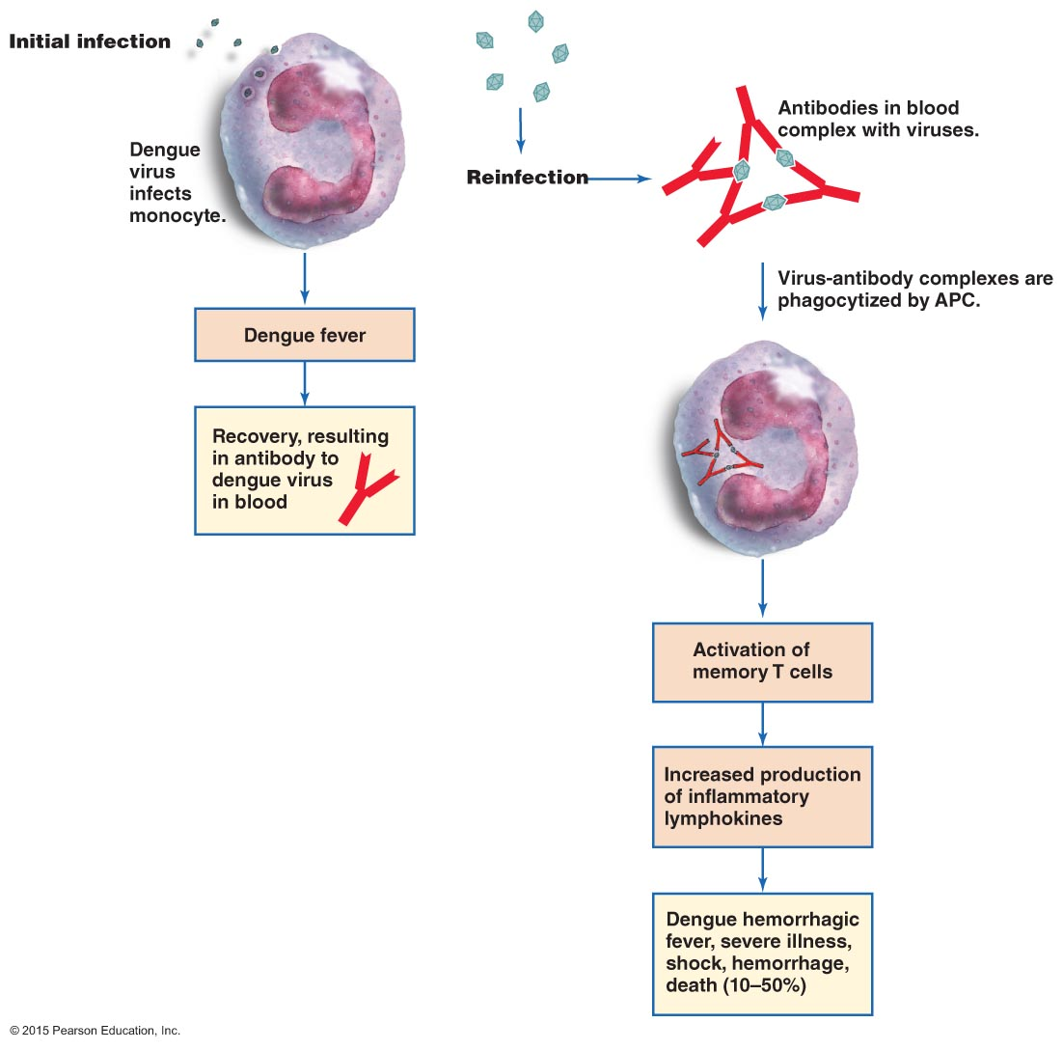
Figure 21.16 Pathogenesis of dengue hemorrhagic fever (DHF).

Slide 44
Viral Cardiovascular and Systemic Diseases
Dengue Fever and Dengue Hemorrhagic Fever
Pathogenesis and epidemiology
Dengue fever is usually a mild disease
Dengue hemorrhagic fever is more severe and can be fatal
Distribution of dengue diseases has expanded
Diagnosis, treatment, and prevention
Diagnosis is based on signs and symptoms in people who have traveled to endemic regions
No specific treatment is available
Prevention requires control of mosquitoes

Slide 45
Viral Cardiovascular and Systemic Diseases
African Viral Hemorrhagic Fever
Signs and symptoms
Fever and fatigue
Minor petechiae progress to severe internal hemorrhaging
Pathogens and virulence factors
Caused by Ebolavirus or Marburgvirus
Pathogenesis and epidemiology
Malfunctioning blood clotting causes hemorrhaging
Occurs primarily in Africa
Transmitted via contact with bodily fluids of infected individual

Slide 46
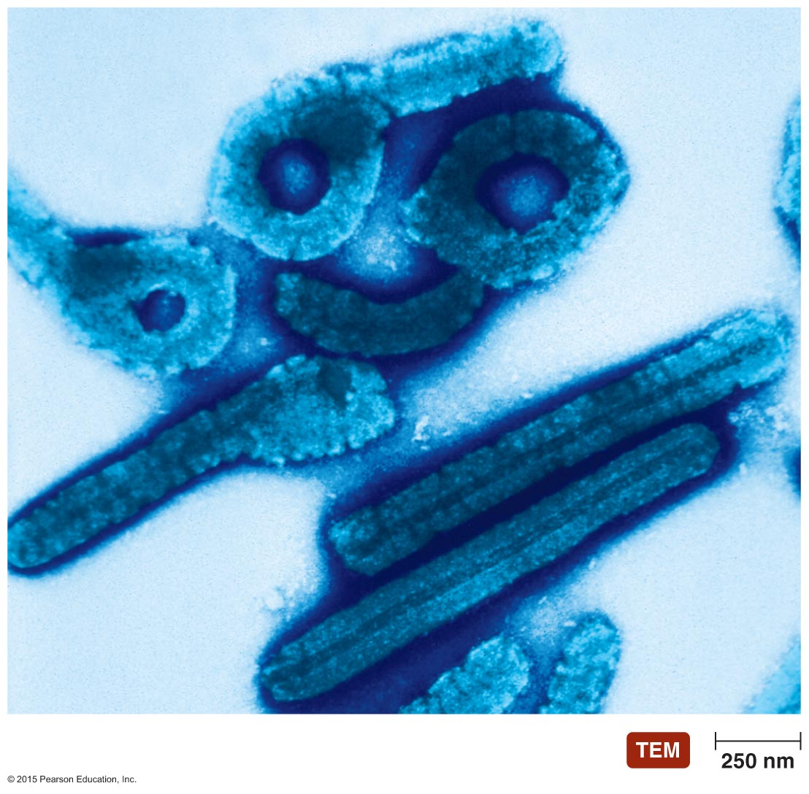
Figure 21.17 Filamentous Ebolavirus.

Slide 47
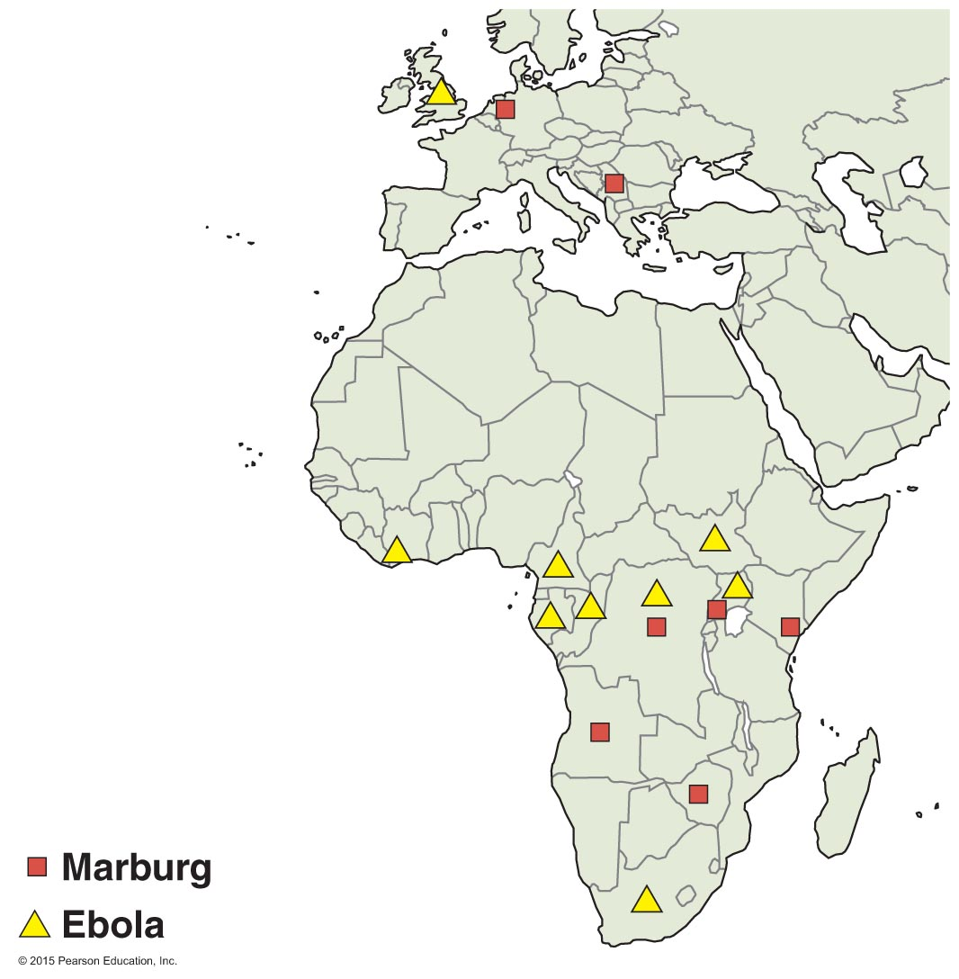
Figure 21.18 Sites in which known locally accquired cases of Marburg and Ebola viruses have occurred.

Slide 48
Viral Cardiovascular and Systemic Diseases
African Viral Hemorrhagic Fever
Diagnosis, treatment, and prevention
Diagnosis is based on characteristic symptoms and presence of virus in the blood
Treatment involves fluid and electrolyte replacement
Vaccines are being studied for their effectiveness in humans

Slide 50
Protozoan and Helminthic Cardiovascular and Systemic Diseases
Malaria
Signs and symptoms
Associated with parasite's life in erythrocytes
Fever, chills, diarrhea, headache
Anemia, weakness, and fatigue gradually occur
Pathogen and pathogenesis
At least four Plasmodium species cause malaria
Disease severity depends on the species
P. falciparum causes the most severe malaria
Children are particularly vulnerable to infection

Slide 51
Protozoan and Helminthic Cardiovascular and Systemic Diseases
Malaria
Pathogen and pathogenesis
Certain genetic traits increase resistance to malaria
Presence of the sickle-cell gene
Presence of two genes for hemoglobin C
Genetic deficiency of glucose-6-phosphate dehydrogenase
Lack of Duffy antigens on erythrocytes

Slide 52
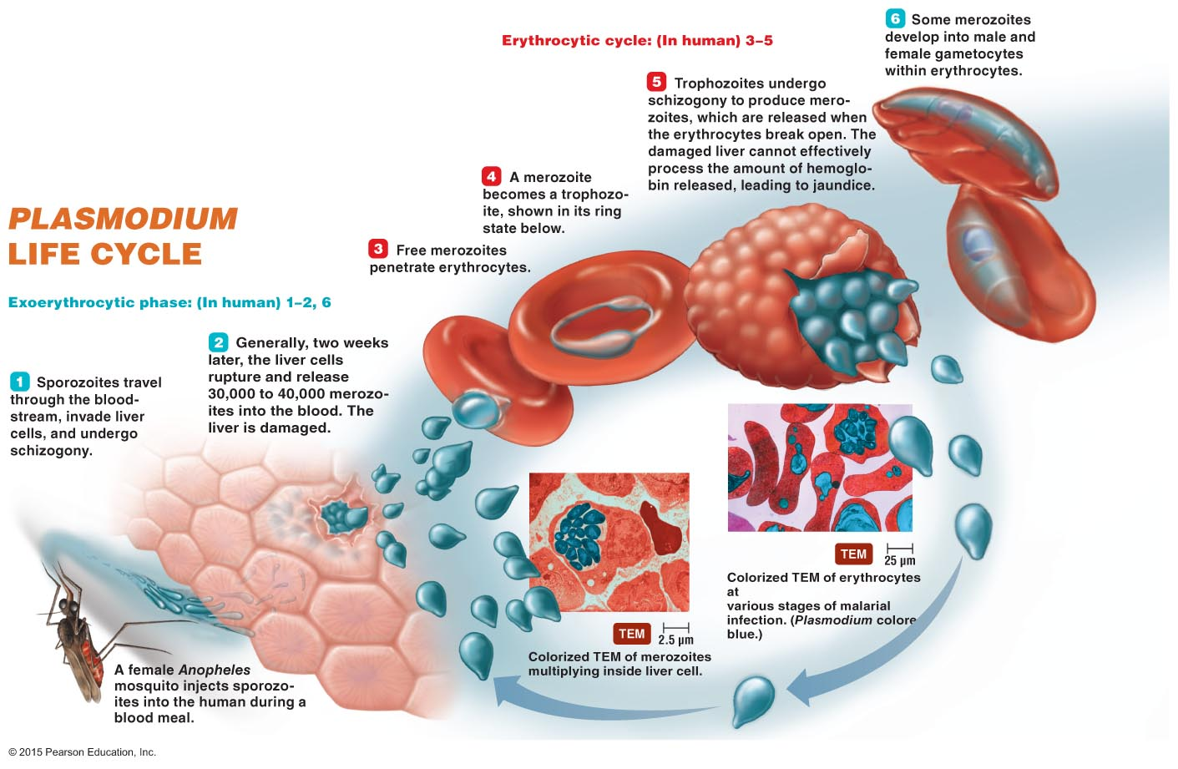
Figure Disease in Depth: The life cycle of Plasmodium.

Slide 53
Protozoan and Helminthic Cardiovascular and Systemic Diseases
Malaria
Virulence factors
Reproductive cycle hides parasite from immune surveillance
Malaria secretome injects toxins into host cells
Adhesins allow red blood cells to adhere to certain tissues
Merozoites form within vesicles and avoid detection
Changes in body chemistry attract other mosquitoes

Slide 54
Protozoan and Helminthic Cardiovascular and Systemic Diseases
Malaria
Epidemiology
Endemic throughout tropics and subtropics
Malaria causes more than 1 million deaths annually
Diagnosis, treatment, and prevention
Diagnosis made by identifying Plasmodium in blood
Treated with various antimalarial drugs
Some Plasmodium strains are resistant to antimalarial drugs
Prevention requires control of mosquitoes
Use of mosquito nets is important way to reduce contact

Slide 55
Protozoan and Helminthic Cardiovascular and Systemic Diseases
Toxoplasmosis
Signs and symptoms
Majority of cases have no symptoms
Symptoms in individuals with poor immunity
Fever, malaise, and inflammation of the lungs, liver, and heart
Fetal infections can cause numerous conditions, including spontaneous abortion or stillbirth
Pathogen and virulence factors
Toxoplasma gondii is the causative agent
Cats are the definitive host
Toxoplasma infects and lives in many cell types

Slide 56
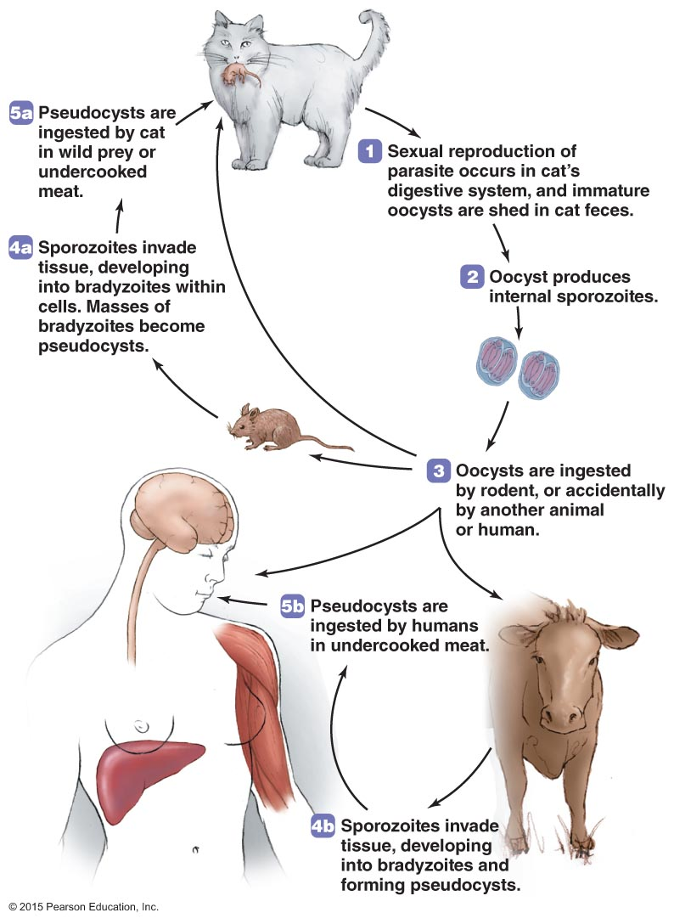
Figure 21.19 The life cycle of Toxoplasma gondii.

Slide 57
Protozoan and Helminthic Cardiovascular and Systemic Diseases
Toxoplasmosis
Pathogenesis and epidemiology
Consumed in undercooked meat containing the parasite
Transmission across the placenta can also occur
Specific mechanism of disease is not yet known
Diagnosis, treatment, and prevention
Diagnosed mainly by detection of organisms in tissues
Treatment needed only in AIDS patients, pregnant women, and newborns
Prevention is difficult because T.gondii has numerous hosts

Slide 58
Protozoan and Helminthic Cardiovascular and Systemic Diseases
Chagas' Disease
Signs and symptoms
Swelling at infection site and nonspecific symptoms
Chronic manifestations can occur years after infection
Pathogen and virulence factors
Caused by Trypanosoma cruzi
Endemic throughout Central and South America
Most mammals can harbor T. cruzi
T. cruzi evades the immune system in several ways
Lives inside host cells
Changes its surface antigens
Suppresses production of immune cytokines

Slide 59
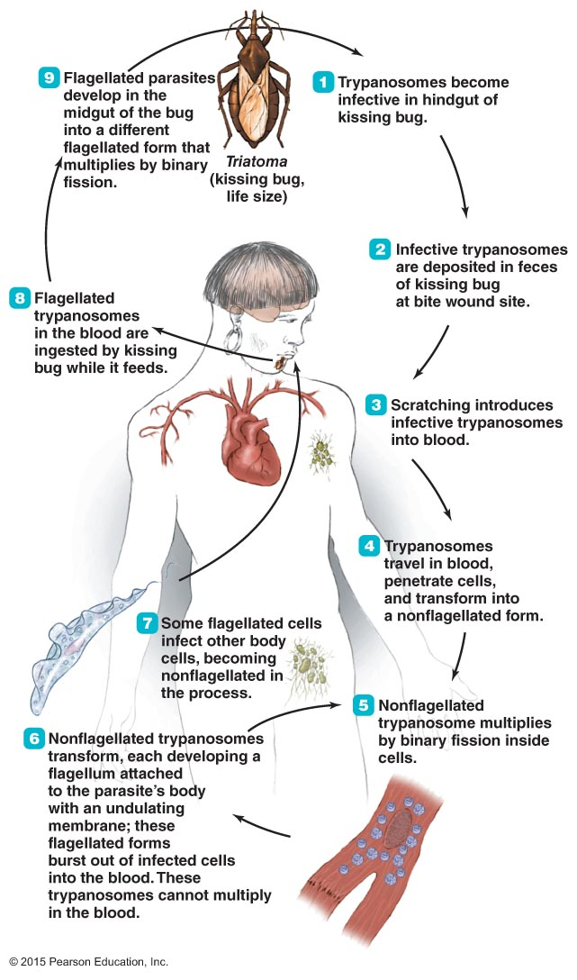
Figure 21.20 The life cycle of Trypanosoma cruzi in a South American.

Slide 60
Protozoan and Helminthic Cardiovascular and Systemic Diseases
Chagas' Disease
Pathogenesis and epidemiology
Transmitted through the bite of infected Triatoma or transfusion with infected blood
Progresses through four stages over several months
Diagnosis, treatment, and prevention
Diagnosed by microscopic identification of T. cruzi or xenodiagnosis
Most patients show no early symptoms, and late stages of the disease cannot be treated
Prevention involves avoidance of Triatoma bugs

Slide 61
Protozoan and Helminthic Cardiovascular and Systemic Diseases
Schistosomiasis
Signs and symptoms
Swimmer's itch may occur at infection site
Eggs deposited throughout body can cause other symptoms
Pathogens and virulence factors
Caused by three species of Schistosoma
Each species is geographically limited

Slide 62
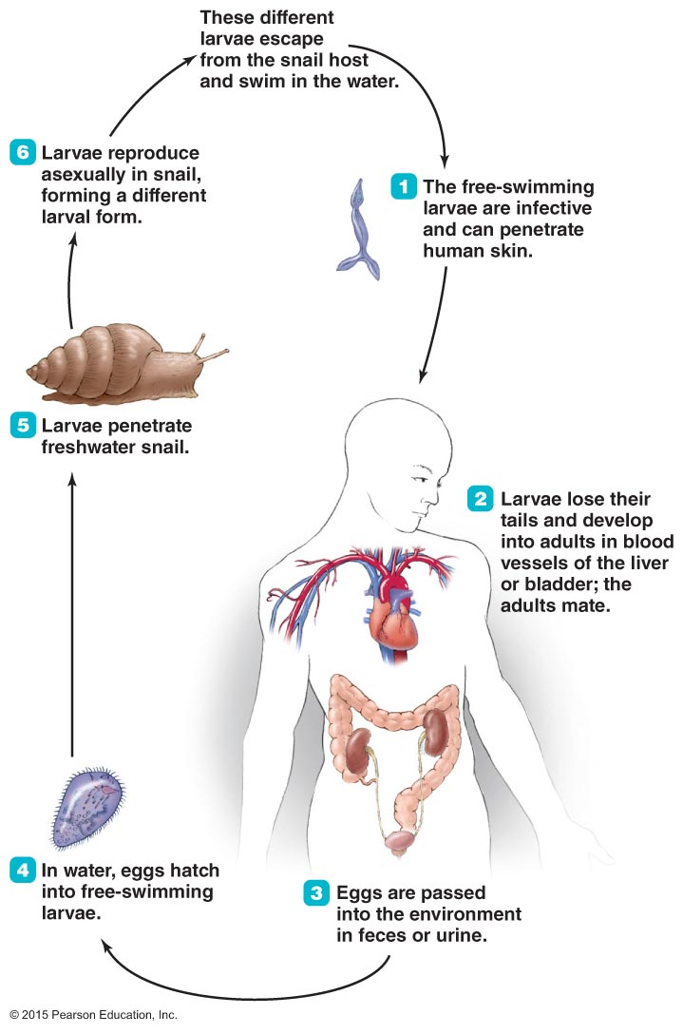
Figure 21.21 The life cycle of Schistosoma, a blood fluke.

Slide 63
Protozoan and Helminthic Cardiovascular and Systemic Diseases
Schistosomiasis
Pathogenesis and epidemiology
Humans are principal host for most Schistosoma species
Schistosomiasis is not found in the U.S.
Diagnosis, treatment, and prevention
Diagnosed by identifying eggs in stool or urine sample
Treated with praziquantel
Prevention requires avoiding potentially contaminated water

