Slide 1
Microbial Diseases of the Urinary and Reproductive Systems
Microbiology
CCV
Dr. Melanie Meyer

Slide 2
Structures of the Urinary and Reproductive Systems
Structures of the Urinary System
Kidneys remove waste from the blood and excrete it in urine
Nephrons are the functional unit of the kidneys
Filter the blood to form urine
Ureters carry urine to the urinary bladder
The urinary bladder stores urine until it can be eliminated
Urine is excreted via the urethra

Slide 3
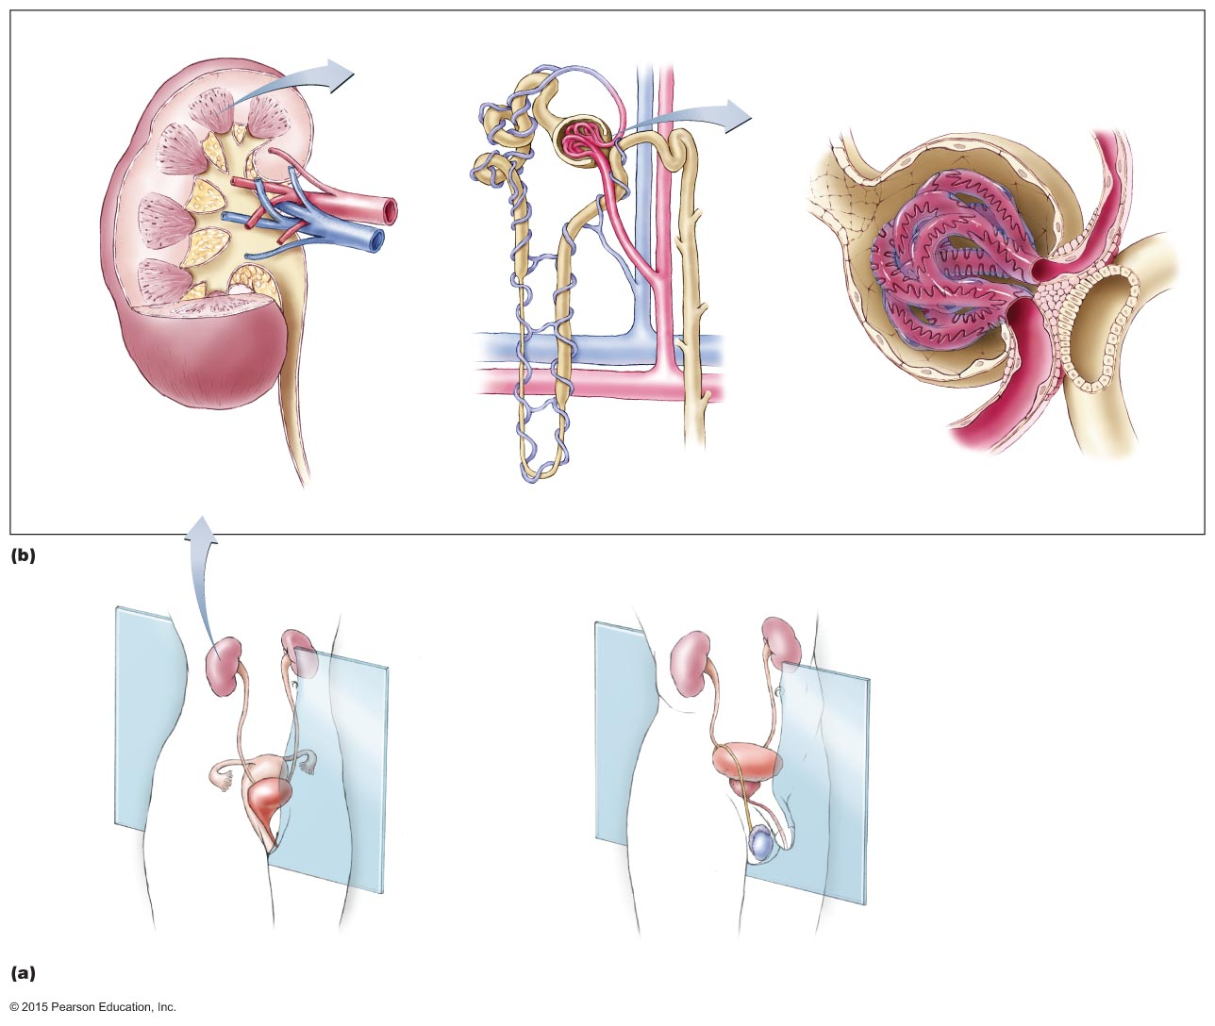
Figure 24.1a-b Urinary and reproductive systems.
Proximal
convoluted
tubule
Glomerulus
Glomerular
(Bowman’s)
capsule
Glomerular
(Bowman’s)
capsule
Capsular
space
Efferent
arteriole
Cortex
Medulla
Renal artery
Renal
pyramid
Proximal
convoluted
tubule
Peritubular
capillaries
Pelvis
Renal vein
Glomerulus
Renal
capsule
Ureter
Nephron
loop
(loop of
Henle)
Afferent
arteriole
Distal
convoluted
tubule
Collecting
duct
Distal
convoluted
tubule
Nephron
Glomerulus
Kidney
Kidney
Ureter
Ureter
Urinary
bladder
Uterus
Urinary
bladder
Urethra
Testis
Urethra
Midsagittal
plane

Slide 4
Structures of the Urinary and Reproductive Systems
Structures of the Reproductive System
Structures of the female reproductive system
Ovaries
Uterine tubes
Uterus
Vagina
External genitalia
Microorganisms enter through the vagina

Slide 5
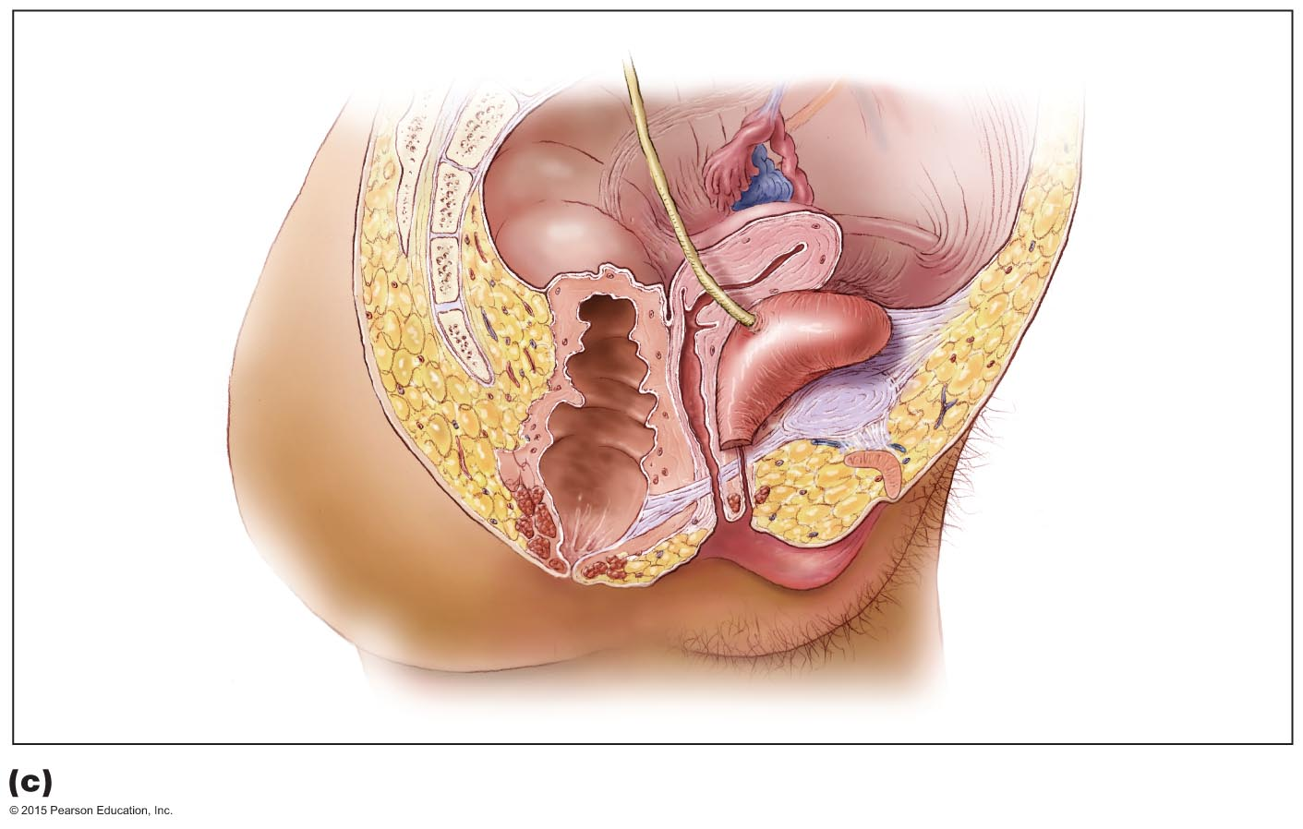
Figure 24.1c Urinary and reproductive systems.
Uterine
(Fallopian)
tube
Ureter
Ovary
Cervix
Uterus
Urinary
bladder
Rectum
Urethra
Vagina
Clitoris
Labium
minus
Anus
Labium
majus

Slide 6
Structures of the Urinary and Reproductive Systems
Structures of the Reproductive System
Structures of the male reproductive system
Testes
Scrotum
System of ducts
Accessory glands
Penis
Microorganisms enter through the urethra and skin of the penis

Slide 7
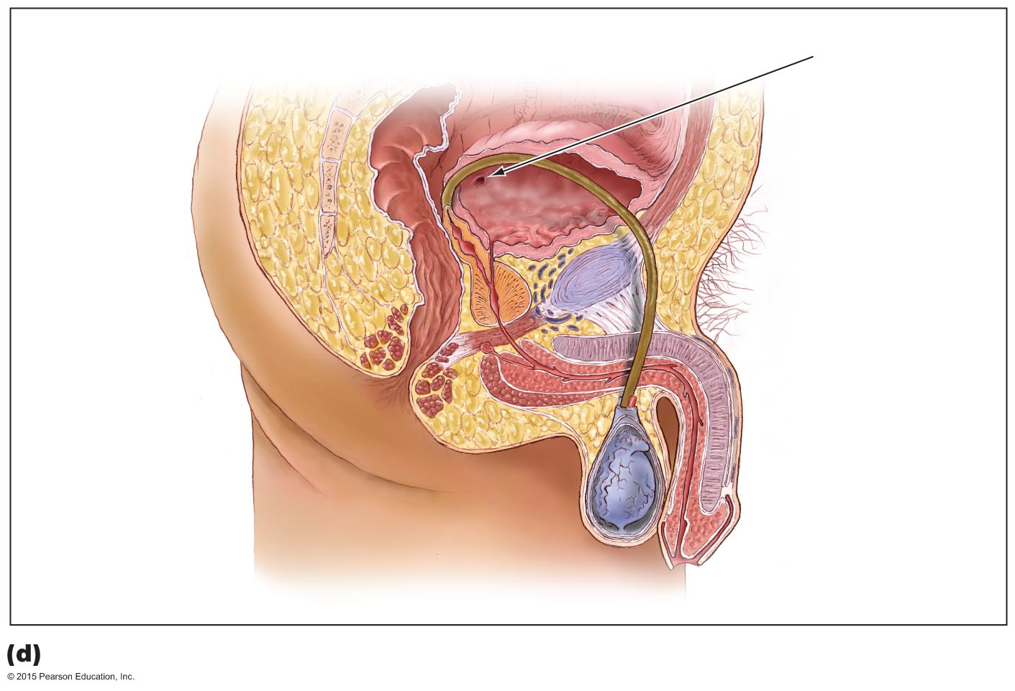
Figure 24.1d Urinary and reproductive systems.
Ureter
opening
Urinary
bladder
Ductus
deferens
Rectum
Seminal
vesicle
Prostate
gland
Urethra
Anus
Penis
Epididymis
Foreskin
Testis

Slide 8
Structures of the Urinary and Reproductive Systems
Normal Microbiota of the Urinary and Reproductive Systems
Urinary system
Urethra supports colonization by some microorganisms
Include Lactobacillus and Staphylococcus
The other urinary organs are sterile
Male reproductive system
Regions above the prostate are sterile
Female reproductive system
The vagina is colonized by various microorganisms, depending on hormone levels

Slide 9
Structures of the Urinary and Reproductive Systems
Normal Microbiota of the Urinary and Reproductive Systems
Microorganisms in the urethra can move up to infect the kidneys
Opportunistic and sexually transmitted microbes can infect the reproductive system

Slide 10
Bacterial Diseases of the Urinary Systems
Bacterial Urinary Tract Infections
Signs and symptoms
Frequent, urgent, painful urination
Urine may be cloudy with foul odor
Pathogens and virulence factors
Enteric bacteria are the most common cause
Escherichia coli causes most cases
Virulence factors include flagella and attachment fimbriae

Slide 11
Bacterial Diseases of the Urinary Systems
Bacterial Urinary Tract Infections
Pathogenesis and epidemiology
Often results when fecal bacteria is self-inoculated into urethra
More common in females
Diagnosis, treatment, and prevention
Diagnosis is based on urinalysis
Many cases resolve without treatment
Some treated with antimicrobial drugs
Prevented by limiting contamination by fecal microbes

Slide 12
Bacterial Diseases of the Urinary Systems
Leptospirosis
Zoonotic disease seen primarily in animals
Signs and symptoms
Abrupt fever, myalgia, muscle stiffness, and headache
Rarely fatal
Pathogen
Caused by Leptospira interrogans
Normally lives in many wild and domestic animals
Virulent strains make adhesins, are motile, and can evade complement activity

Slide 13
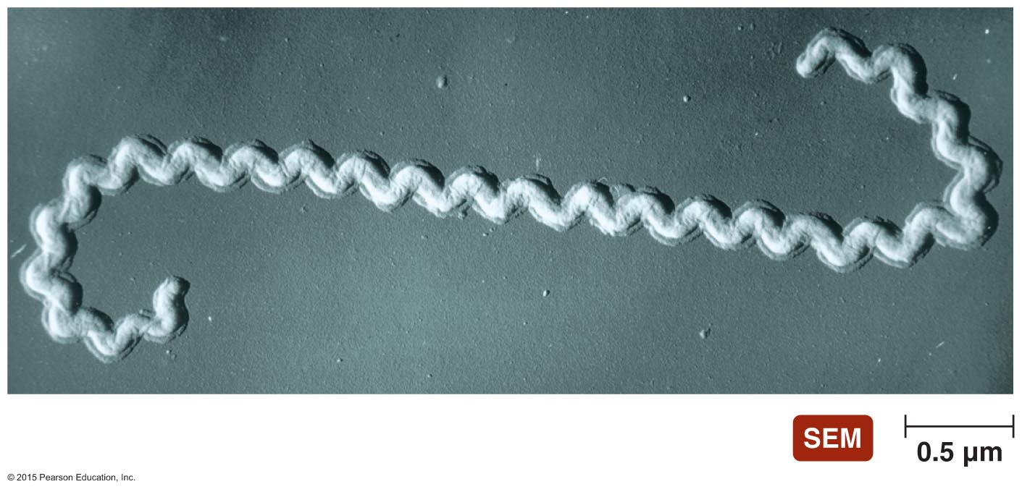
Figure 24.2 Leptospira interrogans.

Slide 14
Bacterial Diseases of the Urinary Systems
Leptospirosis
Pathogenesis
Transmitted by contact with urine of infected animal or urine-contaminated water
Spirochete travels via the bloodstream through the body
Epidemiology
Occurs throughout world but rare in the U.S.
Diagnosis, treatment, and prevention
Diagnosis is based on antibody test
Treated with antimicrobial drugs
Prevented by avoiding contaminated water

Slide 15
Bacterial Diseases of the Urinary Systems
Streptococcal Acute Glomerulonephritis
Some antibody-antigen complexes against group A streptococci strains are not removed from the body
Complexes are deposited in the glomeruli of the kidneys
Cause inflammation of the glomeruli and nephrons
Produce hypertension and low urine output
Irreversible kidney damage can occur in adults

Slide 16
Nonvenereal Diseases of the Reproductive Systems
Staphylococcal Toxic Shock Syndrome
Signs and symptoms
Sudden-onset fever, chills, vomiting, diarrhea, low blood pressure, confusion, and severe red rash
Individuals go into shock if untreated
Pathogen and virulence factors
Caused by some strains of S. aureus
These strains produce toxic shock syndrome toxin
Cause excessive cytokine production by T cells

Slide 17
Nonvenereal Diseases of the Reproductive Systems
Staphylococcal Toxic Shock Syndrome
Pathogenesis and epidemiology
Absorption of toxin into blood triggers toxic shock syndrome
Most cases occur in menstruating females
Diagnosis, treatment, and prevention
Diagnosis is based on signs and symptoms
Considered medical emergency
Requires removal of foreign material and antimicrobial drugs
Avoiding tampons or using less absorbent tampons reduces risk

Slide 18
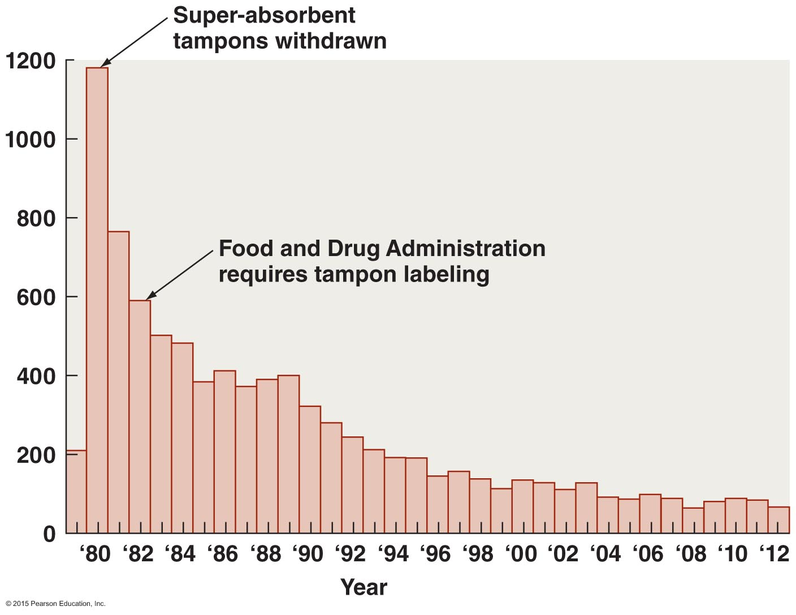
Figure 24.3 The incidence of staphylococcal toxic shock syndrome in the United States, 1979–2012.

Slide 19
Nonvenereal Diseases of the Reproductive Systems
Bacterial Vaginosis
Signs and symptoms
White vaginal discharge with a "fishy" odor
Pathogen and virulence factors
Caused by various anaerobic bacteria
Pathogenesis and epidemiology
Associated with multiple sexual partners and vaginal douching
Diagnosis, treatment, and prevention
Diagnosed is based on signs and symptoms
Treated with oral or vaginal metronidazole

Slide 20
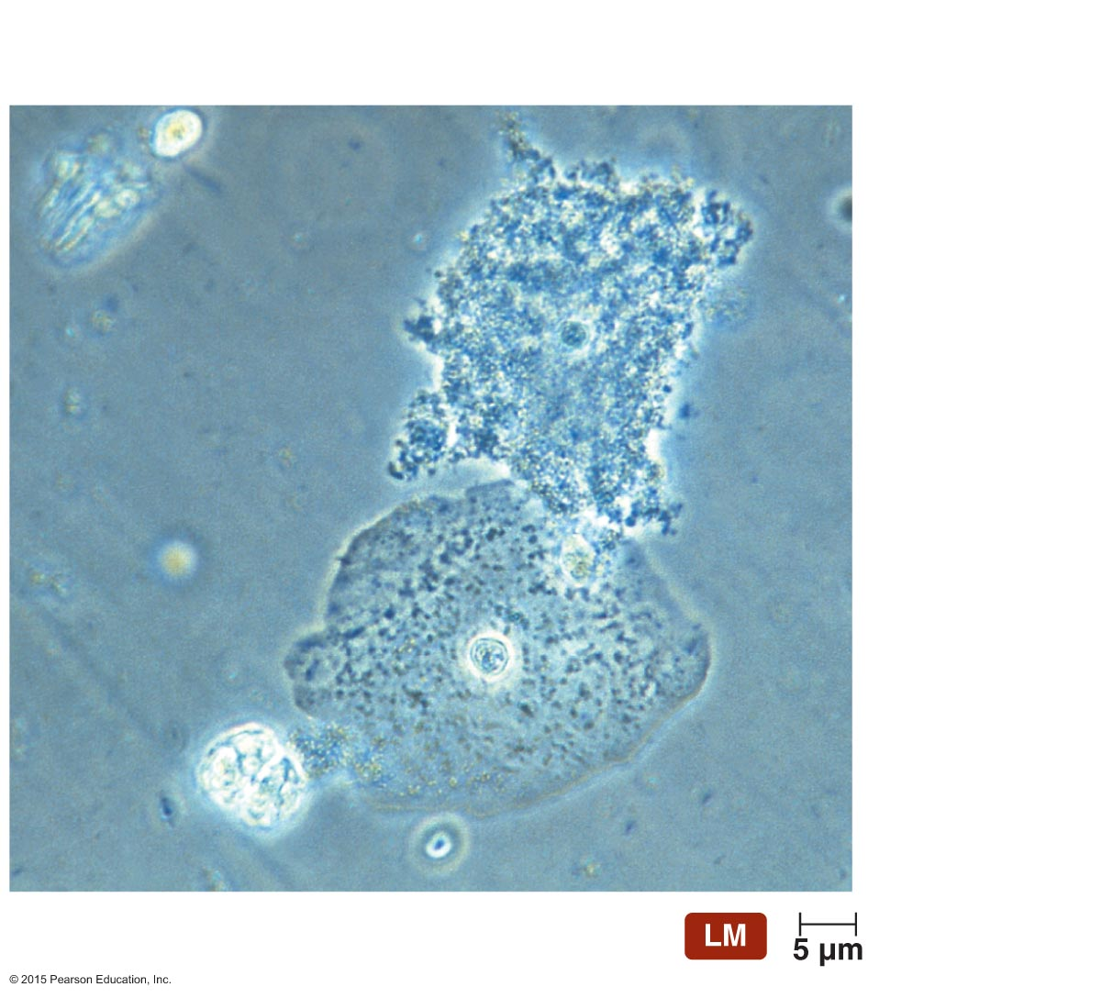
Figure 24.4 Clue cell.
Nucleus of
clue cell
Bacteria
Normal,
non-clue cell

Slide 21
Nonvenereal Diseases of the Reproductive Systems
Vaginal Candidiasis
Signs and symptoms
Severe vaginal itching and burning
Pathogen and virulence factors
Most commonly caused by Candida albicans
Normal microbiota of skin and mucous membranes

Slide 22
Nonvenereal Diseases of the Reproductive Systems
Vaginal Candidiasis
Pathogenesis and epidemiology
Candida overgrows if vaginal pH becomes alkaline or normal microbial populations are reduced
Can become systemic in immunocompromised people
Diagnosis, treatment, and prevention
Identification of Candida in presence of symptoms is diagnostic
Treated with azole or fluconazole
Avoiding excessive use of antibacterial drugs can prevent candidiasis

Slide 23
Sexually Transmitted Infections (STIs) and Diseases (STDs)
STIs occur from the sexual transmission of potential pathogens
Resulting disease is an STD
STDs are common worldwide
Young people who experiment with sex are at risk
Presence of lesions from STDs is a risk factor for transmission of HIV
Female adolescents are at risk because the cervical lining is prone to bacterial infection
Can cause pelvic inflammatory disease

Slide 24
Sexually Transmitted Infections (STIs) and Diseases (STDs)
Prevention includes abstinence or mutual monogamy
Condoms must be used properly and consistently to provide protection

Slide 25
Bacterial STDs
Gonorrhea
Signs and symptoms
Men experience painful urination and a purulent discharge
Women are often asymptomatic
Pelvic inflammatory disease my develop
Pathogen and virulence factors
Caused by Neisseria gonorrhoeae
Virulence factors include fimbriae, capsule, and endotoxin

Slide 26
Bacterial STDs
Gonorrhea
Pathogenesis
Bacteria attach to epithelial cells of the mucous membranes
Infections outside the reproductive tract also occur
Babies delivered vaginally by infected mothers can become infected
Epidemiology
Gonorrhea occurs only in humans
Cases in the U.S. have been declining
Risk increases with frequency of sexual encounters

Slide 27
Figure 24.5 The incidence of civilian gonorrhea in the United States.

Slide 28
Bacterial STDs
Gonorrhea
Diagnosis, treatment, and prevention
Genetic probes are used to diagnose asymptomatic infection
Treated with broad-spectrum cephalosporin
Spread of gonococcal strains resistant to many antimicrobials has complicated treatment
Prevented with safe sex practices

Slide 29
Bacterial STDs
Syphilis
Signs and symptoms
Four phases of syphilis
Primary syphilis
Secondary syphilis
Latent syphilis
Tertiary syphilis

Slide 30
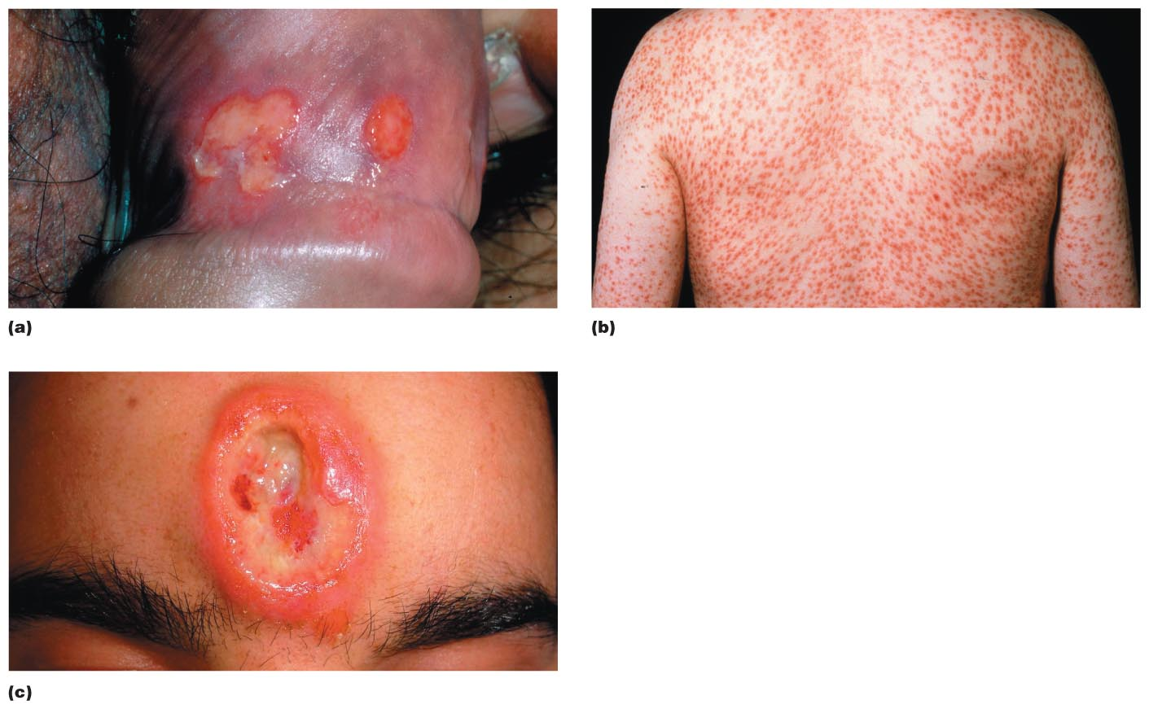
Figure 24.6 The lesions of syphilis.

Slide 31
Bacterial STDs
Syphilis
Pathogen and virulence factors
Treponema pallidum causes syphilis
Lives only in humans
Virulence factors have been difficult to identify
Pathogenesis
Transmitted mostly via sexual contact
Sometimes transmitted from mother to child
Most individuals do not develop tertiary syphilis

Slide 32
Bacterial STDs
Syphilis
Epidemiology
Syphilis occurs worldwide
Endemic among sex workers, men who have sex with men, and users of illegal drugs
Diagnosis, treatment, and prevention
Antibody test is used to diagnose primary, secondary, and congenital syphilis
Tertiary syphilis is difficult to diagnose
Penicillin G is used to treat all but tertiary syphilis
Prevented with safe sex practices

Slide 33
Figure 24.7 The incidence of syphilis in the United States.

Slide 34
Bacterial STDs
Chlamydial Infections
Signs and symptoms
Women are usually asymptomatic
Men have painful urination and pus discharge from penis
Causes numerous diseases
Epididymitis: inflammation of the epididymis
Orchitis: inflammation of the testes
Trachoma: disease of the eye
Lymphogranuloma venereum: formation of a genital lesion and bubo in the groin

Slide 35
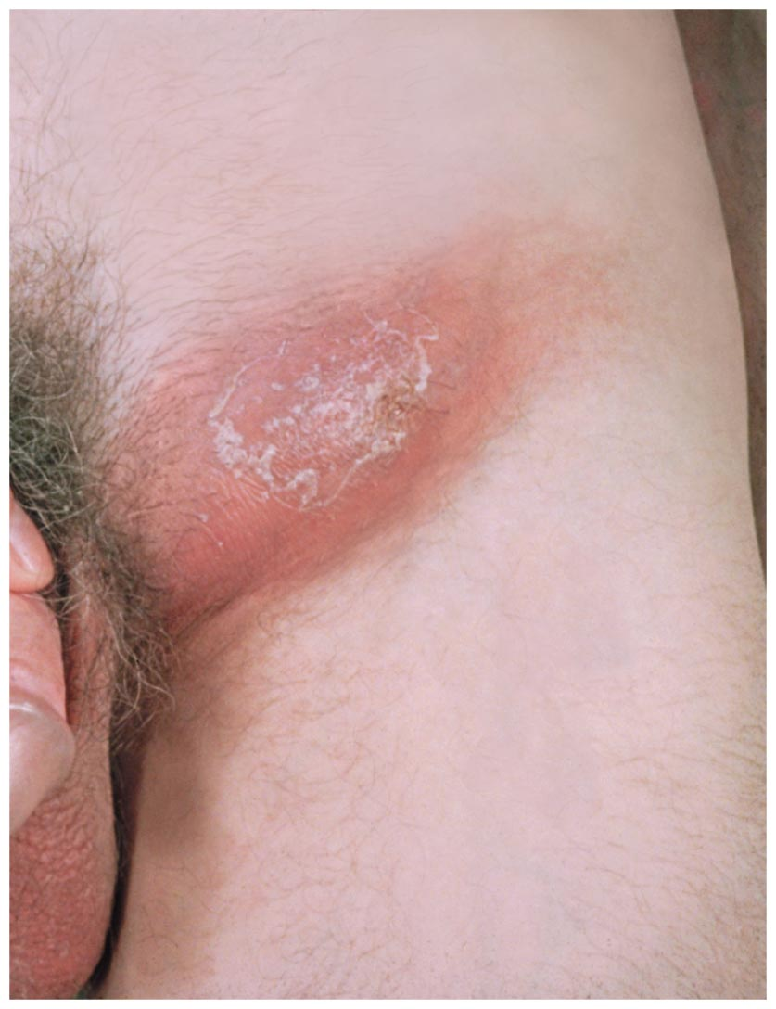
Figure 24.8 An advanced case of lymphogranuloma venereum in a man.

Slide 36
Bacterial STDs
Chlamydial Infections
Pathogens and virulence factors
Caused by Chlamydia trachomatis
All strains but one are pathogens of humans
Grow only within vesicles inside host cells
Developmental cycle
Elementary bodies are the infective form
Reticulate bodies are the reproductive form

Slide 37
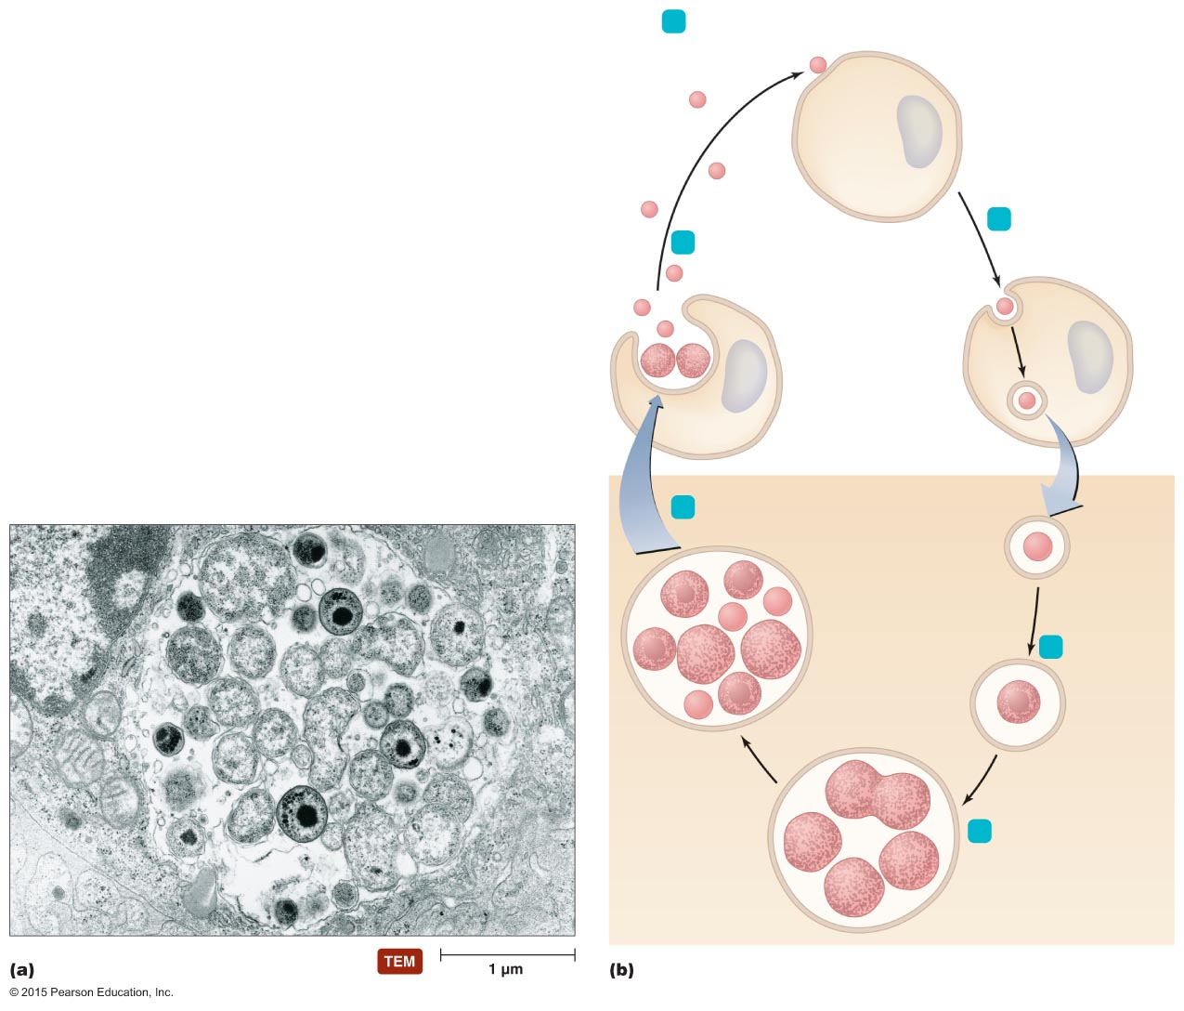
Figure 24.9 The developmental forms and life cycle of Chlamydia.
1
Elementary body (EB)
attaches to receptor
on host cell
(0 hour).
2
EB triggers its
own endocytosis
by host cell.
6
EBs are released
from host cell
(40 hours).
Vesicle
IB
EB
Inclusion body
5
Most IBs convert back
into EBs (21 hours).
EB inside
endocytic
vesicle
EB converts
to initial
body (IB)
within vesicle
(10 hours).
3
4
IB divides rapidly,
resulting in multiple
IBs. The vesicle is
now called an
inclusion body.
Inclusion
body containing
initial bodies

Slide 38
Bacterial STDs
Chlamydial Infections
Pathogenesis
Microbes enter body through scrapes or cuts
Infect conjunctiva or cells lining mucous membranes
Spread to the lymphatic system causes proctitis
Adolescent infection increases cervical cancer risk
Epidemiology
Most common reportable STD in the U.S.
Eye infections endemic in poor, crowded areas
Diagnosis, treatment, and prevention
Detection of chlamydial DNA by PCR is diagnostic
Treated with antimicrobial drugs
Prevented by abstinence or mutual monogamy

Slide 39
Bacterial STDs
Chancroid
Signs and symptoms
Soft chancres; in women, pain upon urination
Pathogen and virulence factors
Caused by Haemophilus ducreyi
Produces a toxin that kills epithelial cells
Pathogenesis and epidemiology
Most cases in the U.S. are due to foreign travel
Diagnosis, treatment, and prevention
Diagnosis based on presence of lesion and buboes
Treated with antimicrobial drugs
Prevented by abstinence or mutual monogamy

Slide 40
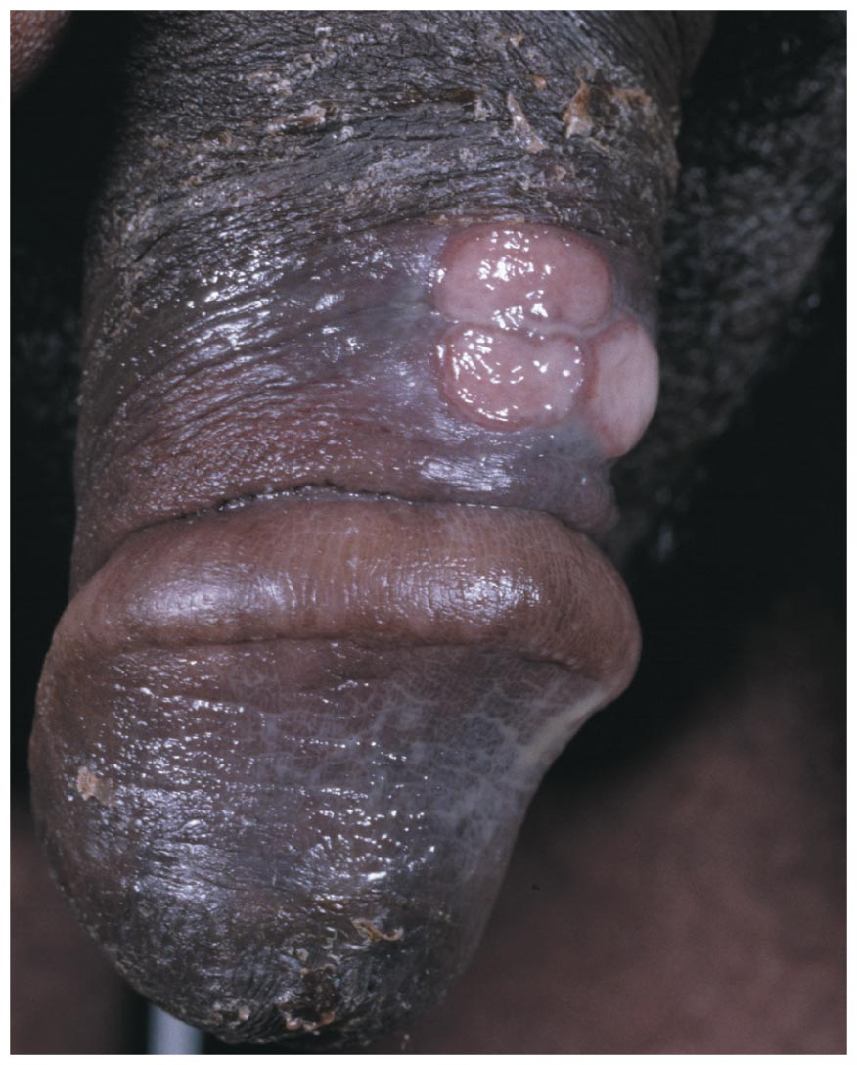
Figure 24.10 Soft chancres of chancroid.

Slide 41
Viral STDs
Genital Herpes
Signs and symptoms
Small blisters on or around the genitals or rectum
Pathogen and virulence factors
Human herpesvirus 2 causes most cases
Human herpesvirus 1 causes remainder of cases
Virus can become latent in nerve cells
Pathogenesis
Herpesvirus kills epithelial cells at infection site
Blisters may form at sites far from initial infection
Babies can become infected during birth

Slide 42
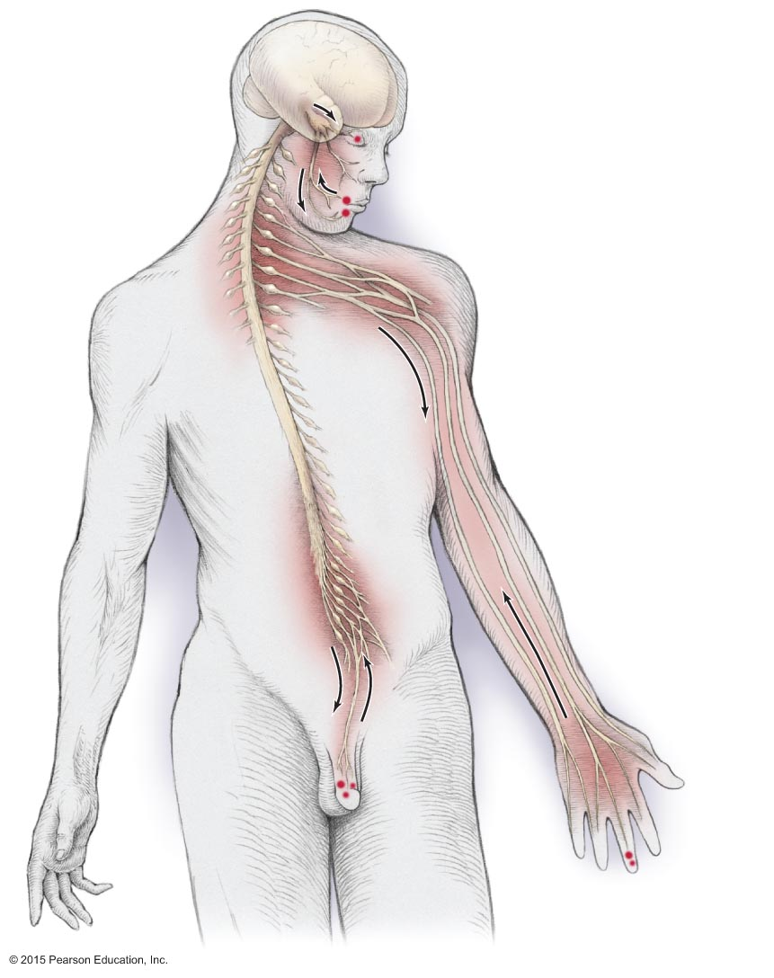
Figure 24.11 Sites of events in genital herpesvirus infections.
Trigeminal (V)
nerve ganglion
(sites of viral latency)
Ocular herpes
Ophthalmic branch
Maxillary branch
Trigeminal
nerve
Brachial nerve
ganglia (sites
of viral latency)
Mandibular branch
Fever blisters
Sacral nerve ganglia
(sites of viral latency)
Genital
herpes
Whitlow

Slide 43
Figure 24.12 Herpes lesions of the eyes and skin.

Slide 44
Viral STDs
Genital Herpes
Epidemiology
Genital herpes quadruples the risk of HIV infection
Diagnosis, treatment, and prevention
Diagnosis is based on characteristic lesions
Acyclovir or other antiviral agents can lessen symptoms
Circumcised males are at lower risk of infection
Condoms often provide little protection
Infected pregnant women should deliver by C-section

Slide 45
Viral STDs
Genital Warts
Signs and symptoms
Warts on the genitalia and surrounding areas
Large growths called condylomata acuminata may form
Pathogens
Caused by human papillomaviruses (HPV)
Viral proteins can trigger cancer

Slide 46
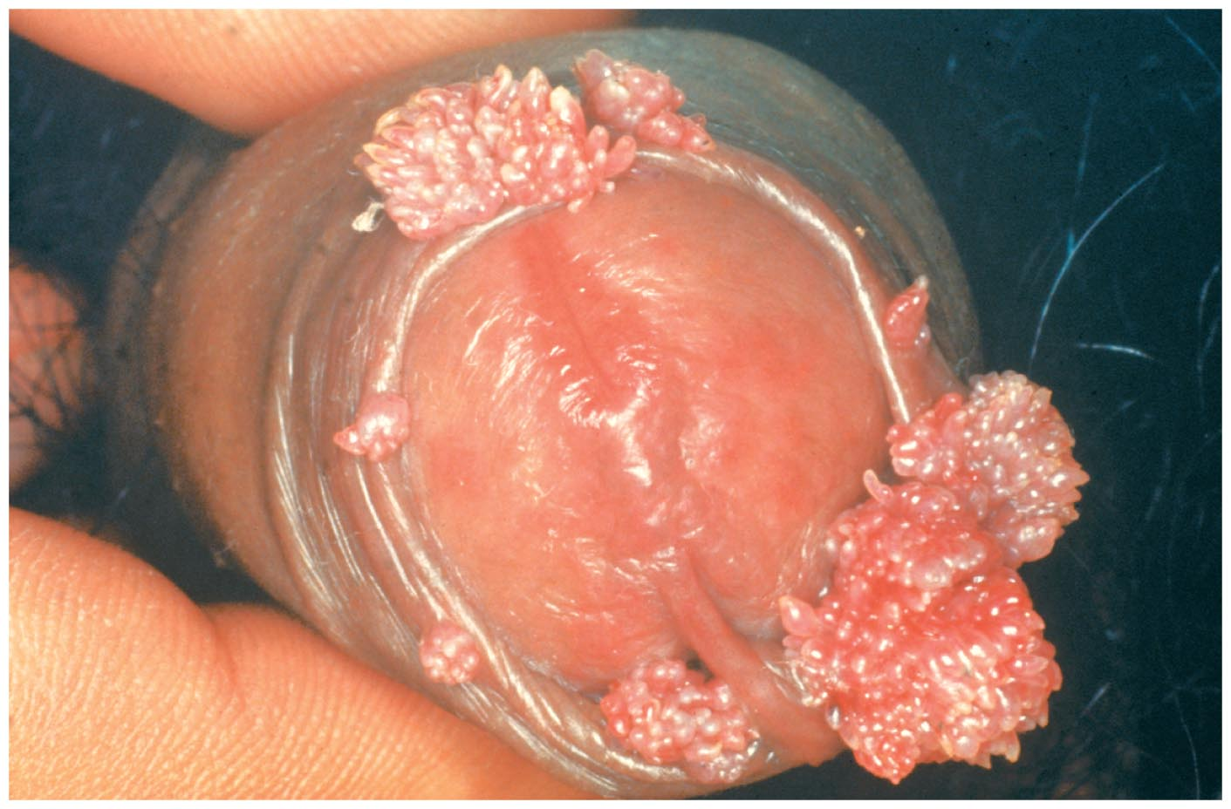
Figure 24.13 Genital warts.

Slide 47
Viral STDs
Genital Warts
Pathogenesis and epidemiology
HPVs invade skin or mucous membranes during sex
Most common STD in the U.S.
Diagnosis, treatment, and prevention
Diagnosis is made by presence of warts
Variety of methods available to remove warts
Vaccine is available against HPV strain associated with cervical cancer

Slide 48
Protozoan STDs
Trichomoniasis
Signs and symptoms
Females have vaginal discharge and irritation
Males are typically asymptomatic
Pathogen and virulence factors
Caused by Trichomonas vaginalis
Pathogenesis and epidemiology
Transmitted primarily via sexual intercourse
Most common curable STD in women
Trichomoniasis increases risk of infection by HIV
Various virulence factors contribute to disease

Slide 49
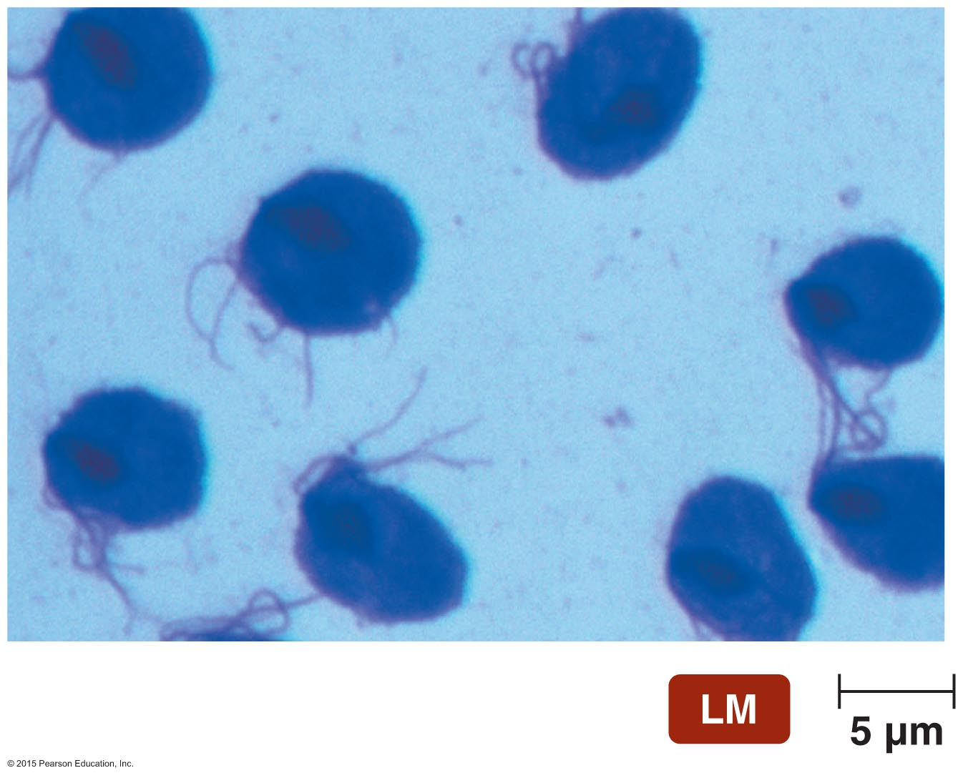
Disease at a Glance 24.8

Slide 50
Protozoan STDs
Trichomoniasis
Diagnosis, treatment, and prevention
Diagnosed by presence of Trichomonas in clinical samples
Treated with a single dose of oral metronidazole
Prevented by avoiding sexual intercourse with infected persons

