Slide 1
Innate Immunity
CCV
Microbiology
Ch. 15

Slide 2
An Overview of the Body's Defenses
Resistance to most plant and animal pathogens
Species resistance
Due to physiological processes of humans that are incompatible with those of the pathogen
Correct chemical receptors are not present on human cells
Conditions may be incompatible with those needed for pathogen's survival
Humans do not have innate resistance to a number of pathogens

Slide 3
An Overview of the Body's Defenses
Three main lines of defense
Innate immunity — first two lines of defense
External physical barriers to pathogens
Protective cells, bloodborne chemicals, and processes
Adaptive immunity

Slide 4
The Body's First Line of Defense
Structures, chemicals, and processes that work to prevent pathogens entering the body
Skin and mucous membranes of the respiratory, digestive, urinary, and reproductive systems

Slide 5
The Body's First Line of Defense
The Role of Skin in Innate Immunity
Skin is composed of two major layers
Epidermis
Multiple layers of tightly packed cells
Few pathogens can penetrate these layers
Shedding of dead skin cells removes microorganisms
Epidermal dendritic cells phagocytize pathogens
Dermis
Collagen fibers help skin resist abrasions that could introduce microorganisms

Slide 6
The Body's First Line of Defense
The Role of Skin in Innate Immunity
Skin has chemicals that defend against pathogens
Antimicrobial peptides (defensins) secreted by dermal cells
Perspiration secreted by sweat glands
Salt inhibits growth of pathogens
Antimicrobial peptides called dermcidins act against many bacteria and fungi
Lysozyme destroys cell wall of bacteria

Slide 7
The Body's First Line of Defense
The Role of Skin in Innate Immunity
Skin has chemicals that defend against pathogens
Sebum secreted by sebaceous (oil) glands
Helps keep skin pliable and less likely to break or tear
Lowers skin pH to a level inhibitory to many bacteria

Slide 8
The Body's First Line of Defense
The Role of Mucous Membranes in Innate Immunity
Mucous membranes line all body cavities open to environment
Two distinct layers
Epithelium
Thin, outer covering of the mucous membranes
Epithelial cells are living
Tightly packed to prevent entry of many pathogens
Continual shedding of cells carries away microorganisms
Dendritic cells below epithelium phagocytize pathogens
Goblet and ciliated columnar cells help remove invaders
Deeper connective layer that supports the epithelium
Produce chemicals that defend against pathogens

Slide 9
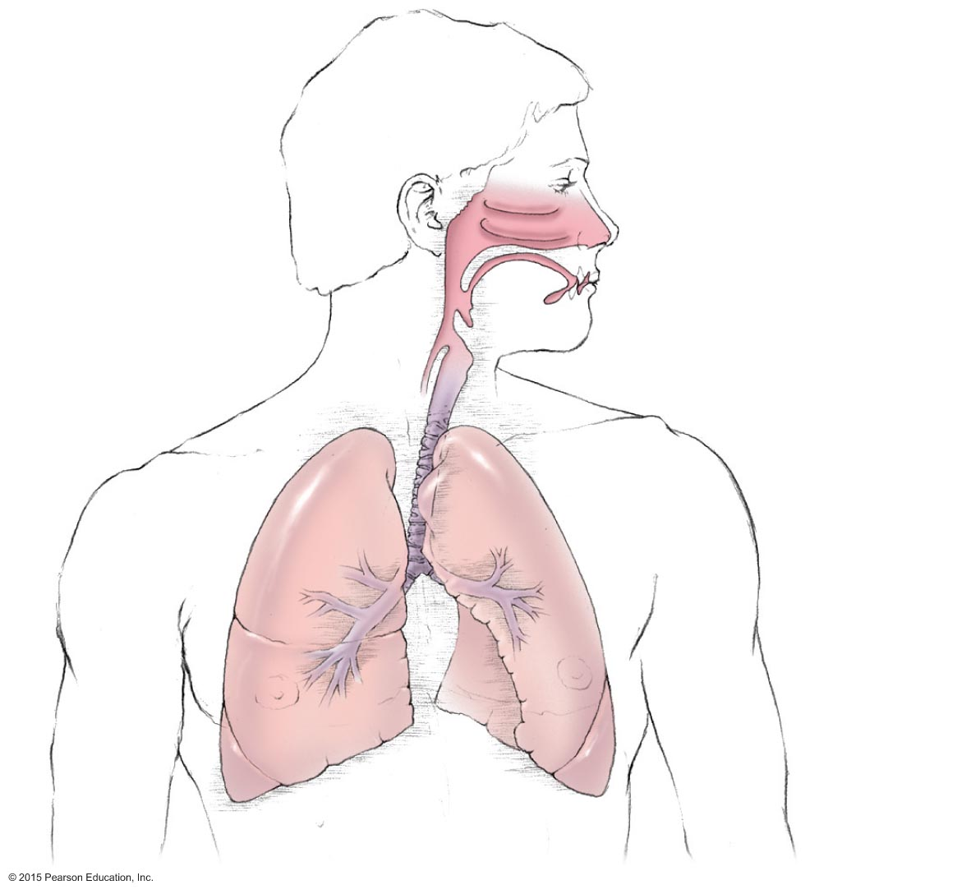
Figure 15.2 The structure of the respiratory system, which is lined with a mucous membrane.
Nasal cavity
Pharynx
Tongue
Epiglottis
Larynx
(voice box)
Esophagus
Trachea
Bronchus
Bronchioles

Slide 10
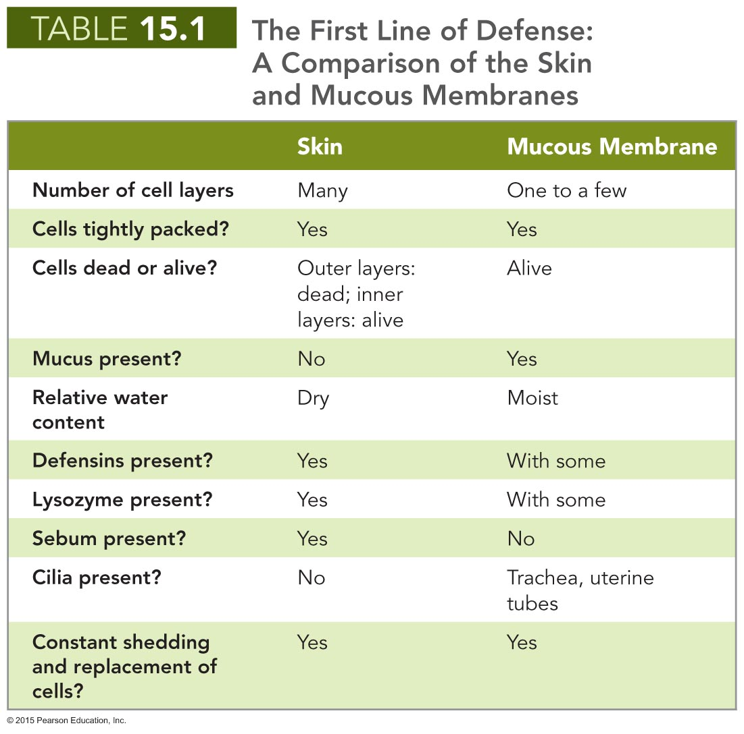

Slide 11
The Body's First Line of Defense
The Role of the Lacrimal Apparatus in Innate Immunity
Lacrimal apparatus
Produces and drains tears
Blinking spreads tears and washes surface of the eye
Lysozyme in tears destroys bacteria

Slide 12
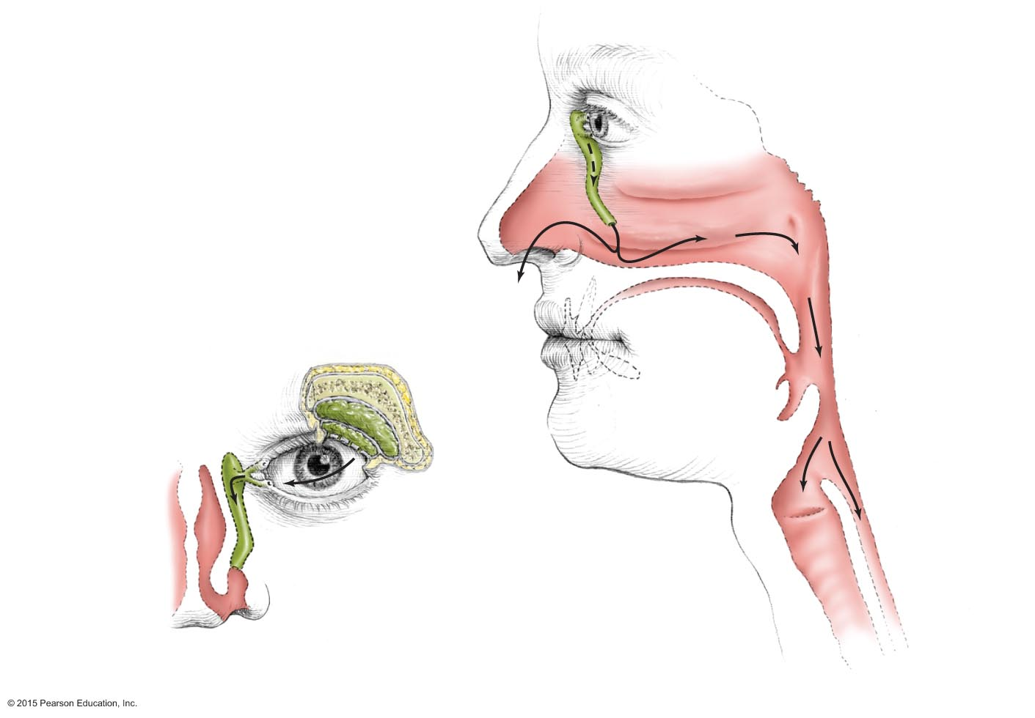
Figure 15.3 The lacrimal apparatus.
Nasolacrimal
duct
Paranasal
sinus
Lacrimal
apparatus
Lacrimal
glands
Lacrimal
gland duct
Pharynx
Lacrimal
canal
Nasolacrimal duct
Trachea
Esophagus
Anterior view
Lateral view

Slide 13
The Body's First Line of Defense
The Role of Normal Microbiota in Innate Immunity
Microbial antagonism
Normal microbiota compete with potential pathogens
Activities of normal microbiota make it hard for pathogens to compete
Consume nutrients
Create an environment unfavorable to other microorganisms
Help stimulate the body's second line of defense
Promote overall health by providing vitamins to host

Slide 14
The Body's First Line of Defense
Other First-Line Defenses
Antimicrobial peptides
Present in skin, mucous membranes, neutrophils
Act against a variety of microbes
Work in several ways
Other processes and chemicals
Many organs secrete chemicals with antimicrobial properties

Slide 15
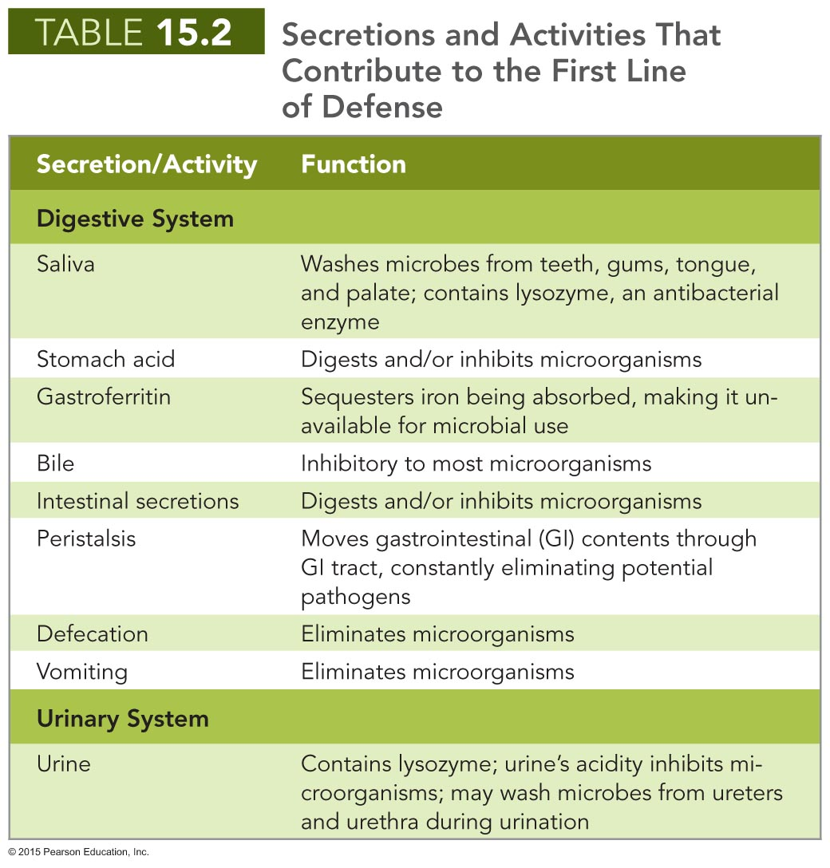

Slide 16
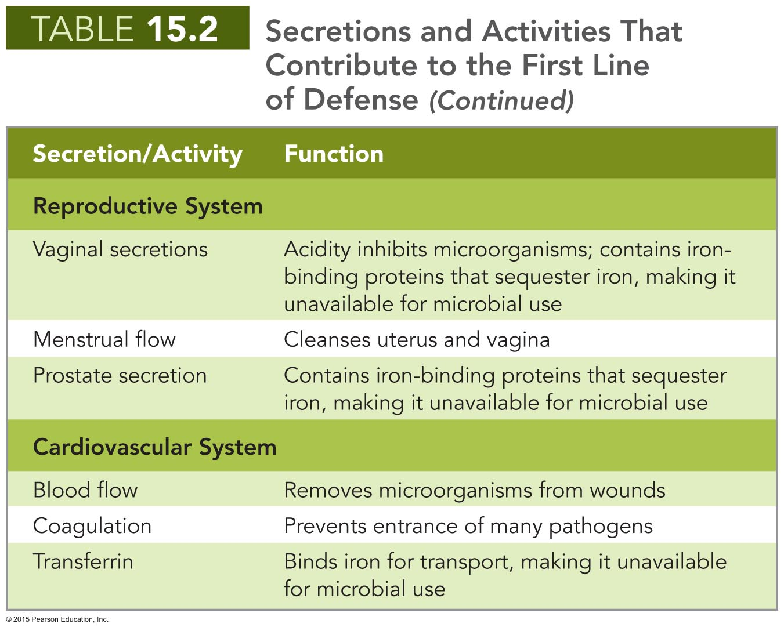

Slide 17
The Body's Second Line of Defense
Operates when pathogens penetrate the skin or mucous membranes
Composed of cells, antimicrobial chemicals, and processes
Many of these components are contained or originate in the blood

Slide 18
The Body's Second Line of Defense
Defense Components of Blood
Plasma
Mostly water containing electrolytes, dissolved gases, nutrients, and proteins
Serum is the fluid remaining when clotting factors are removed
Contains iron-binding compounds
Iron is needed for metabolism
Some microbes produce iron-binding proteins (siderophores)
Complement proteins and antibodies are also found in plasma

Slide 19
The Body's Second Line of Defense
Defense Components of Blood
Defensive blood cells: leukocytes
Cells and cell fragments in plasma are called formed elements
Three types of formed elements
Erythrocytes
Carry oxygen and carbon dioxide in the blood
Platelets
Involved in blood clotting
Leukocytes
Involved in defending the body against invaders
Classified as granulocytes and agranulocytes

Slide 20
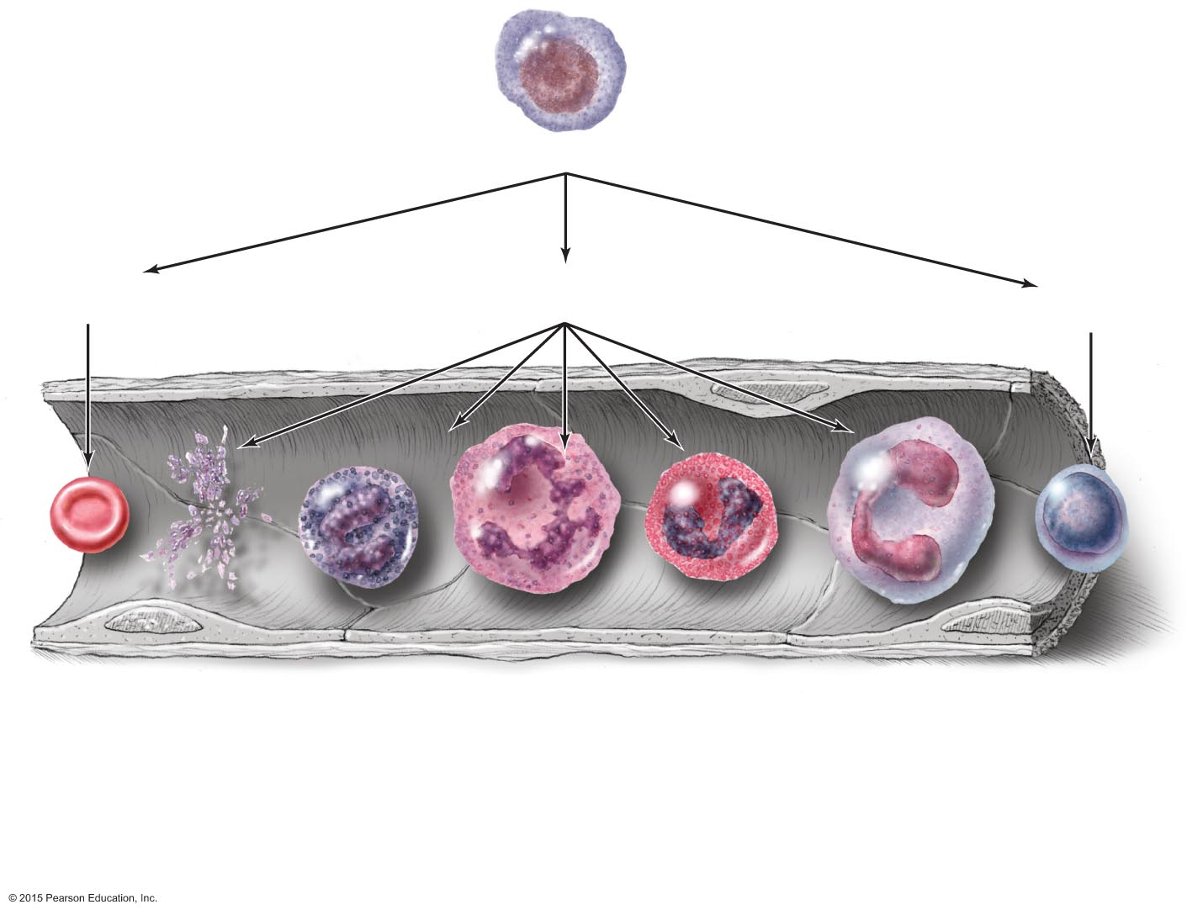
Figure 15.4 A schematic representation of hematopoiesis.
Blood stem cell in bone marrow
Erythroid
stem cell
Myeloid
stem cell
Lymphoid
stem cell
Erythrocyte
Platelets
Basophil
Neutrophil
Eosinophil
Monocyte
Lymphocyte
Clotting,
inflammation
Inflammation
Phagocytosis
Gas
transportation
Innate immunity, second line of defense
Adaptive immunity
Leukocytes

Slide 21
The Body's Second Line of Defense
Defense Components of Blood
Defensive blood cells: leukocytes
Granulocytes
Contain large granules that stain different colors
Three types
Basophils – stain blue with basic dye methylene blue
Eosinophils – stain red/orange with acidic dye eosin
Neutrophils – stain lilac with mix of acidic and basic dyes
Neutrophils and eosinophils
Phagocytize pathogens
Capable of diapedesis

Slide 22
The Body's Second Line of Defense
Defense Components of Blood
Defensive blood cells: leukocytes
Agranulocytes
Cytoplasm appears uniform under a light microscope
Two types
Lymphocytes
Most involved in adaptive immunity
Natural killer lymphocytes
Monocytes
Leave the blood and mature into macrophages
Phagocytic cells that devour foreign objects

Slide 23
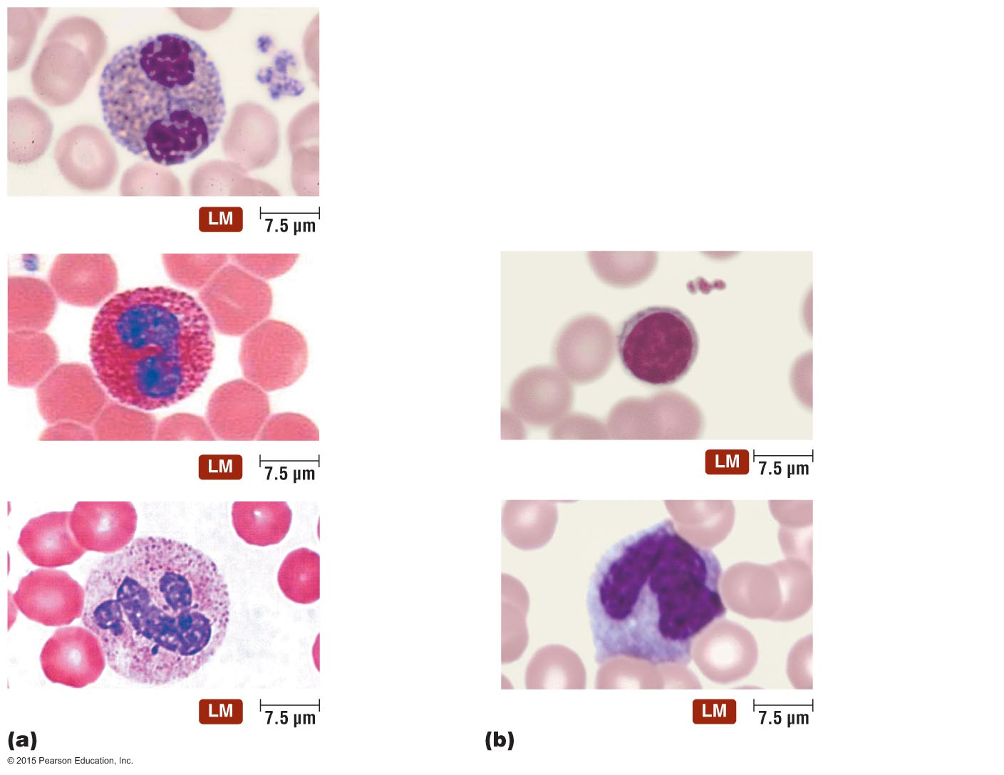
Figure 15.5 Leukocytes as seen in stained blood smears.
Basophil 0.5–1%
Granulocytes
Eosinophil 2–4%
Lymphocyte 20–25%
Agranulocytes
Neutrophil 60–70%
Monocyte 3–8%

Slide 24
The Body's Second Line of Defense
Defense Components of Blood
Defensive blood cells: leukocytes
Lab analysis of leukocytes
Differential white blood cell count can signal disease
Increased eosinophils indicate allergies or parasitic worm infection
Bacterial diseases often show increase in leukocytes and neutrophils
Viral infections show increase in lymphocytes

Slide 25
The Body's Second Line of Defense
Phagocytosis
Cells capable of phagocytosis are called phagocytes
Phagocytosis is not completely understood
Can be divided into six stages
Chemotaxis
Adherence
Ingestion
Maturation
Killing
Elimination

Slide 26
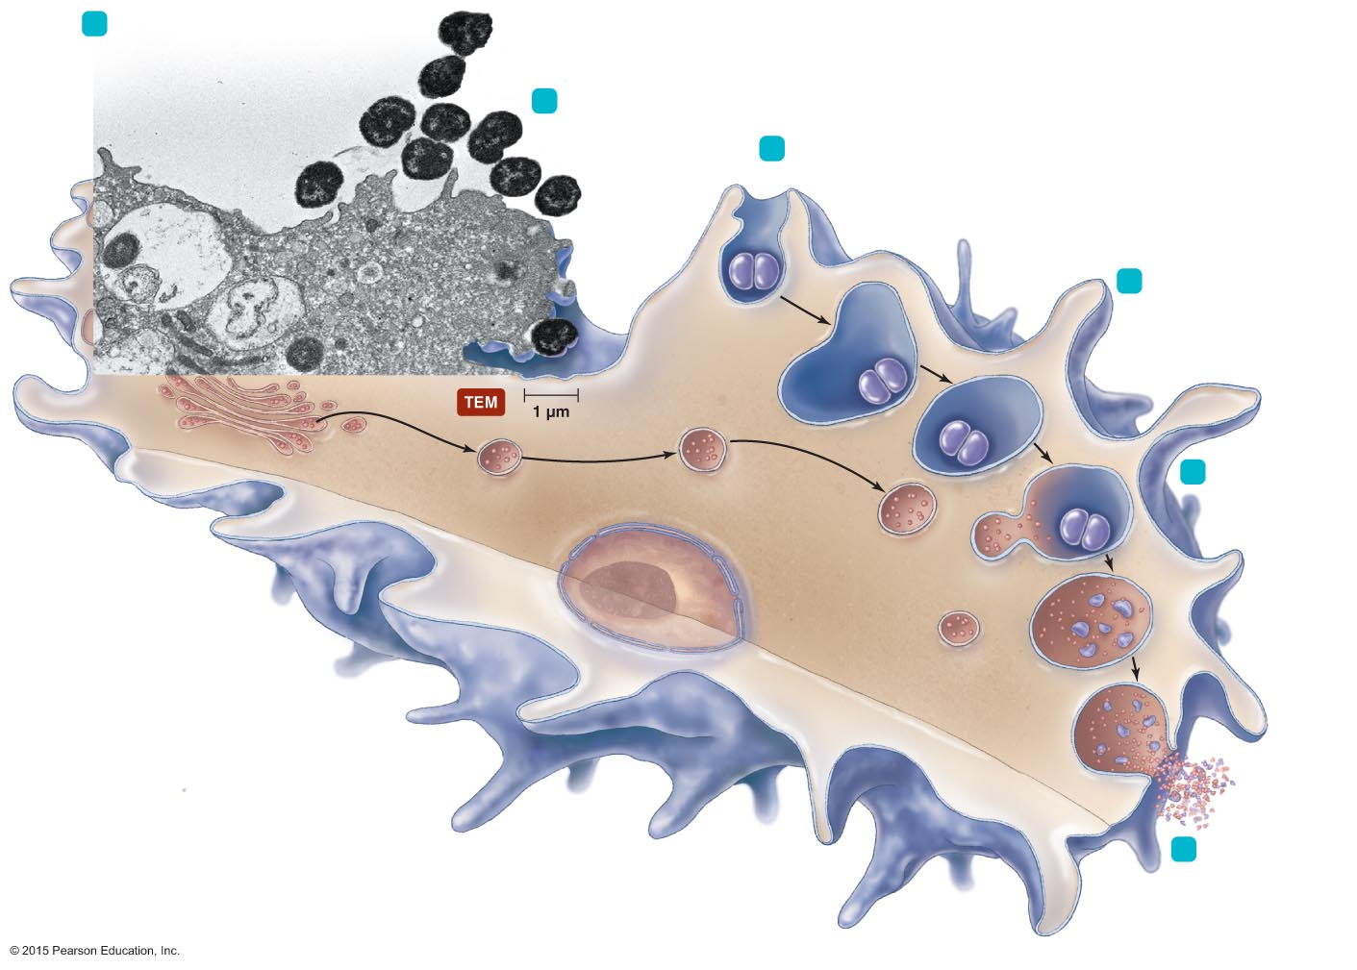
Figure 15.6 The events in phagocytosis.
1
Chemotaxis of
phagocyte
to microbes
Neisseria
(microbes)
2
Adherence
Pseudopodia move
(chemotaxis)
Ingestion of microbes
by phagocytes
3
4
Fusion of a
series of vesicles,
including lysosomes
Phagosome
Golgi body
5
Killing of
microbes by
enzymes and
other chemicals
Lysosome
Nucleus
Phagolysosome
Residual
body
Pseudopod
Phagocyte
6
Elimination
by exocytosis

Slide 27
The Body's Second Line of Defense
Nonphagocytic Killing
Killing by eosinophils
Attack parasitic helminths by attaching to their surface
Secrete toxins that weaken or kill the helminth
Eosinophilia is often indicative of a helminth infestation or allergies
Eosinophil mitochondrial DNA and proteins form structure that kills some bacteria

Slide 28
The Body's Second Line of Defense
Nonphagocytic Killing
Killing by natural killer lymphocytes
Secrete toxins onto surface of virally infected cells and tumors
Differentiate normal body cells because they have membrane proteins similar to the NK cells

Slide 29
The Body's Second Line of Defense
Nonphagocytic Killing
Killing by neutrophils
Can destroy microbes without phagocytosis
Produce chemicals that kill nearby invaders
Generate extracellular fibers called neutrophil extracellular traps (NETs) that bind to and kill bacteria

Slide 30
The Body's Second Line of Defense
Nonspecific Chemical Defenses Against Pathogens
Toll-like receptors (TLRs)
Integral membrane proteins produced by phagocytic cells
Bind pathogen-associated molecular patterns (PAMPs)
Initiate defensive responses
Apoptosis
Secretion of inflammatory mediators
Stimulate adaptive immune response

Slide 31
The Body's Second Line of Defense
Nonspecific Chemical Defenses Against Pathogens
NOD proteins
Cytosolic proteins that bind PAMPs
Trigger inflammation, apoptosis, and other innate responses
Mechanism of action still being researched
Mutations in NOD genes associated with some inflammatory bowel diseases

Slide 32
The Body's Second Line of Defense
Nonspecific Chemical Defenses Against Pathogens
Interferons
Protein molecules released by host cells to nonspecifically inhibit the spread of viral infections
Cause many symptoms associated with viral infections
Two types
Types I (alpha and beta)
Type II (gamma)

Slide 33
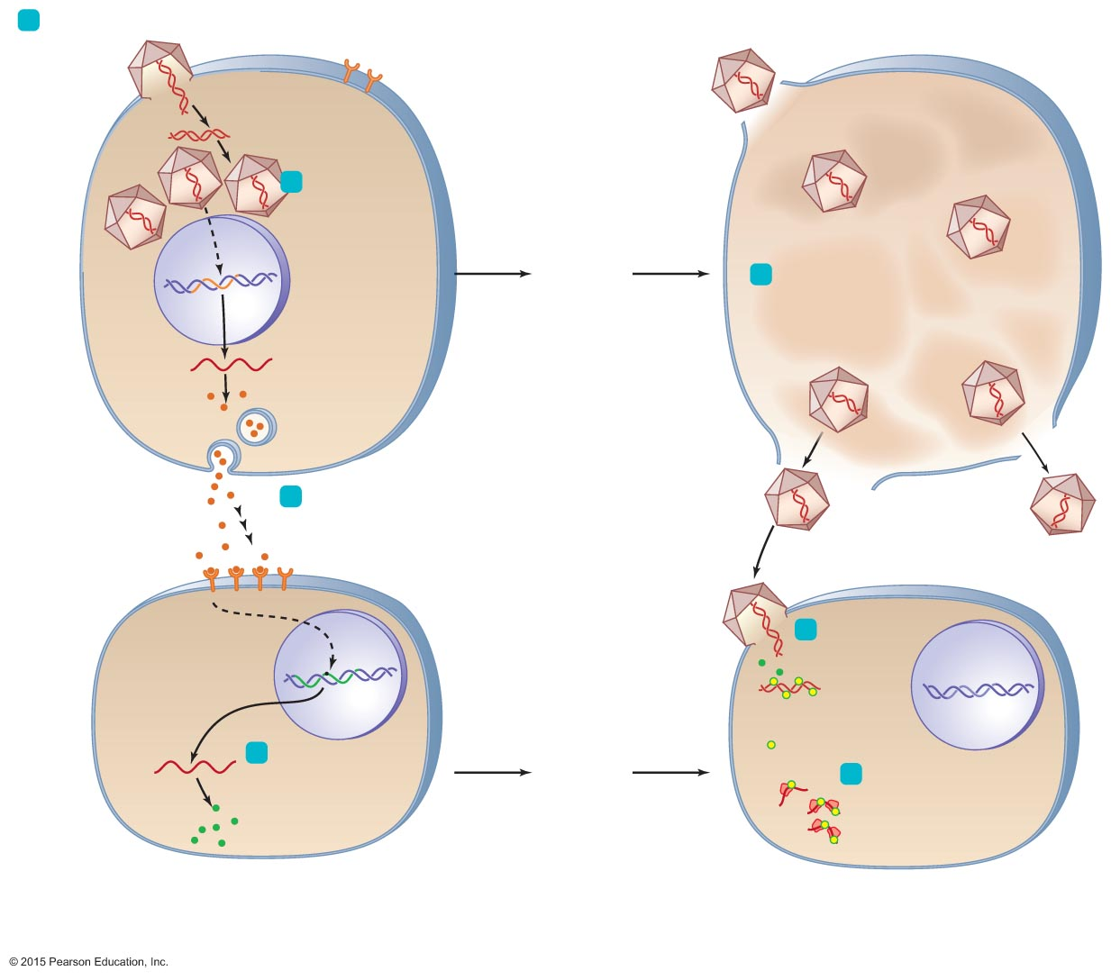
Figure 15.7 The actions of alpha and beta interferons.
1
Virus infects cell.
Virus
Double-
stranded
RNA
Viral replication
in cell triggers
transcription and
translation of
IFN-α or IFN-β,
depending on
type of host cell.
2
IFN
gene
Time
passes
5
Meanwhile, the
infected cell dies,
releasing viruses.
Nucleus
mRNA
IFN
Infected cell
Infected cell
at a later time
3
Interferon is released,
diffuses to neighboring
uninfected cells, and
binds to receptors.
Interferon receptor
Inactive AVP
6
When the second
cell becomes infected
with viruses, double-
stranded RNA
of the virus
activates AVP.
AVP
gene
Double-
stranded
viral RNA
4
Binding triggers
transcription
and translation of
inactive antiviral
proteins (AVPs).
Time
passes
Active AVPs
mRNA
Ribosome
7
Active AVPs degrade
mRNA and bind to ribosomes, which stops protein synthesis and
viral replication.
Inactive
AVPs
mRNA
Uninfected
neighboring cell
Same
neighboring
cell now protected
at the later time

Slide 35
The Body's Second Line of Defense
Nonspecific Chemical Defenses Against Pathogens
Complement
Set of serum proteins designated numerically according to their order of discovery
Complement activation results in lysis of the foreign cell
Indirectly trigger inflammation and fever
Complement can be activated in three ways
Classical pathway
Alternative pathway
Lectin pathway

Slide 36
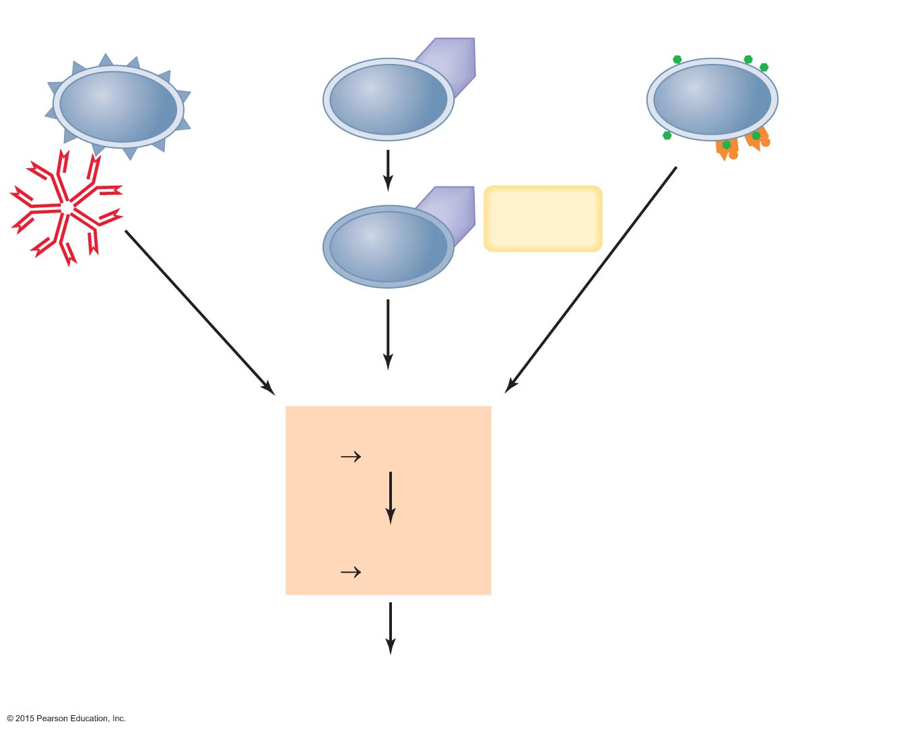
Figure 15.8 Pathways by which complement is activated.
Classical pathway
Alternative pathway
Lectin pathway
Antigen
C3b
Mannose
Endotoxin and
glycoproteins
Lectins
Antibody
C3b
Factors B,
D, and P
Complement
proteins
1, 2, 4
Complement cascade
Activation
(C3 C3a + C3b)
Opsonization
Inflammation
C5 convertase
C5 C5a + C5b
Inflammation
Membrane attack
complex and cell lysis

Slide 37
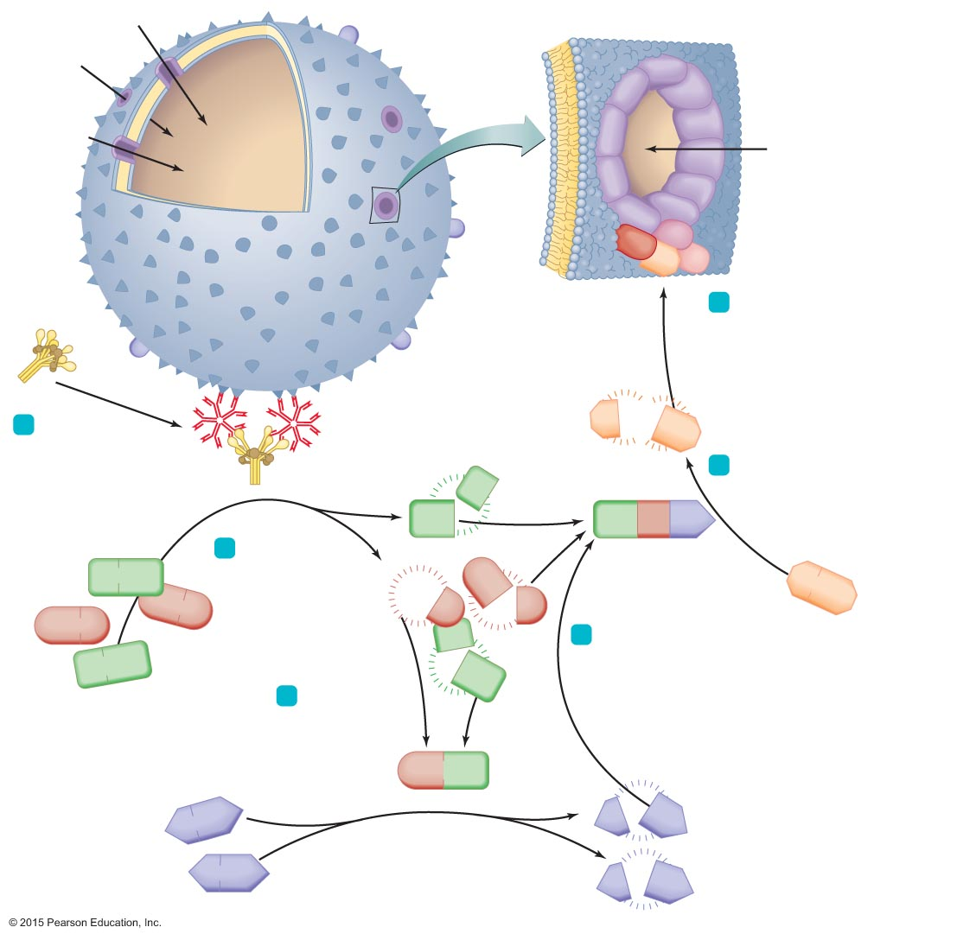
Figure 15.9 The classical pathway and complement cascade.
H₂O
H₂O
Membrane
attack
complex
C9
Cytoplasmic
membrane
C9
C9
H₂O
C9
C9
C9
H₂O
C9
C9
C9
C9
C8
C7
Pathogen
C5b
C6
C5b combines with C6, C7, C8,
and several molecules of C9
to form a membrane attack
complex (MAC). A MAC drills a
circular hole in the pathogen’s
cytoplasmic membrane,
leading to lysis of the cell.
6
C1
Causes chemotaxis
of phagocytes
and triggers
inﬂammation
Antigen
Antibody
C5a
1
C1 becomes
an active enzyme
when it binds to
antibody-antigen
complexes.
C5b
Causes
inflammation
5
Enzymatic C1
C4a
This enzyme cleaves
C5 into C5a and C5b.
C4b
C4b
C2b
C3b
Enzyme C1
splits molecules
of C2 and of C4.
2
Enzyme
(C5 convertase)
C4
C2a
C5
C2
C2b
C2b
C2
C3b combines
with the remaining
fragments of C2
and C4 to form a
third enzyme.
C4a
4
C4
C4b
3
Fragments of C2
and C4 combine
to form a second
enzyme that
splits C3 into
C3a and C3b.
C2a
C4b
Enzyme
C3a
C3b
C3
C3
Causes chemotaxis of phagocytes and triggers
inﬂammation
Acts as
opsonin
C3a
C3b

Slide 38
The Body's Second Line of Defense
Inflammation
Nonspecific response to tissue damage from various causes
Characterized by redness, heat, swelling, and pain
Two types
Acute
Chronic

Slide 39
The Body's Second Line of Defense
Inflammation
Acute inflammation
Develops quickly and is short lived
Is typically beneficial
Is important in the second line of defense
Dilation and increased permeability of the blood vessels
Migration of phagocytes
Tissue repair
Chronic inflammation
Long-lasting
Damage to tissues can cause disease

Slide 40
The Body's Second Line of Defense
Inflammation
Dilation and increased permeability of blood vessels
Initial response to injury or invasion of pathogens
Release of inflammatory mediators triggers dilation of blood vessels
Bradykinin
Prostaglandins
Leukotrienes
Histamine
Signs and symptoms of inflammation can be blocked with antihistamines or antiprostaglandins

Slide 41
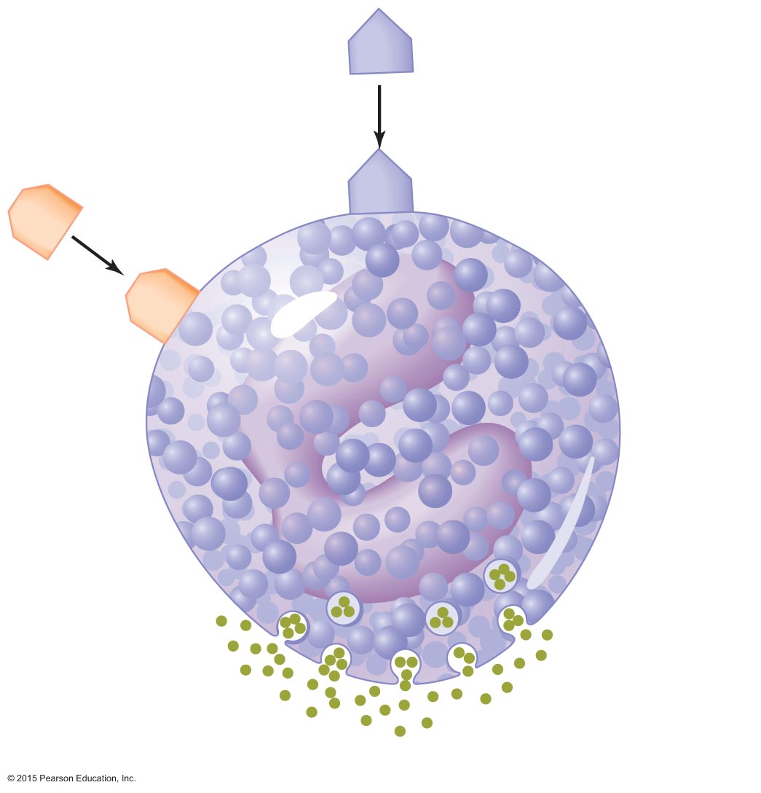
Figure 15.11 The stimulation of inflammation by complement.
C3a
C3a
C5a
C5a
Granule
containing
chemicals
Inflammatory mediators

Slide 42
Figure 15.12 The dilating effect of inflammatory mediators on small blood vessels.
Dilated
capillaries
Capillaries
Mediator
Blood
flow
Blood
flow
Venule
Arteriole
Before
After

Slide 43
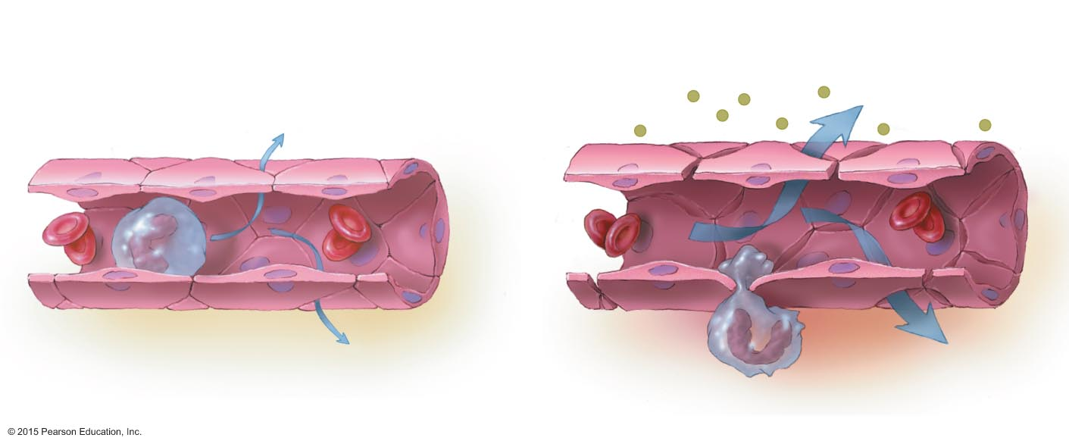
Figure 15.13 Increased vascular permeability during inflammation.
Normal permeability
of venule
Increased permeability of venule
during inflammation
More fluid
and antimicrobial
chemicals
Small amount
of fluid
Interstitial
spaces
Venule wall
Monocyte
Small amount
of fluid
Monocyte squeezing
through interstitial space
(diapedesis)
More fluid

Slide 44
The Body's Second Line of Defense
Inflammation
Migration of phagocytes
Increased blood flow delivers leukocytes to site of infection
Attach to receptors lining vessels via margination
Squeeze between vessel's walls
Attracted to site of infection by chemotactic factors
Neutrophils arrive first, followed by monocytes

Slide 45
The Body's Second Line of Defense
Inflammation
Tissue repair
Final stage of inflammation
Delivers extra nutrients and oxygen to site
Some sites cannot be fully repaired and form scar tissue

Slide 46
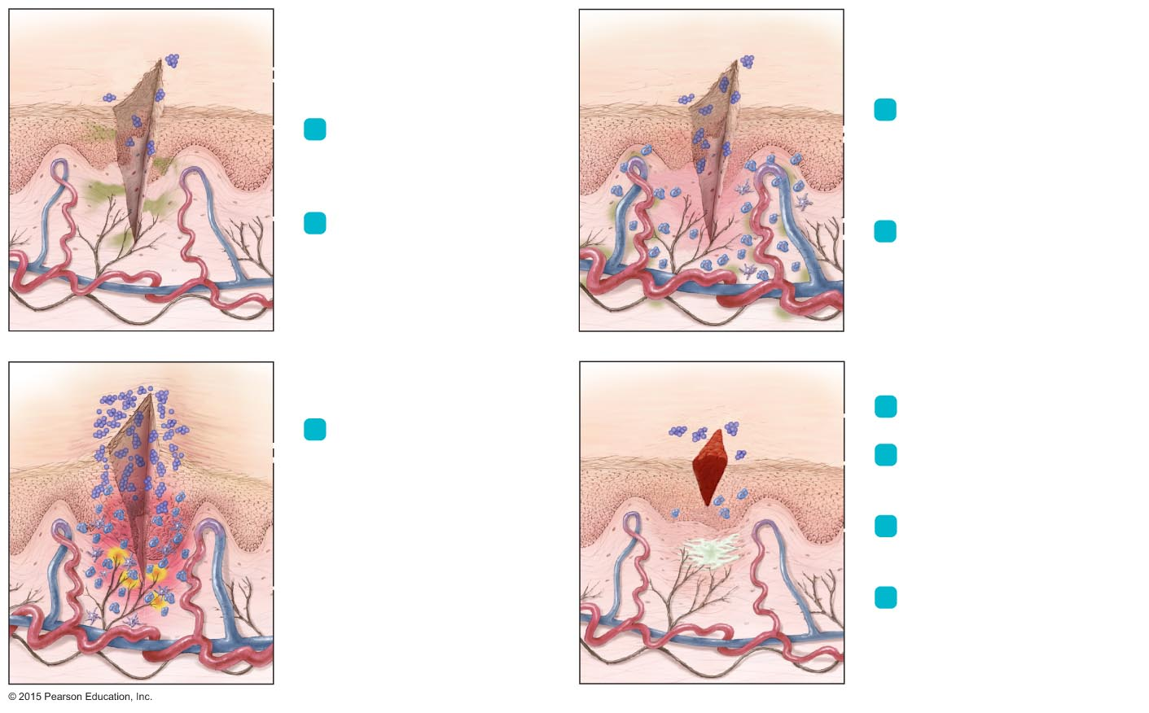
Figure 15.14 An overview of the events in inflammation following a cut and infection.
Bacteria
3
Prostaglandins and
leukotrienes make vessels more permeable. Histamine causes vasodilation, increasing
blood flow to the site.
1
A cut penetrates the epidermis barrier, and bacteria invade.
2
Damaged cells release
prostaglandins, leukotrienes, and histamine (shown in
green here).
4
Macrophages and neutrophils squeeze through walls of
blood vessels (diapedesis).
Swelling
Heat
6
Blood clot forms.
5
Increased permeability allows antimicrobial chemicals and clotting proteins to seep into
damaged tissue but also
results in swelling, pressure on nerve endings, and pain.
7
More phagocytes migrate to the site and devour bacteria.
8
Accumulation of damaged tissue and leukocytes forms pus.
Nerve ending
9
Undifferentiated stem cells repair the damaged tissue. Blood clot is absorbed or falls
off as a scab.

Slide 48
The Body's Second Line of Defense
Fever
Body temperature over 37°C
Results when pyrogens trigger the hypothalamus to increase the body's core temperature
Various types of pyrogens
Bacterial toxins
Cytoplasmic contents of bacteria released by lysis
Antibody-antigen complexes
Pyrogens released by phagocytes that have phagocytized bacteria
Exact mechanism of fever is not known

Slide 49
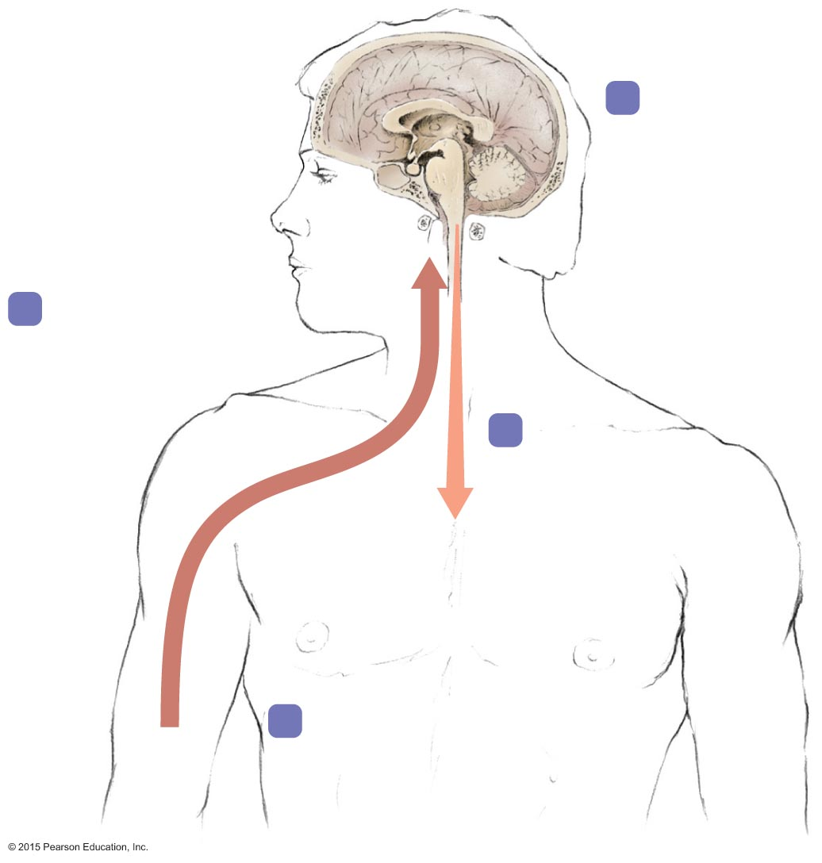
Figure 15.15 One theoretical explanation for the production of fever in response to infection.
Hypothalamus
2
Hypothalamus
secretes
prostaglandin,
which resets
hypothalamic
thermostat.
1
Chemicals secreted
by phagocytes
travel in blood to
hypothalamus.
3
Nerve impulses
cause shivering,
higher metabolic rate,
inhibition of sweating,
and vasoconstriction.
4
These processes increase body
temperature to the point set by
the hypothalamic thermostat.
Wound

Slide 50
The Body's Second Line of Defense
Fever
Continues as long as pyrogens are present
Outcomes of fever
Enhances effects of interferons
Inhibits growth of some microbes
May enhance the activities of phagocytes, cells of specific immunity, and the process of tissue repair

Slide 51
