Slide 1
Microscopy, Staining, and classification
Ch. 4
Microbiology
CCV

Slide 2
Notes:
2

Slide 3
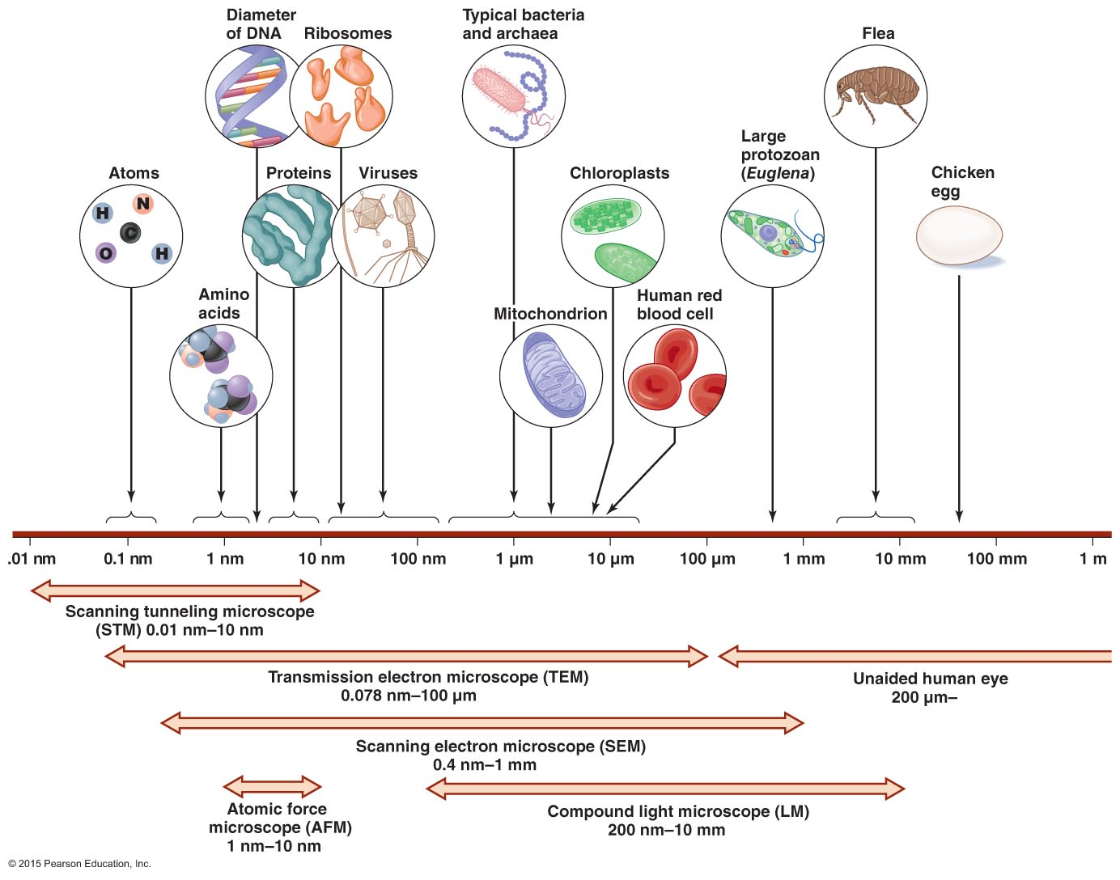
Figure 4.3 The limits of resolution (and some representative objects within those ranges) of the human eye and of various types of microscopes.
Notes:
3

Slide 4
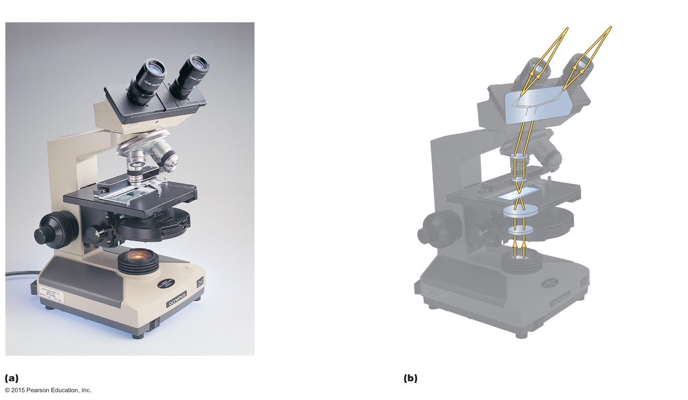
Figure 4.4 A bright-field, compound light microscope.
Line of vision
Ocular lens
Remagnifies the image formed by
the objective lens
Body
Transmits the image from the
objective lens to the ocular lens
using prisms
Ocular lens
Path of light
Arm
Prism
Objective lenses
Primary lenses that
magnify the specimen
Body
Objective
lenses
Stage
Holds the microscope
slide in position
Specimen
Condenser
Focuses light
through specimen
Condenser
lenses
Diaphragm
Controls the amount of
light entering the condenser
Illuminator
Illuminator
Light source
Coarse focusing knob
Moves the stage up and
down to focus the image
Fine focusing knob
Base
Notes:
4

Slide 5
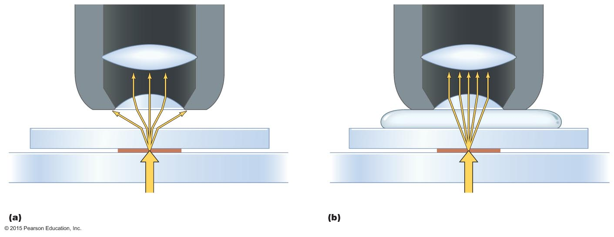
Figure 4.5 The effect of immersion oil on resolution.
Microscope
objective
Microscope
objective
Lenses
Refracted light
rays lost to lens
More light
enters lens
Immersion oil
Glass cover slip
Glass cover slip
Slide
Slide
Specimen
Light source
Light source
Without immersion oil
With immersion oil
Notes:
5

Slide 6
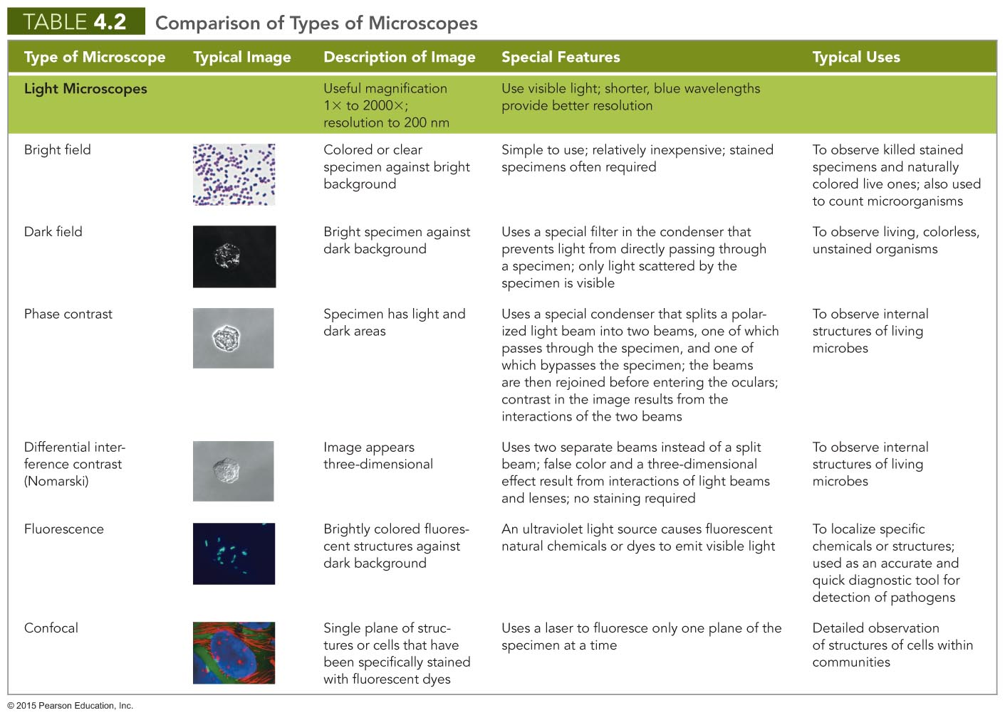
Notes:
6

Slide 7
Notes:
7

Slide 8
Staining
Most microorganisms are difficult to view by bright-field microscopy
Coloring specimen with stain increases contrast and resolution
Specimens must be prepared for staining

Slide 9
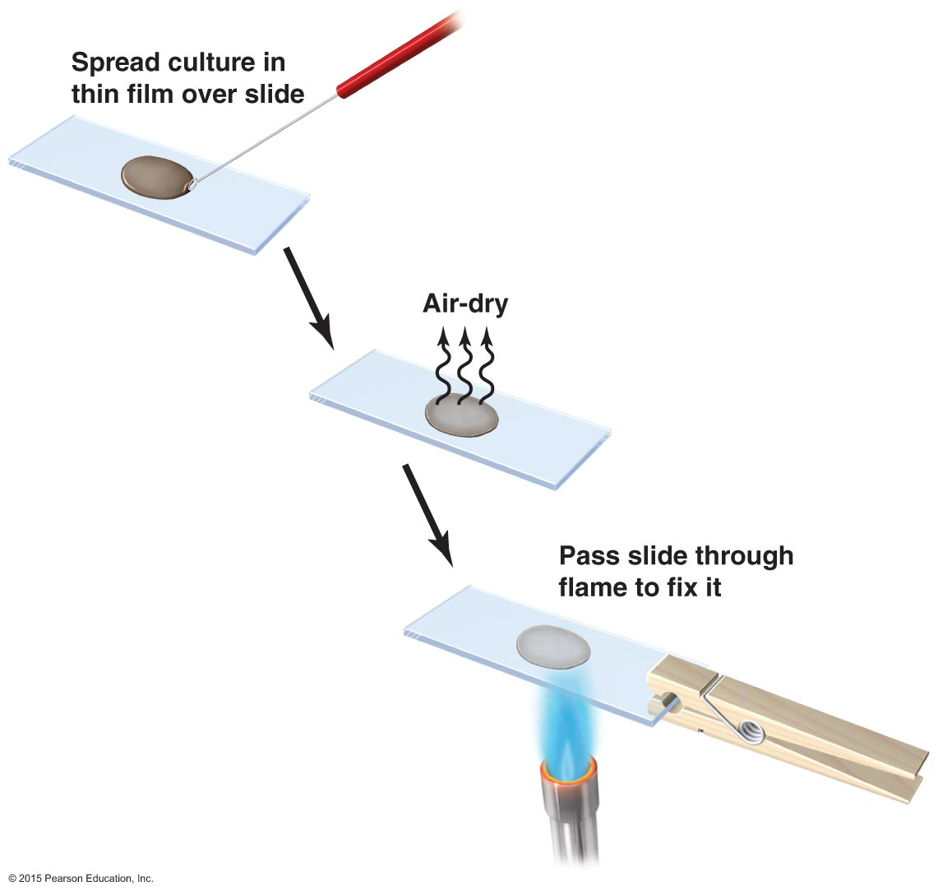
Figure 4.15 Preparing a specimen for staining.
Notes:
9

Slide 10
Staining
Principles of Staining
Dyes used as stains are usually salts
Chromophore is the colored portion of the dye
Acidic dyes stain alkaline structures
Basic dyes stain acidic structures
More common because most cells are negatively charged

Slide 11
Staining
Simple stains—composed of single dye
Differential stains—use more than one dye
Gram stain
Acid-fast stain
Endospore stain
Histological stains
Special stains—reveal specific structures
Negative (capsule) stain
Flagellar stain

Slide 12
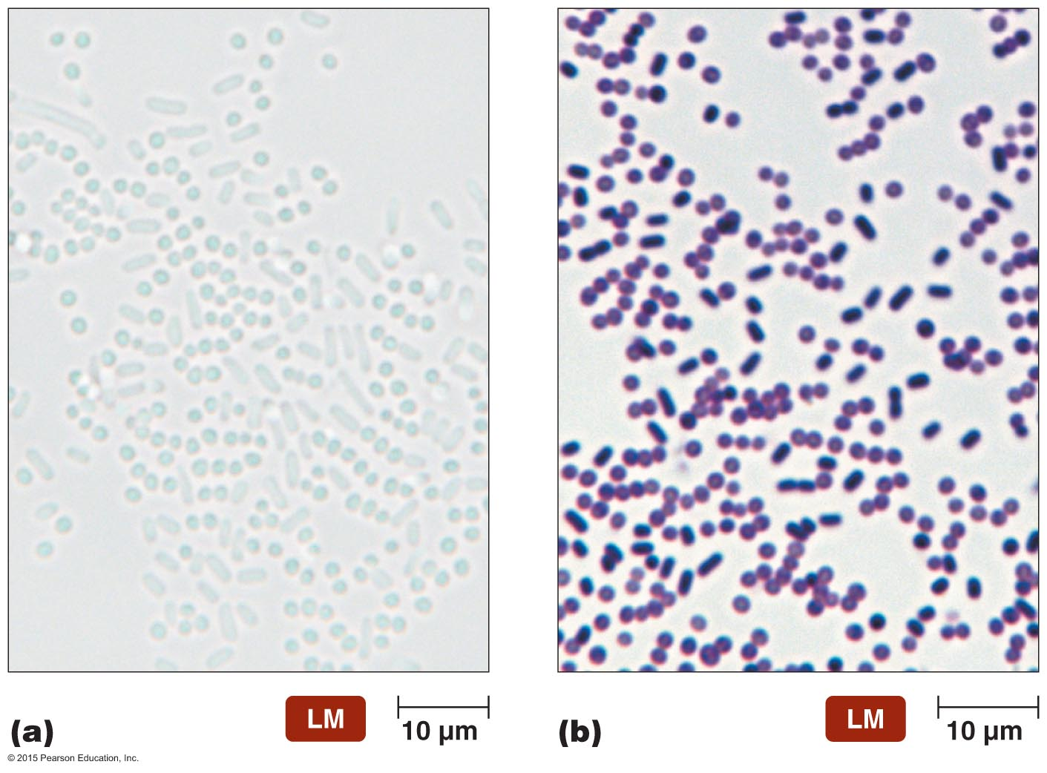
Figure 4.16 Simple stains.
Notes:
12

Slide 13
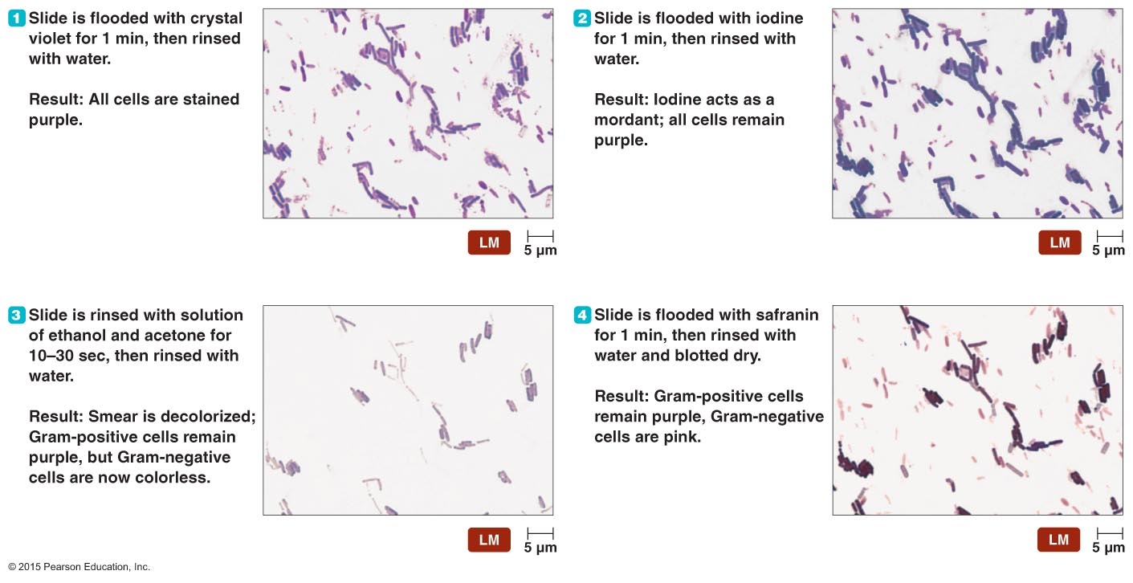
Figure 4.17 The Gram staining procedure.
Notes:
13

Slide 14
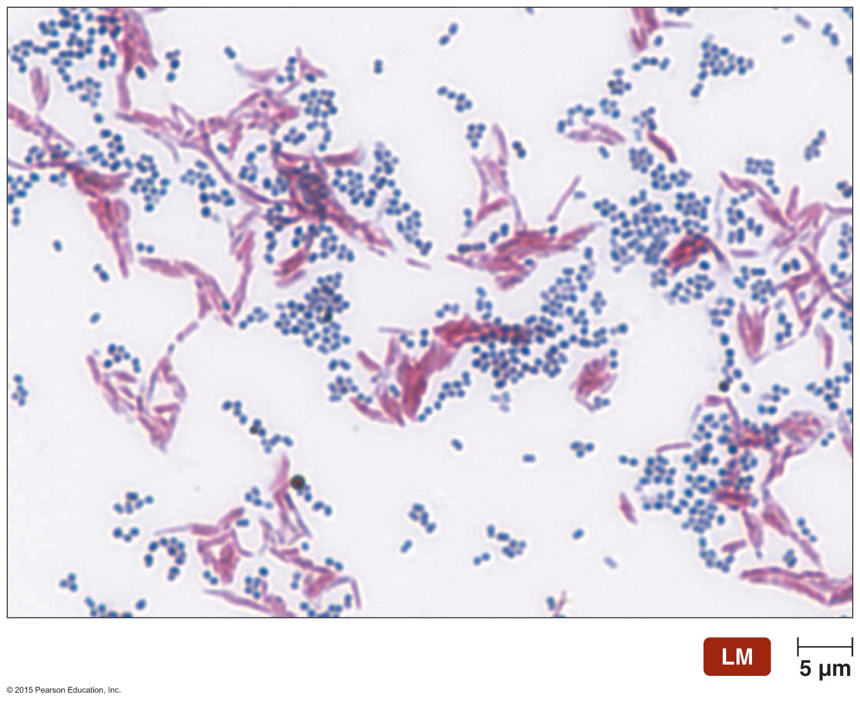
Figure 4.18 Ziehl-Neelsen acid-fast stain.
Notes:
14

Slide 15
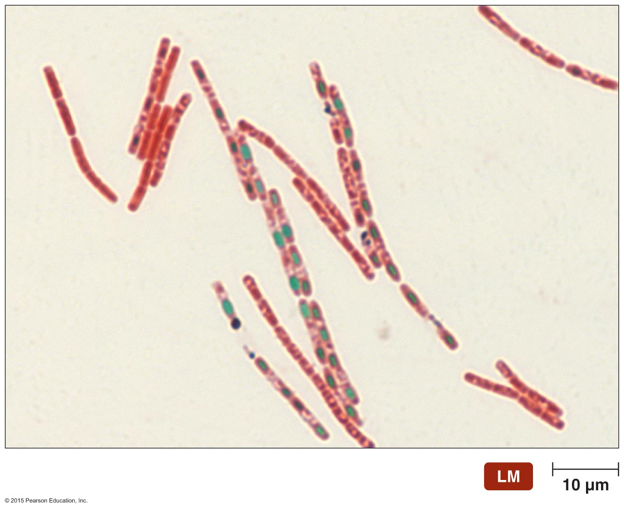
Figure 4.19 Schaeffer-Fulton endospore stain of Bacillus anthracis.
Notes:
15

Slide 16
Staining
Differential Stains
Histological stains
Two common stains used for histological specimens
Gomori methenamine silver (GMS) stain
Hematoxylin and eosin (HE) stain

Slide 17
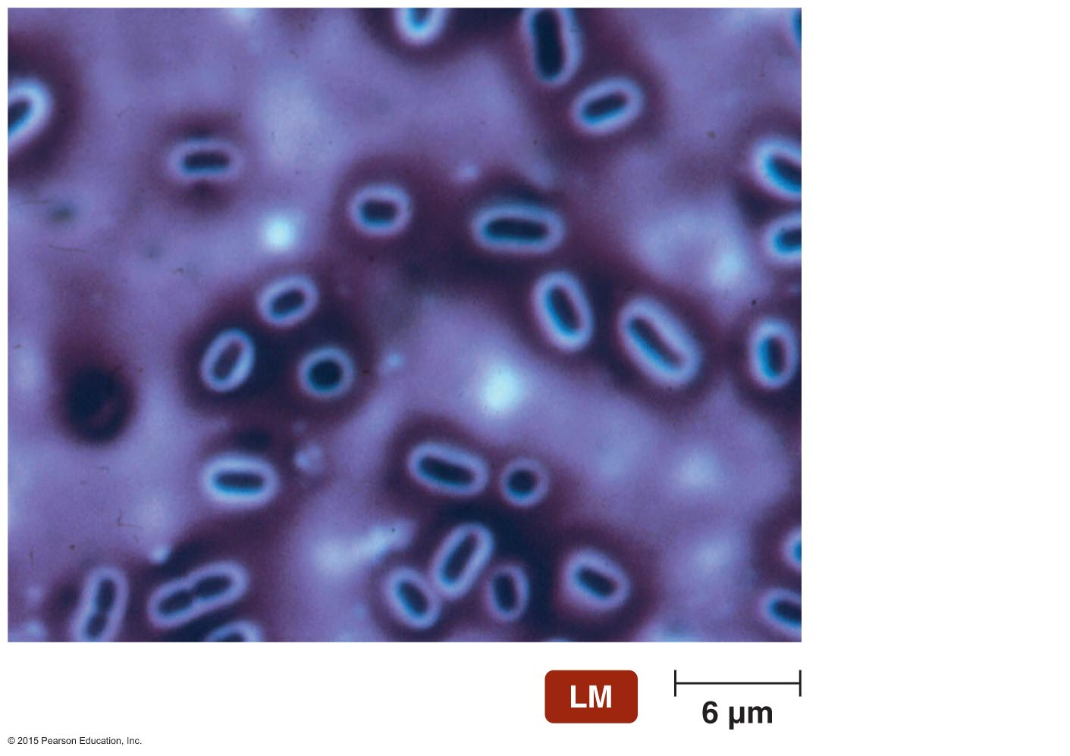
Figure 4.20 Negative (capsule) stain of Klebsiella pneumoniae.
Bacterium
Capsule
Background
stain
Notes:
17

Slide 18
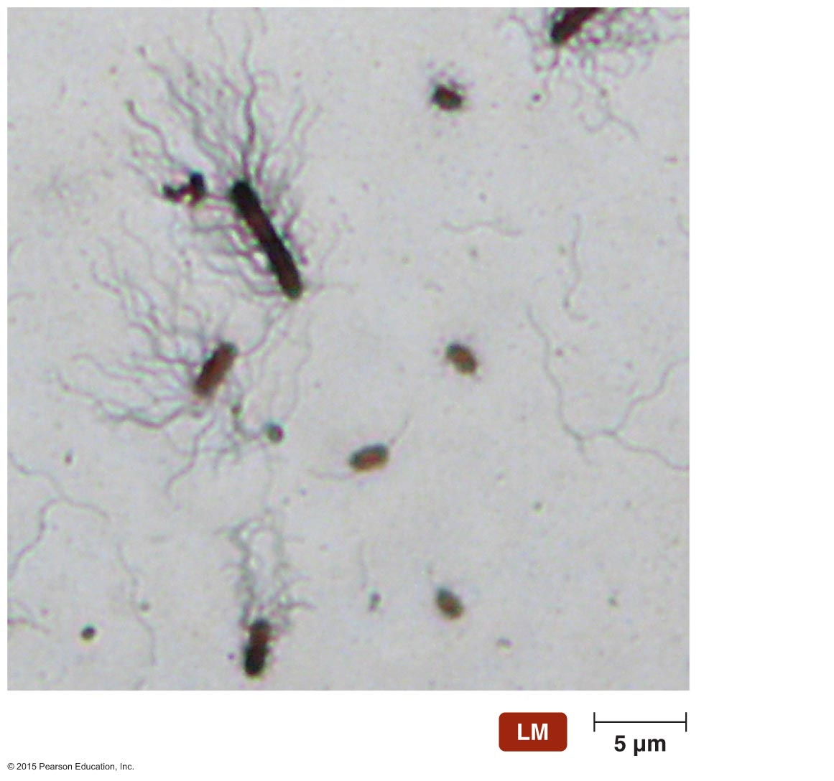
Figure 4.21 Flagellar stain of Proteus vulgaris.
Flagella
Notes:
18

Slide 19
Notes:
19

Slide 20
Classification and Identification of Microorganisms
Taxonomy consists of classification, nomenclature, and identification
Organize large amounts of information about organisms
Make predictions based on knowledge of similar organisms

Slide 21
Classification and Identification of Microorganisms
Linnaeus and Taxonomic Categories
Current taxonomy system began with Carolus Linnaeus
His system classified organisms based on characteristics in common
Grouped organisms that can successfully interbreed into categories called species
Used binomial nomenclature

Slide 22
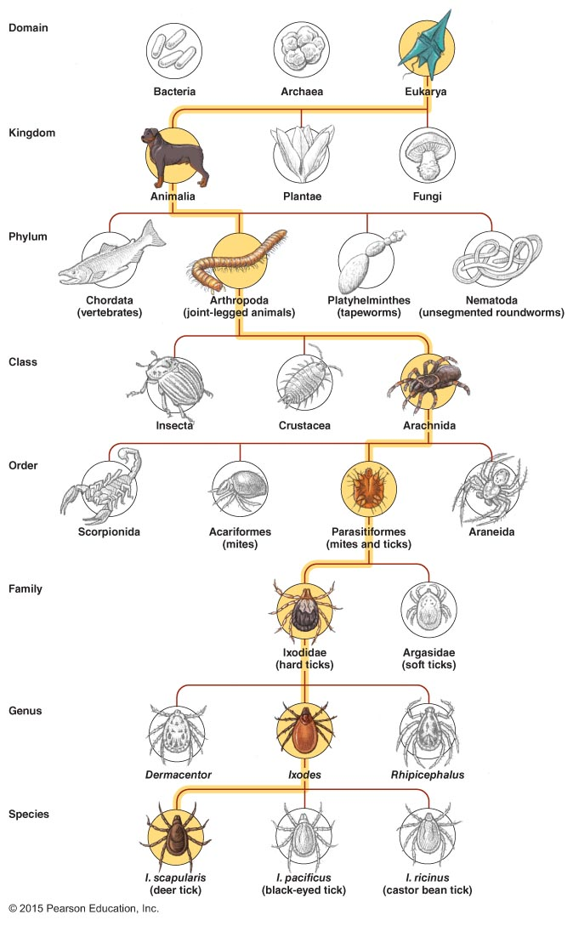
Figure 4.22 Levels in a Linnaean taxonomic scheme.
Notes:
22

Slide 23
Classification and Identification of Microorganisms
Linnaeus and Taxonomic Categories
Linnaeus proposed only two kingdoms
Later taxonomic approach based on five kingdoms
Animalia, Plantae, Fungi, Protista, and Prokaryotae
Linnaeus's goal was to classify organisms in order to catalog them
Modern goal is to understand relationships among organisms
Goal of modern taxonomy is to reflect phylogenetic hierarchy
Greater emphasis on comparisons of organisms' genetic material led to proposal to add domain

Slide 24
Classification and Identification of Microorganisms
Domains
Carl Woese compared nucleotide sequences of rRNA subunits
Proposal of three domains as determined by ribosomal nucleotide sequences
Eukarya, Bacteria, and Archaea
Cells in the three domains also differ with respect to many other characteristics

Slide 25
Classification and Identification of Microorganisms
Taxonomic and Identifying Characteristics
Physical characteristics
Biochemical tests
Serological tests
Phage typing
Analysis of nucleic acids

Slide 26
Classification and Identification of Microorganisms
Taxonomic and Identifying Characteristics
Physical characteristics
Can often be used to identify microorganisms
Protozoa, fungi, algae, and parasitic worms can often be identified based only on their morphology
Some bacterial colonies have distinct appearance used for identification

Slide 27
Classification and Identification of Microorganisms
Taxonomic and Identifying Characteristics
Serological tests
Serology—study of serum (liquid portion of blood after clotting factors removed)
Many microorganisms are antigenic
Trigger immune response that produces antibodies
Serum is an important source of antibodies
Antibodies can be isolated and bind to the antigens that triggered their production

Slide 28
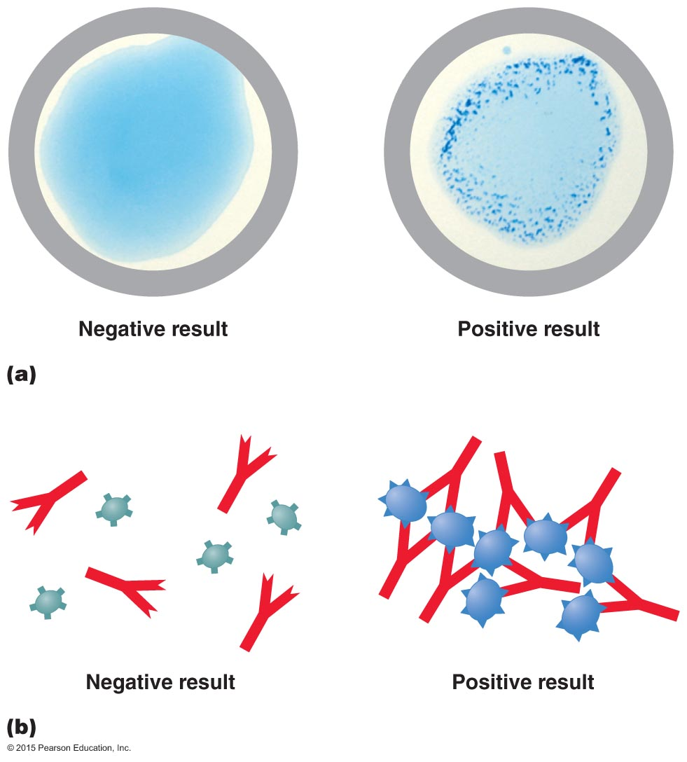
Figure 4.25 An agglutination test, one type of serological test.
Notes:
28

Slide 29
Classification and Identification of Microorganisms
Taxonomic and Identifying Characteristics
Phage typing
Bacteriophage (phage)—virus that infects bacteria
Phages are specific for the host they infect
Phage typing is based on this specificity

Slide 30
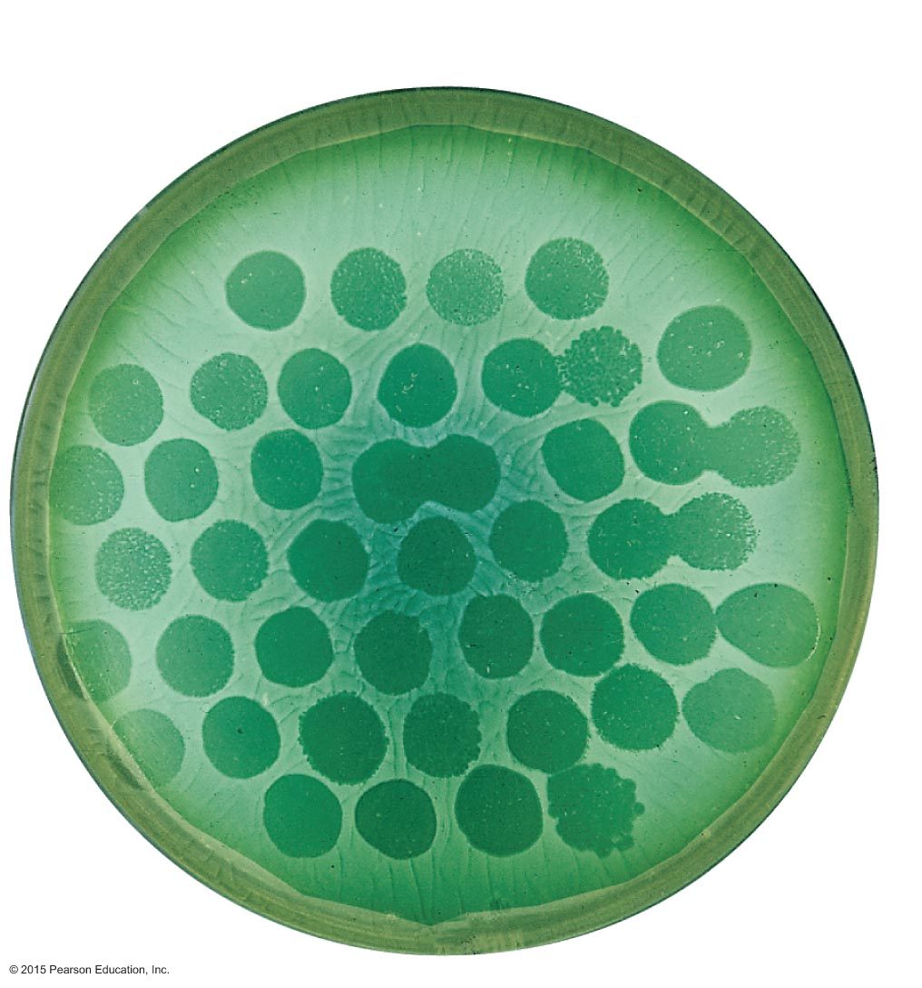
Figure 4.26 Phage typing.
Bacterial lawn
Plaques
Notes:
30

Slide 31
Classification and Identification of Microorganisms
Taxonomic and Identifying Characteristics
Analysis of nucleic acids
Nucleic acid sequence can be used to classify and identify microbes

Slide 32
Classification and Identification of Microorganisms
Taxonomic Keys
Dichotomous keys
Series of paired statements where only one of two "either/or" choices applies to any particular organism
Key directs user to another pair of statements or provides name of organism

Slide 33
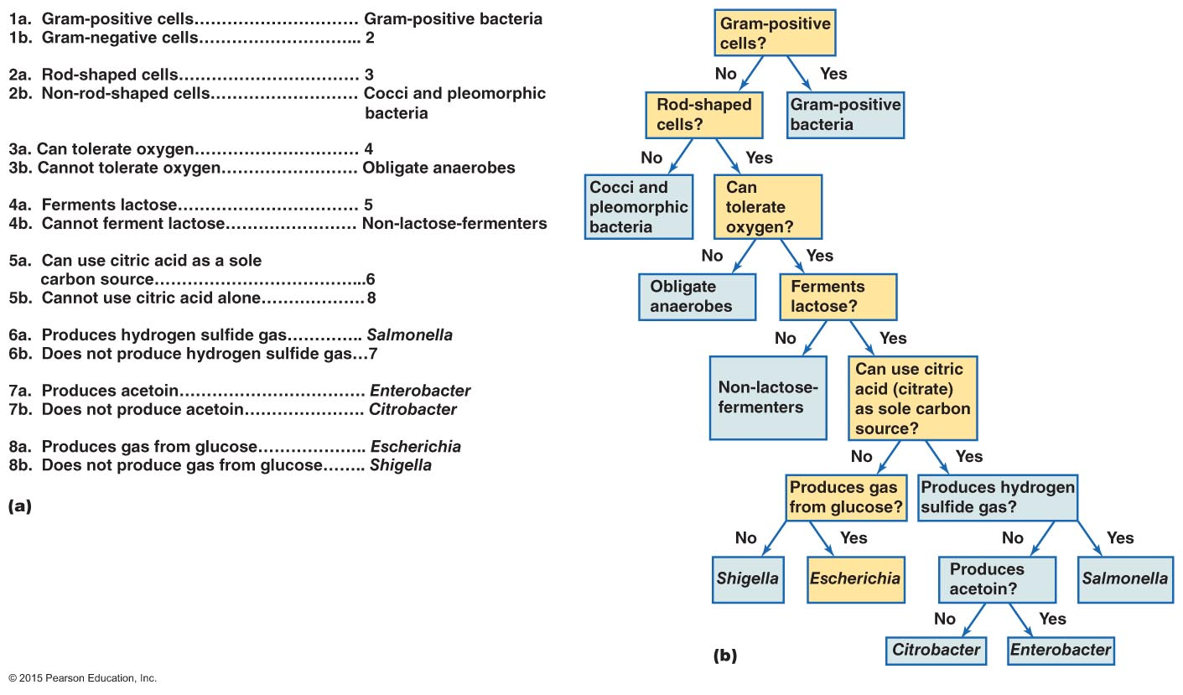
Figure 4.27 Use of a dichotomous taxonomic key.
Notes:
33

