Slide 1
Characterizing & Classifying Prokaryotes
Abbreviated Ch. 11 Material
CCV
Microbiology

Slide 2
General Characteristics of Prokaryotic Organisms
Prokaryotes
Most numerous and diverse group of cellular microbes
Thrive in various habitats
Only a few are capable of colonizing humans and causing disease

Slide 3
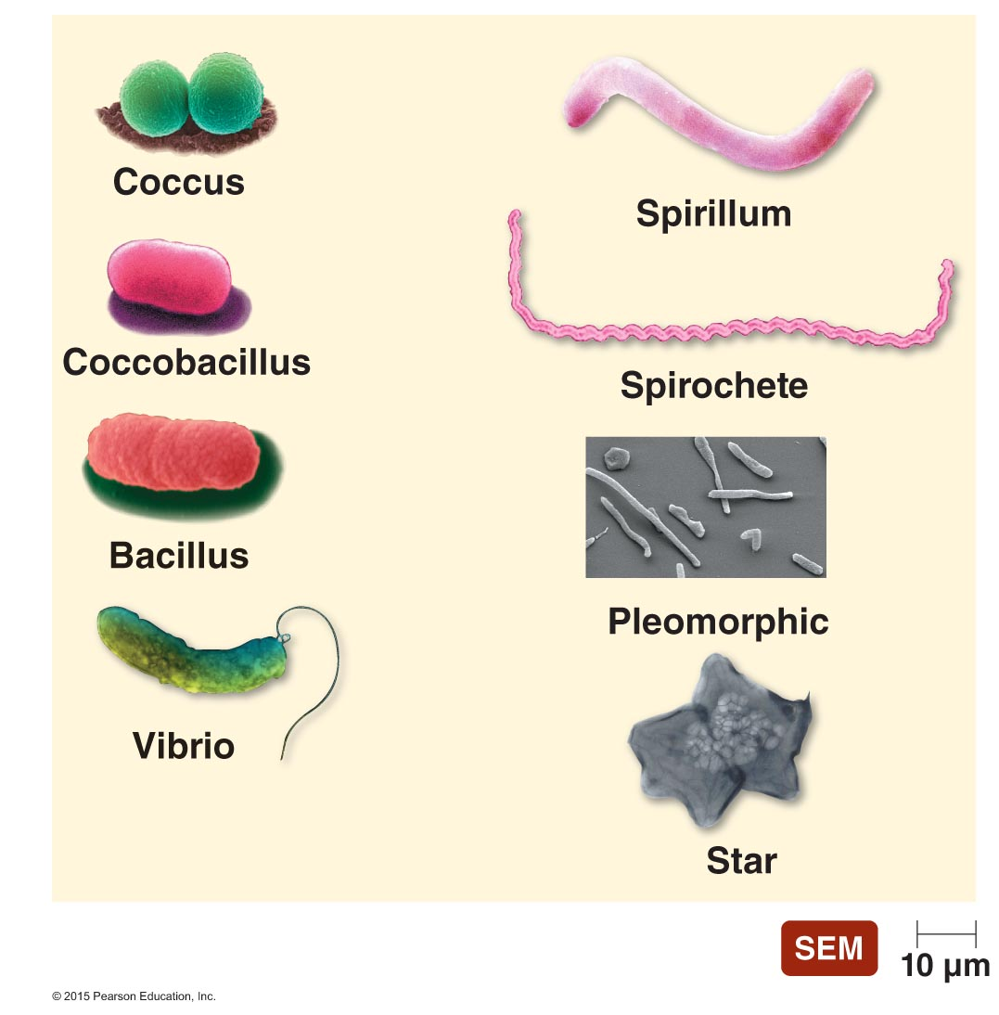
Figure 11.1 Typical prokaryotic morphologies.

Slide 4
General Characteristics of Prokaryotic Organisms
Endospores
Produced by Gram-positive bacteria Bacillus and Clostridium
Each vegetative cell transforms into one endospore
Each endospore germinates to form one vegetative cell
Defensive strategy against unfavorable conditions
Endospores are often difficult to kill
Concern to food processors, health care professionals, and government

Slide 5
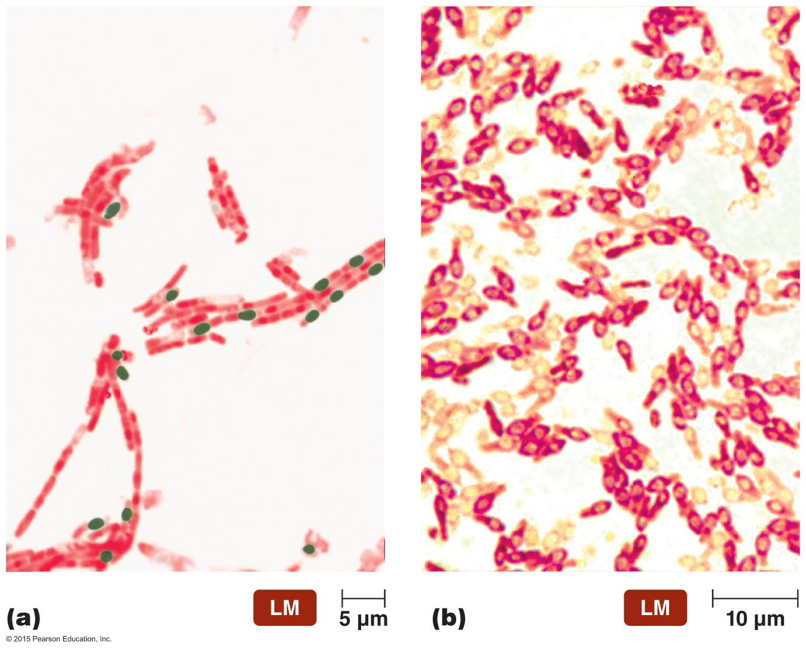
Figure 11.2 Locations of endospores.
Endospore
Endospore
Vegetative
cell

Slide 6
General Characteristics of Prokaryotic Organisms
Reproduction of Prokaryotic Cells
All reproduce asexually
Several different methods
Binary fission (most common)
Snapping division
Reproductive spores
Budding
Viviparity

Slide 7
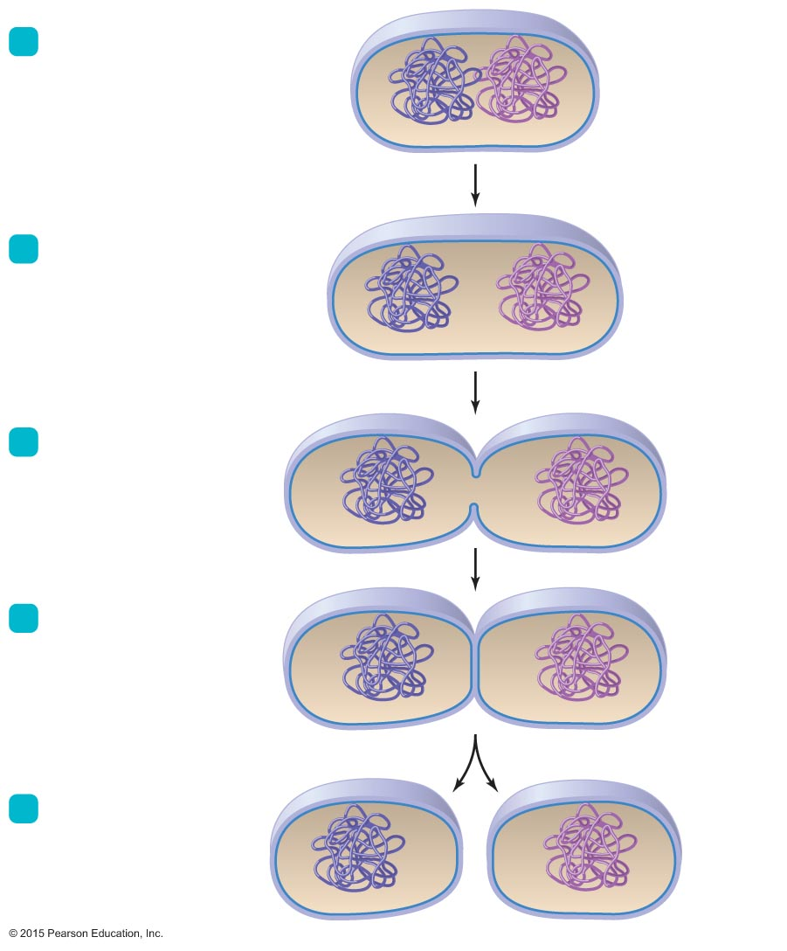
Figure 11.3 Binary fission.
1
Cell replicates its DNA.
Cell wall
Cytoplasmic
membrane
Nucleoid
Replicated
DNA
2
The cytoplasmic
membrane elongates,
separating DNA
molecules.
3
Cross wall forms;
membrane
invaginates.
4
Cross wall forms
completely.
5
Daughter cells
may separate.

Slide 8
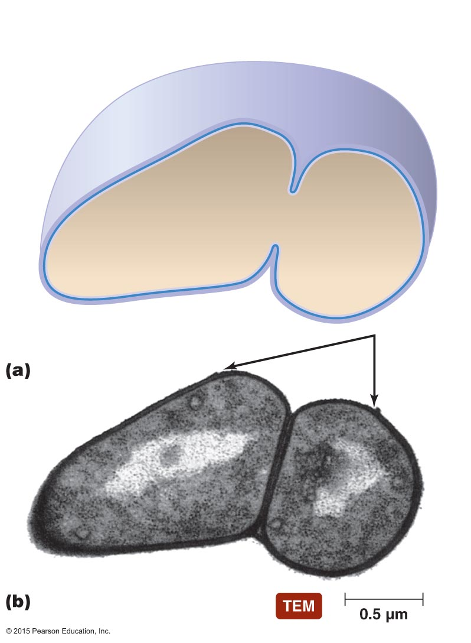
Figure 11.4 Snapping division, a variation of binary fission.
Newer, inner portion
of cell wall
Older, outer portion
of cell wall
Ruptured
remains
of old cell
wall
Hinge

Slide 9
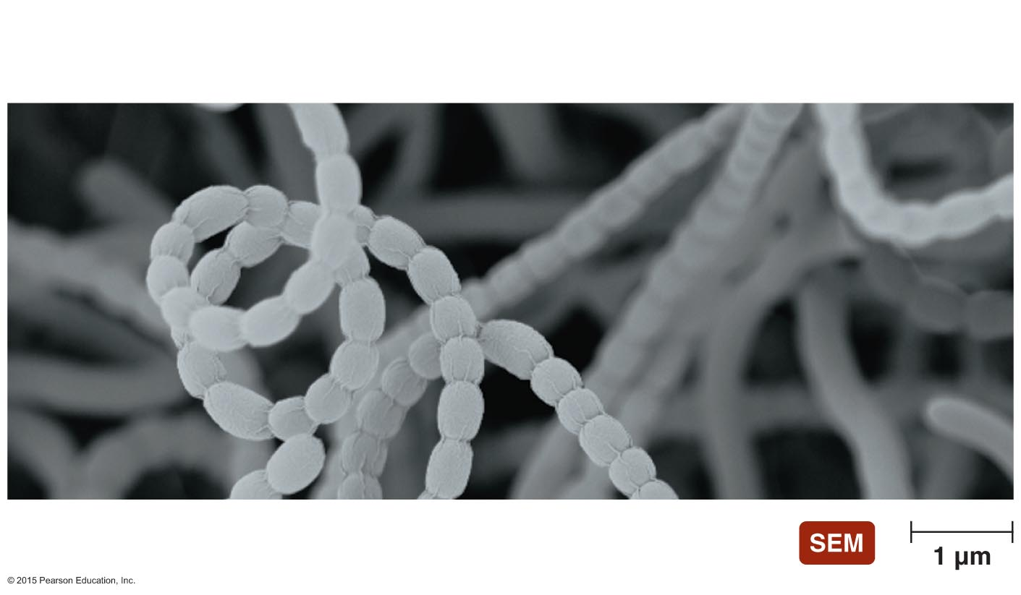
Figure 11.5 Spores of actinomycetes.
Filamentous
vegetative cells
Spores

Slide 10
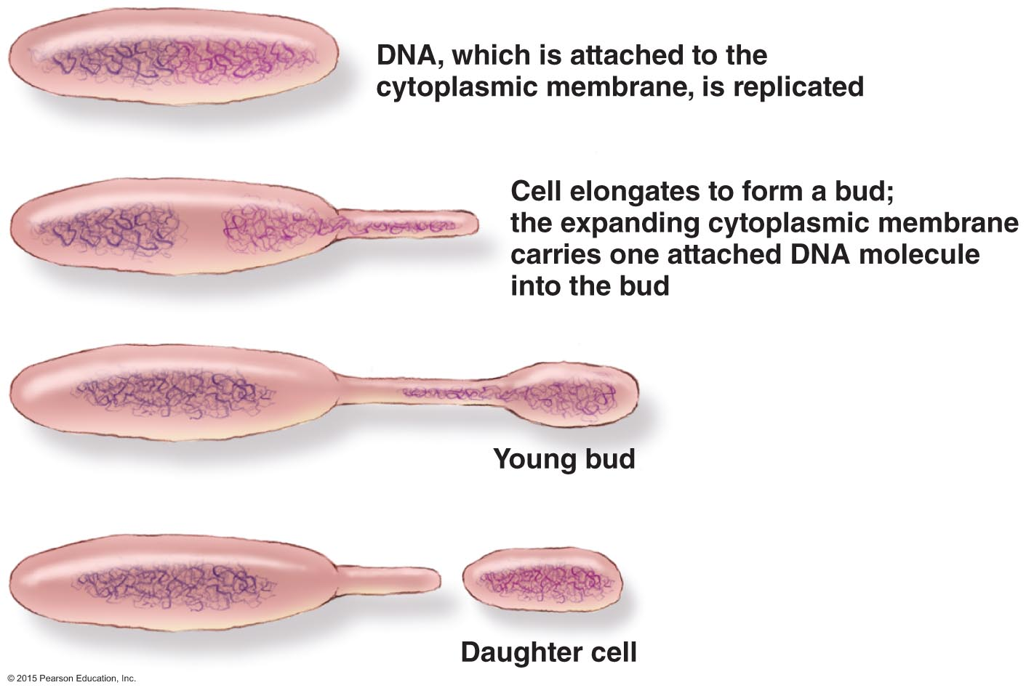
Figure 11.6 Budding.

Slide 11
General Characteristics of Prokaryotic Organisms
Reproduction of Prokaryotic Cells
Epulopiscium and its relatives have unique method of reproduction
Live offspring emerge from the body of the dead mother cell (viviparity)
First noted case of viviparous behavior in prokaryotic world

Slide 12
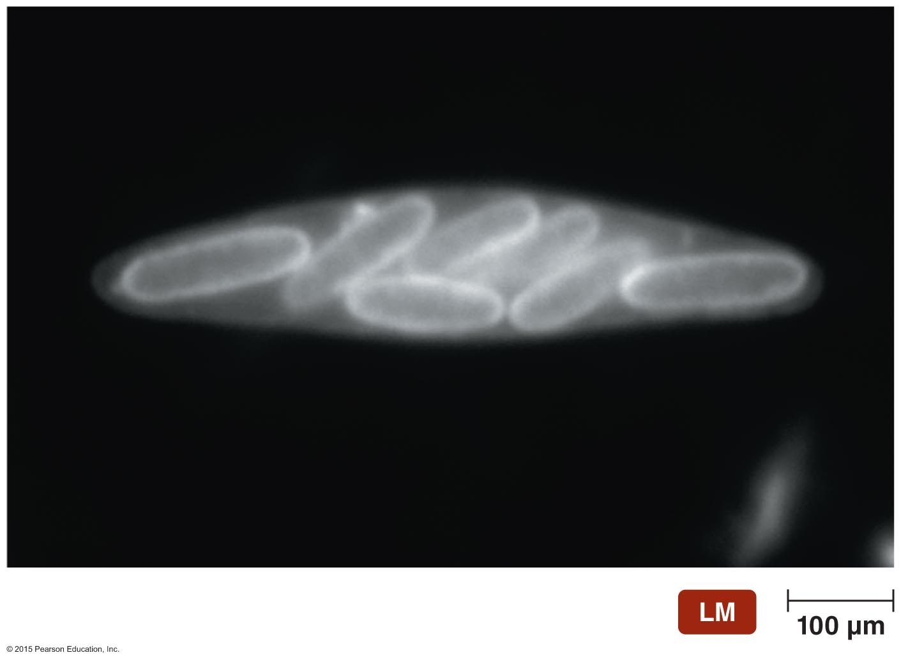
Figure 11.7 Viviparity in Epulopiscium.

Slide 13
General Characteristics of Prokaryotic Organisms
Arrangements of Prokaryotic Cells
Result from two aspects of division during binary fission
Planes in which cells divide
Separation of daughter cells

Slide 14
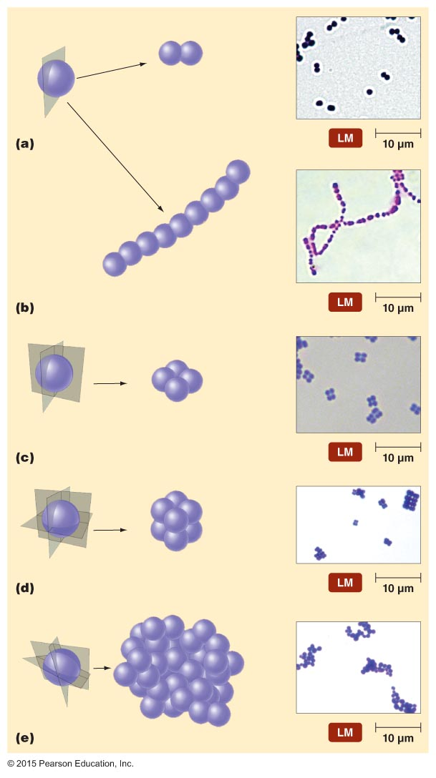
Figure 11.8 Arrangements of cocci.
Plane of division
Diplococci
Streptococci
Tetrads
Sarcinae
Staphylococci

Slide 15
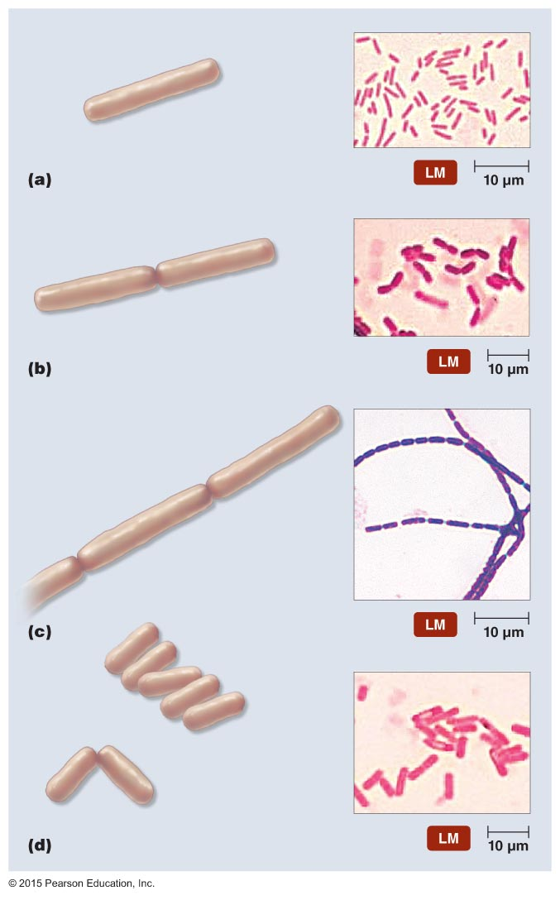
Figure 11.9 Arrangements of bacilli.
Single bacillus
Diplobacilli
Streptobacilli
Palisade
V-shape

Slide 16
Modern Prokaryotic Classification
Currently based on genetic relatedness of rRNA sequences
Three domains
Archaea
Bacteria
Eukarya
Bergey's Manual of Systematic Bacteriology provides prokaryotic classification scheme

Slide 17
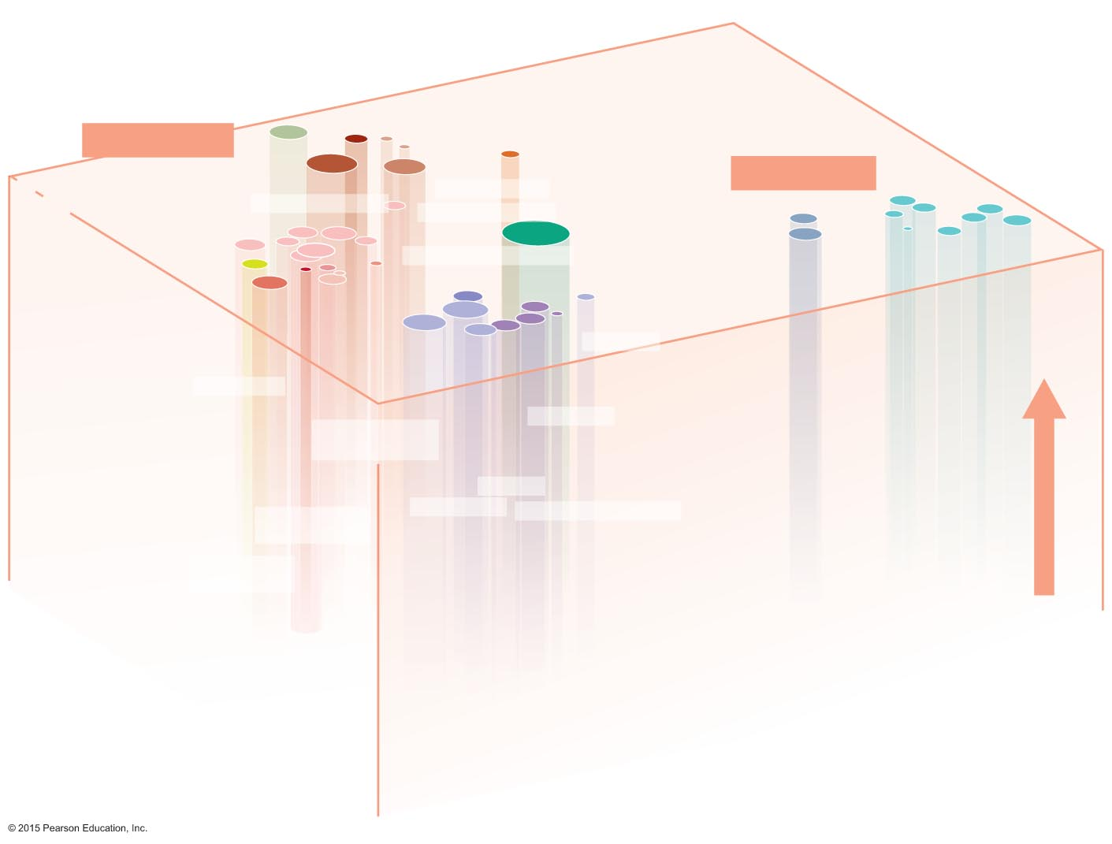
Figure 11.10 Prokaryotic taxonomy.
Thermophilic
bacteria
PHYLUM DEINOCOCCUS-THERMUS
PHYLUM CHLOROFLEXI
(green nonsulfur)
Deeply branching bacteria
PHYLUM EURYARCHAEOTA
PHYLUM AQUIFICAE
Methanogens
BACTERIA
Nitrifying (β)
PHYLUM CYANOBACTERIA
ARCHAEA
Halophiles
GRAM-NEGATIVE BACTERIA
Purple nonsulfur (α)
Myxobacteria (δ)
PHYLUM PROTEOBACTERIA
Campylobacteria (ε)
PHYLUM
CRENARCHAEOTA
Nitrogen fixing (α)
Rickettsias (α)
Gammaproteobacteria (γ)
PHYLUM FUSOBACTERIA
PHYLUM
CHLOROBI
(green sulfur)
Selenomonas
Streptomyces
Thermophilic
archaea
PHYLUM
BACTEROIDETES
Atopobium
TIME
PHYLUM
PLANCTOMYCETES
Neisserias (β)
Corynebacterium
Mycobacterium
Nocardia
PHYLUM
FIBROBACTERES
Arthrobacter
Low G+C Gram-positive
PHYLUM FIRMICUTES
Clostridia
PHYLUM
SPIROCHAETES
Mycoplasmas
Bacilli, lactobacili, cocci
PHYLUM
CHLAMYDIAE
PHYLUM ACTINOBACTERIA
GRAM-POSITIVE BACTERIA
High G+C Gram-positive

Slide 18
Survey of Archaea
Common features
Lack true peptidoglycan
Cell membrane lipids have branched hydrocarbon chains
AUG codon codes for methionine
Two phyla: Crenarchaeota, Euryarchaeota
Reproduce by binary fission, budding, or fragmentation
Are cocci, bacilli, spirals, or pleomorphic
Not known to cause disease

Slide 19
Survey of Archaea
Extremophiles
Require extreme conditions to survive
Temperature, pH, and/or salinity
Prominent members are thermophiles and halophiles
Thermophiles
DNA, RNA, cytoplasmic membranes, and proteins do not function properly below 45ºC
Hyperthermophiles—require temperatures over 80ºC
Halophiles—Inhabit extremely saline habitats
Depend on greater than 9% NaCl to maintain integrity of cell walls
Many contain red or orange pigments
May protect from sunlight

Slide 20
Survey of Archaea
Methanogens
Largest group of archaea
Convert carbon dioxide, hydrogen gas, and organic acids to methane gas
Convert organic wastes in pond, lake, and ocean sediments to methane
Some live in colons of animals
One of primary sources of environmental methane
Produced ~10 trillion tons of methane buried on ocean floor
Digest sludge during sewage treatment

Slide 21
Survey of Bacteria
Deeply Branching and Phototrophic Bacteria
Deeply branching bacteria
Scientists believe these organisms are similar to earliest bacteria
Autotrophic
Live in habitats similar to those thought to exist on early Earth

Slide 22
Survey of Bacteria
Deeply Branching and Phototrophic Bacteria
Phototrophic bacteria
Phototrophs that contain photosynthetic lamellae
Autotrophic
Divided into five groups based on pigments and source of electrons for photosynthesis
Blue-green bacteria (cyanobacteria)
Green sulfur bacteria
Green nonsulfur bacteria
Purple sulfur bacteria
Purple nonsulfur bacteria

Slide 23
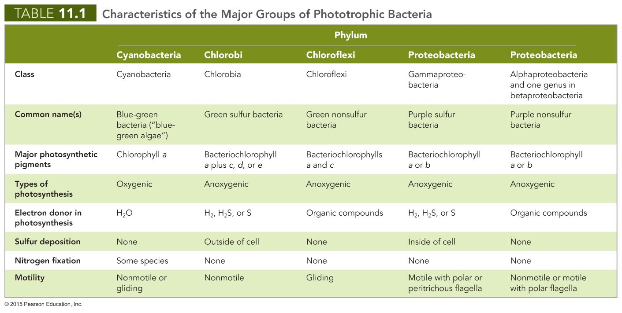

Slide 24
Survey of Bacteria
Low G + C Gram-Positive Bacteria
Gram + bacteria sub-classification
G + C content below 50%
Refers to % of base pairs in the genome that are guanine-cytosine pairings
Have similar 16S rRNA sequences
Classified in phylum Firmicutes
Rod-shaped, obligate anaerobes
Ex. Clostridia, Mycoplasma, Listeria, Lactobacillus, Streptococcus, Staphylococcus, Bacillus, Enterococcus

Slide 25
Survey of Bacteria
High G + C Gram-Positive Bacteria
Gram + bacteria sub-classification
Frequency of G + C pairs in the genome is greater than 50%
Key examples: Corynebacterium (Diptheria), Mycobacterium (TB and leprosy) and Actinocycetes: Actinomyces, Nocardia and Streptomyces

Slide 26
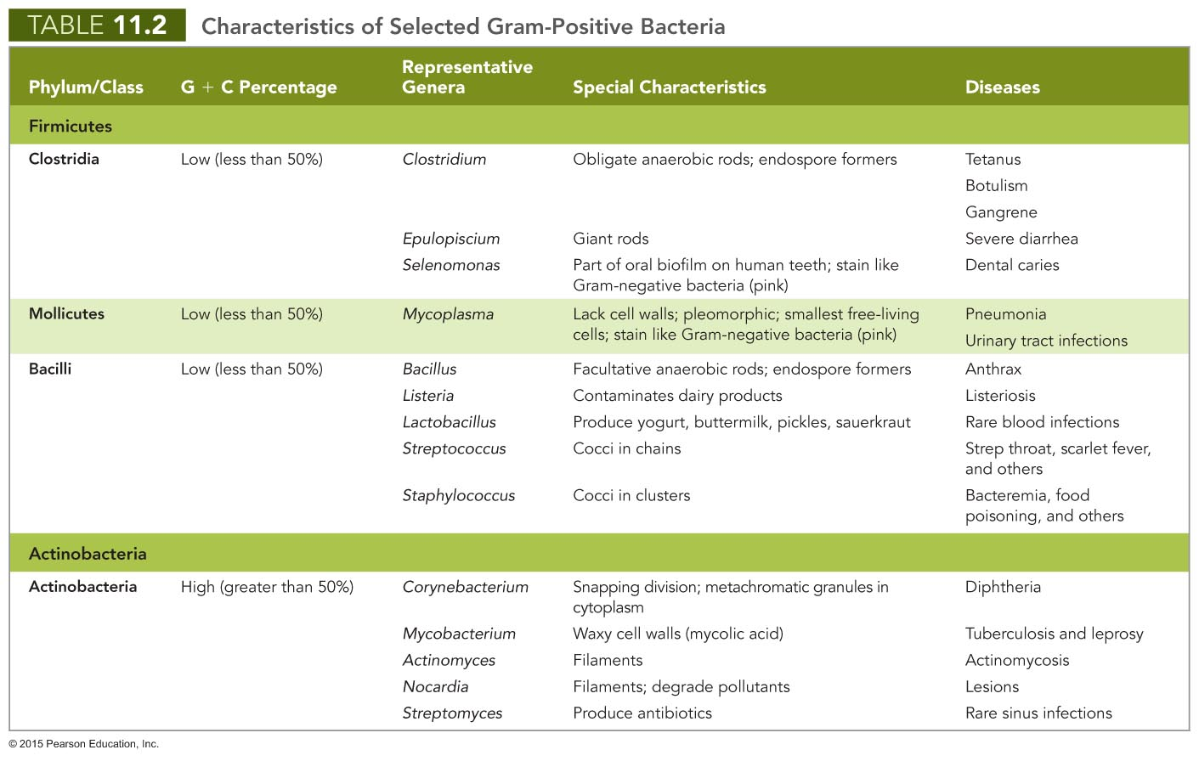

Slide 27
Survey of Bacteria
Gram-Negative Proteobacteria
Largest and most diverse group of bacteria
Different shapes, reproductive strategies, & nutritional types
Share: common 16S rRNA nucleotide sequences
Five classes of proteobacteria, distinguished by minor differences in rRNA sequences
Alphaproteobacteria
Betaproteobacteria
Gammaproteobacteria
Deltaproteobacteria
Epsilonproteobacteria

Slide 28
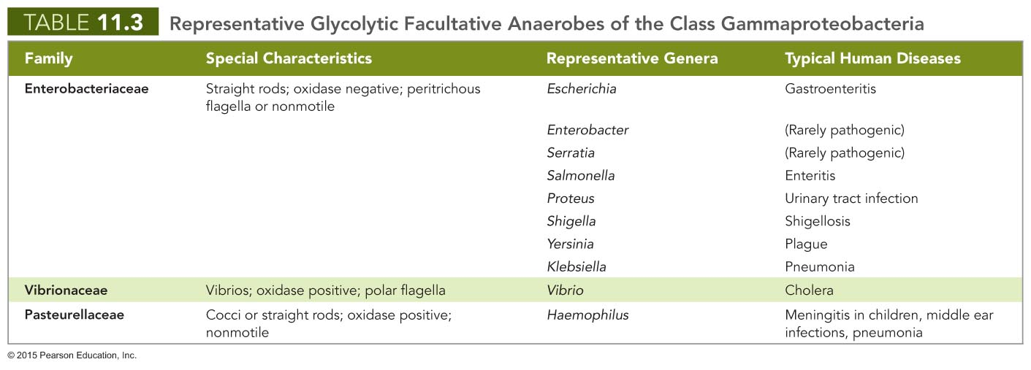

Slide 29
