Slide 1
Controlling microbial growth in the body
Chapter 10
CCV
Microbiology

Slide 2
The History of Antimicrobial Agents
Drugs
Chemicals that affect physiology in any manner
Chemotherapeutic agents
Drugs that act against diseases
Antimicrobial agents
Drugs that treat infections

Slide 3
The History of Antimicrobial Agents
Paul Ehrlich
"Magic bullets"
Arsenic compounds that killed microbes
Alexander Fleming
Penicillin released from Penicillium
Gerhard Domagk
Discovered sulfanilamide
Selman Waksman
Antibiotics
Antimicrobial agents produced naturally by organisms

Slide 4
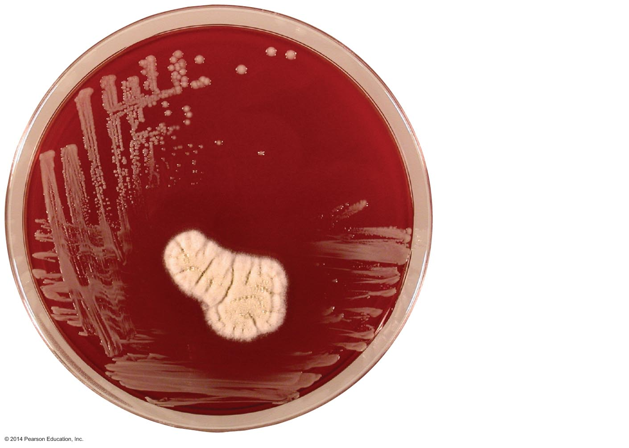
Figure 10.1 Antibiotic effect of the mold Penicillium chrysogenum.
Staphylococcus
aureus
(bacterium)
Penicillium
chrysogenum
(fungus)
Zone where
bacterial growth
is inhibited

Slide 5
The History of Antimicrobial Agents
Semisynthetics
Chemically altered antibiotics that are more effective, longer lasting, or easier to administer than naturally occurring ones
Synthetics
Antimicrobials that are completely synthesized in a lab

Slide 6
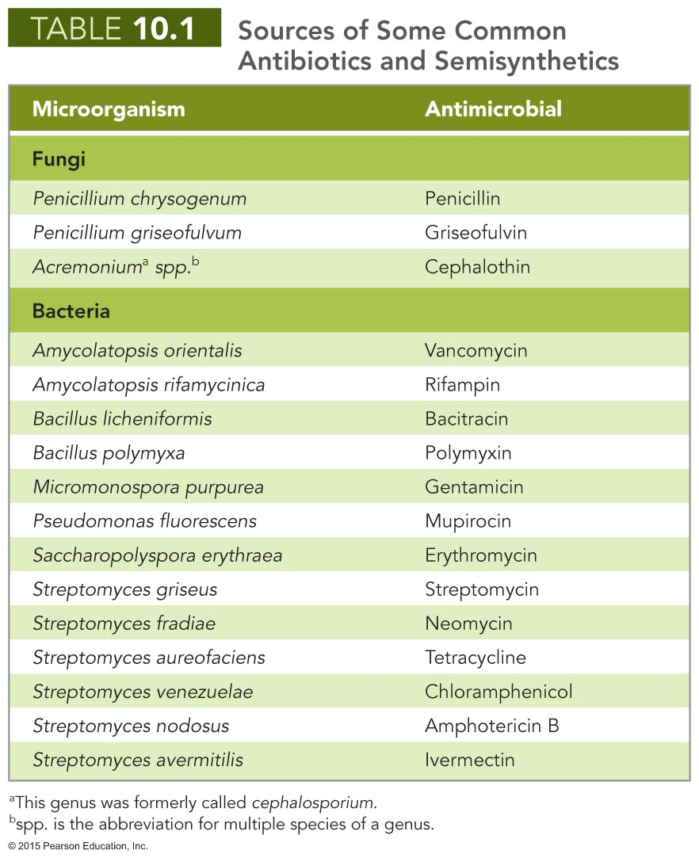

Slide 7
Mechanisms of Antimicrobial Action
Successful chemotherapy requires selective toxicity
Antibacterial drugs constitute largest number and diversity of antimicrobial agents
Fewer drugs to treat eukaryotic infections
Antiviral drugs limited

Slide 8
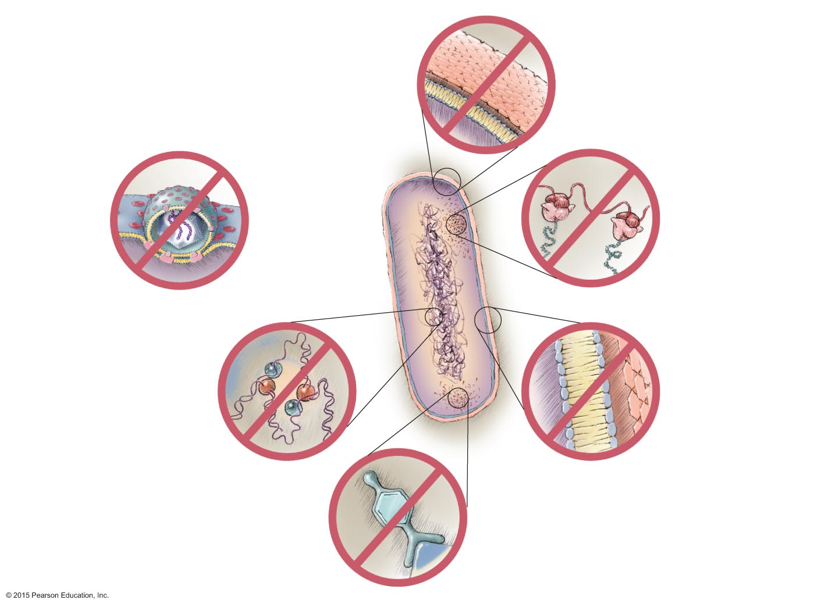
Figure 10.2 Mechanisms of action of microbial drugs.
Inhibition of cell
wall synthesis
Penicillins
Carbapenems
Cephalosporins
Vancomycin
Bacitracin
Isoniazid
Ethambutol
Echinocandins
(antifungal)
Inhibition of pathogen’s
attachment or entry
into host cell
Arildone
Pleconaril
Enfuvirtide
Inhibition of
protein synthesis
Aminoglycosides
Tetracyclines
Chloramphenicol
Macrolides
Antisense nucleic acids
Human
cell membrane
Inhibition of DNA
or RNA synthesis
Actinomycin
Nucleotide
analogs
Quinolones
Rifampin
Disruption of
cytoplasmic membrane
Polymyxins
Polyenes (antifungal)
Inhibition of general
metabolic pathway
Sulfonamides
Trimethoprim
Dapsone

Slide 9
Mechanisms of Antimicrobial Action
Inhibition of Cell Wall Synthesis
Inhibition of synthesis of bacterial walls
Most common agents prevent cross-linkage of NAM subunits
Beta-lactams are most prominent in this group
Functional groups are beta-lactam rings
Beta-lactams bind to enzymes that cross-link NAM subunits
Bacteria have weakened cell walls and eventually lyse

Slide 10
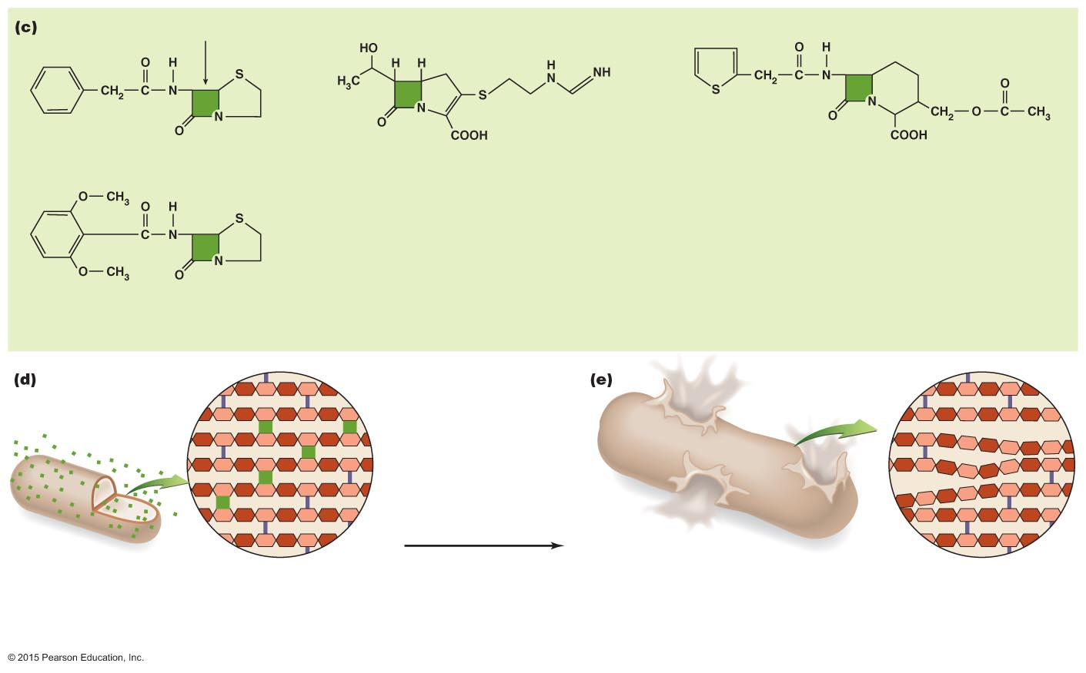
Figure 10.3c-e Bacterial cell wall synthesis and the inhibitory effects of beta-lactams on it.
β-lactam ring
Penicillin G (natural)
Imipenem (semisynthetic)
Cephalothin (natural)
Carbapenems
Cephalosporins
Methicillin (semisynthetic)
Penicillins
New cross-links
inhibited by
beta-lactam
Previously
formed
cross-link
Growth
Beta-lactam interferes with the linking enzymes, and NAM
subunits remain unattached to their neighbors. However,
the cell continues to grow as it adds more NAG and NAM
subunits.
The cell bursts from osmotic pressure
because the integrity of peptidoglycan is not
maintained.

Slide 11
Mechanisms of Antimicrobial Action
Inhibition of Cell Wall Synthesis
Inhibition of synthesis of bacterial walls
Semisynthetic derivatives of beta-lactams
More stable in acidic environments
More readily absorbed
Less susceptible to deactivation
More active against more types of bacteria

Slide 12
Mechanisms of Antimicrobial Action
Inhibition of Cell Wall Synthesis
Inhibition of synthesis of bacterial walls
Vancomycin and cycloserine
Interfere with particular bridges that link NAM subunits in many Gram-positive bacteria
Bacitracin
Blocks transport of NAG and NAM from cytoplasm
Isoniazid and ethambutol
Disrupt mycolic acid formation in mycobacterial species

Slide 13
Mechanisms of Antimicrobial Action
Inhibition of Cell Wall Synthesis
Inhibition of synthesis of bacterial walls
Prevent bacteria from increasing amount of peptidoglycan
Have no effect on existing peptidoglycan layer
Effective only for growing cells

Slide 14
Mechanisms of Antimicrobial Action
Inhibition of Cell Wall Synthesis
Inhibition of synthesis of fungal walls
Fungal cells are composed of various polysaccharides not found in mammalian cells
Echinocandins inhibit the enzyme that synthesizes glucan

Slide 15
Mechanisms of Antimicrobial Action
Inhibition of Protein Synthesis
Prokaryotic ribosomes are 70S (30S and 50S)
Eukaryotic ribosomes are 80S (40S and 60S)
Drugs can selectively target translation
Mitochondria of animals and humans contain 70S ribosomes
Can be harmful

Slide 16
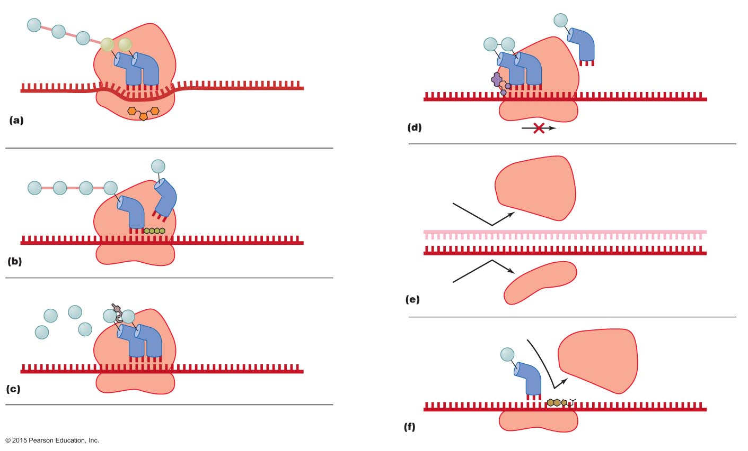
Figure 10.4 The mechanisms by which antimicrobials target prokaryotic ribosomes to inhibit protein synthesis.
Incorrect
amino acids
Lincosamides or
macrolides bind
to 50S subunit,
blocking proper
mRNA movement
through ribosome.
Synthesis stops.
Ribosome
mRNA
50S
30S
Some aminoglycosides, for
example streptomycin, cause
change in 30S shape, so
mRNA is misread.
mRNA
50S
Tetracycline and some
aminoglycosides block
docking site of tRNA.
Antisense
nucleic acid
50S
mRNA
mRNA
30S
Amino acids
Chloramphenicol blocks
peptide bond formation.
50S
fMet
mRNA
50S
mRNA
30S
Oxazolidinone

Slide 17
Mechanisms of Antimicrobial Action
Disruption of Cytoplasmic Membranes
Some drugs form channel through cytoplasmic membrane and damage its integrity
Amphotericin B attaches to ergosterol in fungal membranes
Humans somewhat susceptible because cholesterol is similar to ergosterol
Bacteria lack sterols; not susceptible

Slide 18
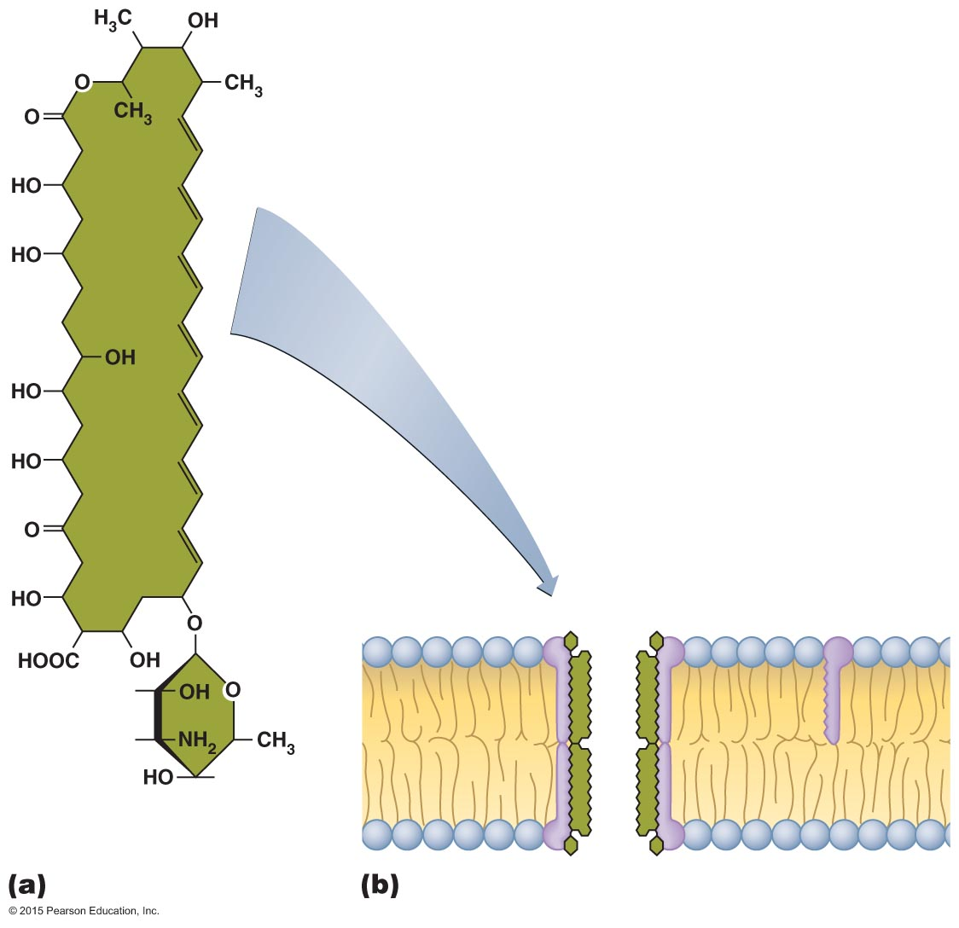
Figure 10.5 Disruption of the cytoplasmic membrane by the antifungal amphotericin B.
Amphotericin B
Phospholipid
Ergosterol
Pore
Amphotericin B

Slide 19
Mechanisms of Antimicrobial Action
Disruption of Cytoplasmic Membranes
Azoles and allylamines inhibit ergosterol synthesis
Polymyxin disrupts cytoplasmic membranes of Gram-negative bacteria
Toxic to human kidneys
Pyrazinamide only disrupts transport across the cytoplasmic membrane of Mycobacterium tuberculosis
Some antiparasitic drugs act against cytoplasmic membranes

Slide 20
Mechanisms of Antimicrobial Action
Inhibition of Metabolic Pathways
Antimetabolic agents can be effective when pathogen and host metabolic processes differ
Atovaquone interferes with electron transport in protozoa and fungi
Heavy metals inactivate enzymes
Agents that disrupt tubulin polymerization and glucose uptake by many protozoa and parasitic worms
Drugs block activation of viruses
Metabolic antagonists

Slide 21
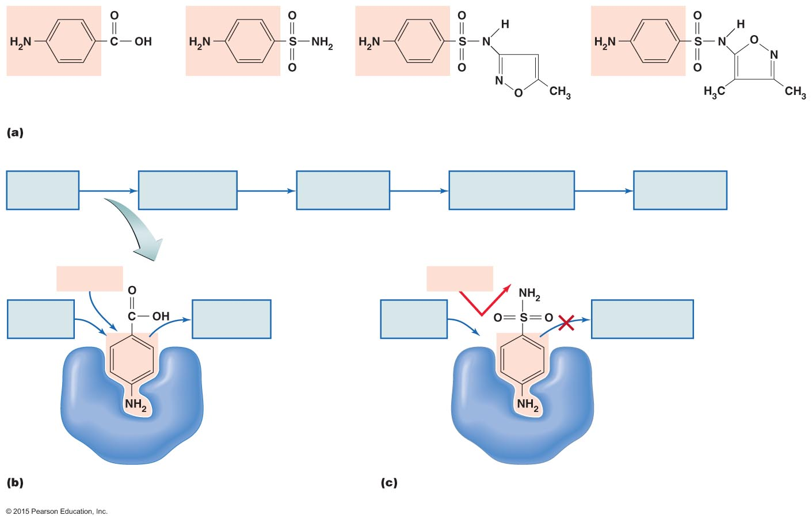
Figure 10.6 The antimetabolic action of sulfonamides in inhibiting nucleic acid synthesis.
PABA
Sulfanilamide
Sulfamethoxazole
Sulfisoxazole
Para-aminobenzoic acid (PABA) and its structural analogs, the sulfonamides
PABA
Enzyme
Dihydrofolic
acid
Enzyme
Tetrahydrofolic
acid (THF)
Enzymes
Purine and
pyrimidine
nucleotides
Enzymes
DNA and RNA
PABA
PABA
Other
substrates
Dihydrofolic
acid
Other
substrates
Dihydrofolic acid
not produced
Active site
Enzyme
Enzyme
Role of PABA in folic acid synthesis in bacteria
and protozoa
Inhibition of folic acid synthesis by sulfonamide

Slide 22
Mechanisms of Antimicrobial Action
Inhibition of Metabolic Pathways
Antiviral agents can target unique aspects of viral metabolism
Amantadine, rimantadine, and weak organic bases prevent viral uncoating
Protease inhibitors interfere with an enzyme that HIV needs in its replication cycle

Slide 23
Mechanisms of Antimicrobial Action
Inhibition of Nucleic Acid Synthesis
Several drugs block DNA replication or RNA transcription
Drugs often affect both eukaryotic and prokaryotic cells
Not normally used to treat infections
Used primarily in research and perhaps to slow cancer cell replication

Slide 24
Mechanisms of Antimicrobial Action
Inhibition of Nucleic Acid Synthesis
Nucleotide or nucleoside analogs
Interfere with function of nucleic acids
Distort shapes of nucleic acid molecules and prevent further replication, transcription, or translation
Most often used against viruses
Effective against rapidly dividing cancer cells

Slide 25
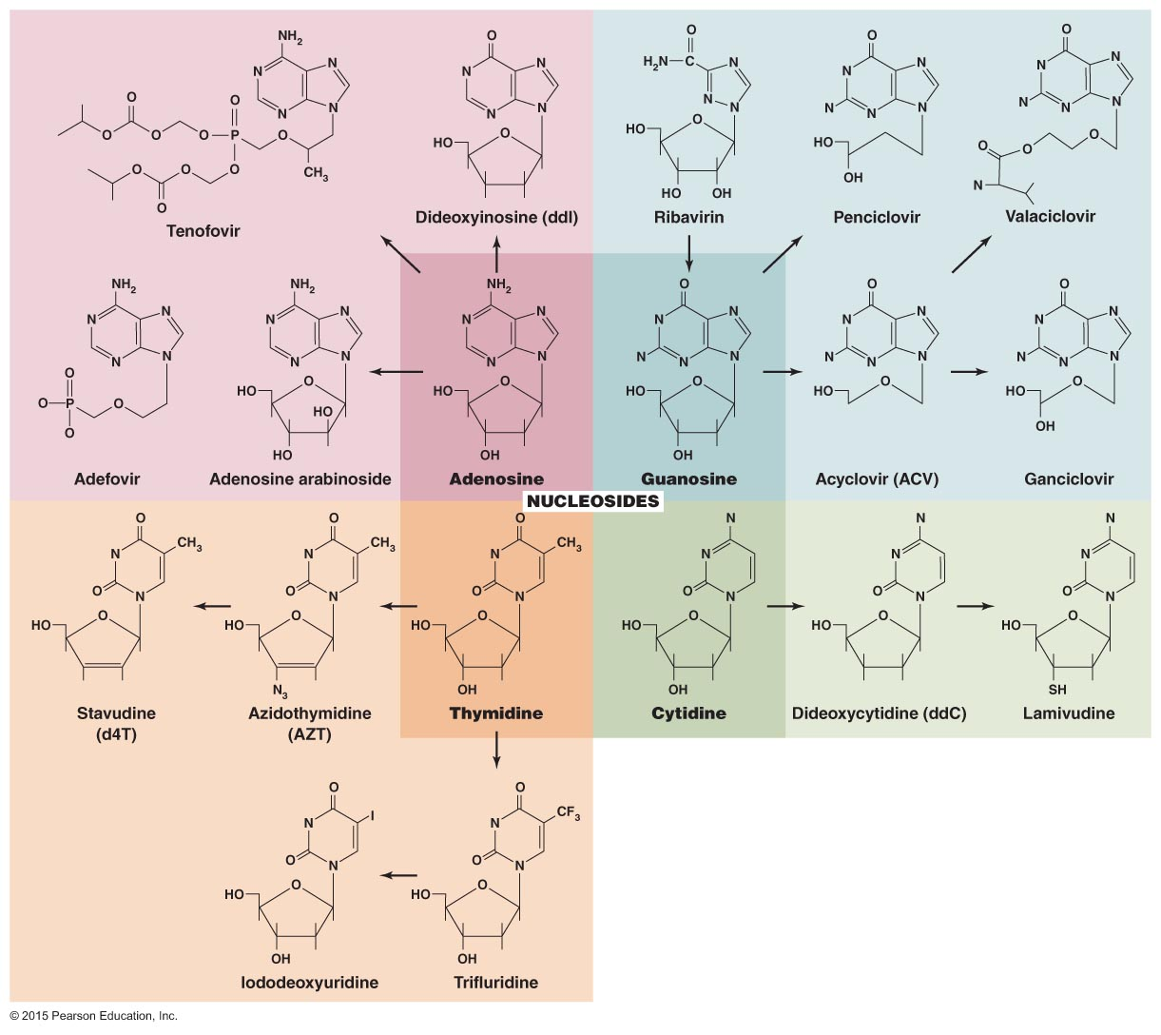
Figure 10.7 Nucleosides and some of their antimicrobial analogs.

Slide 26
Mechanisms of Antimicrobial Action
Inhibition of Nucleic Acid Synthesis
Quinolones and fluoroquinolones
Act against prokaryotic DNA gyrase
Inhibitors of RNA polymerase
Reverse transcriptase inhibitors
Act against an enzyme HIV uses in its replication cycle
Do not harm people because humans lack reverse transcriptase

Slide 27
Mechanisms of Antimicrobial Action
Prevention of Virus Attachment and Entry
Attachment antagonists block viral attachment or receptor proteins
New area of antimicrobial drug development

Slide 28
Clinical Considerations in Prescribing Antimicrobial Drugs
Ideal Antimicrobial Agent
Readily available
Inexpensive
Chemically stable
Easily administered
Nontoxic and nonallergenic
Selectively toxic against wide range of pathogens

Slide 29
Clinical Considerations in Prescribing Antimicrobial Drugs
Spectrum of Action
Number of different pathogens a drug acts against
Narrow-spectrum: effective against few organisms
Broad-spectrum: effective against many organisms
May allow for secondary or superinfections to develop
Killing of normal flora reduces microbial antagonism

Slide 30
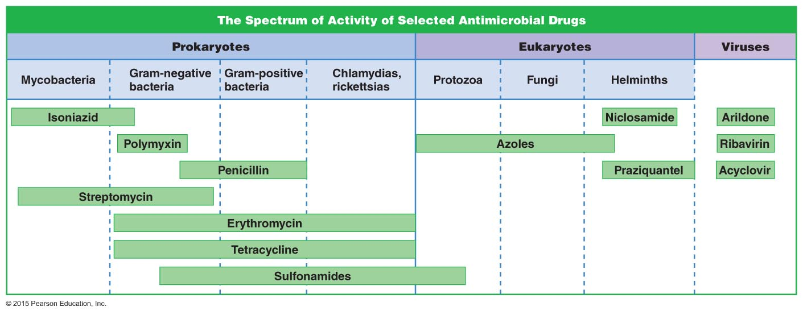
Figure 10.8 Spectrum of action for selected antimicrobial agents.

Slide 31
Clinical Considerations in Prescribing Antimicrobial Drugs
Effectiveness
Efficacy of antimicrobials assessed by a variety of tests
Diffusion susceptibility test
Minimum inhibitory concentration test
Minimum bactericidal concentration test

Slide 32
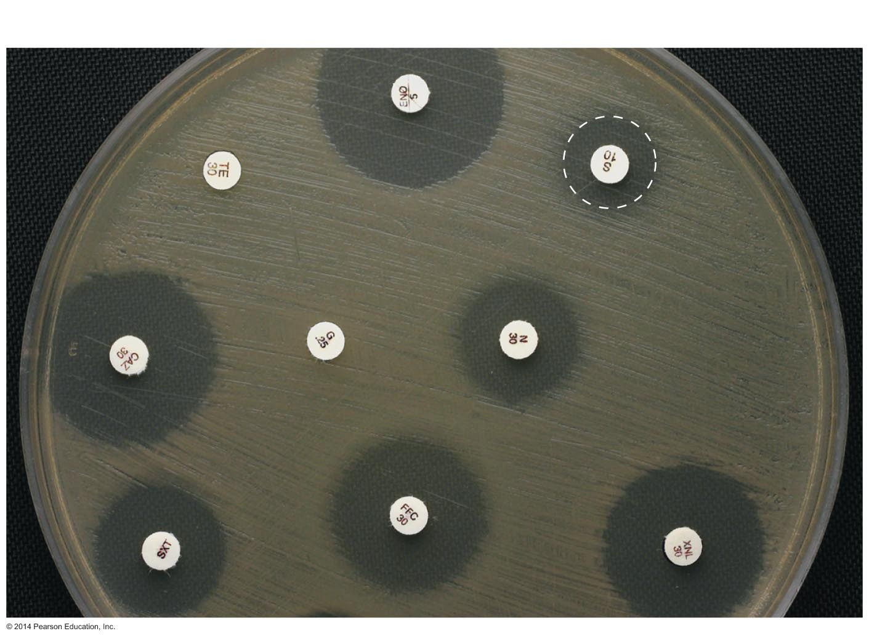
Figure 10.9 Zones of inhibition in a diffusion susceptibility (Kirby-Bauer) test.
Bacterial lawn
Zone of inhibition

Slide 33
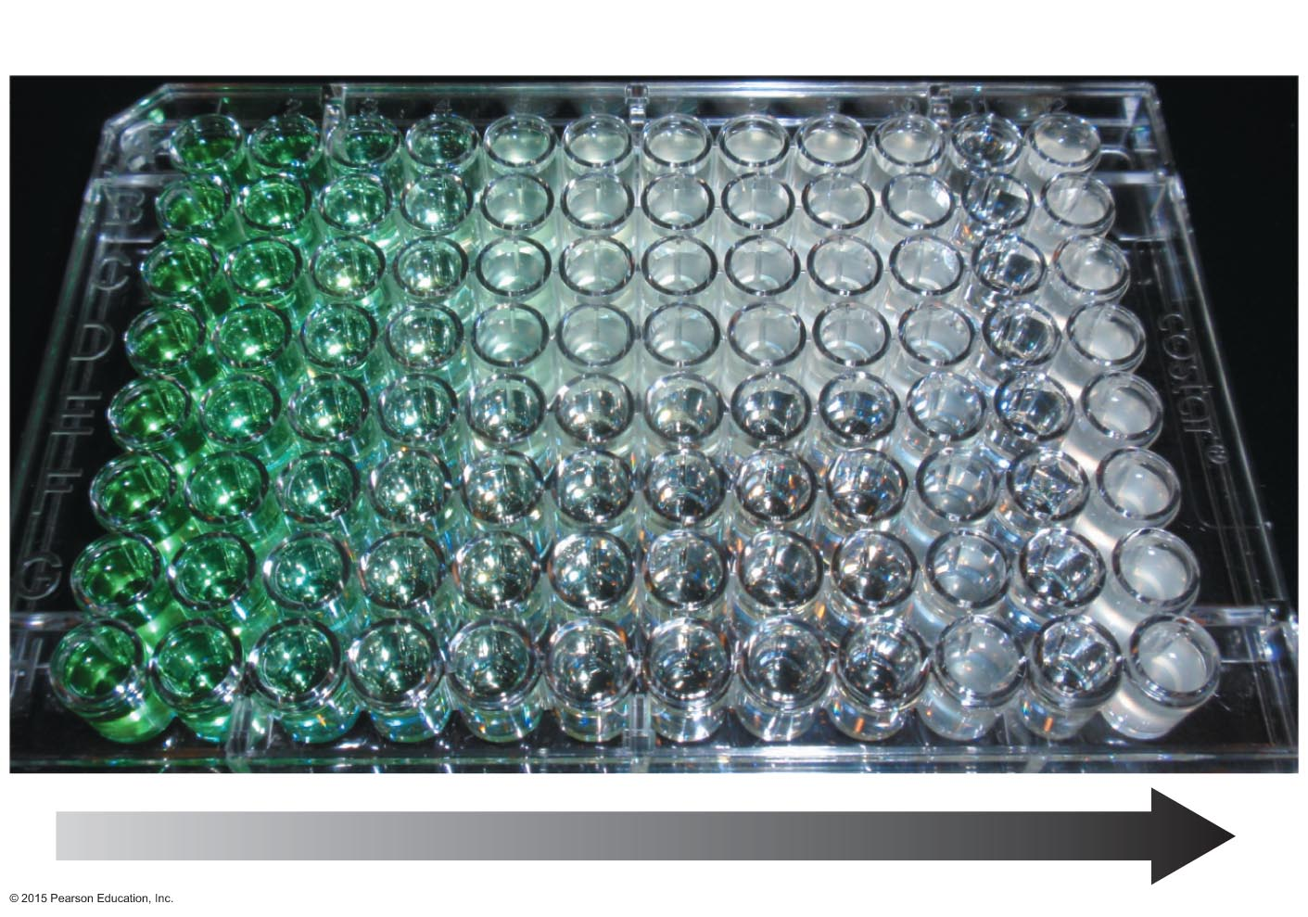
Figure 10.10 Minimum inhibitory concentration (MIC) test in test tubes.
Turbid wells
Clear wells
Increasing concentration of drug
Increasing concentration of drug

Slide 34
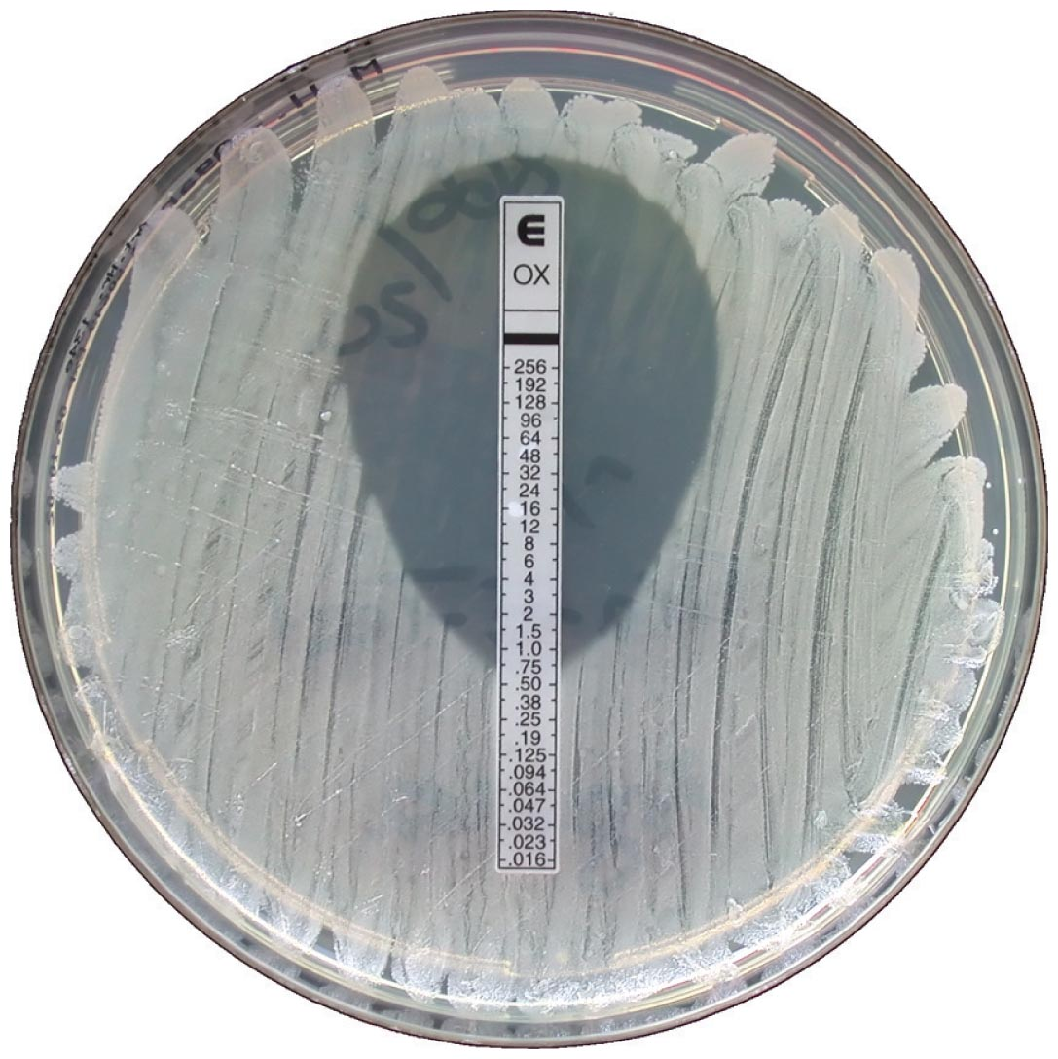
Figure 10.11 An Etest, which combines aspects of Kirby-Bauer and MIC tests.

Slide 35
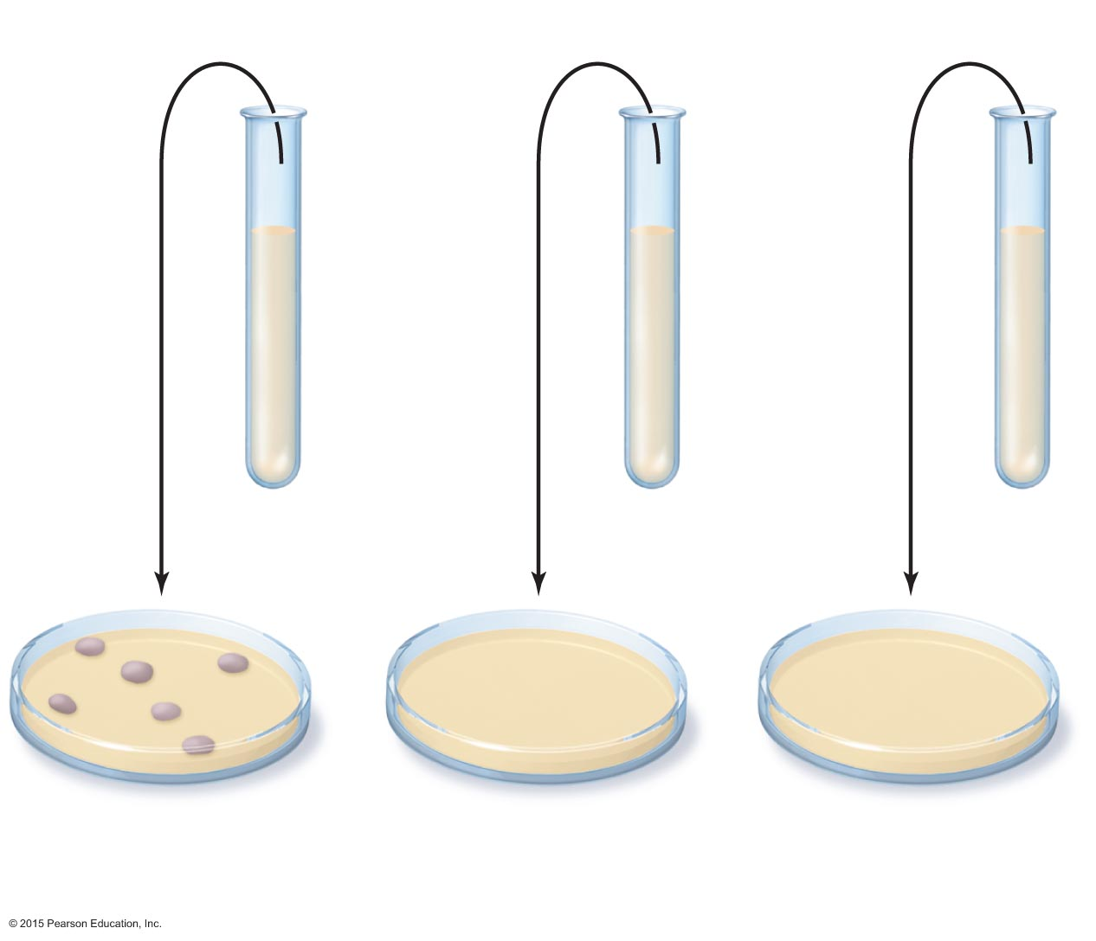
Figure 10.12 A minimum bactericidal concentration (MBC) test.
Concentration of antibacterial drug (µg/ml)
Clear
MIC tube
8 μg/ml
16 μg/ml
25 μg/ml
Bacterial colonies
No colonies
No colonies
Drug-free media

Slide 36
Clinical Considerations in Prescribing Antimicrobial Drugs
Routes of Administration
Topical application of drug for external infections
Oral route requires no needles and is self-administered
Intramuscular administration delivers drug via needle into muscle
Intravenous administration delivers drug directly to bloodstream
Must know how antimicrobial agent will be distributed to infected tissues

Slide 37
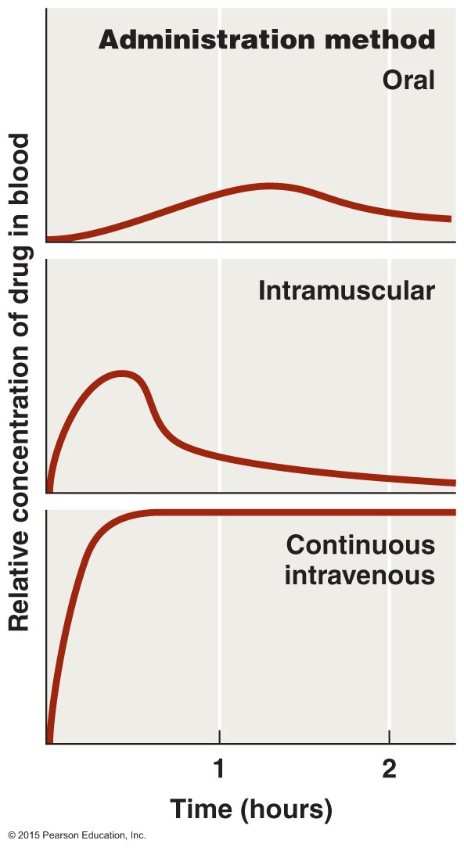
Figure 10.13 The effect of route of administration on blood levels of a chemotherapeutic agent.

Slide 38
Clinical Considerations in Prescribing Antimicrobial Drugs
Safety and Side Effects
Toxicity
Cause of many adverse reactions is poorly understood
Drugs may be toxic to kidneys, liver, or nerves
Consideration needed when prescribing drugs to pregnant women
Therapeutic index is the ratio of the dose of a drug that can be tolerated to the drug's effective dose
Use drug within its therapeutic range

Slide 39
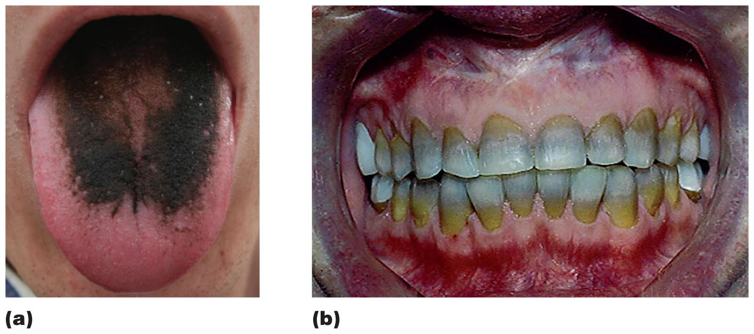
Figure 10.14 Some side effects resulting from toxicity of antimicrobial agents.

Slide 40
Clinical Considerations in Prescribing Antimicrobial Drugs
Safety and Side Effects
Allergies
Allergic reactions are rare but may be life threatening
Anaphylactic shock
Disruption of normal microbiota
May result in secondary infections
Overgrowth of normal flora, causing superinfections
Of greatest concern for hospitalized patients

Slide 41
Resistance to Antimicrobial Drugs
The Development of Resistance in Populations
Some pathogens are naturally resistant
Bacteria acquire resistance in two ways
New mutations of chromosomal genes
Acquisition of R plasmids via transformation, transduction, and conjugation.

Slide 42
Figure 10.15 The development of a resistant strain of bacteria.
Drug-sensitive cells
Drug-resistant
mutant
Exposure
to drug
Remaining
population
grows over
time
Population of microbial cells
Sensitive cells inhibited by exposure to drug
Most cells now resistant

Slide 43
Resistance to Antimicrobial Drugs
Mechanisms of Resistance
At least seven mechanisms of microbial resistance exist
Produce enzyme that destroys or deactivates drug
Slow or prevent entry of drug into the cell
Alter target of drug so it binds less effectively
Alter their own metabolic chemistry
Pump antimicrobial drug out of the cell before it can act
Bacteria in biofilms can resist antimicrobials
Mycobacterium tuberculosis produces MfpA protein
Binds DNA gyrase, preventing the binding of fluoroquinolone drugs

Slide 44
Figure 10.16 How β-lactamase (penicillinase) renders penicillin inactive.
Lactam ring
β-lactamase (penicillinase)
breaks this bond
Penicillin
Inactive penicillin

Slide 45
Resistance to Antimicrobial Drugs
Multiple Resistance and Cross Resistance
Pathogen can acquire resistance to more than one drug
Common when R plasmids exchanged
Develop in hospitals and nursing homes
Constant use of drugs eliminates sensitive cells
Multi-drug-resistant pathogens are resistant to at least three antimicrobial agents
Cross resistance to similar drugs may develop

Slide 46
Resistance to Antimicrobial Drugs
Retarding Resistance
Maintain high concentration of drug in patient for sufficient time
Inhibit the pathogen so immune system can eliminate
Use antimicrobial agents in combination
Synergism versus antagonism

Slide 47
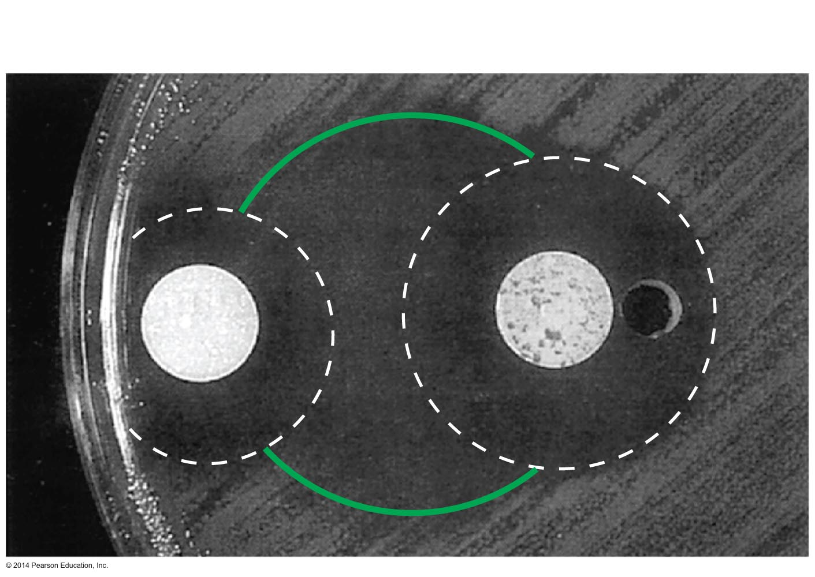
Figure 10.17 An example of synergism between two antimicrobial agents.
Disk with semisynthetic
amoxicillin-clavulanic acid
Disk with semisynthetic
aztreonam

Slide 48
Resistance to Antimicrobial Drugs
Retarding Resistance
Use antimicrobials only when necessary
Develop new variations of existing drugs
Second-generation drugs
Third-generation drugs
Search for new antibiotics, semisynthetics, and synthetics

