Slide 1
Principles of Micro Economics, Ninth Edition N. Gregory Mankiw
Notes:
N. Gregory Mankiw Principles Of Micro Economics Ninth Edition

Slide 2
Chapter 13
The Costs of Production

Slide 3
What are Costs?, Part 1
Industrial organization
The study of how firms’ decisions about prices and quantities depend on the market conditions they face
Assumption
The goal of a firm is to maximize profit
Profit
Total revenue minus total cost

Slide 4
What are Costs?, Part 2
Total revenue, TR = P × Q
Amount a firm receives for the sale of its output
Quantity of output the firm produces times the price at which it sells its output
Total cost, TC
Market value of the inputs a firm uses in production

Slide 5
What are Costs?, Part 3
Costs as opportunity costs
The cost of something is what you give up to get it
Firm’s cost of production
Include all the opportunity costs of making its output of goods and services
Explicit costs
Implicit costs

Slide 6
What are Costs?, Part 4
Explicit costs
Input costs that require an outlay of money by the firm
Implicit costs
Input costs that do not require an outlay of money by the firm
Ignored by accountants
Total costs
= Explicit costs + Implicit costs

Slide 7
What are Costs?, Part 5
The cost of financial capital as an opportunity cost
Implicit cost
Interest income not earned on financial capital
Owned as saving
Invested in business
Not shown as cost by an accountant

Slide 8
What are Costs?, Part 6
Economic profit
Total revenue minus total cost
Total costs includes both explicit and implicit costs
Accounting profit
Total revenue minus total explicit cost
Usually larger than economic profit

Slide 9
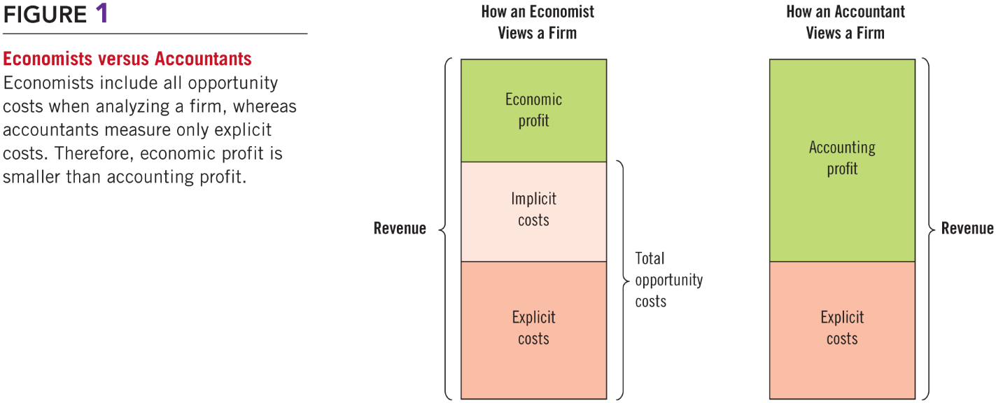
Figure 1 Economists versus Accountants

Slide 10
Production and Costs, Part 1
Production function
Relationship between
Quantity of inputs used to make a good
And the quantity of output of that good
Gets flatter as production rises
Marginal product
Increase in output that arises from an additional unit of input
Slope of the production function

Slide 11
Table 1 A Production Function and Total Cost: Caroline’s Cookie Factory
(1) Number of Workers | (2) Output (quantity of cookies produced per hour) | (3) Marginal Product of Labor | (4) Cost of Factory | (5) Cost of Workers | (6) Total Cost of Inputs (cost of factory plus cost of workers)
0 | 0 |  | $30 | $0 | $30
1 | 50 | 50 | 30 | 10 | 40
2 | 90 | 40 | 30 | 20 | 50
3 | 120 | 30 | 30 | 30 | 60
4 | 140 | 20 | 30 | 40 | 70
5 | 150 | 10 | 30 | 50 | 80
6 | 155 | 5 | 30 | 60 | 90

Slide 12
Production and Costs, Part 2
Diminishing marginal product
Marginal product of an input declines as the quantity of the input increases
Production function gets flatter as more inputs are being used
The slope of the production function decreases

Slide 13
Production and Costs, Part 3
Total-cost curve
Relationship between quantity produced and total costs
Gets steeper as the amount produced rises
Diminishing marginal product
Producing one additional unit of output requires a lot of additional units of inputs: very costly

Slide 14
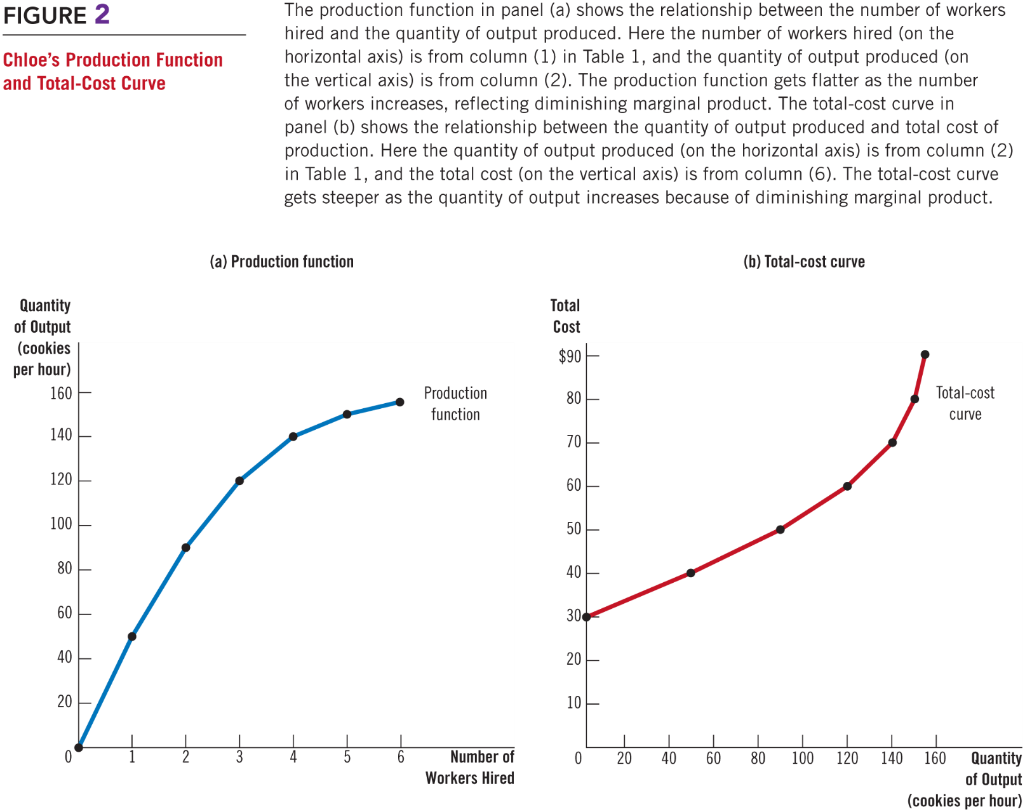
Figure 2 Chloe’s Production Function and Total-Cost Curve

Slide 15
The Various Measures of Cost, Part 1
Fixed costs, FC
Costs that do not vary with the quantity of output produced
Variable costs, VC
Costs that vary with the quantity of output produced
Total cost, TC
= Fixed cost + Variable cost

Slide 16
The Various Measures of Cost, Part 2
Average fixed cost, AFC
Fixed cost divided by the quantity of output
Average variable cost, AVC
Variable cost divided by the quantity of output

Slide 17
Table 2 The Various Measures of Cost: Caleb’s Coffee Shop
(1) Output (cups of coffee per hour) | (2) Total Cost | (3) Fixed Cost | (4) Variable Cost | (5) Average Fixed Cost | (6) Average Variable Cost | (7) Average Total Cost | (8) Marginal Cost
0 | $3.00 | $3.00 | $0.00
1 | 3.30 | 3.00 | 0.30 | $3.00 | $0.30 | $3.30 | $0.30
2 | 3.80 | 3.00 | 0.80 | 1.50 | 0.40 | 1.90 | 0.50
3 | 4.50 | 3.00 | 1.50 | 1.00 | 0.50 | 1.50 | 0.70
4 | 5.40 | 3.00 | 2.40 | 0.75 | 0.60 | 1.35 | 0.90
5 | 6.50 | 3.00 | 3.50 | 0.60 | 0.70 | 1.30 | 1.10
6 | 7.80 | 3.00 | 4.80 | 0.50 | 0.80 | 1.30 | 1.30
7 | 9.30 | 3.00 | 6.30 | 0.43 | 0.90 | 1.33 | 1.50
8 | 11.00 | 3.00 | 8.00 | 0.38 | 1.00 | 1.38 | 1.70
9 | 12.90 | 3.00 | 9.90 | 0.33 | 1.10 | 1.43 | 1.90
10 | 15.00 | 3.00 | 12.00 | 0.30 | 1.20 | 1.50 | 2.10

Slide 18
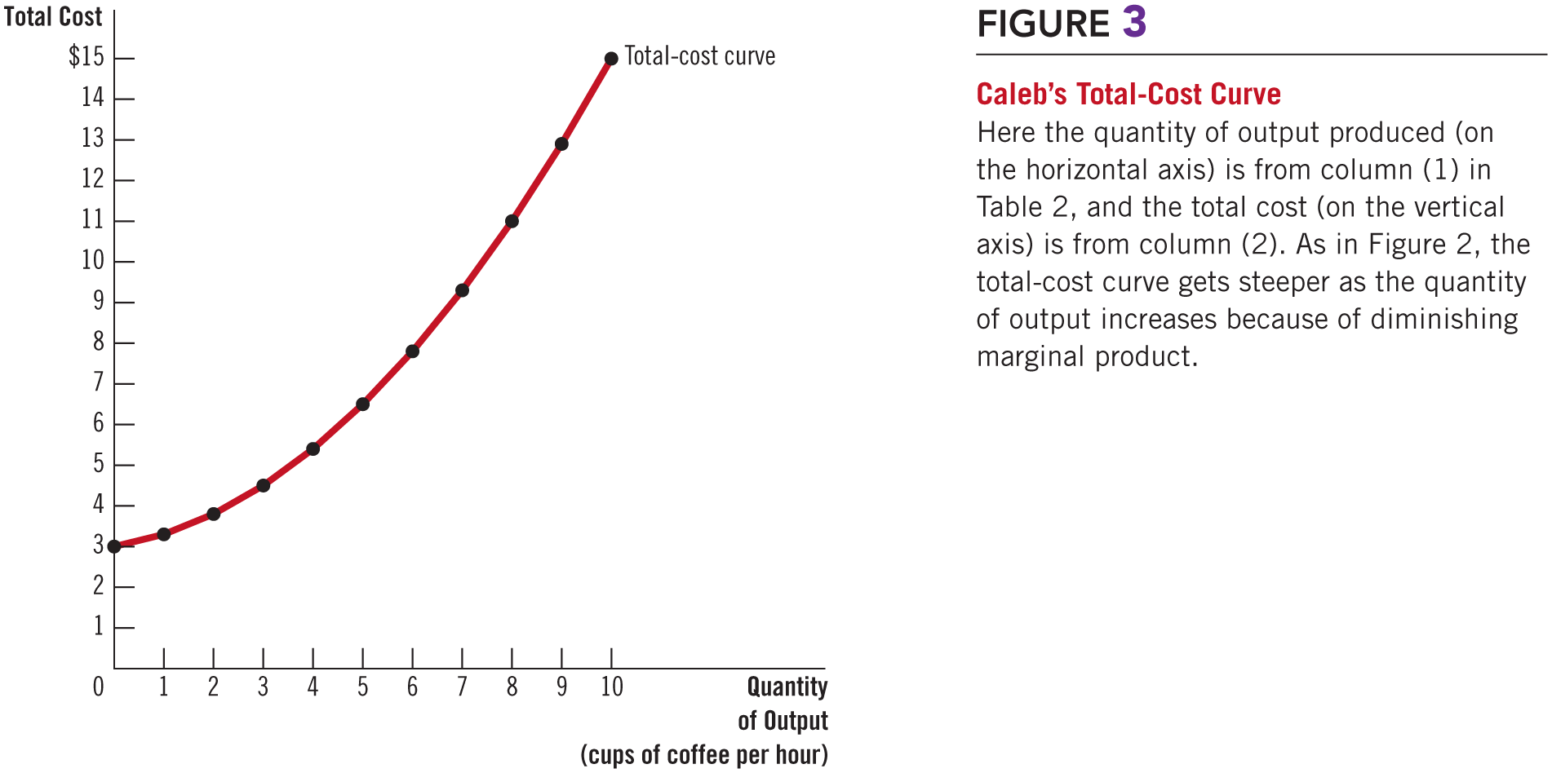
Figure 3 Caleb’s Total-Cost Curve

Slide 19
The Various Measures of Cost, Part 3
Average total cost, ATC
Total cost divided by the quantity of output
Average total cost = Total cost / Quantity
ATC = TC / Q
Cost of a typical unit of output
If total cost is divided evenly over all the units produced

Slide 20
The Various Measures of Cost, Part 4
Marginal cost, MC
Increase in total cost arising from an extra unit of production
Marginal cost = Change in total cost / Change in quantity
MC = ΔTC / ΔQ
Increase in total cost
From producing an additional unit of output

Slide 21
The Various Measures of Cost, Part 5
Rising marginal cost curve
Because of diminishing marginal product
U-shaped average total cost curve
ATC = AVC + AFC
AFC – always declines as output rises
AVC – typically rises as output increases
Because of diminishing marginal product
The bottom of the U-shape
At quantity that minimizes average total cost

Slide 22
The Various Measures of Cost, Part 6
Efficient scale
Quantity of output that minimizes ATC
Relationship between MC and ATC
When MC < ATC: average total cost is falling
When MC > ATC: average total cost is rising
The marginal-cost curve crosses the average-total-cost curve at its minimum

Slide 23
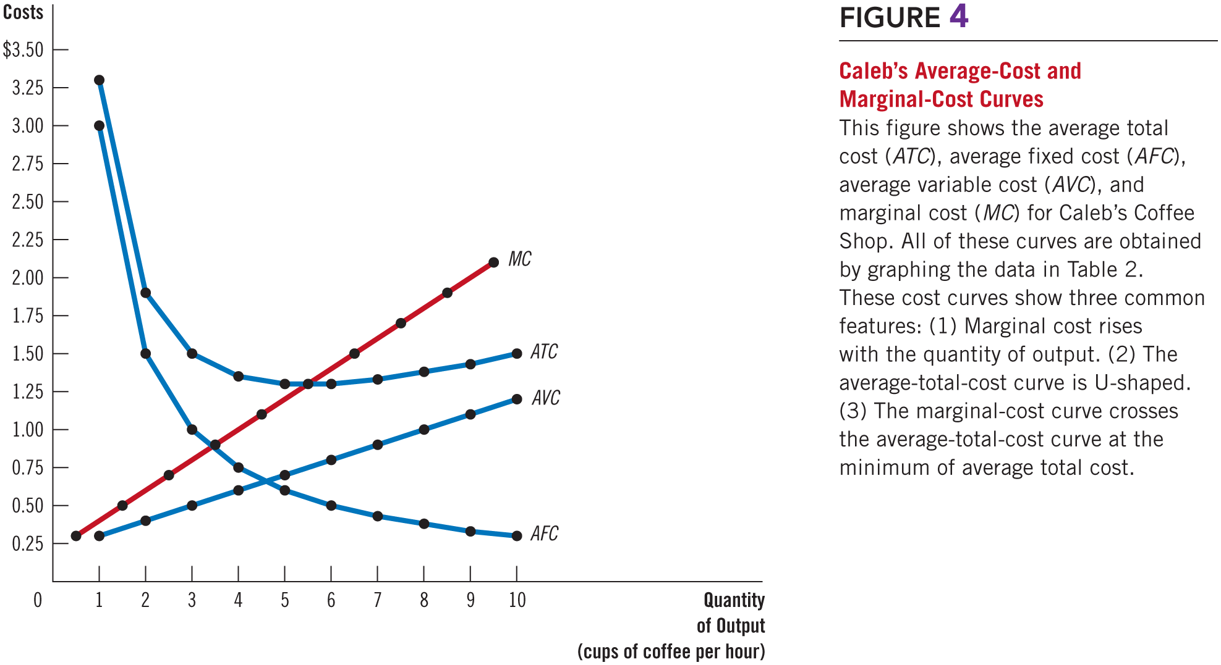
Figure 4 Caleb’s Average-Cost and Marginal-Cost Curves

Slide 24
The Various Measures of Cost, Part 7
Typical cost curves
Marginal cost eventually rises with the quantity of output
Average-total-cost curve is U-shaped
Marginal-cost curve crosses the average-total-cost curve at the minimum of average total cost

Slide 25
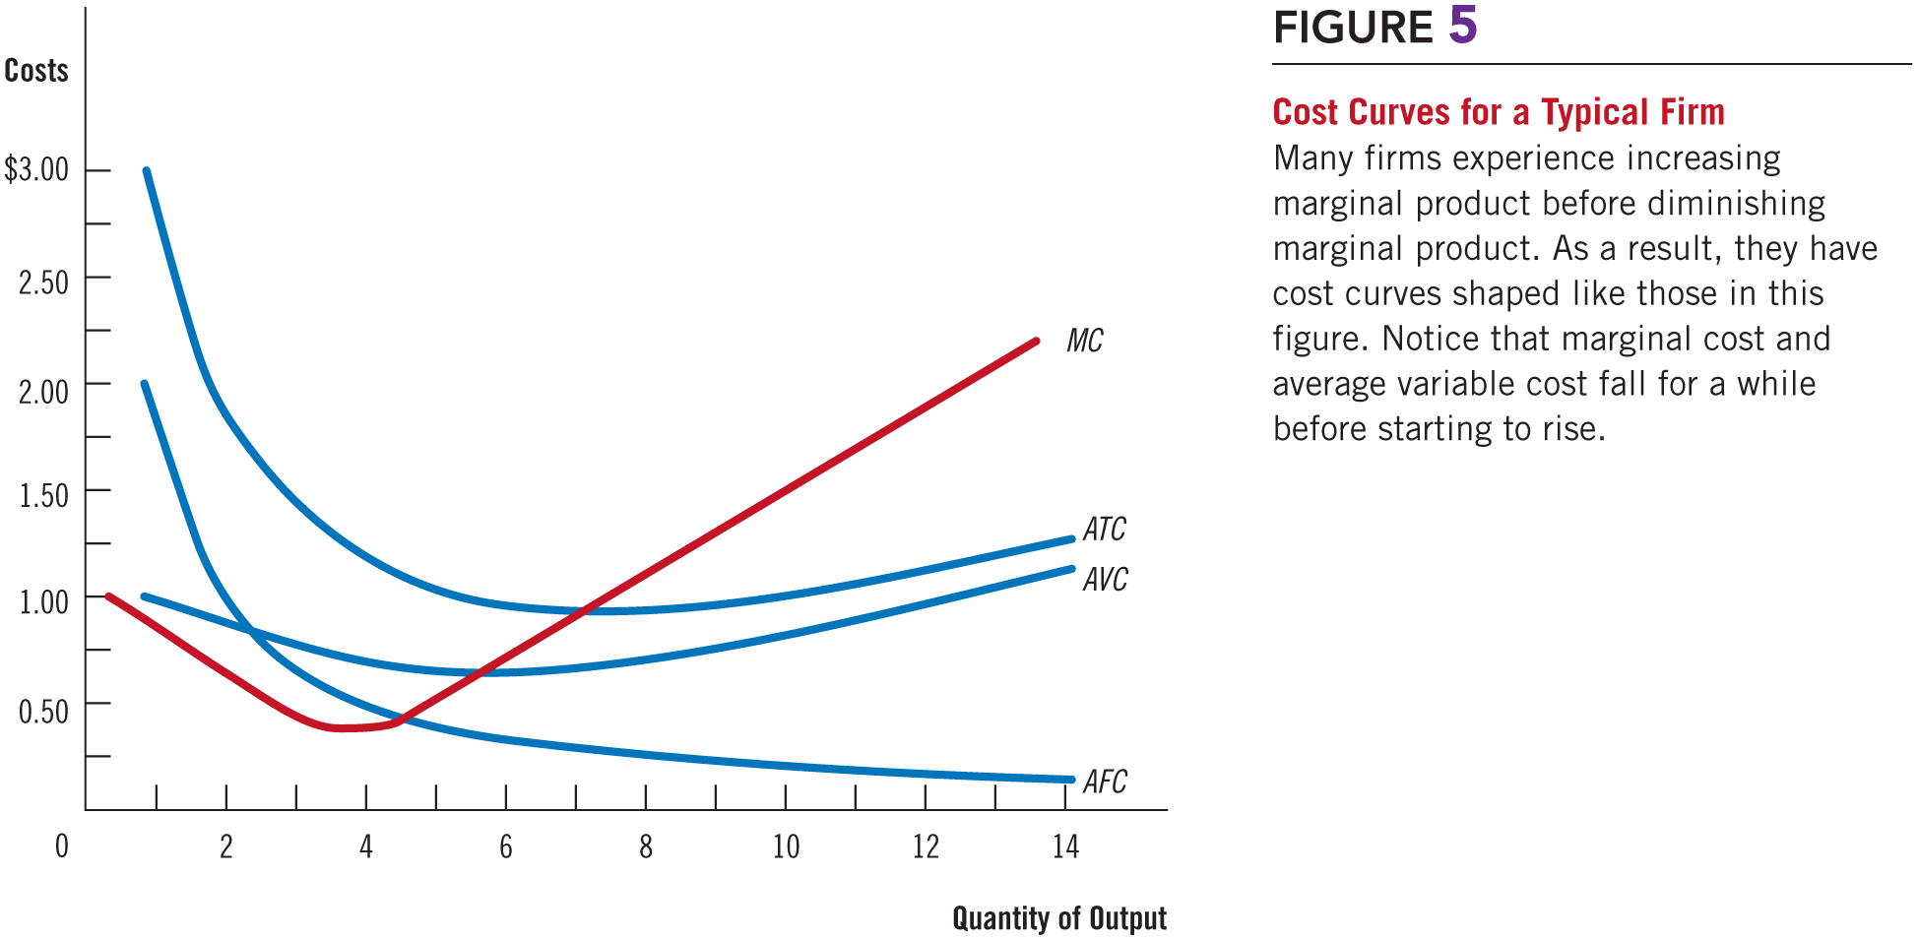
Figure 5 Cost Curves for a Typical Firm

Slide 26
Costs in Short and Long Run, Part 1
Many decisions
Fixed in the short run
Variable in the long run
Firms – greater flexibility in the long-run
Long-run cost curves
Differ from short-run cost curves
Much flatter than short-run cost curves
Short-run cost curves
Lie on or above the long-run cost curves

Slide 27
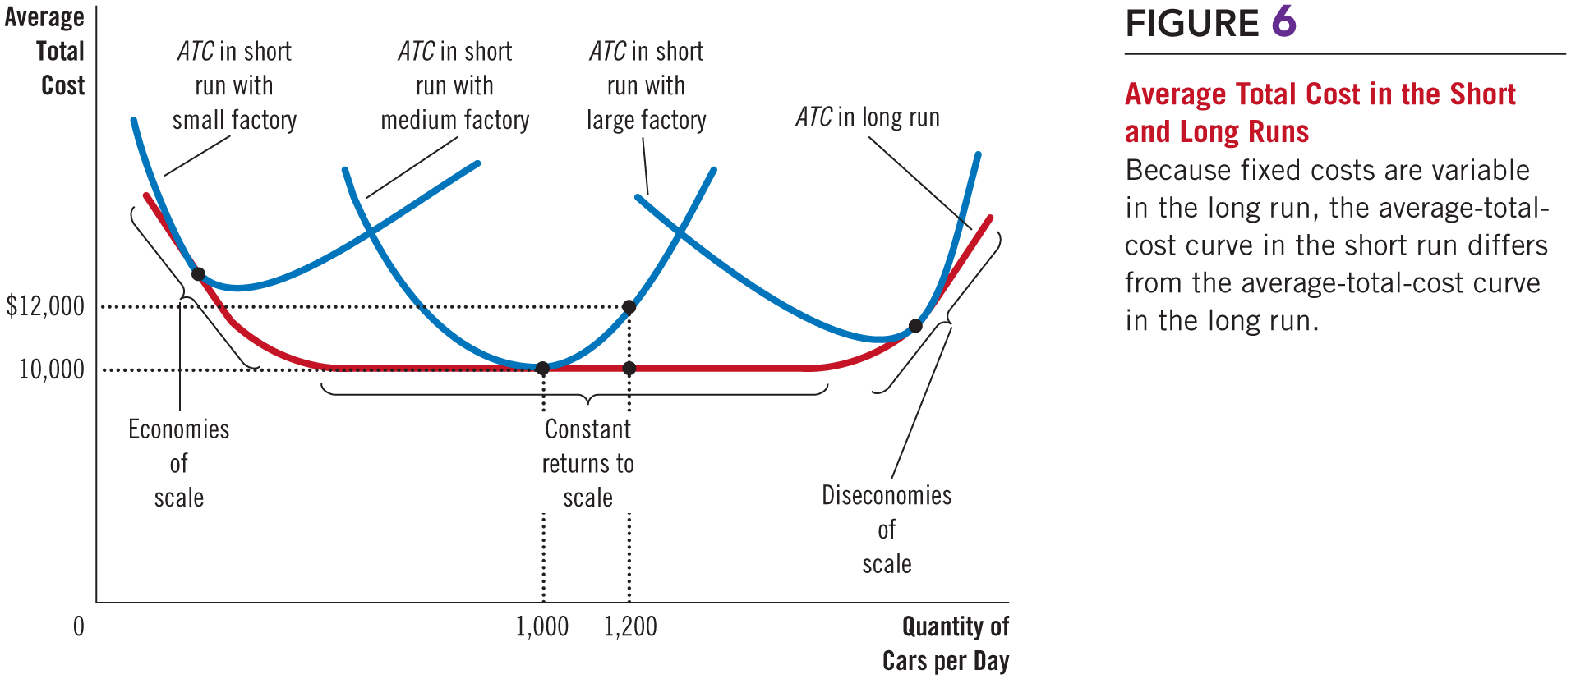
Figure 6 Average Total Cost in Short & Long Runs

Slide 28
Costs in Short and Long Run, Part 2
Economies of scale
Long-run average total cost falls as the quantity of output increases
Increasing specialization among workers
Constant returns to scale
Long-run average total cost stays the same as the quantity of output changes

Slide 29
Costs in Short and Long Run, Part 3
Diseconomies of scale
Long-run average total cost rises as the quantity of output increases
Increasing coordination problems

Slide 30
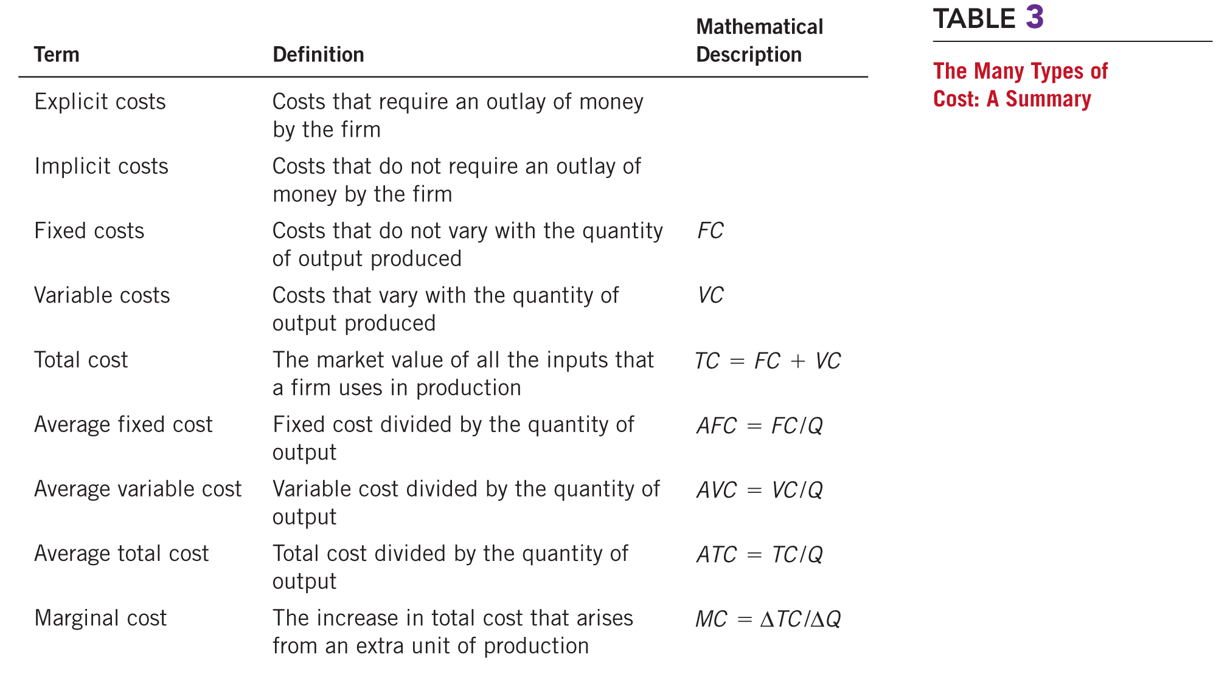
Table 3 The Many Types of Cost: A Summary

