Slide 1
Principles of Micro Economics, Ninth Edition N. Gregory Mankiw
Notes:
N. Gregory Mankiw Principles Of Micro Economics Ninth Edition

Slide 2
Chapter 19
Earnings and Discrimination

Slide 3
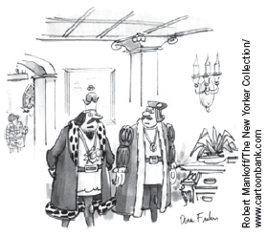
Determinants of Equilibrium Wages
Compensating differentials
Difference in wages that arises to offset the nonmonetary characteristics of different jobs
Higher supply of labor for “good” jobs
Lower equilibrium wage
Lower supply of labor for “bad” jobs
Higher equilibrium wage
“On the one hand, I know I could make more money if I left public service for the private sector, but, on the other hand, I couldn’t chop off heads.”

Slide 4
Human Capital, Part 1
Human capital
Accumulation of investments in people
Education
On-the-job training
Higher productivity
Workers with more human capital earn more

Slide 5
Human Capital, Part 2
Firms — demanders of labor
Willing to pay more for highly educated workers
Higher marginal products
Workers — suppliers of labor
Willing to pay the cost of becoming educated
Only if there is a reward for doing so

Slide 6
Human Capital, Part 3
Wage differentials
Highly educated workers earn higher wages
Less educated workers earn lower wages
Compensating differential
Cost of becoming educated

Slide 7
The Increasing Value of Skills, Part 1
Earnings gap between skilled and unskilled workers increased over the past two decades
Man with a college degree
1974, 42% higher earnings than without a college degree
2014, 81% higher earnings
Woman with a college degree
1974, 35% higher earnings than without a college degree
2014, 71% higher earnings

Slide 8
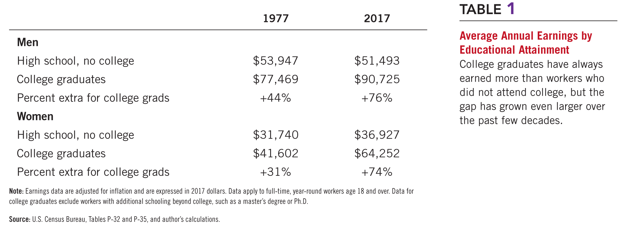
Table 1 Average Annual Earnings by Educational Attainment

Slide 9
The Increasing Value of Skills, Part 2
Widened earnings gap
Increased demand for skilled labor relative to unskilled labor
Higher wages for skilled labor
Greater inequality
Two possible causes:
Increase in international trade
Changes in technology

Slide 10
The Increasing Value of Skills, Part 3
Increase in international trade
Domestic demand for skilled labor rises
Domestic demand for unskilled labor falls
Skill-biased technological change; changes in technology
Raise the demand for skilled workers who can use the new machines
Reduce the demand for the unskilled workers whose jobs are replaced by the computers

Slide 11
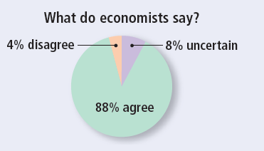
ASK THE EXPERTS
Inequality and Skills
“One of the leading reasons for rising U.S. income inequality over the past three decades is that technological change has affected workers with some skill sets differently than others.”

Slide 12
Ability, Effort, and Chance
Natural ability
Workers with greater natural ability earn more
Effort
People who work hard are more productive and earn more
Chance
Can influence wage

Slide 13
The Benefits of Beauty, Part 1
How prevalent are the economic benefits of beauty?
Labor economists Daniel
Hamermesh and Jeff Biddle
More attractive people
Earn 5% more than people of
average looks
People of average looks
Earn 5 to 10% more than people
considered less attractive than average
Good looks pay.

Slide 14
The Benefits of Beauty, Part 2
What explains these differences in wages?
Good looks — a type of innate ability
Determines productivity and wages
Attractive worker — more valuable to the firm
Acting, sales, and waiting on tables
Firm’s willingness to pay more to attractive workers reflects its customers’ preferences

Slide 15
The Benefits of Beauty, Part 3
What explains these differences in wages?
Reported beauty — indirect measure of other abilities
Dress, hairstyle, personal demeanor
Attributes that a person can control
Perhaps — more likely to be an intelligent person who succeeds at other tasks as well
Beauty premium — type of discrimination

Slide 16
Signaling, Part 1
Earn a college degree
No real productivity benefit
Signal high ability to prospective employers
Easier for high-ability people to earn a college degree

Slide 17
Signaling, Part 2
Human-capital theory
Education — workers more productive
Policy to increase education attainment
Higher productivity and wages
Signaling theory
Education — natural ability
Policy to increase education attainment
No increase in productivity
No change in wages

Slide 18
The Superstar Phenomenon
Superstars in the field
Great public appeal and astronomical incomes
Superstars arise in markets where
Every customer in the market
Wants the good supplied by the best producer
The good is produced with a technology
That makes it possible for the best producer to supply every customer at low cost

Slide 19
Above-Equilibrium Wages, Part 1
Reasons for above-equilibrium wages
Minimum-wage laws
Market power of labor unions
Theory of efficiency wages
Effects of above-equilibrium wages
Surplus of labor
Unemployment

Slide 20
Above-Equilibrium Wages, Part 2
Union
Worker association — bargains with employers over wages & working conditions
Strike
Organized withdrawal of labor from a firm by a union
Efficiency wages
Above-equilibrium wages paid by firms to increase worker productivity

Slide 21
Economics of Discrimination, Part 1
Discrimination
Offering of different opportunities to similar individuals who differ only by
Race
Ethnic group
Sex
Age
Other personal characteristics

Slide 22
Table 2 Median Annual Earnings by Race and Sex

Slide 23
Economics of Discrimination, Part 2
Different groups of workers earn substantially different wages
Discrimination?
Human capital
Quality and quantity of education
Job experience
Kinds of work able & willing to do
Compensating differentials
Working conditions

Slide 24
Economics of Discrimination, Part 3
Differences in educational attainment
2017, men and women age 25 and older
34% of the white population had a college degree
24% of the black population

Slide 25
Economics of Discrimination, Part 4
Quality of public schools
As measured by: expenditure, class size, and so on
Historically: public schools in predominantly black areas have been of lower quality than public schools in predominantly white areas

Slide 26
Economics of Discrimination, Part 5
Human capital acquired in the form of job experience
Women are more likely to interrupt their careers to raise children
Population aged 25 to 44
75% of women are in the labor force
90% of men

Slide 27
Economics of Discrimination, Part 6
Compensating differentials
Men and women do not always choose the same type of work
Women are more likely to be secretaries
Men are more likely to be truck drivers
Different working conditions

Slide 28
Is Emily more Employable than Lakisha? (Part 1)
Economists Marianne Bertrand and Sendhil Mullainathan
Answered more than 1,300 help-wanted ads run in Boston and Chicago newspapers
Send in nearly 5,000 fake résumés - similar
Half of the résumés had names that were common in the African American community
The other half had names that were more common among the white population

Slide 29
Is Emily more Employable than Lakisha? (Part 2)
Results
Job applicants with white names
Received about 50% more calls
Discrimination occurred for all types of employers
Conclusion
“Racial discrimination is still a prominent feature of the labor market”

Slide 30
Discrimination by Employers, Part 1
If one group in society receives a lower wage than another group
Even after controlling for human capital and job characteristics
Who is to blame for this differential?
Employers — discriminatory wage differences?
Competitive market economies
Natural antidote to employer discrimination: profit motive

Slide 31
Discrimination by Employers, Part 2
Workers differentiated by hair color
Blondes and brunettes
Same skills, experience, and work ethic
Discrimination: employers prefer not to hire blondes
Demand for blondes – lower
Blondes – earn a lower wage

Slide 32
Discrimination by Employers, Part 3
Workers differentiated by hair color
New firms – hire blonde workers
Lower wages
Lower production costs
Higher profits
“Brunette” firms
Higher production costs
Diminishing profits
Losses

Slide 33
Discrimination by Employers, Part 4
Workers differentiated by hair color
“Brunette” firms to go out of business
Eventually:
Demand for blonde workers – rises
Demand for brunette workers – falls
Wage differential disappears
Competitive markets
Have a natural remedy for employer discrimination

Slide 34
Segregated Streetcars and the Profit Motive, Part 1
Early 20th century
Streetcars in many southern cities were segregated by race
White passengers sat in the front of the streetcars
Black passengers sat in the back

Slide 35
Segregated Streetcars and the Profit Motive, Part 2
Why?
Laws required such segregation
Before these laws were passed, racial discrimination in seating was rare
Common to segregate smokers and nonsmokers

Slide 36
Segregated Streetcars and the Profit Motive, Part 3
Firms that ran the streetcars
Often opposed the laws requiring racial segregation
Separate seating for different races
Raised firms’ costs
Reduced firms’ profit

Slide 37
Segregated Streetcars and the Profit Motive, Part 4
General lesson
Business owners – more interested in making profit
Than in discriminating against a particular group
When firms engage in discriminatory practices
Ultimate source of the discrimination often lies not with the firms themselves but elsewhere

Slide 38
Economics of Discrimination
Discrimination by customers and governments
Limits to the profit motive corrective abilities
Customer preferences (discriminatory)
Willing to pay more to maintain the discriminatory practice
Government policies
Mandate discriminatory practices

Slide 39
Discrimination in Sports
Measuring discrimination is often difficult
Correct for differences in the productivity
Professional sports team
Can measure productivity
Racial discrimination is common
Much of the blame lies with customers
Discriminatory wage gap can persist
Even if team owners care only about profit
Market prices of old baseball cards
Customer discrimination

