Slide 1
Principles of Micro Economics, Ninth Edition N. Gregory Mankiw
Notes:
N. Gregory Mankiw Principles Of Micro Economics Ninth Edition

Slide 2
Chapter 16
Monopolistic Competition

Slide 3
Monopolistic Competition, Part 1
Imperfect competition
Between perfect competition and monopoly
Oligopoly
Monopolistic competition
Oligopoly
Few sellers
Offer similar or identical products

Slide 4
Monopolistic Competition, Part 2
Concentration ratio
Percentage of total output in the market supplied by the four largest firms
Oligopolies, highly-concentrated industries (concentration ratio %)
Major household appliances (90%)
Tires (91%), Light bulbs (92%)
Soda (94%)
Wireless telecommunications (95%)

Slide 5
Monopolistic Competition, Part 3
Monopolistic competition
Many sellers
Product differentiation
Not price takers
Downward sloping demand curve
Free entry and exit
Zero economic profit in the long run

Slide 6
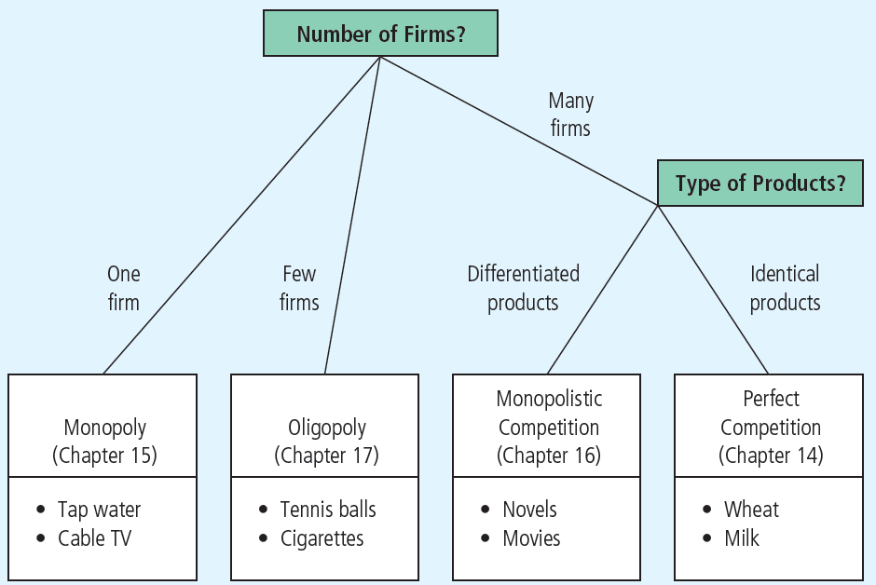
Figure 1 The Four Types of Market Structure
Economists who study industrial organization divide markets into four types—monopoly, oligopoly, monopolistic competition, and perfect competition.

Slide 7
Short Run Equilibrium
Profit maximization
Produce the quantity where marginal revenue = marginal cost
Price: on the demand curve
If P > ATC: profit
If P < ATC: loss
Similar to monopoly

Slide 8
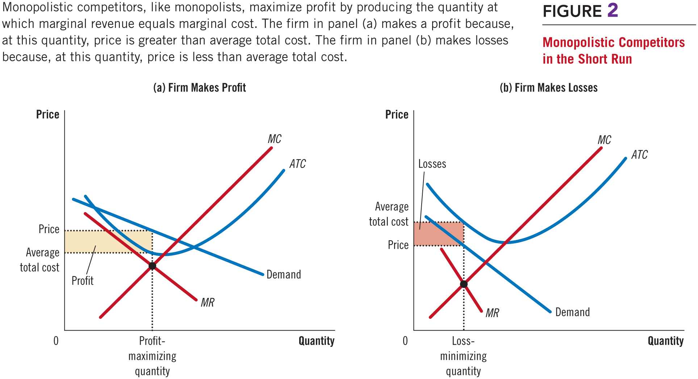
Figure 2 Monopolistic Competitors in the Short Run

Slide 9
Long Run Equilibrium, Part 1
If firms are making profit in short run
New firms - incentive to enter the market
Increase number of products
Reduces demand faced by each firm
Demand curve shifts left
Each firm’s profit declines until: zero economic profit

Slide 10
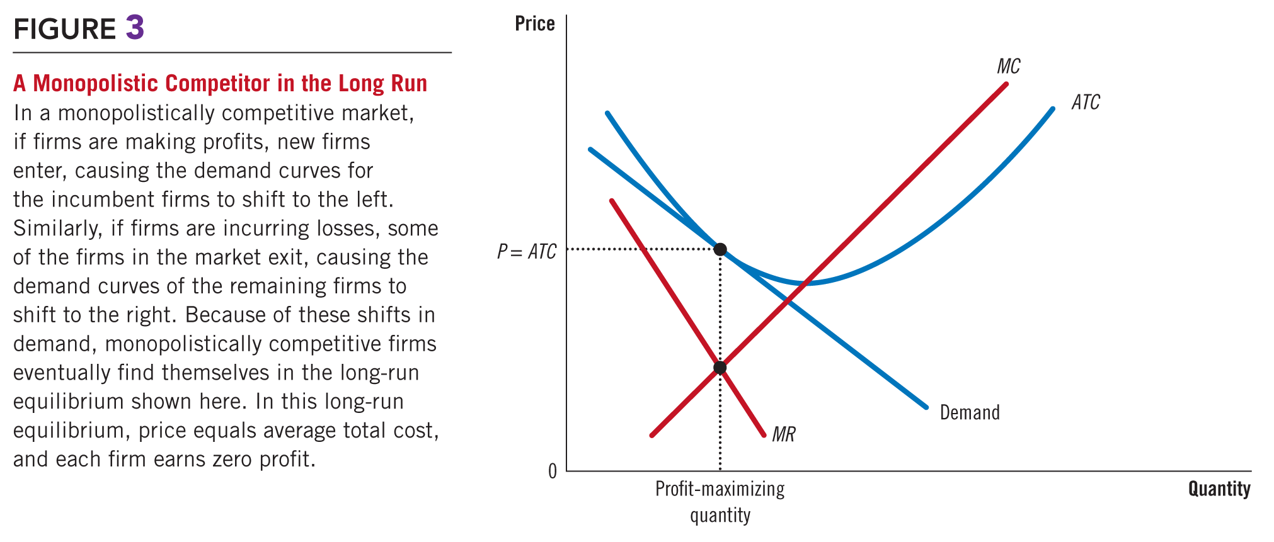
Figure 3 A Monopolistic Competitor in Long Run

Slide 11
Long Run Equilibrium, Part 2
Zero economic profit
Demand curve
Tangent to average total cost curve
At quantity where marginal revenue = marginal cost
Price = average total cost
Price exceeds marginal cost

Slide 12
Long Run Equilibrium, Part 3
Monopolistic versus perfect competition
Monopolistic competition
Quantity: not at minimum ATC (excess capacity)
P > MC, markup over marginal cost
Perfect competition
Quantity: at minimum ATC (efficient scale)
P = MC

Slide 13
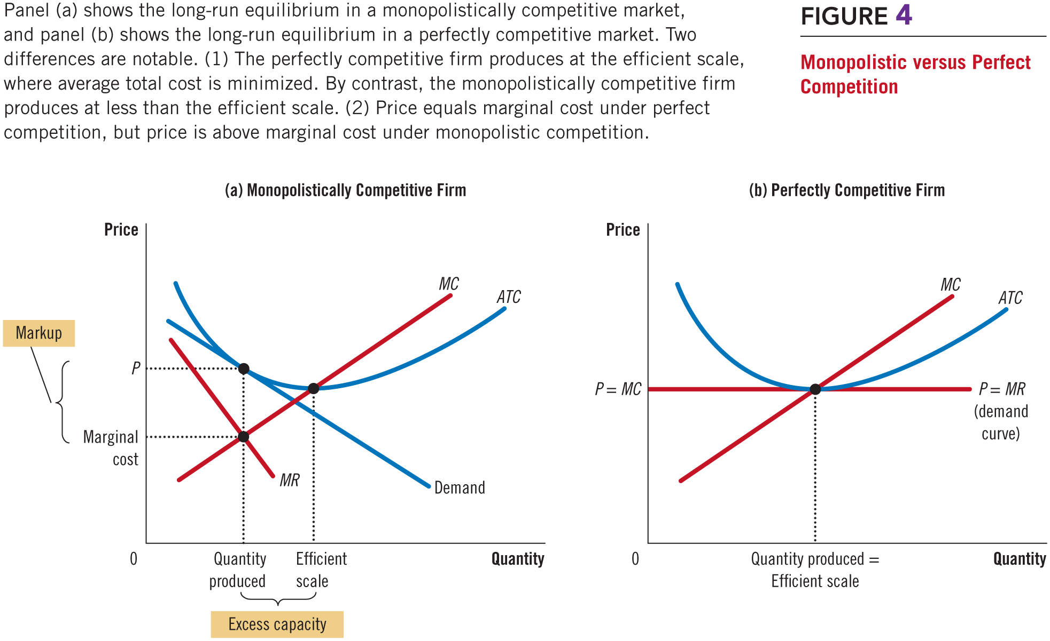
Figure 4 Monopolistic versus Perfect Competition

Slide 14
Welfare of Society
Sources of inefficiency
Markup of price over marginal cost
Deadweight loss of monopoly pricing
Too much or too little entry
Product-variety externality (positive externality on consumers)
Business-stealing externality (negative externality on existing firms)

Slide 15
Advertising, Part 1
Incentive to advertise
When firms sell differentiated products and charge prices above marginal cost
Advertise to attract more buyers
Advertising spending
Highly differentiated goods: 10-20% of revenue
Industrial products: Little advertising
Homogenous products: No advertising

Slide 16
Advertising, Part 2
Debate over advertising
Wasting resources?
Valuable purpose?
The critique of advertising
Firms advertise to manipulate people’s tastes
Psychological rather than informational
Creates a desire that otherwise might not exist

Slide 17
Advertising, Part 3
The critique of advertising
Impedes competition
Increase perception of product differentiation
Foster brand loyalty
Makes buyers less concerned with price differences among similar goods

Slide 18
Advertising, Part 4
The defense of advertising
Provide information to customers
Customers - make better choices
Enhances the ability of markets to allocate resources efficiently
Fosters competition
Customers - take advantage of price differences
Allows new firms to enter more easily

Slide 19
Advertising and the Price of Eyeglasses, Part 1
What effect does advertising have on the price of a good?
Consumers – view products as being more different than they otherwise would
Markets less competitive
Firms’ demand curves less elastic
Higher prices

Slide 20
Advertising and the Price of Eyeglasses, Part 2
What effect does advertising have on the price of a good?
Consumers – easier to find firms with the best prices
Markets – more competitive
Firms’ demand curves more elastic
Lower prices

Slide 21
Advertising and the Price of Eyeglasses, Part 3
1972, economist Lee Benham
States that prohibited advertising
Average price = $33 ($272 in 2018 dollars)
States that did not restrict advertising
Average price = $26 ($214 in 2018 dollars)
Advertising
Reduced average prices
Fosters competition

Slide 22
Advertising, Part 5
Advertising as a signal of quality
Little apparent information
Real information offered – a signal
Willingness to spend large
amount of money
= signal about quality of the product
Content of advertising = irrelevant
Is it rational for consumers to be impressed that
George Clooney is endorsing this product?

Slide 23
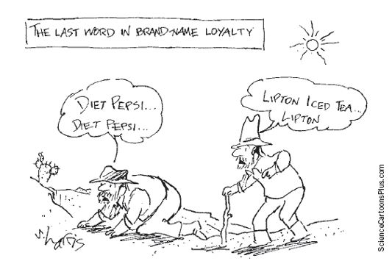
Advertising, Part 6
Brand names
Spend more on advertising and charge higher prices than generic substitutes

Slide 24
Advertising, Part 7
Critics of brand names
Products – not differentiated
Irrationality: consumers are willing to pay more for brand names
Defenders of brand names
Consumers – information about quality
Firms – incentive to maintain high quality

Slide 25
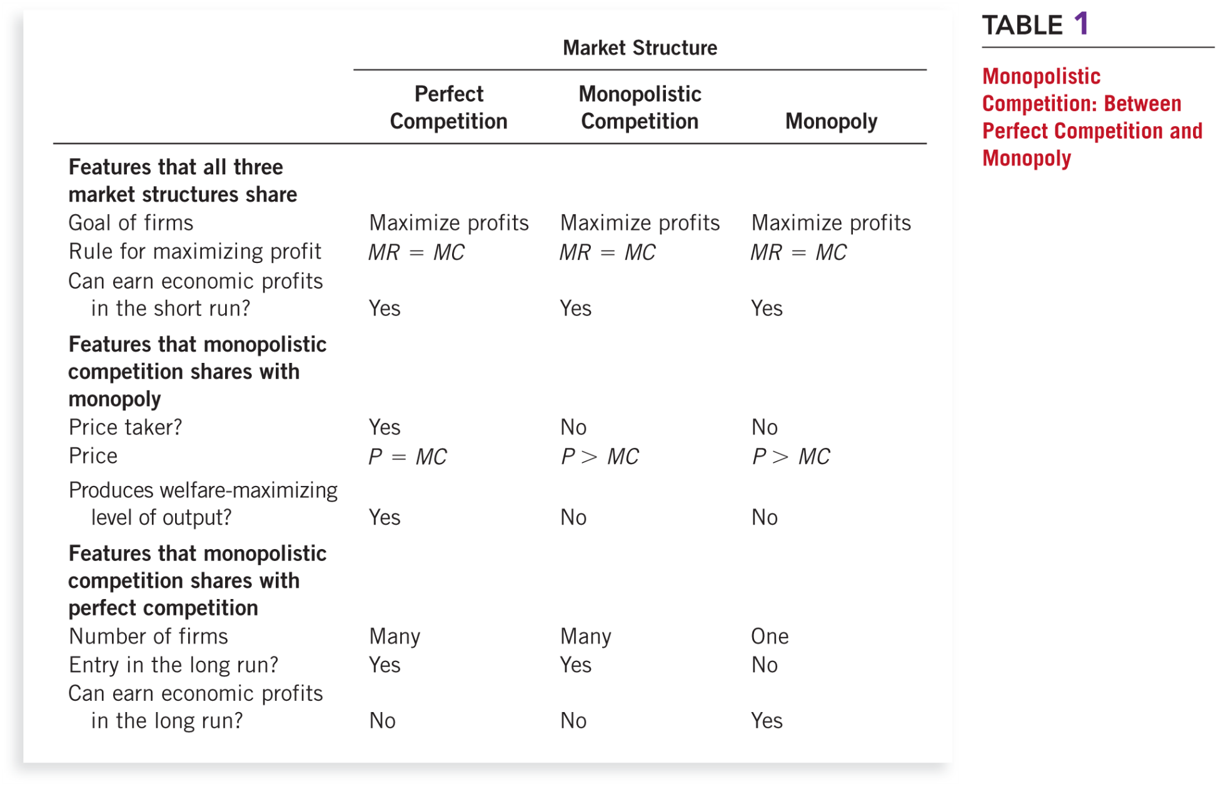
Table 1 Monopolistic Competition: Between Perfect Competition and Monopoly

