Slide 1
The Components of a Computer System
Von Neumann architecture
Foundation for nearly all modern computers
Characteristics
Central Processing Unit (CPU)
Memory
Input/output
Arithmetic/logic unit
Control unit
Stored program concept
Sequential execution of instructions

Slide 2
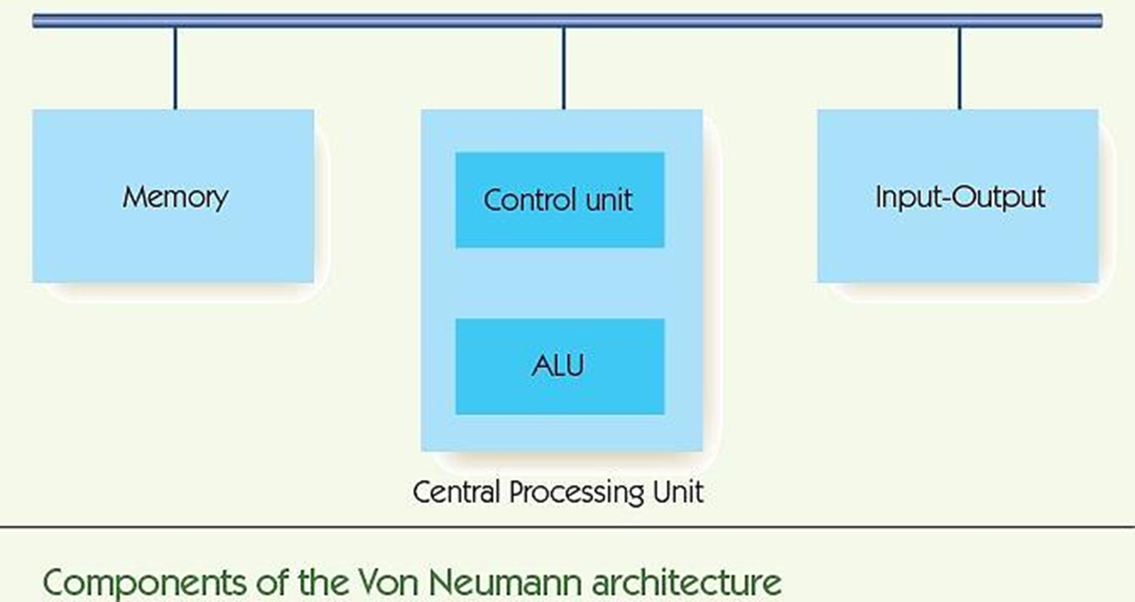

Slide 3
The Components of a Computer System Memory and Cache (cont'd)
Memory: functional unit where data is stored/retrieved
Random access memory (RAM)
Organized into cells, each given a unique address
Equal time to access any cell
Cell values may be read and changed
Cell size/memory width is typically 8 bits
Maximum memory size/address space is 2^{N}, where N is length of address

Slide 4
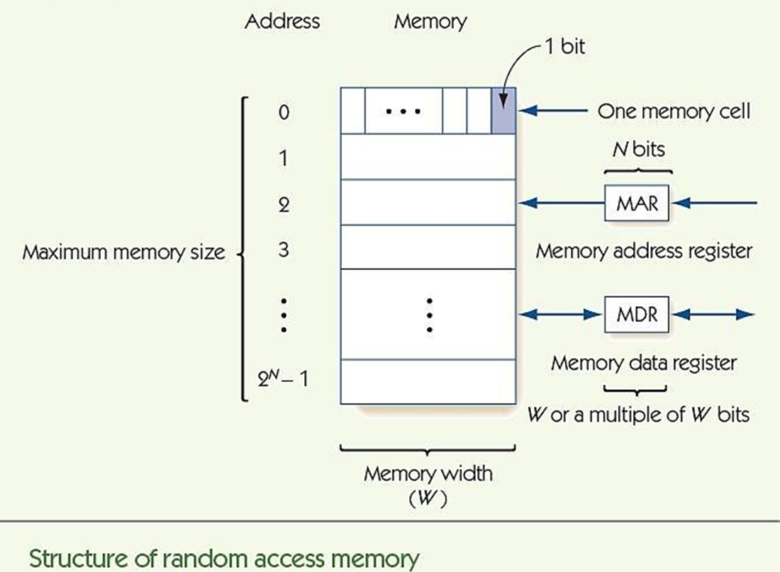

Slide 5
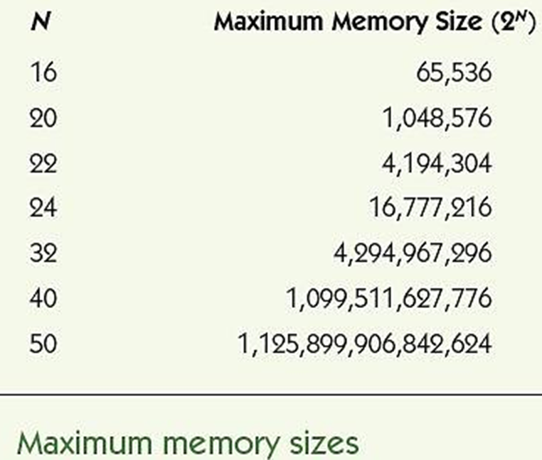

Slide 6
The Components of a Computer System Memory and Cache (cont'd)
Fetch: retrieve from memory (nondestructive fetch)
Store: write to memory (destructive store)
Memory access time
Time required to fetch/store
Modern RAM requires 5-10 nanoseconds
MAR holds memory address to access
MDR receives data from fetch, holds data to be stored

Slide 7
The Components of a Computer System Memory and Cache (cont'd)
Memory system circuits: decoder and fetch/store controller
Decoder converts MAR into signal to a specific memory cell
One-dimensional versus two-dimensional memory organization
Fetch/Store controller ► traffic cop for MDR
Takes in a signal that indicates fetch or store
Routes data flow to/from memory cells and MDR

Slide 8
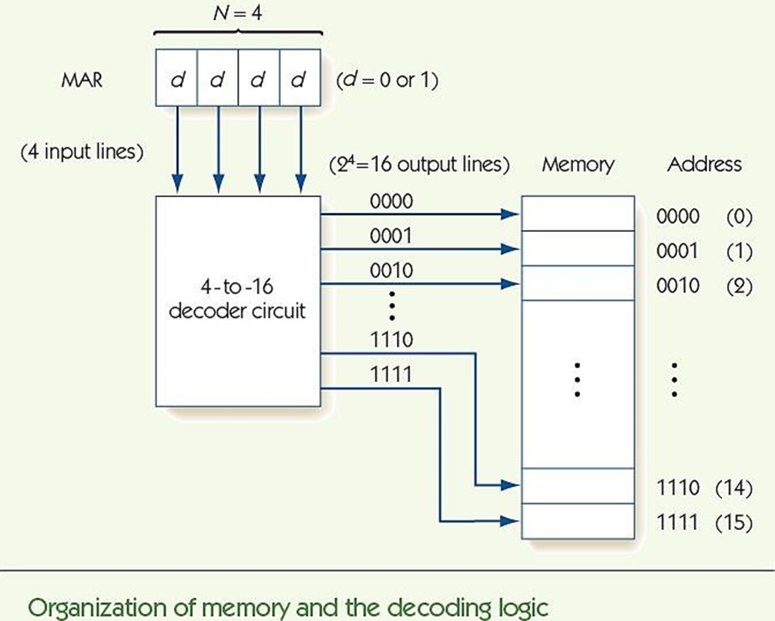

Slide 9
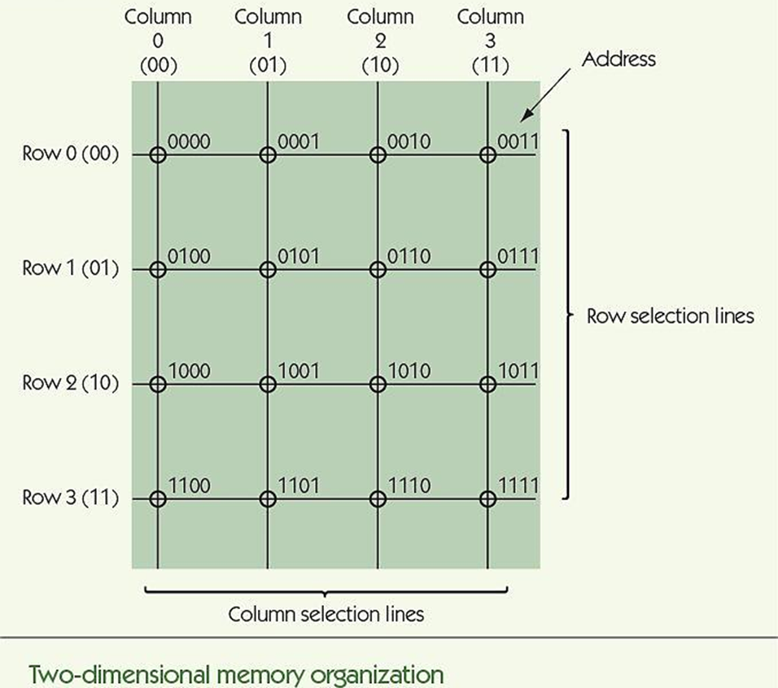

Slide 10
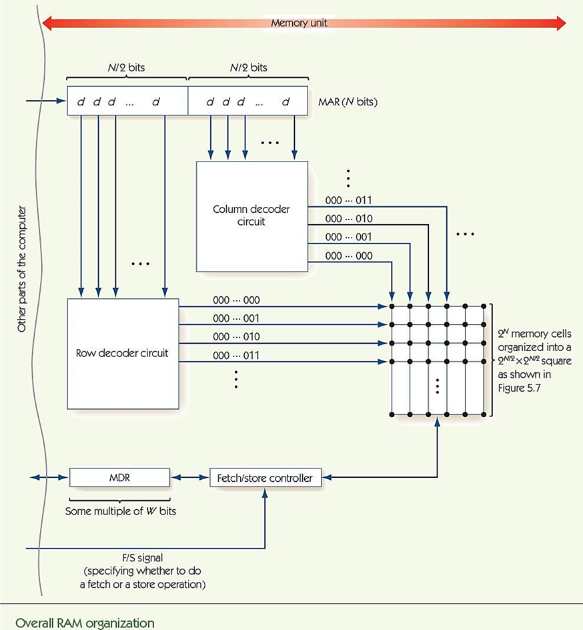

Slide 11
The Components of a Computer System Memory and Cache (cont'd)
RAM speeds increased more slowly than CPU speeds
Cache memory is fast but expensive
Principle of locality
Values close to recently-accessed memory are more likely to be accessed
Load neighbors into cache and keep recent values there
Cache hit rate: percentage of times values are found in cache

Slide 12
The Components of a Computer System Input/Output and Mass Storage
Input/output (I/O) connects the processor to the outside world
Humans: keyboard, monitor, etc.
Data storage: hard drive, DVD, flash drive
Other computers: network
RAM = volatile memory (gone without power)
Mass storage systems = nonvolatile memory
Direct access storage devices (DASDs)
Sequential access storage devices (SASDs)

Slide 13
The Components of a Computer System I/O and Mass Storage (cont'd)
DASDs
Hard drives, CDs, DVDs contain disks
Tracks: concentric rings around disk surface
Sectors: fixed size segments of tracks, unit of retrieval
Time to retrieve data based on:
Seek time
Latency
Transfer time
Other non-disk DASDs: flash memory, optical

Slide 14
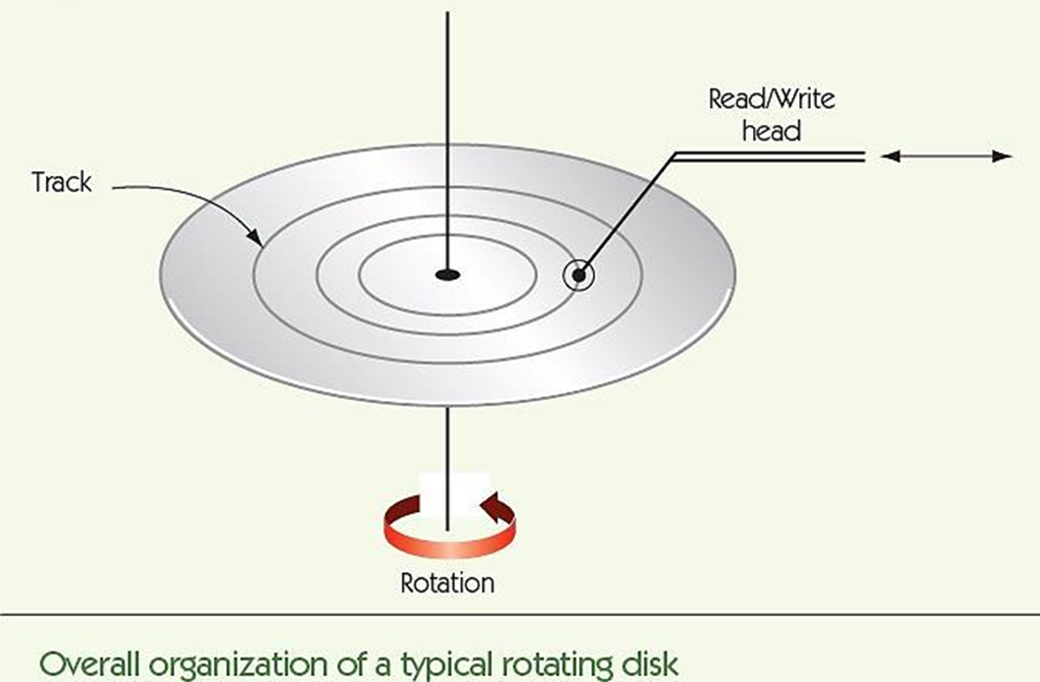

Slide 15
The Components of a Computer System I/O and Mass Storage (cont'd)
DASDs and SASDs are orders of magnitude slower than RAM: (microseconds or milliseconds)
I/O Controller manages data transfer with slow I/O devices, freeing processor to do other work
Controller sends an interrupt signal to processor when I/O task is done

Slide 16
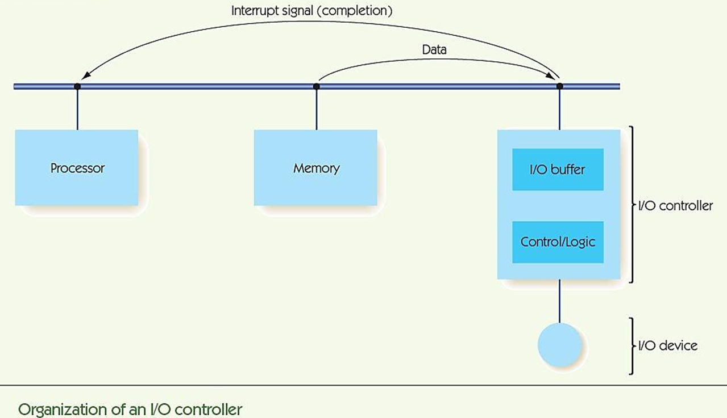

Slide 17
The Components of a Computer System The Arithmetic/Logic Unit
ALU is part of the processor
Contains circuits for arithmetic:
Addition, subtraction, multiplication, and division
Contains circuits for comparison and logic:
Equality, and, or, not
Contains registers: super-fast, dedicated memory connected to circuits
Data path: how information flows in ALU
From registers to circuits
From circuits back to registers

Slide 18
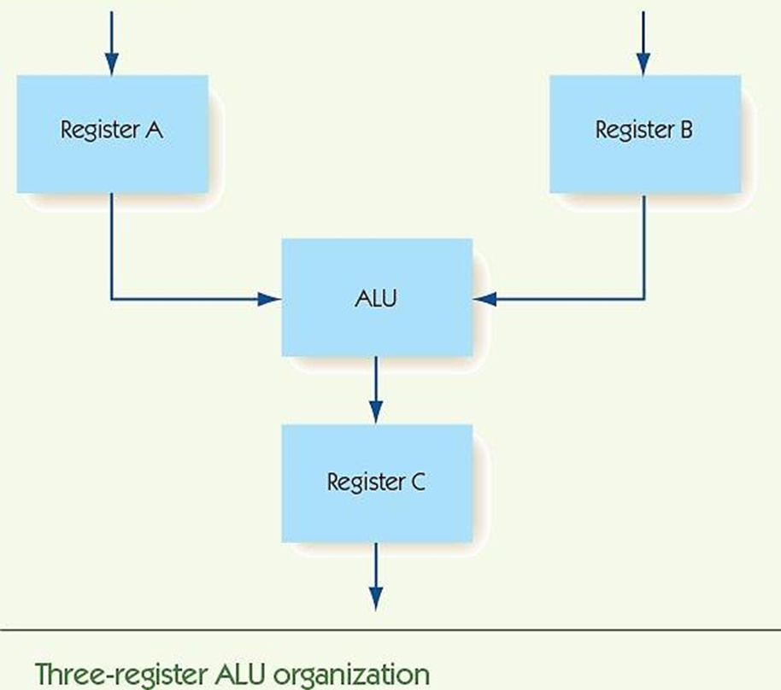

Slide 19
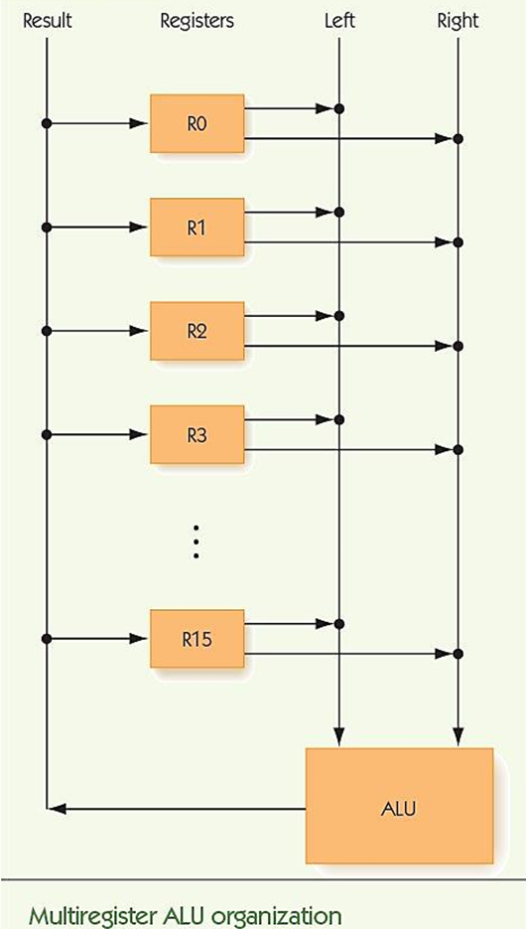

Slide 20
The Components of a Computer System The ALU (cont'd)
How is the operation to perform chosen?
Option 1: decoder signals one circuit to run
Option 2: run all circuits, multiplexor selects one output from all circuits
In practice, option 2 is usually chosen
Information flow
Data comes in from outside ALU to registers
Signal comes to multiplexor, which operation
Result goes back to register, and then to outside

Slide 21
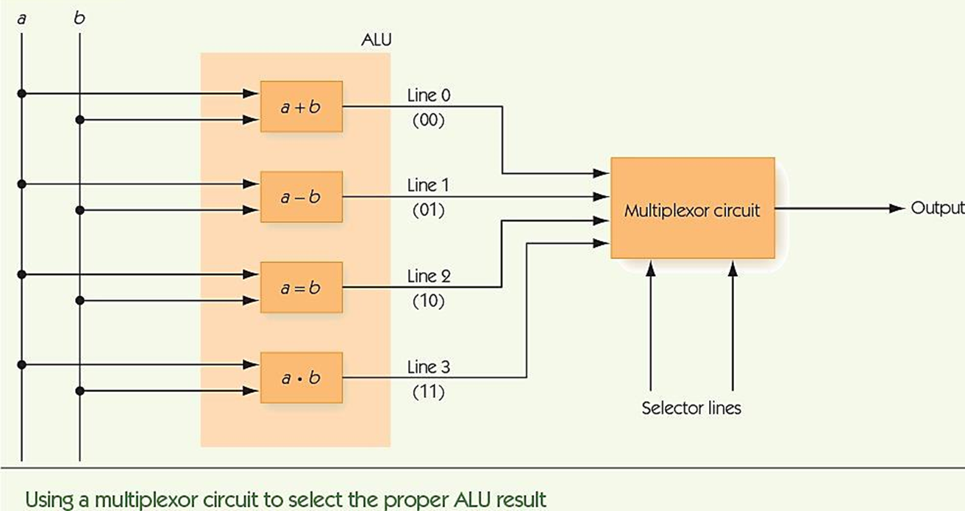

Slide 22
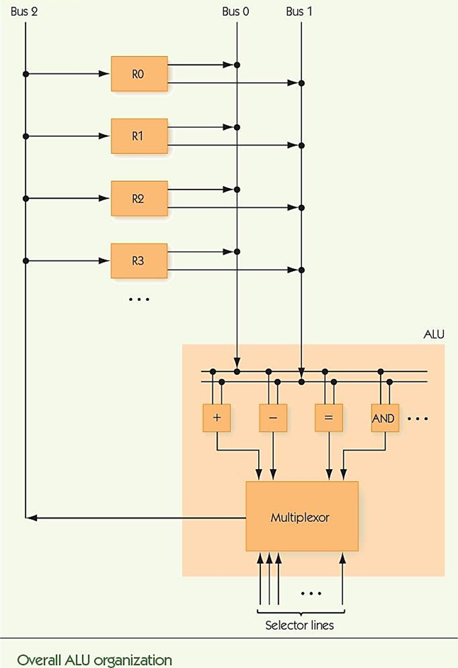

Slide 23
The Components of a Computer System The Control Unit
Stored program characteristic
Programs are encoded in binary and stored in computer’s memory
Control unit fetches instructions from memory, decodes them, and executes them
Instructions encoded
Operation code (op code) tells which operation
Addresses tell which memory addresses/registers to operate on

Slide 25
The Components of a Computer System The Control Unit (cont'd)
Machine language
Binary strings that encode instructions
Instructions can be carried out by hardware
Sequences of instructions encode algorithms
Instruction set
The instructions implemented by a particular chip
Each kind of processor speaks a different language

Slide 26
The Components of a Computer System The Control Unit (cont'd)
RISC machines and CISC machines
Reduced instruction set computers
Small instruction sets
Each instruction highly optimized
Easy to design hardware
Complex instruction set computers
Large instruction set
Single instruction can do a lot of work
Complex to design hardware
Modern hardware: some RISC and some CISC

Slide 27
The Components of a Computer System The Control Unit (cont'd)
Kinds of instructions
Data transfer, e.g., move data from memory to register
Arithmetic, e.g., add, but also “and”
Comparison: compare two values
Branch: change to a non-sequential instruction
Branching allows for conditional and loop forms
E.g., JUMPLT a = If previous comparison of A and B found A < B, then jump to instruction at address a

Slide 28
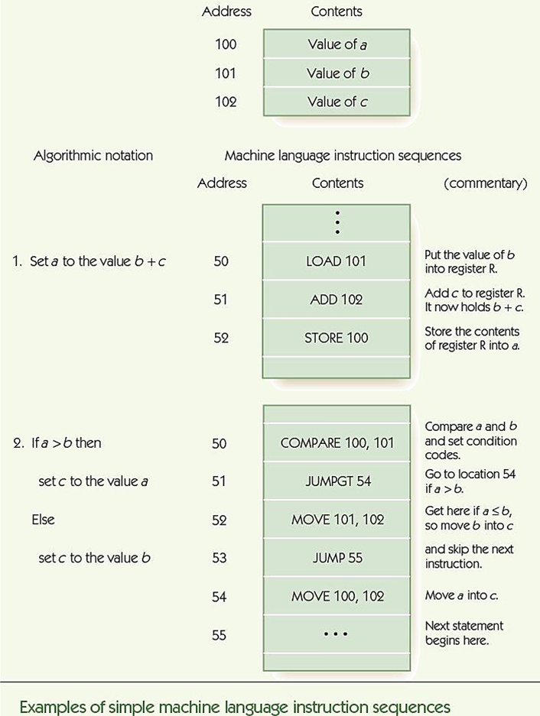

Slide 29
The Components of a Computer System The Control Unit (cont'd)
Control unit contains:
Program counter (PC) register: holds address of next instruction
Instruction register (IR): holds encoding of current instruction
Instruction decoder circuit
Decodes op code of instruction and signals helper circuits, one per instruction
Helpers send addresses to proper circuits
Helpers signal ALU, I/O controller, and memory

Slide 30
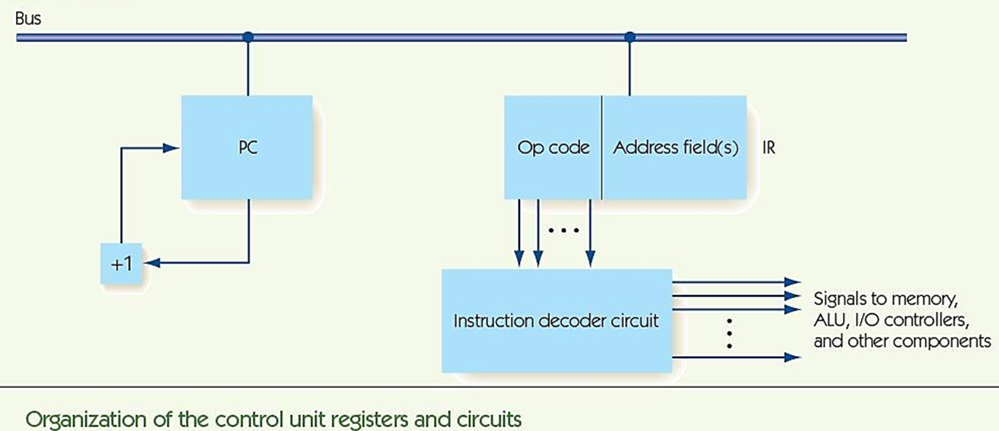

Slide 31
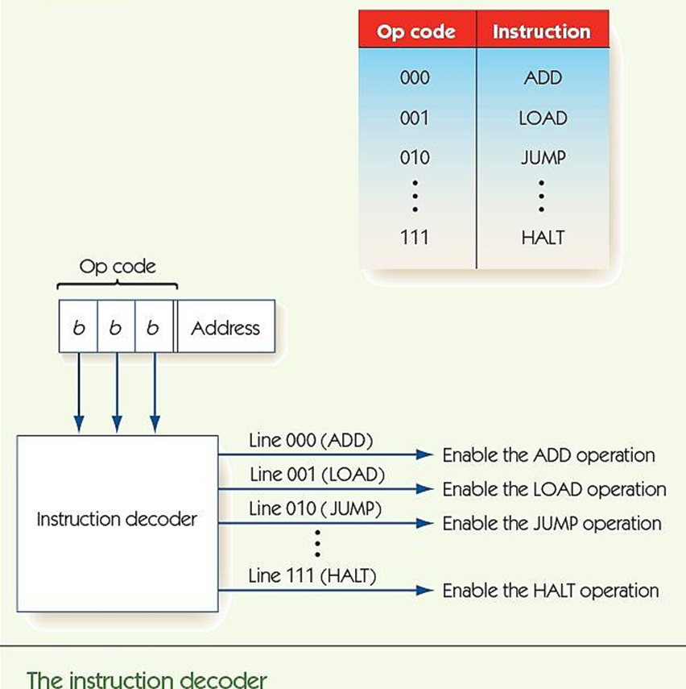

Slide 32
Putting the Pieces Together—the Von Neumann Architecture
Combine previous pieces: Von Neumann machine
Fetch-Decode-Execute cycle
Machine repeats until HALT instruction or error
Also called Von Neumann cycle
Fetch phase: get next instruction into memory
Decode phase: instruction decoder gets op code
Execute phase: different for each instruction

Slide 33
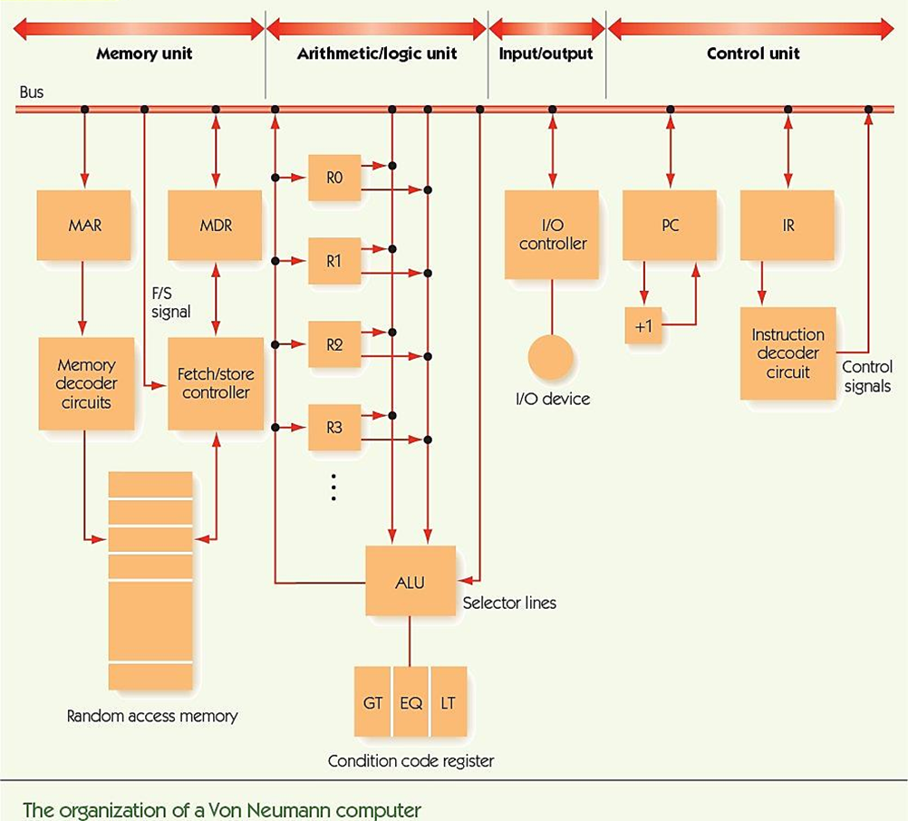

Slide 34
Putting the Pieces Together—the Von Neumann Architecture (cont'd)
Notation for computer’s behavior
CON(A) | Contents of memory cell A
A -> B | Send value in register A to register B (special registers: PC, MAR, MDR, IR, ALU, R, GT, EQ, LT, +1)
FETCH | Initiate a memory fetch operation
STORE | Initiate a memory store operation
ADD | Instruct the ALU to select the output of the adder circuit
SUBTRACT | Instruct the ALU to select the output of the subtract circuit

Slide 35
Putting the Pieces Together—the Von Neumann Architecture (cont'd)
Fetch phase
PC -> MAR Send address in PC to MAR
FETCH Initiate Fetch, data to MDR
MDR -> IR Move instruction in MDR to IR
PC + 1 -> PC Add one to PC
Decode phase
IR_{op} -> instruction decoder

Slide 36
Putting the Pieces Together—the Von Neumann Architecture (cont'd)
LOAD X meaning CON(X) -> R
IR_{addr} -> MAR Send address X to MAR
FETCH Initiate Fetch, data to MDR
MDR -> R Move data in MDR to R
STORE X meaning R -> CON(X)
IR_{addr} -> MAR Send address X to MAR
R -> MDR Send data in R to MDR
STORE Initiate store of MDR to X

Slide 37
Putting the Pieces Together—the Von Neumann Architecture (cont'd)
ADD X meaning R + CON(X) -> R
IR_{addr} -> MAR Send address X to MAR
FETCH Initiate Fetch, data to MDR
MDR -> ALU Send data in MDR to ALU
R -> ALU Send data in R to ALU
ADD Select ADD circuit as result
ALU -> R Copy selected result to R
JUMP X meaning get next instruction from X
IR_{addr} -> PC Send address X to PC

Slide 38
Putting the Pieces Together—the Von Neumann Architecture (cont'd)
COMPARE X meaning:
if CON(X) > R then GT = 1 else 0
if CON(X) = R then EQ = 1 else 0
if CON(X) < R then LT = 1 else 0
IR_{addr} -> MAR Send address X to MAR
FETCH Initiate Fetch, data to MDR
MDR -> ALU Send data in MDR to ALU
R -> ALU Send data in R to ALU
SUBTRACT Evaluate CON(X) – R
Sets EQ, GT, and LT

Slide 39
Putting the Pieces Together—the Von Neumann Architecture (cont'd)
JUMPGT X meaning:
if GT = 1 then jump to X
else continue to next instruction
IF GT = 1 THEN IR_{addr} -> PC

Slide 40
Non-Von Neumann Architectures
Problems to solve are always larger
Computer chip speeds no longer increase exponentially
Reducing size puts gates closer together, faster
Speed of light pertains to signals through wire
Cannot put gates much closer together
Heat production increases too fast
Von Neumann bottleneck: inability of sequential machines to handle larger problems

Slide 41
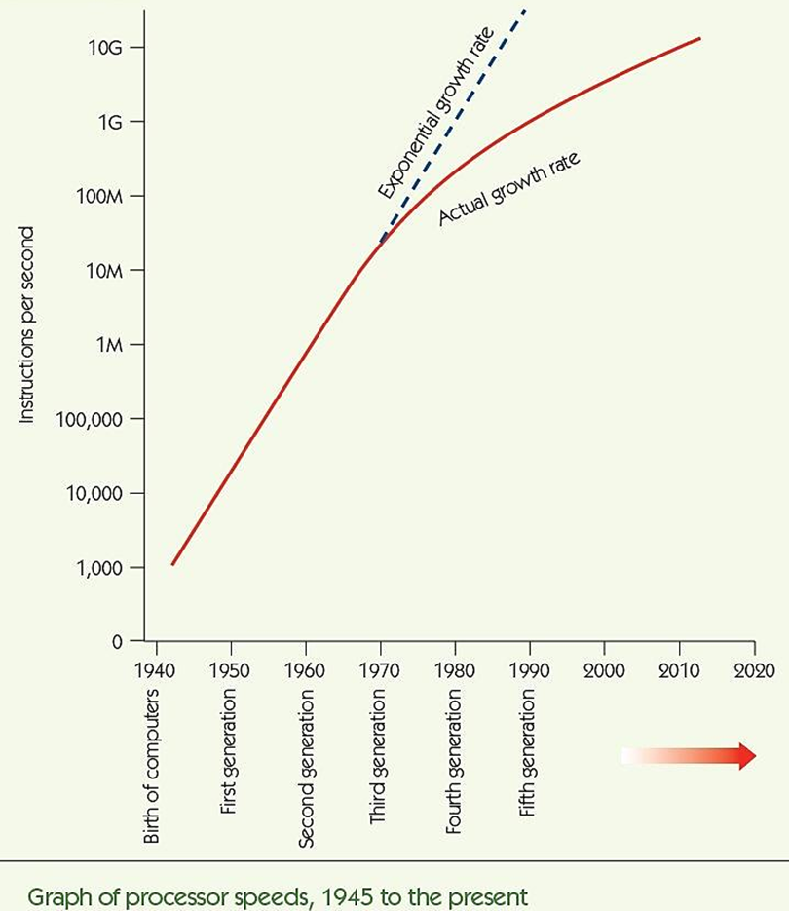

Slide 42
Non-Von Neumann Architectures (cont'd)
Non-Von Neumann architectures
Other ways to organize computers
Most are experimental/theoretical, EXCEPT parallel processing
Parallel processing
Many processing units operating at the same time
Supercomputers (in the past)
Desktop multi-core machines (in the present)
“The cloud” (in the future)

Slide 43
Non-Von Neumann Architectures (cont'd)
MIMD parallel processing
Multiple Instruction stream/Multiple Data streams
Cluster computing
Multiple, independent processors
Each ALU operates on its own data
Each processor can operate independently:
On its own data
On its own program
At its own rate

Slide 44
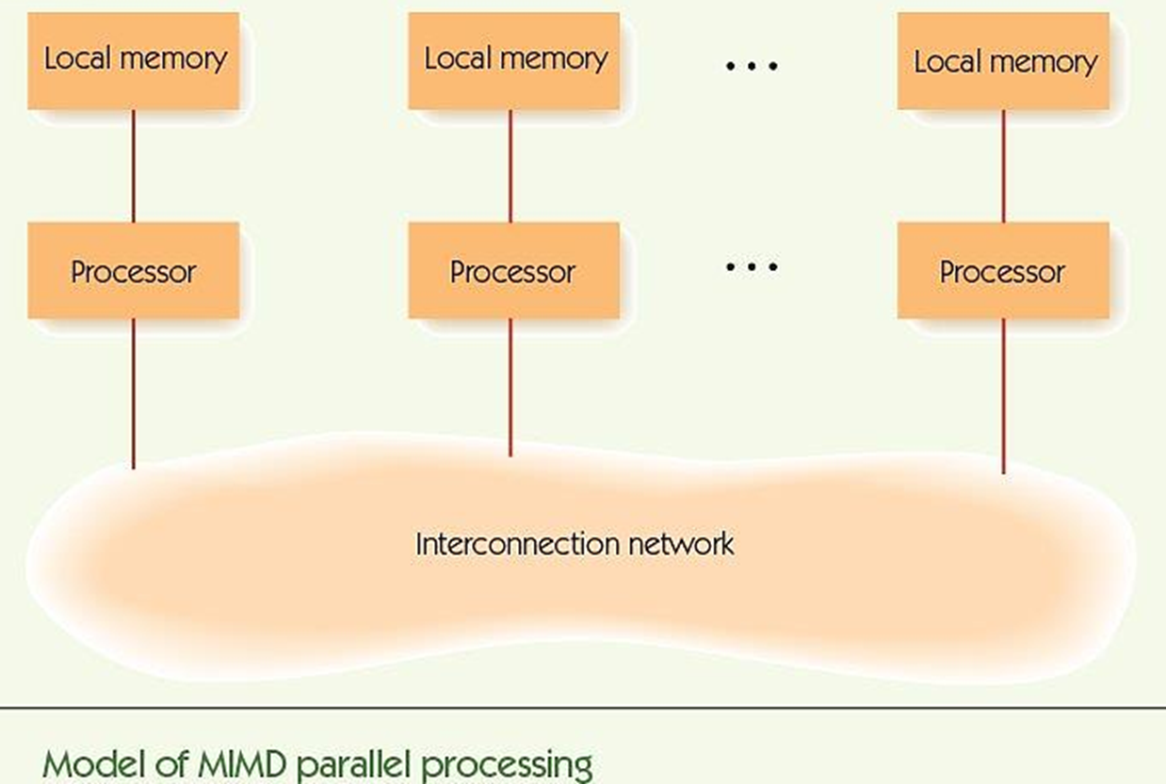

Slide 45
Non-Von Neumann Architectures (cont'd)
Varieties of MIMD systems
Special-purpose systems: newer supercomputers
Cluster computing: standard machines communicating over LAN or WAN
Grid computing: machines of varying power, over large distances/Internet
Example: SETI project
Hot research area ► parallel algorithms
Need to take advantage of all this processing power

Slide 46
Summary
We must abstract in order to manage system complexity
Von Neumann architecture is standard for modern computing
Von Neumann machines have memory, I/O, ALU, and control unit; programs are stored in memory; execution is sequential unless program says other
Memory is organized into addressable cells; data is fetched and stored based on MAR and MDR; uses decoder and fetch/store controller

Slide 47
Summary (cont'd)
Mass data storage is nonvolatile; disks store and fetch sectors of data stored in tracks
I/O is slow, needs dedicated controller to free CPU
ALU performs computations, moving data to/from dedicated registers
Control unit fetches, decodes, and executes instructions; instructions are written in machine language
Parallel processing architectures can perform multiple instructions at one time

